Slide 1
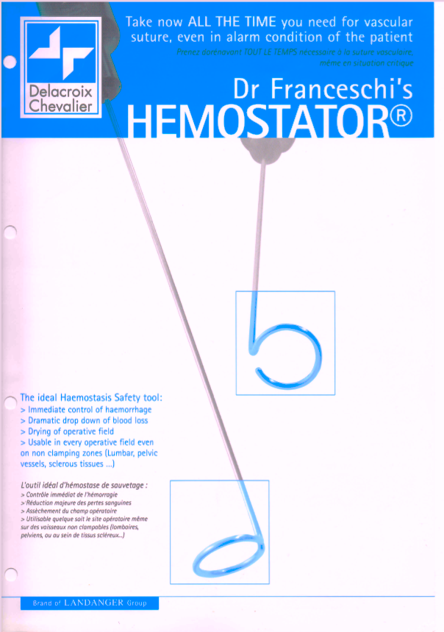
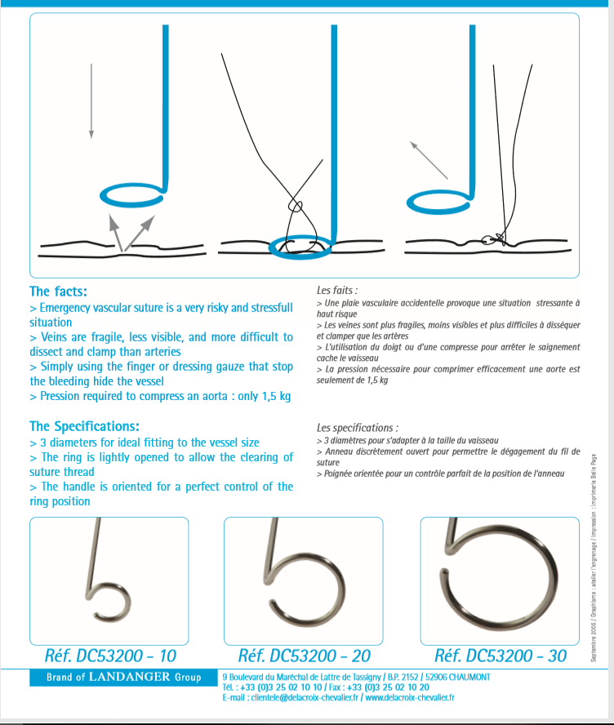

Slide 2
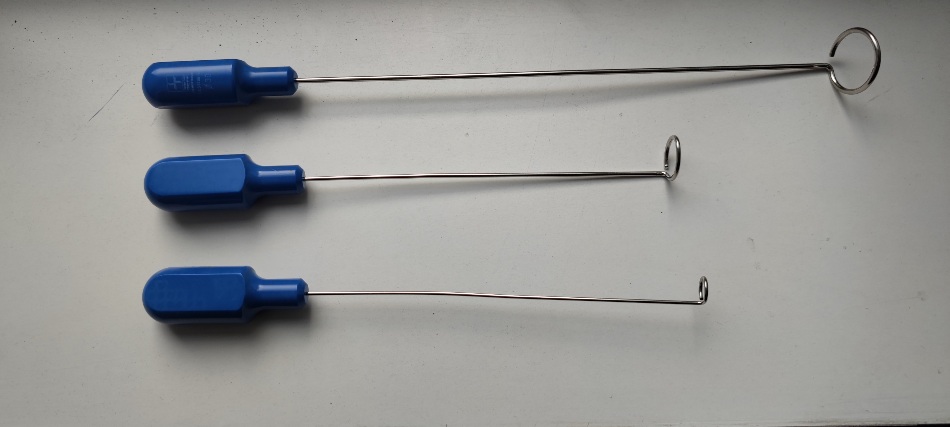
Open rings to let the thread off
deformable stainless steel
300 mm lenght
3mm width
30mm diameter
20mm diameter
200 mm
length
2.5 mm
width
10mm diameter
200 mm
length
2 mm
width
Easy to copy because I made the patent free otherwise you can by it at Landanger France

Slide 3
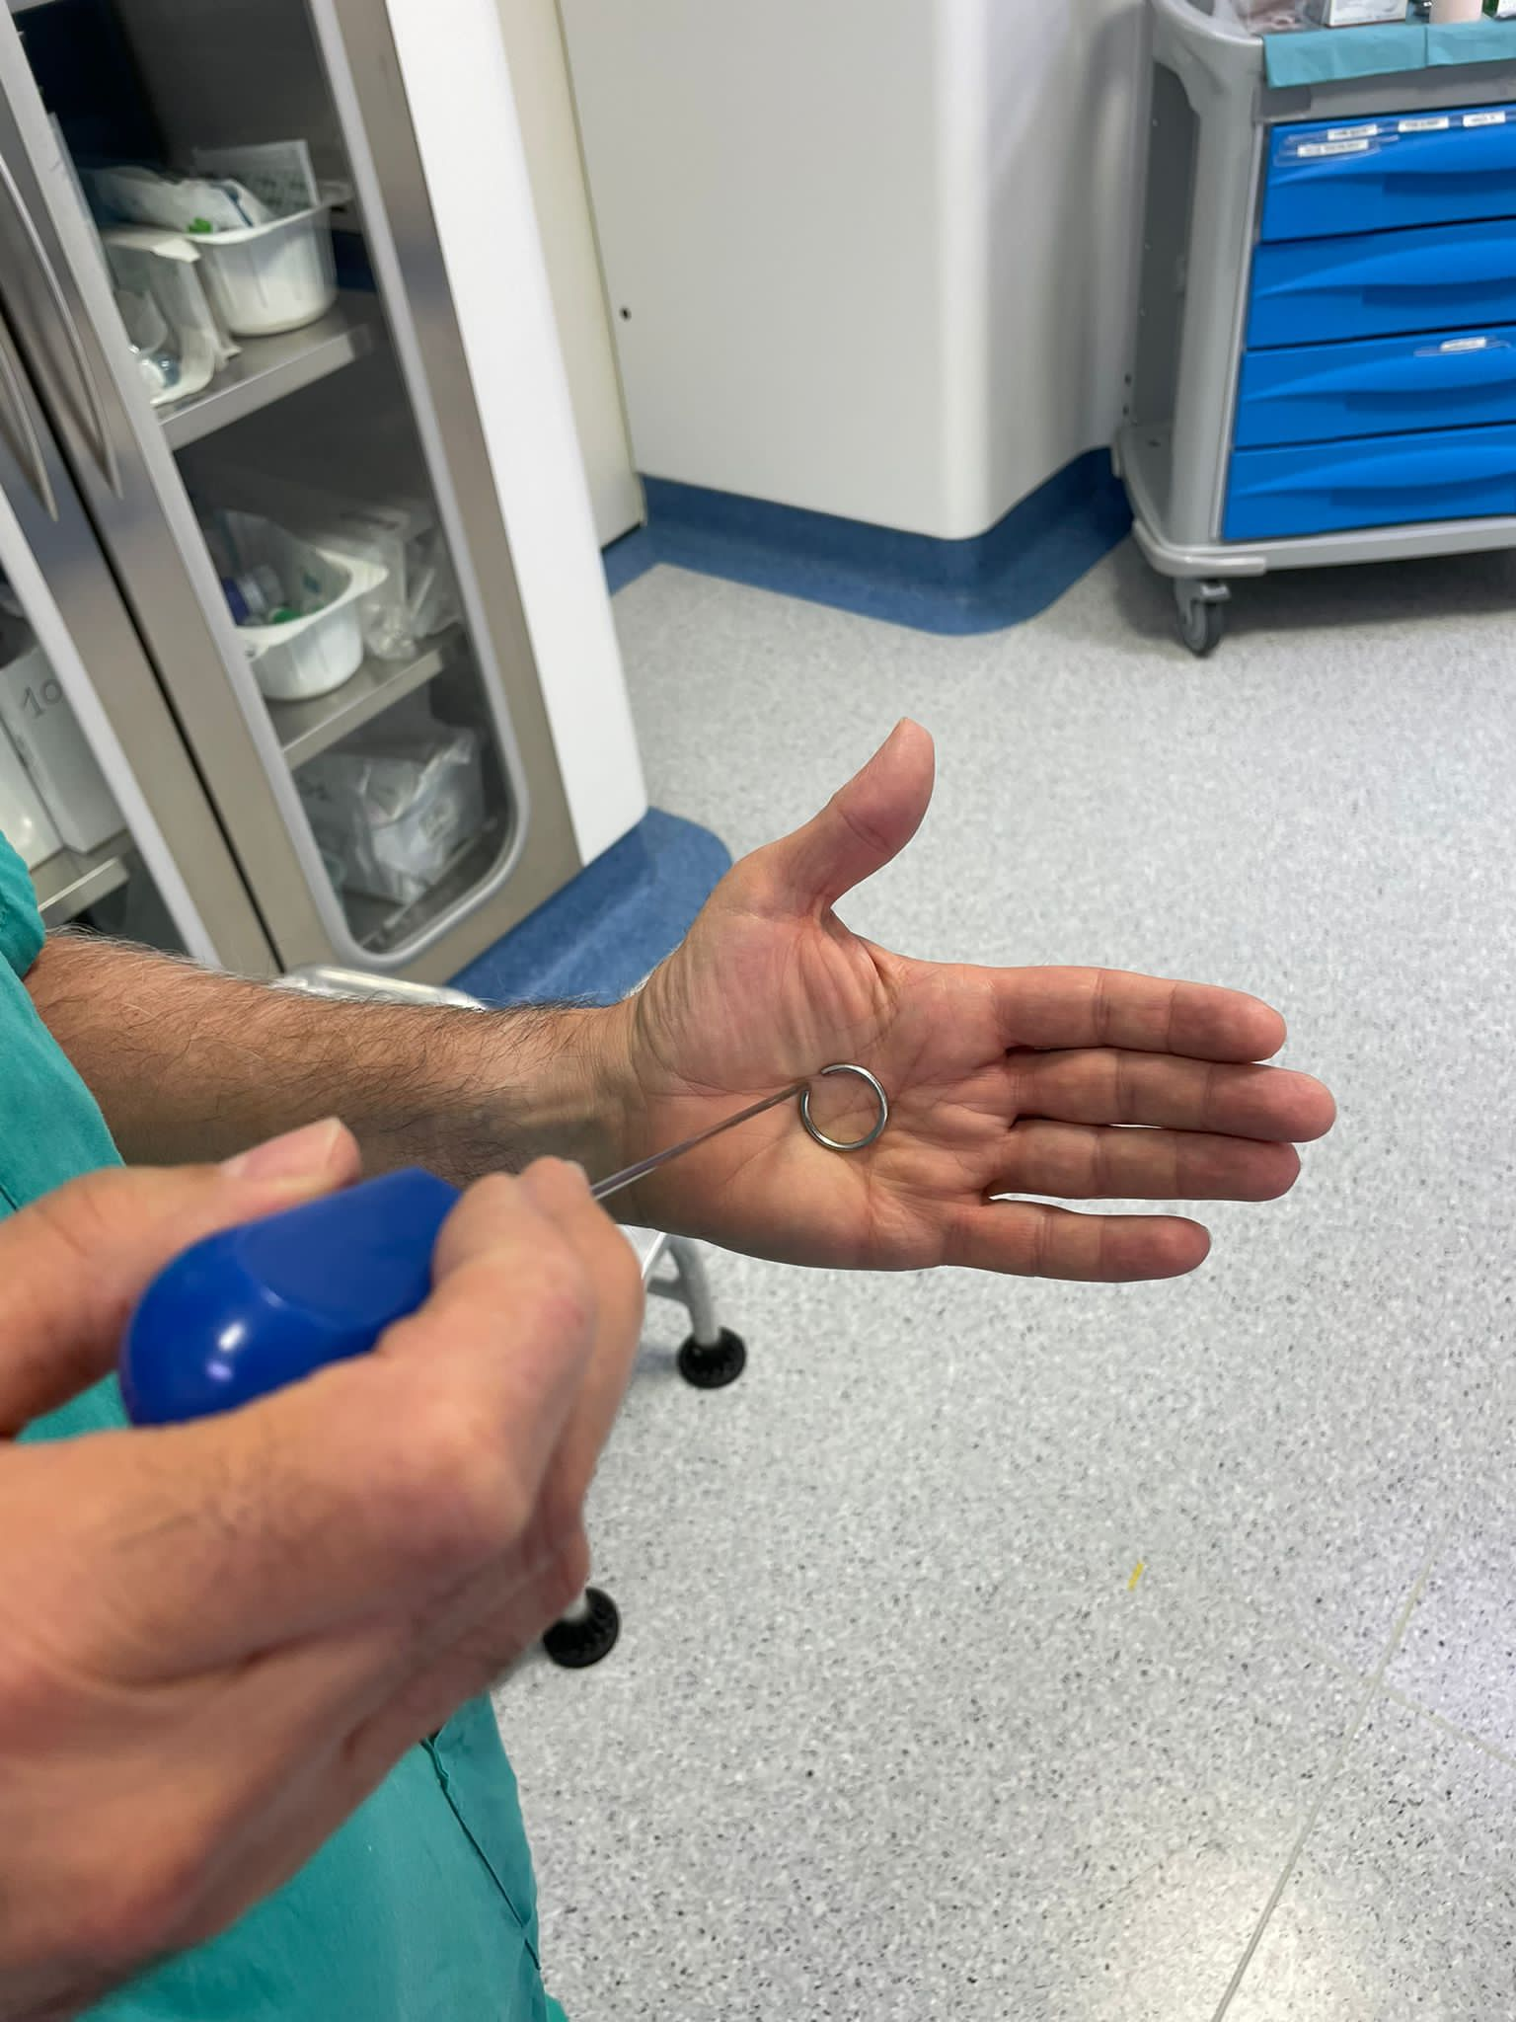
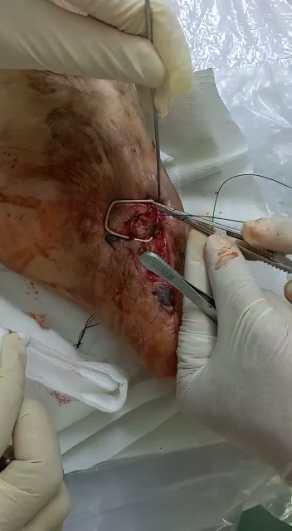
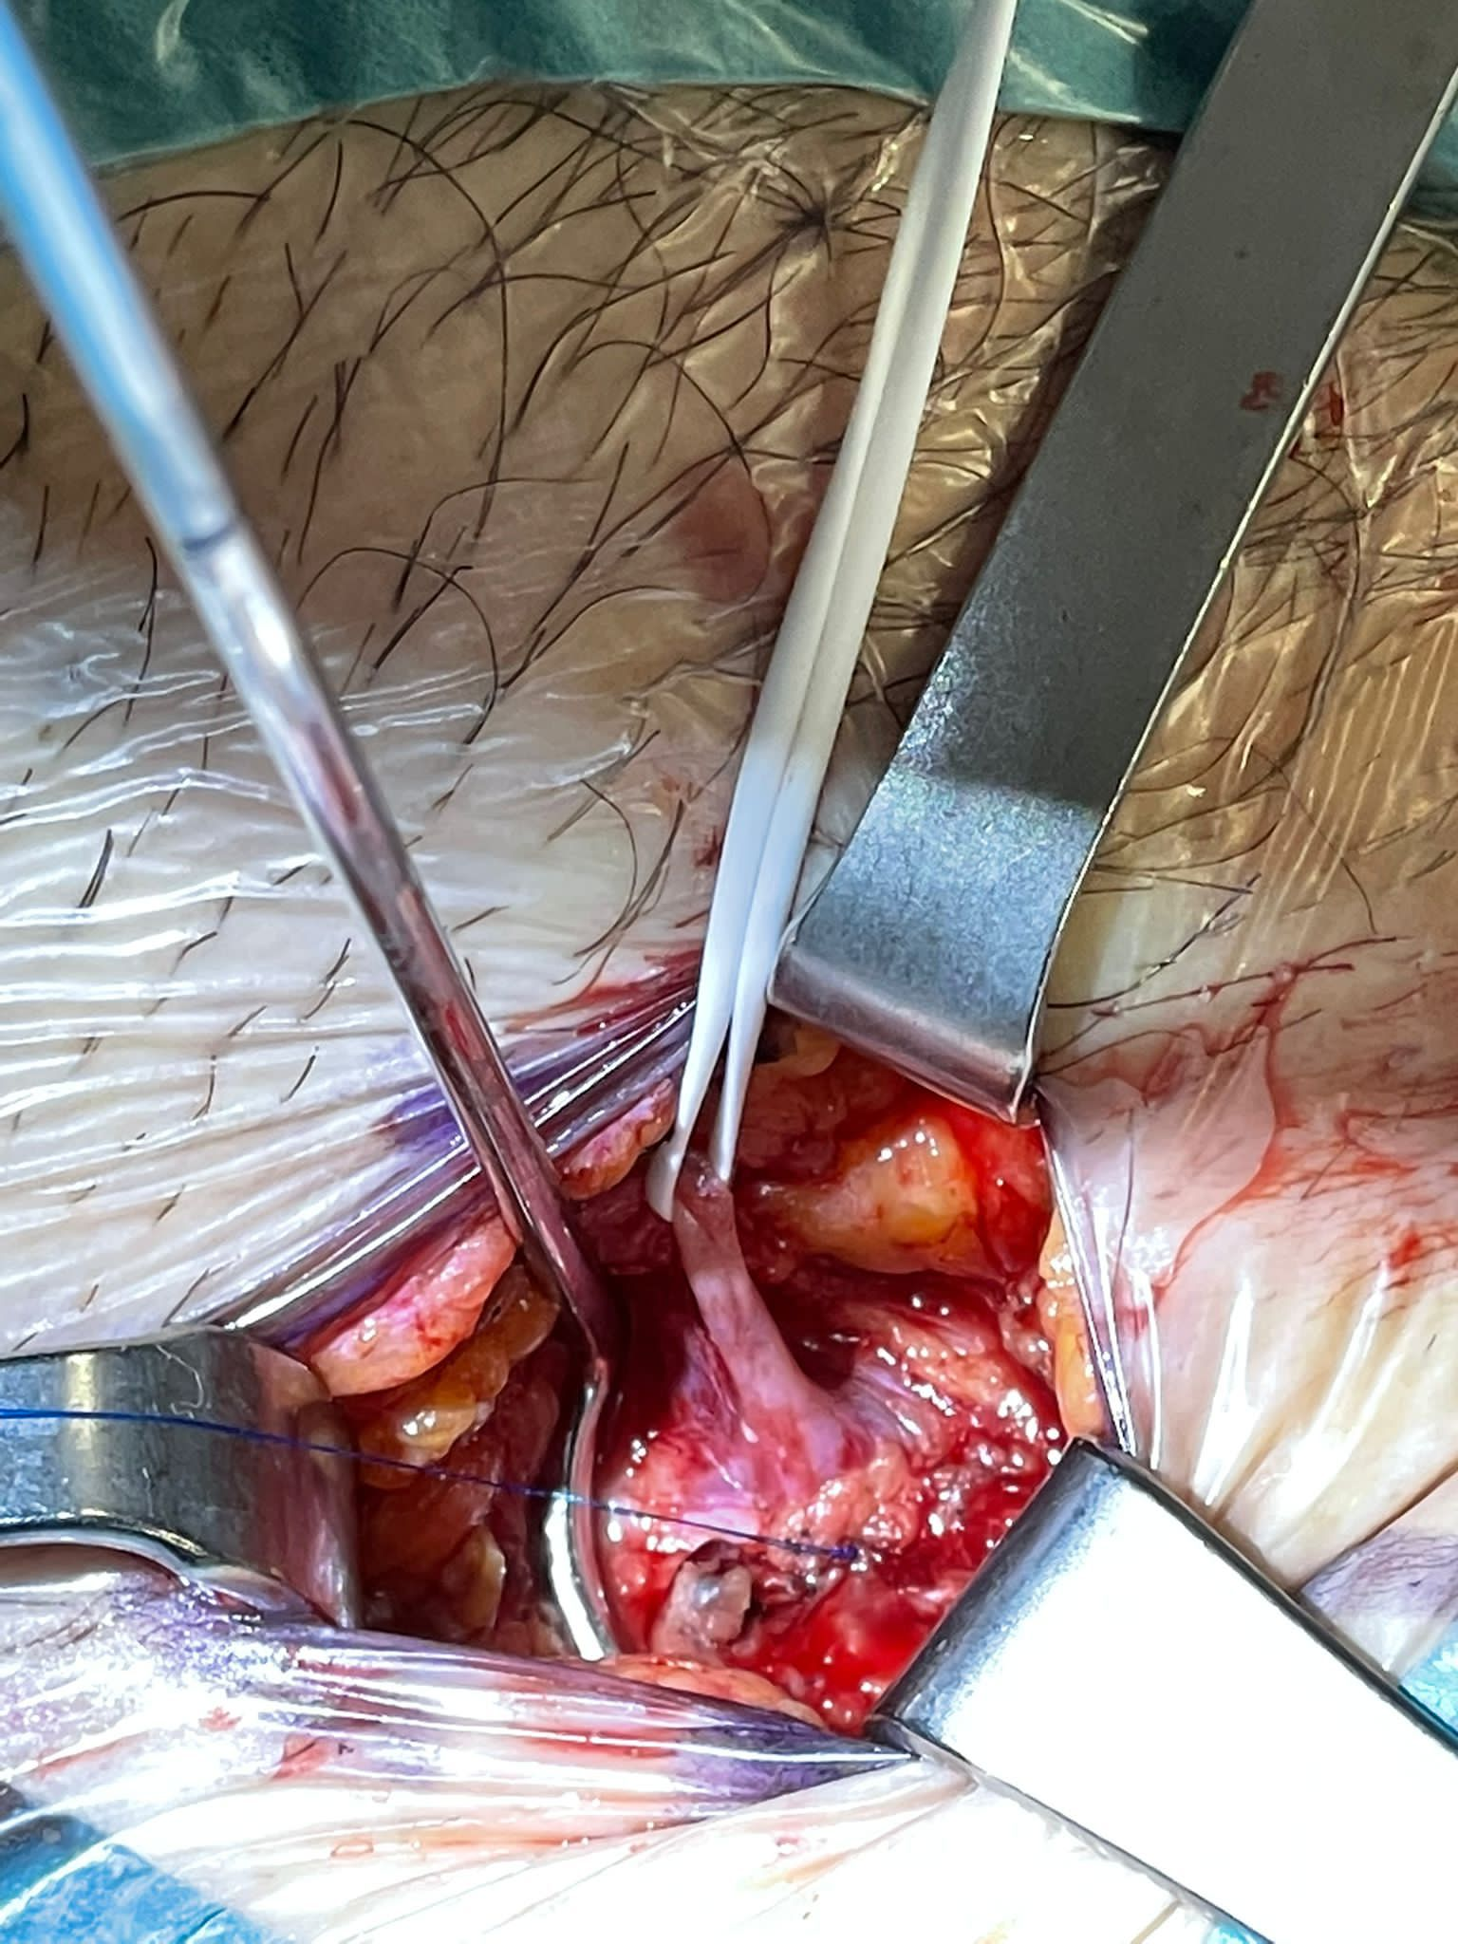
The hemostator ring compresses the vessels around the wound and stops the bleeding.
This allows the wound to be stitched inside the ring. When the wound is stitched, the ring is removed. The ring has an opening that allows it to be removed without cutting the thread.
Easy to copy because I made the patent free

