Slide 1
ANGIODYSPLASIAS
or
VASCULAR MALFORMATIONS
Congénital usually non hereditary rarely familial but more frequentely somatic mutations
(Dysembryogenesis)
Claude Franceschi

Slide 2

?
Confuse and complex
nosography
Dysplasias
Angiomatous
malformation
Lymphangioma
Angioma
Hamartoma
Phacomatosis
Hemangioma
Neurecto-mesodermosis

Slide 3
?
Confuse and complex
nosography
Kasabach-Merritt syndrome
    Klippel-Trenaunay-Weber syndrome
Proteus syndrome
Parkes-Weber syndrome

Slide 4
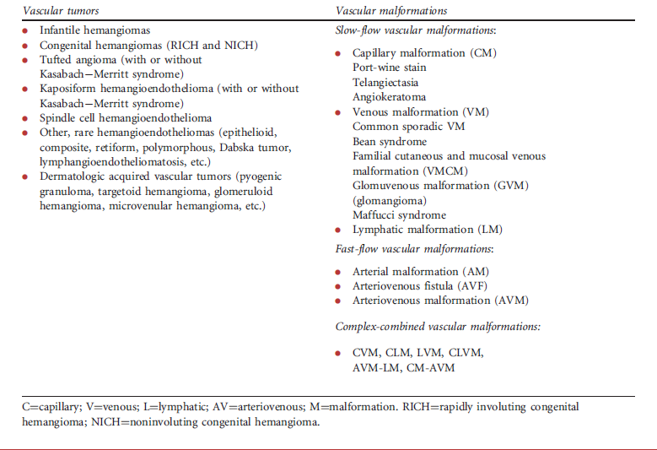
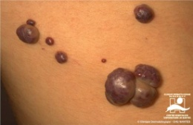
Cambridge University Press
978-0-521-84851-0 - Color Atlas of Vascular Tumors and Vascular Malformations
Odile Enjolras, Michel Wassef and Rene Chapot

Slide 5
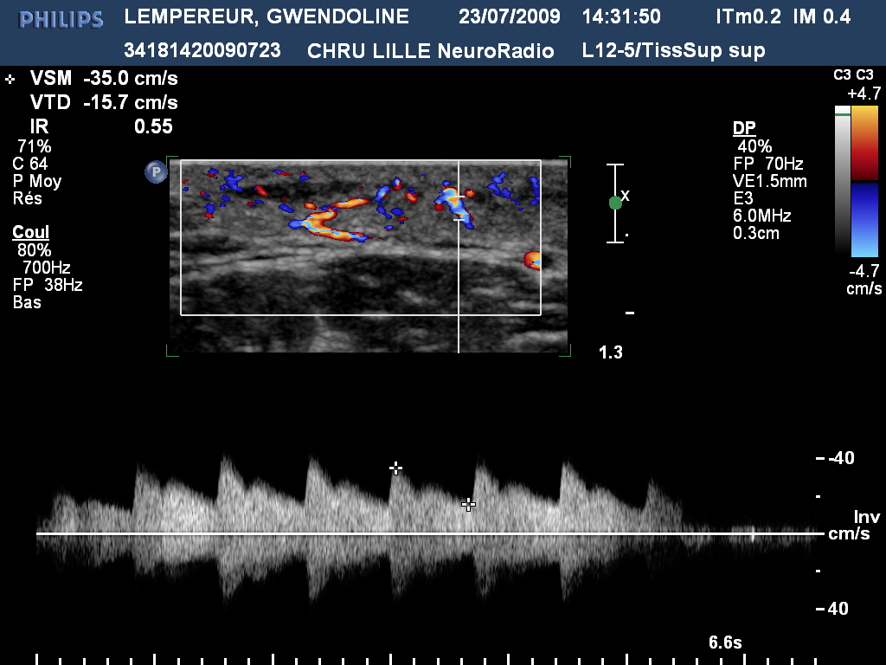
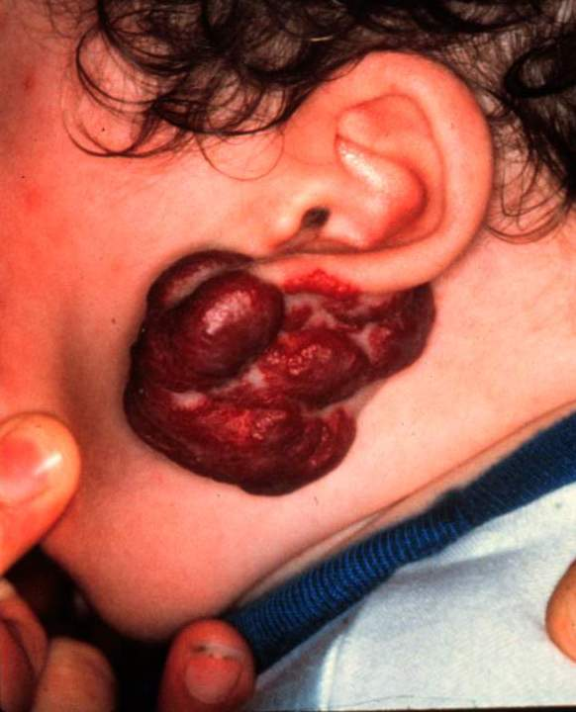
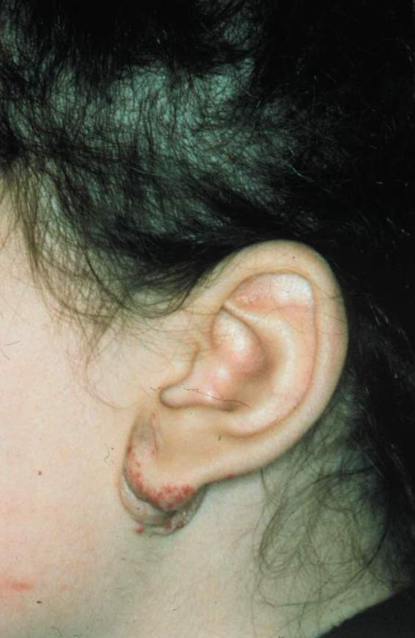
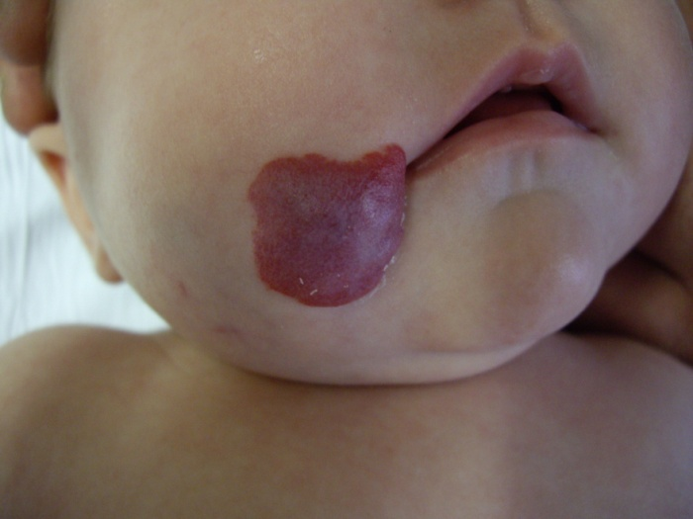
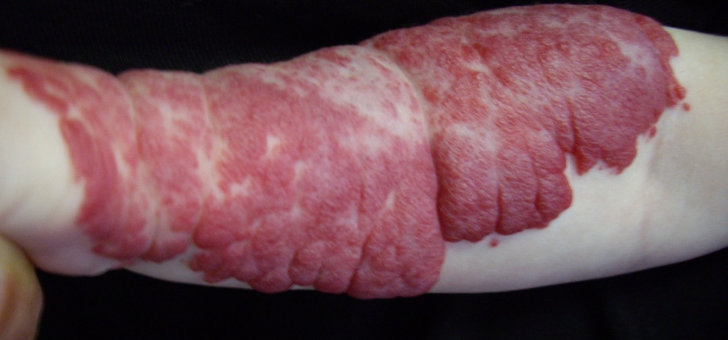
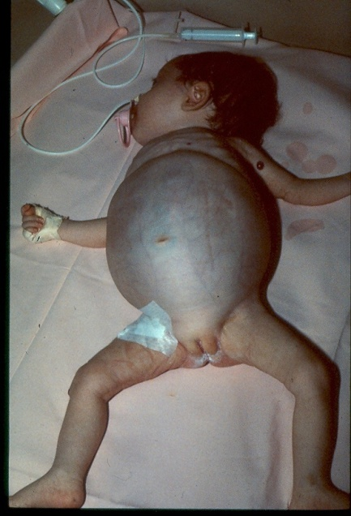
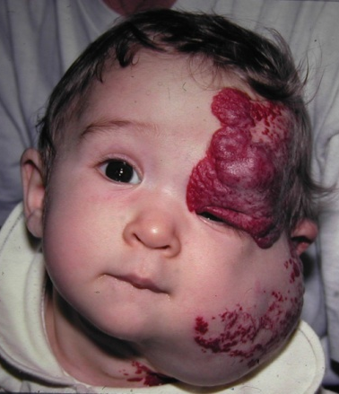
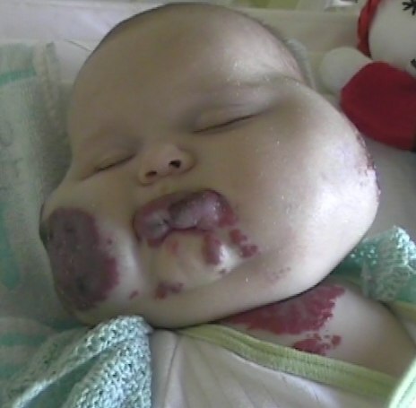
Vascular tumors are not malformation but :
-Infantile hemangiomas ( very frequent!!!)
Must be known because :
-differential diagnosis with vascular malformations
-benign , spontaneously involuting by 3-5 ears
- but may be dangerous according to its location and requires specific treatment : Cortisone, Beta-blockers

Slide 6
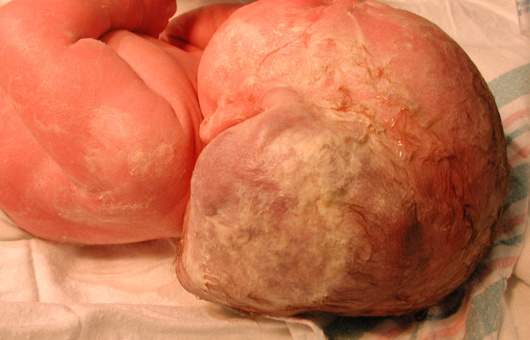
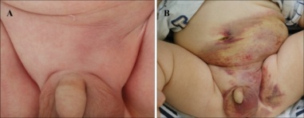
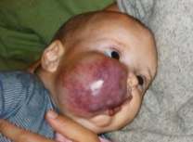
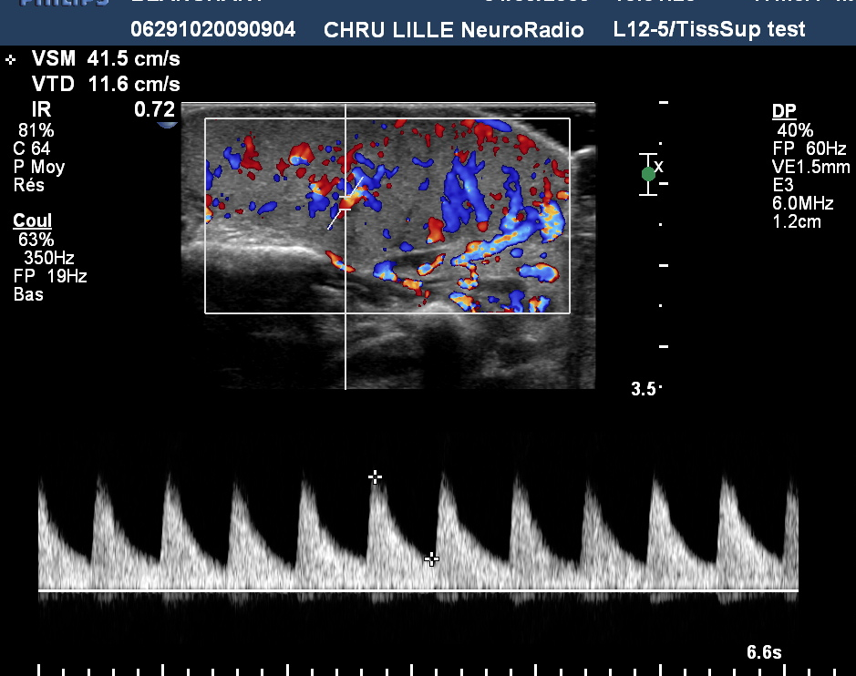
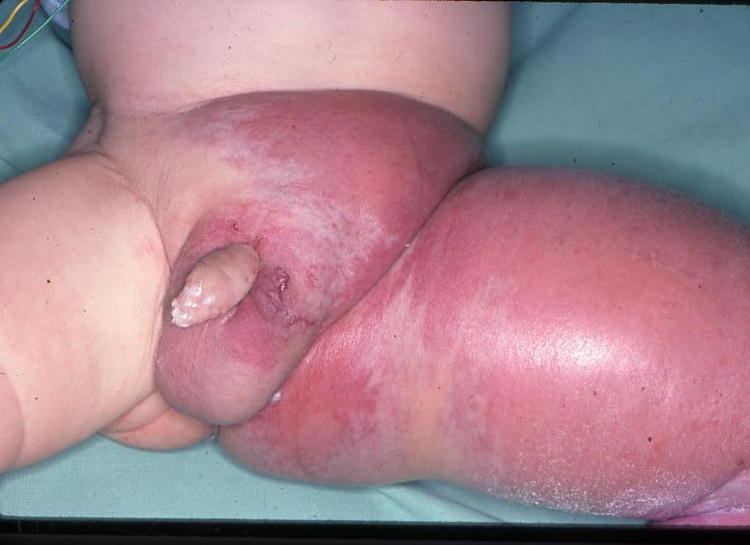
Vascular tumors are not malformation but :
-Rapidly Congenital hemangiomas (RICH)
-Non involuting Congenital hemangiomas (NICH)
-Tufted angioma
- Kaposiform hemangioendothelioma
-differential diagnosis with vascular malformations
-benign BUT may be dangerous when combined with Kasabach-Merrit syndrome (Hemangioma with thrombocytopenia) with disseminated intravascular coagulation and even death. CORTISONE+++++

Slide 7
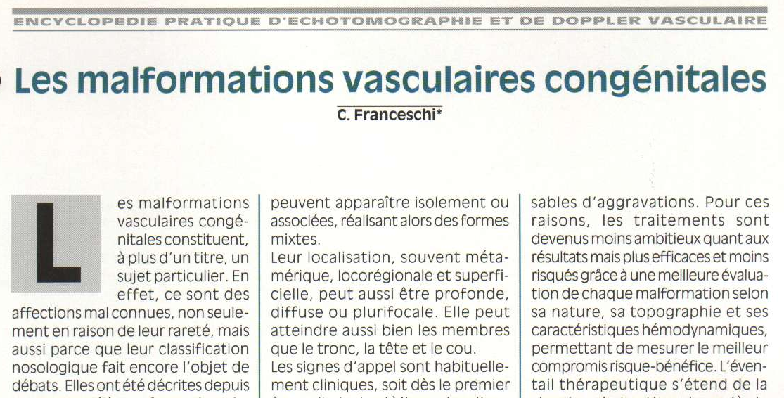
CLASSIFICATION
PHYSIOPATHOLOGIQUE
1994

Slide 8
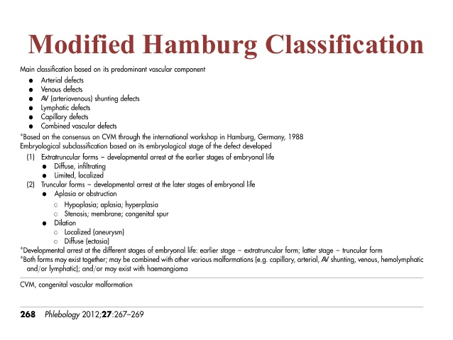
1993-2012

Slide 9
ANGIODYSPLASIAS
or
VASCULAR MALFORMATIONS
Congenital usually non hereditary rarely familial but more frequentely somatic mutations
(Dysembryogenesis)
Regarding the early angiogenesis

Slide 10
COMBINATED MALFORMATIONS
Vascular
Artérielles
Artério-veineuses
Veineuses
Artério-veino-lymphatiques
Veino-lymphatiques
Lymphatiques
NEURO-CUTANEOUS
DYSTROPHY
OSTEO-MUSCULAR
DYSTROPHY

Slide 11
ANGIODYSPLASIAS
or
VASCULAR MALFORMATIONS
Arterial
AVF
Arterio-venous
Venous
Unique or associated
Lymphatic

Slide 12
Arterial
Malformations

Slide 13
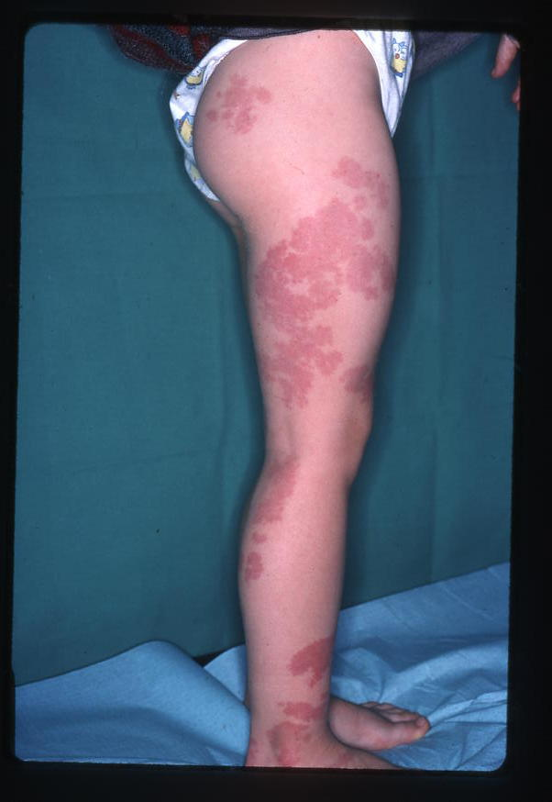
Arterial
Capillary
Low Flow
Mega arterial capillaries

Slide 14
Arterial
Truncular
Hypoplasia,
Coarctatio
Aplasia ,
Megadolichoarteries
Vestigila aneurism
Fibro-muscular dysplasia
AORTA
CERVICO-
CEREBRAL ARTERIES
RENAL ARTERIES
LIMBS ARTERIES

Slide 15
Venous
Malformations

Slide 16
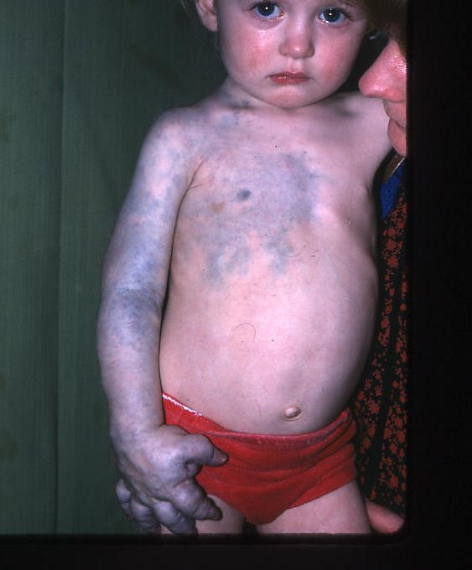
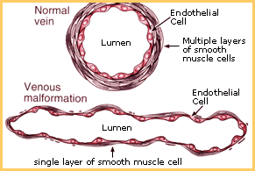
Venous
Capillary
Extra-truncular
        Simple Venous Mega capillary
        Nodular Venous Mega capillary
        Cavernous Venous Mega capillary
Risk of Kasabach-Merrit syndrome

Slide 17
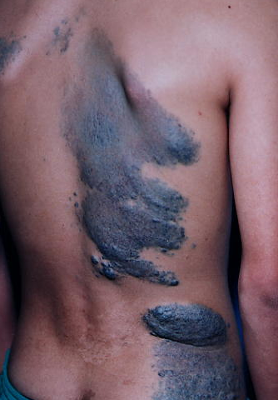
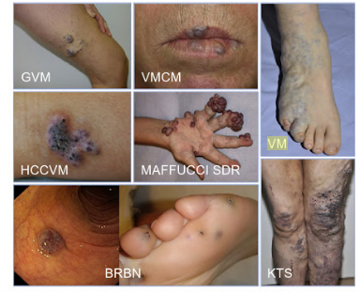
Rare but important venous capillary M to know
Cutaneous and mucosal VM
Glomuvenous M
+Cartilage benign tumor + malignant T risk!
Hyperkeratotic cutaneous capillaryvenous M
Blue Rubber Bleb Nevus Sd (Bean)
Vital risk! Intestinal bleeding location

Slide 18
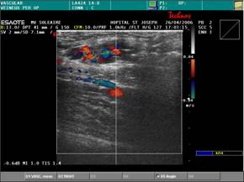
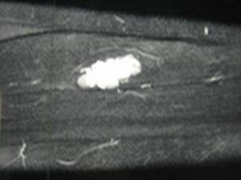
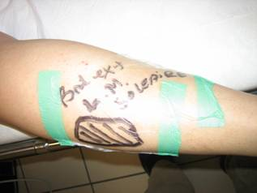
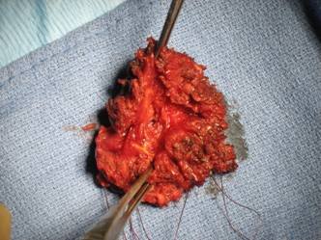
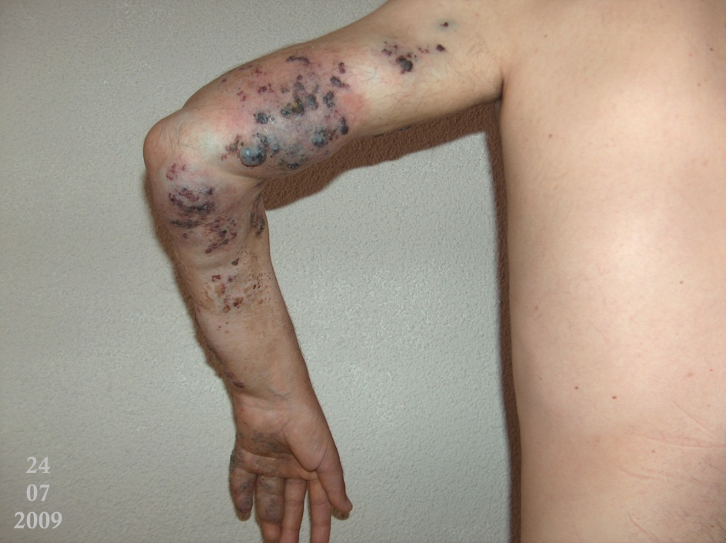
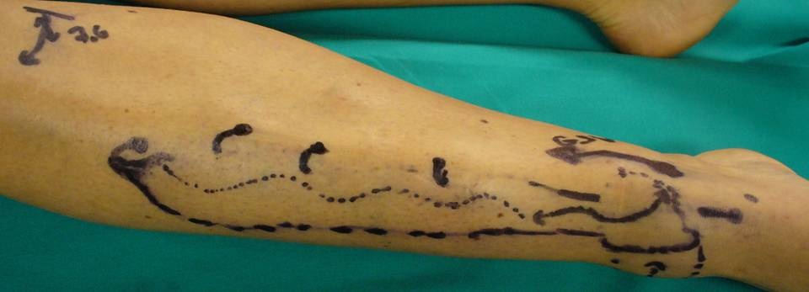
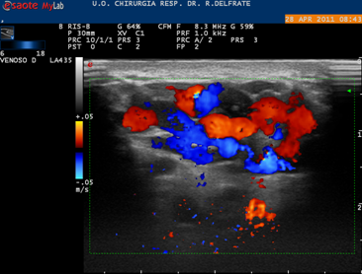
Usual venous capillary deep /superficial VM
Deep intramuscular VM
Deep extra_muscular VM
Deep/Superficial extra_muscular VM

Slide 19

Knee synovial location: bleeding, hemartrosis then joint destruction

Slide 20
NON DRAINING VM
Treatment
Indication
      Pain, Edema, cosmetic
      Complications
        Thrombosis
        PE
        Knee hemartrosis
Means:
    Compression, aspirin
    Ablative Surgery whenever feasible
    Laser, sclerotherapy in addition to surgery or when surgery is not feasible . Ethanol must be prohibited ( DANGEROUS !!!!!)

Slide 21
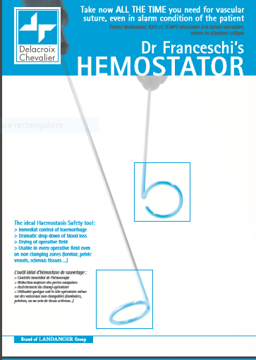
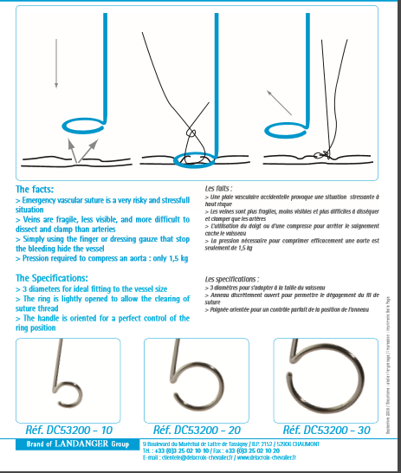
Bleeding control

Slide 22
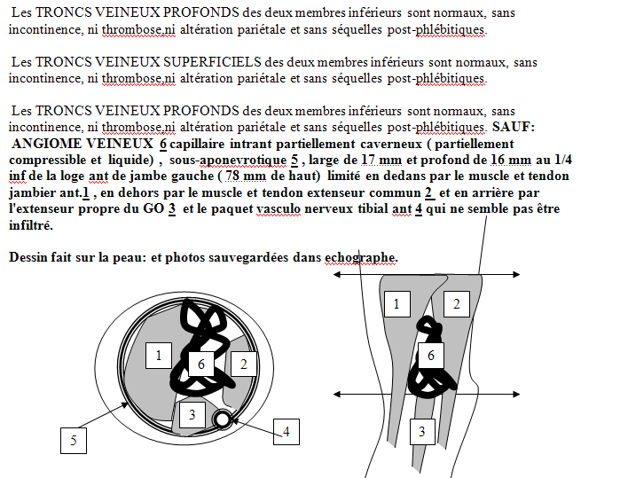
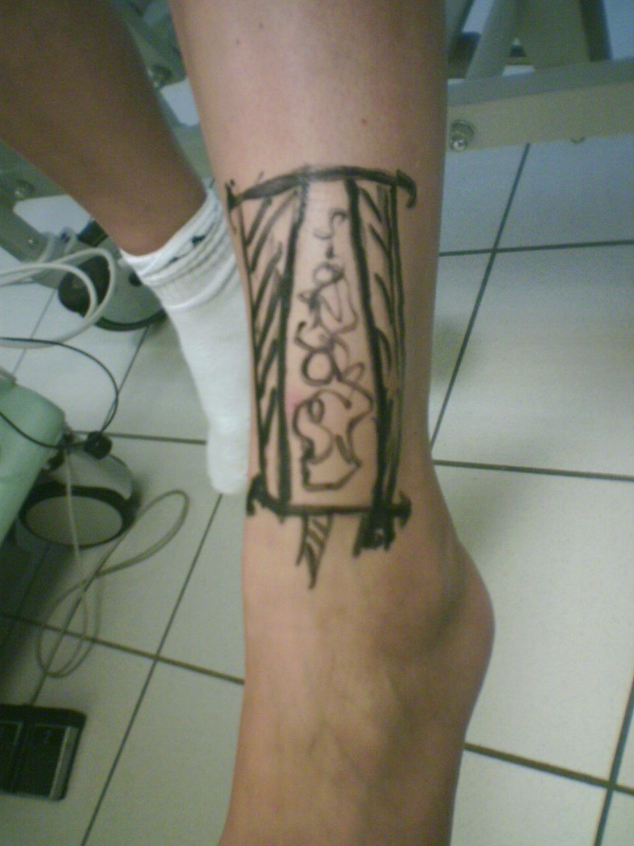
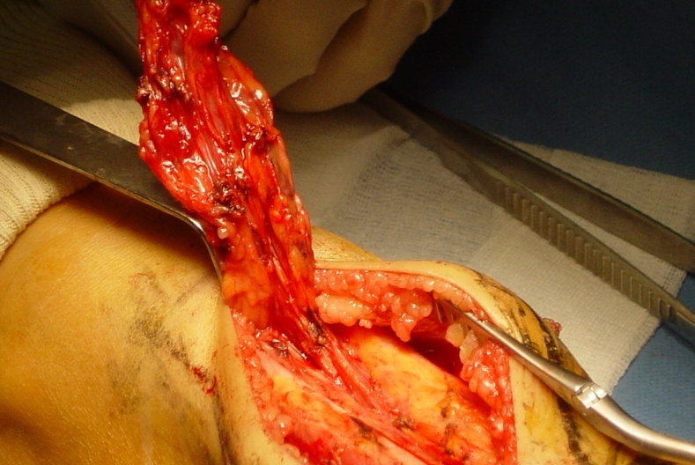
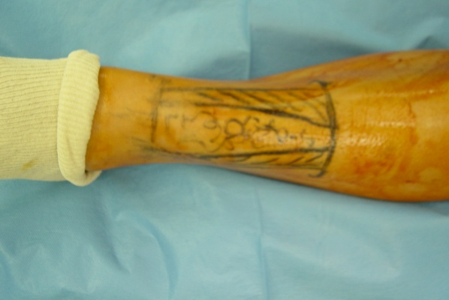

Slide 23
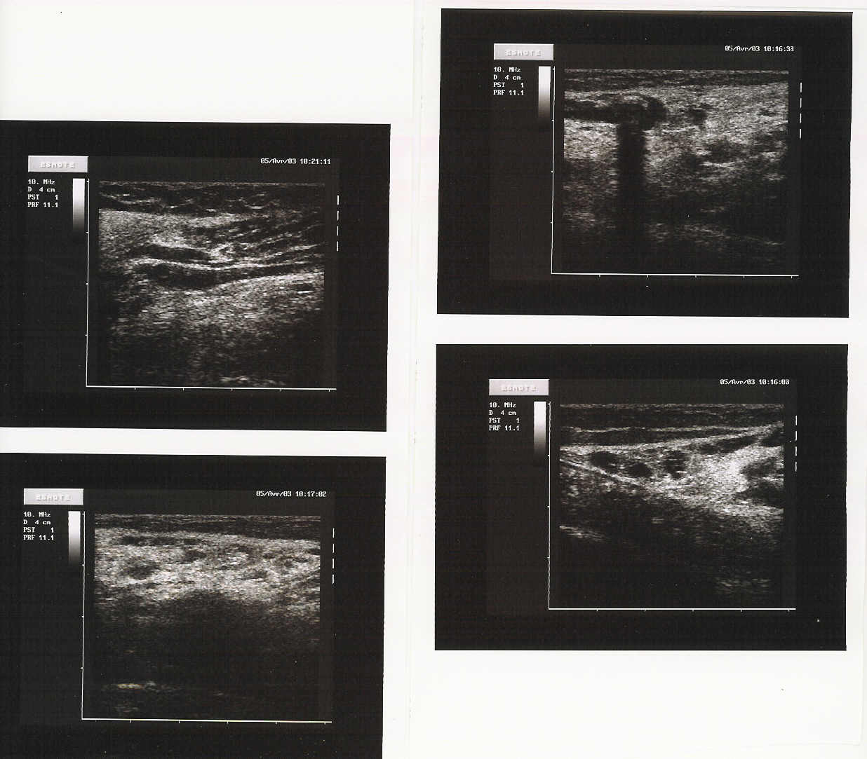
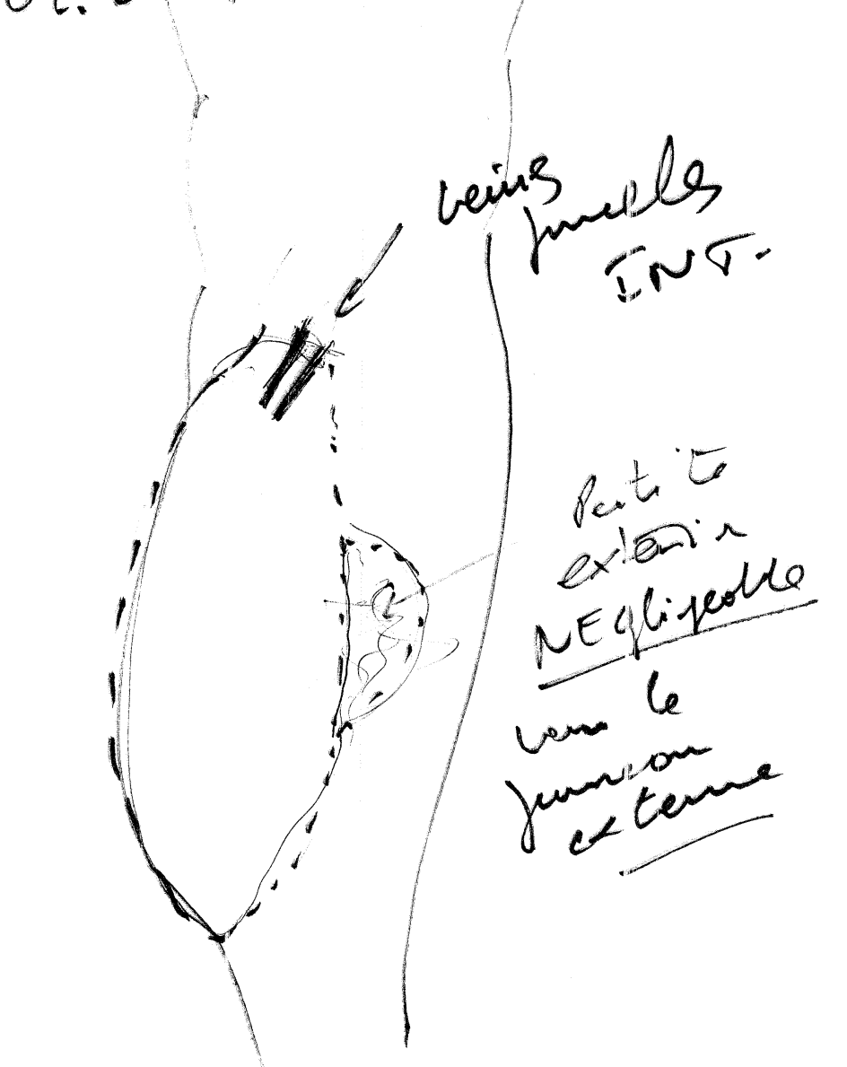
VM of gastrocnemius (caput mediale)

Slide 24
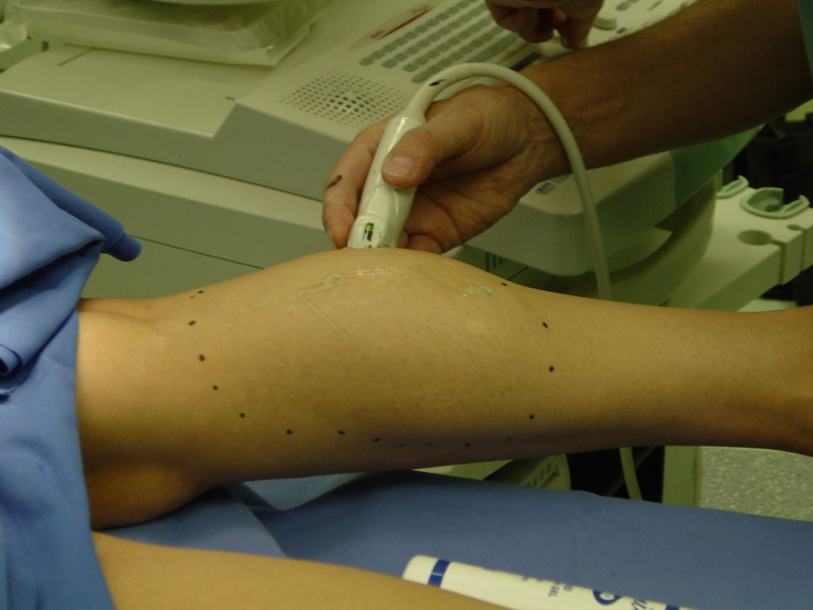
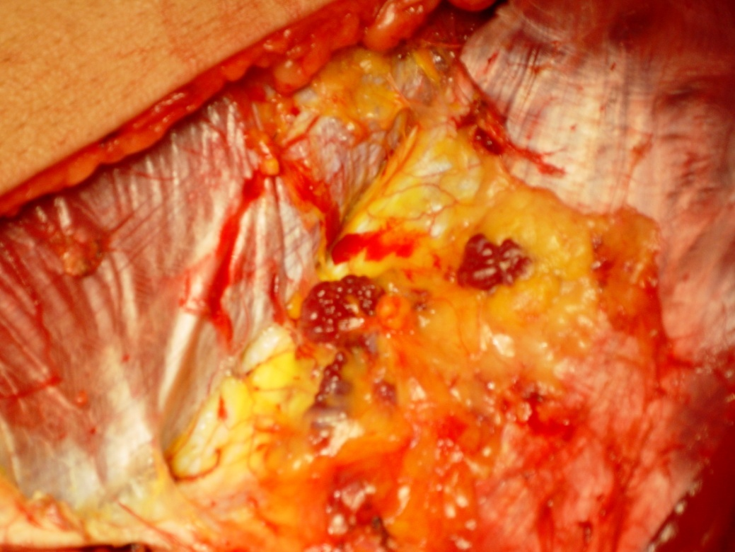
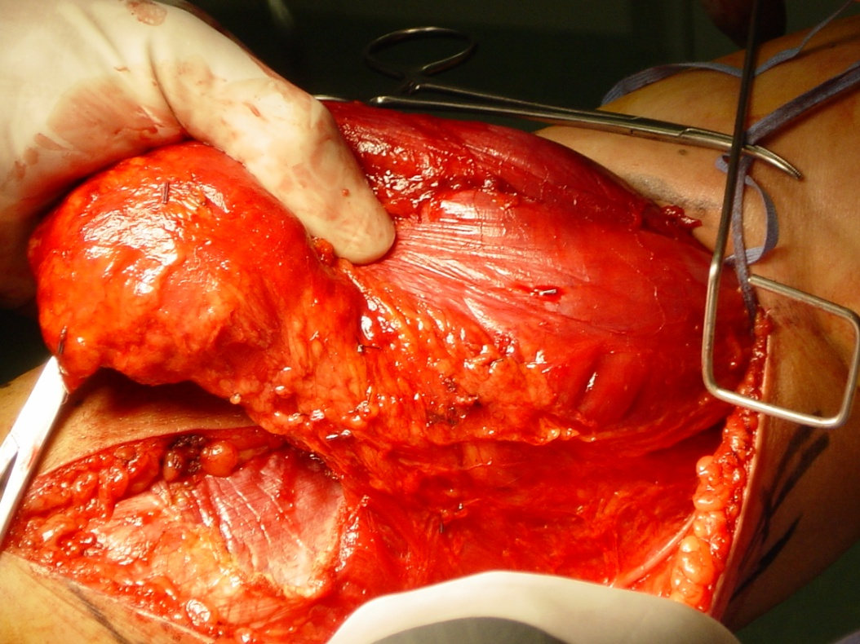
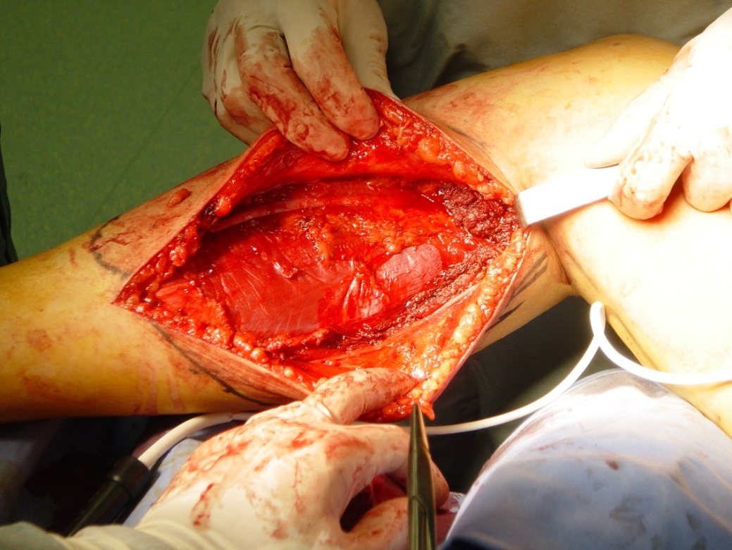
Medial gastrocnemus excision

Slide 25
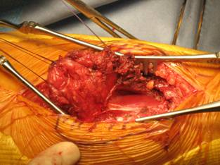
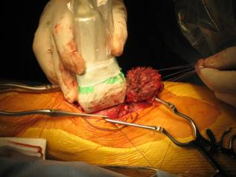
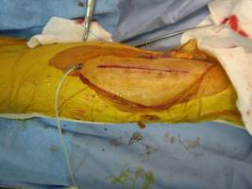
Duplex
MRI
Duplex marking

Slide 26
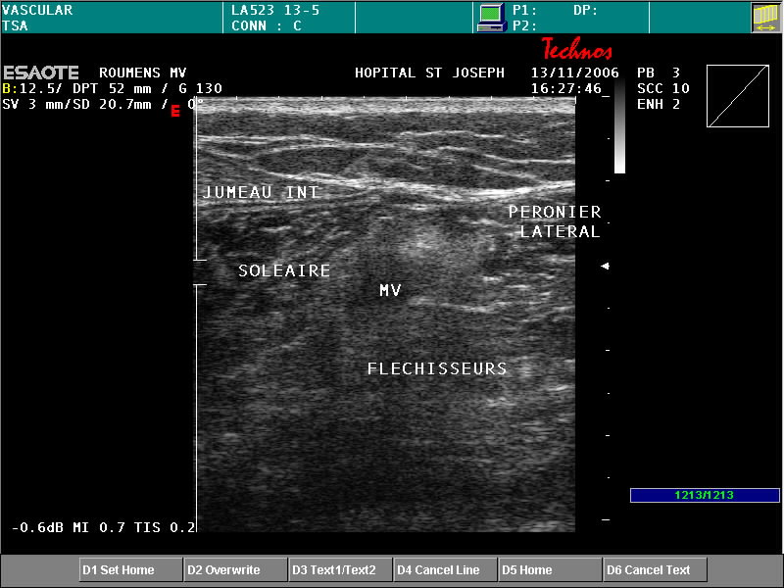
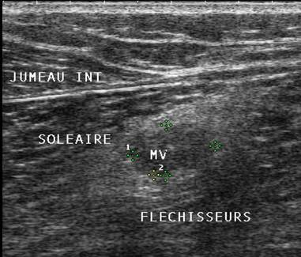
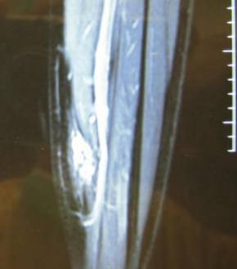
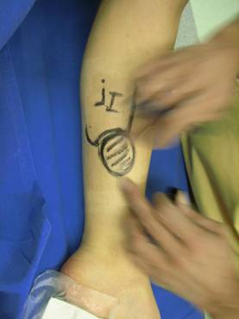
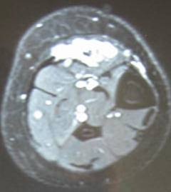
MALFORMATION VEINEUSE DU MUSCLE SOLEAIRE
Echodoppler
IRM
Marquage pré_opératoire

Slide 27
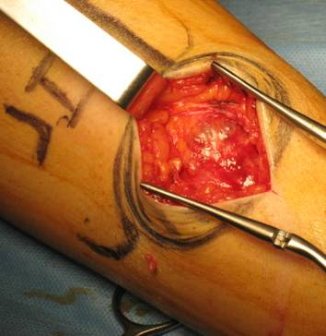




MALFORMATION VEINEUSE DU MUSCLE SOLEAIRE
EXERESE ECHOGUIDEE

Slide 28




VM sub aponeurotic Ant. Tibial compartment.Previous foam treatment.Pain increased after foam (1 year) .VM unchanged

Slide 29



Echo guided surgical exhaustive ablation

Slide 30




30 days post Op. Swelling dramatically reduced. No pain.

Slide 31




Slide 32

CAVA VEIN
DEEP and SPRFICIAL VEINS
Venous
Troncular
Venous
Troncular
        Hypoplasia
        Aplasia
        Varicose veins
        Avalvulation.

Slide 33
CAVA VEIN
DEEP and SPRFICIAL VEINS
Venous
Troncular
Asymptomatic,
Cosmetic
Pain
Limited function
Thrombosis,
Pulmonar Emboly (chronic….)

Slide 34
CAVA VEIN
DEEP and SPRFICIAL VEINS
Venous
Troncular
Duplex anatomic and hemodynamic mapping BECAUSE most malformative veins are draining pathways which are to be respected

Slide 35
DRAINING VM
Treatment
Indication
      Pain, Edema, cosmetic
      Complications
        Thrombosis
        PE
Means:
    Compression, aspirin
    CHIVA whenever feasible
    Laser, sclerotherapy in addition to surgery or when surgery is not feasible . Ethanol must be prohibited ( DANGEROUS !!!!!)

Slide 36
Bleeding control

Slide 37
Pattern 1
Angoma, angiokeratoma
skin
Superf. Vein = eg Marginal vein
perforators
Deep veins
Suppressing the superficial vein leads to angioma aggravation and varicose collaterals
Cutaneous angioma : normal draining venous network

Slide 38
Pattern 2
Angoma, angiokeratoma
skin
Superf. Vein = eg Marginal vein
Re-entry perf.
perforators escape points
Deep veins
Cutaneous angioma : incompetent superficial vein: Closed shunt
Overloaded: Angioma flow + Deep diverted retrograde flow ( closed circuit)

Slide 39
Pattern 2 treatment
Angoma, angiokeratoma
skin
Marginal vein
Re-entry perf.
perforators escape points
Disconnecting the closed shunts drains ( relieves) the angioma and suppresses the deep overloading flow
Cutaneous angioma : incompetent superficial vein: Closed shunt
Overloaded: Angioma flow + Deep diverted retrograde flow ( closed circuit)

Slide 40
Pattern 2 treatment
skin
Marginal vein
Re-entry perf.
perforators escape points
When angima or angiokeratoma is absent or small, Marginal vein destruction doesn’t lead to recurrence and the outcome is roughly similar to disconnection
Cutaneous angioma : incompetent superficial vein: Closed shunt
Overloaded: Angioma flow + Deep diverted retrograde flow ( closed circuit)

Slide 41
Pattern 2 treatment
Closed shunts disconnections stage by stage

Slide 42
Pattern 3
Angoma, angiokeratoma
skin
Marginal vein
Re-entry perf.
perf escape point
Deep vein aplasia
Open Vicarious shunt is preserved in order to avoid the dangerous block of the deep and superficial draining flow and further varicose collaterals
Cutaneous angioma : incompetent superficial vein: Open Vicarious Shunt Overloaded: Angioma flow + Deep antegrade flow + segmental Deep veins aplasia (open circuit)

Slide 43
Pattern 3 treatment =0
Angoma, angiokeratoma
skin
Marginal vein
Re-entry perf.
perf escape point
Deep vein aplasia
Open Vicarious shunt is preserved in order to avoid the dangerous block of the deep and superficial draining flow and further varicose collaterals
Cutaneous angioma : incompetent superficial vein: Open Vicarious Shunt Overloaded: Angioma flow + Deep antegrade flow + segmental Deep veins aplasia (open circuit)

Slide 44
Pattern 4
Angoma, angiokeratoma
skin
Marginal vein
Oppen V Shunt Re-entry
Closed Shunt Re-entry
Common escape point
Deep vein aplasia
Cutaneous angioma : incompetent superficial vein: Mixed shunt : Closed + Open Vicarious Shunt: common escape point, different re-entries

Slide 45
Pattern 4 treatment
Angoma, angiokeratoma
skin
Marginal vein
Oppen V Shunt Re-entry
Closed Shunt Re-entry
Common escape point
Deep vein aplasia
Disconnecting the closed shunts drains ( relieves) the angioma and suppresses the deep overloading flow and preserving the Open Vicarious avoids the dangerous block of the deep and superficial draining flow and further varicose collaterals
Cutaneous angioma : incompetent superficial vein: Mixed shunt : Closed + Open Vicarious Shunt: common escape point, different re-entries

Slide 46
Pattern 4 treatment
Closed shunts disconnections stage by stage
Preserved open vicarious shunt varicose (marginal) shunts

Slide 47
Prospective study (2012 et 2013) of venous mallformations with varicose veins assessed by Duplex US : 56 patients (58 limbs).
Objective: identify the varicose veins necessary to the limb drainage in order to avoid their ablation witch could increase the obstructive syndrome.
Method: Probes: 14, 7 and 3 Mhz. Assessment of aplasia, hypoplasia and incompetence of the deep and superficial veins of the lower limbs, iliac and cava veins.
Compensatory Vein Test prosed by C. Franceschi.

Slide 48



Compensatory Vein Test (Franceschi)
While the patient rocks ( oscillates) , one hand compresses and occludes the varicose vein with the US probe and the other hand assesses its tension (pression) just below.
Compensatory vein: Tension increases
Not compensatory vein: Tension decreases

Slide 49
Varices are compensatory in
35% of varices located in the marginal vein territory
37% of varices located in the saphena vein territory ( in absence of marginal vein)
Not compensatory varices
37 limbs
Varicose territory:
Saphena (17) Marginal (14) Saphena+Marginal (6)
Deep veins:
32 limbs: ectasia, avalvulation, extra-truncular ( muscle, nerve and interfascial infitration )
Compensatory varices
Varicose territory: 21 limbs
Saphena (10) Marginal (3)
Saphena+Marginal (8)
Deep veins:
aplasia and agenesia
leg veins and/or Popliteal V and/or Femoral V and /or Iliac V and /or Cava V.

Slide 50


Example of Duplex Mapping
Not compensatory Varice
(No Open vicarious shunt)
Compensatory Varice
( Open vicarious shunt)
Blue = Superficial veins Black = Deep veins Dotted black = aplasia

Slide 51
In 35-37 % of Venous Malfornations including superficial varicose veins one ore more of them are compensatory .
Their ablation could increase the obstructive syndrome
An exhaustive topographic and hemodynamic mapping with compensatory vein test prevents theses mistakes.

Slide 52
Pattern 3
Angioma, angiokeratoma
skin
Marginal vein
Re-entry perf.
perf escape point
Deep vein aplasia
When the deep veins ( femoral, popliteal ) are hypoplastic and the Marginal vein plays the role of “natural” by-pass, ablating the vicarious segment is too dangerous for the leg drainage.

Slide 53
Pattern 4
Angioma, angiokeratoma
skin
Marginal vein
Closed Shunt Re-entry
Common escape point
Open V Shunt Re-entry
Deep vein aplasia
On the other hand, the Marginal vein segment is disconnected when its not involved in the vicarious effect but responsible for a closed shunt .

Slide 54
Pattern 4 treatment
Angioma, angiokeratoma
skin
Marginal vein
Closed Shunt Re-entry
Common escape point
Open V Shunt Re-entry
Deep vein aplasia
Disconnecting the closed shunts segment drains and relieves the angioma and suppresses the deep overloading flow whilst preserving the Open Vicarious segment avoids the dangerous stop of the deep and superficial draining flow and further varicose collaterals

Slide 55
Pattern 4 treatment
Closed shunts disconnections stage by stage
Preserved open vicarious shunt varicose (marginal) shunts

Slide 56
Pattern 5
Angioma, angiokeratoma
skin
Superf. Vein = eg Marginal vein
Re-entry perf.
perforators escape points
Deep veins
Cutaneous angioma : incompetent superficial and deep veins: Despite the deep incompetence, if the Marginal vein shows a diastolic reflux ; the treatment is = pattern 2 and 4.

Slide 57
Since these patterns are frequently associated not only with lymphatic malformations, but other VM patterns according to their topography and feature, see below some examples:

Slide 58
CAVA VEIN
DEEP and SPRFICIAL VEINS
Venous
Troncular
Duplex anatomic and hemodynamic mapping BECAUSE most malformative veins are draining pathways which are to be respected

Slide 59
CAVA VEIN
DEEP and SPRFICIAL VEINS
Venous
Troncular
Asymptomatic,
Pain ,
limited function
Thrombosis,
Pulmonar Emboly (chronic….)

Slide 60
Arterio-venous
Malformations

Slide 61




Arterio-venous
Arterio-venous fistula
High flow
Low resistances
AVF Capillary
AVF Artertiolo-venular
AVF Troncular

Slide 62
Arterio-venous fistula
High flow
Low resistances
Arterio-venous
DANGEROUS according to:
Flow rate: Cardiac failure
Location: Bleeding, pain ,function

Slide 63





Treatment:
Compression++++
ONLY If complications:
Surgery whenever possible
Ebolization when surgery not possible

Slide 64
Bleeding control

Slide 65
Lymphatic
Malformations

Slide 66



Lymphatic
Capillairies
Cutaneous Verrucous nodules
and papilloma (angiokeratoma)
Simple cyst
Cavernous cyst

Slide 67

Lymphatic
Truncular
Hypoplasia,
Aplasia
Avalvulation

Slide 68
COMBINATED MALFORMATIONS
Vascular
Artérielles
Artério-veineuses
Veineuses
Artério-veino-lymphatiques
Veino-lymphatiques
Lymphatiques
NEURO-CUTANEOUS
DYSTROPHY
OSTEO-MUSCULAR
DYSTROPHY

Slide 69
AV Fistula
    Parkes-WeberSyndrome ( P.W.) :
      Truncular AVF + or – capillar (bones and joints)
      Very high flow
      -CONSEQUENCES :
      Venous Hypertension
      Varicose draining veins
      Arm (hypertrophic hémangiectasia)

Slide 70



AV Fistula
    Cirsoid AVM: extratruncular
    Scalp
    Hands
    Feet

Slide 71
AV Fistula
    Cutaneous capillary angioma :
      May be low flow…nevertheless higher than normal skin
      Which is a good reason for sparing the draining veins

Slide 72
Combined VM
      Klippel-Trenaunay-Weber Syndrome
      Definition still disputed……
        - Metameric Topography - More or less malformations lymphatiques
        Deep veins agenesia ( hypoplasia)
        Limb hypertrophy ( angio-ostéo-hypertrophicsyndrome )
        - Capillary cutaneous angioma + or less angiokeratoma

Slide 74



MALFORMATIONS VASCULAIRES COMPLEXES : « ANGIODYSPLASIES OSTEO-HYPERTROPHIQUES » → Syndrome de KLIPPEL-TRENAUNAY ( = MCVL)

Slide 75
Combined VM
    KTW signs without:
    Deep venous aplasia
    And/or Capillary Cutanaeous Angioma
    And/or limb hypertrophy
    FREQUENTLY intereszting the
    MARGINAL VEIN

Slide 76
Combined VM
    KTW signs without:
    Deep venous aplasia
    And/or limb hypertrophy
    BUT
    KNEE SYNOVIAL VM

Slide 77
SYNDROMES MULTI-MALFORMATIFS
    Le Syndrome de Proteus
    association de malformations essentiellement veineuses ,capillaires et lymphatiques dans lesquels dominent :
      - Capillary various angiomas.
      - Lymphangiomes
      - Lymphatic M.
      - Venous M
-Limbs , hands, feet hypertrophy

Slide 78




Sd de Protée = ML + hémihypertrophie corporelle +hypertrophie osseuse

Slide 81


Slide 83


Slide 84



. Hamburg classification 1993. (surgeons, pathologists). Truncular and extratruncular lesions. VM/LM/AVM/combined

Slide 85
Acquired tufted angioma A large, well-defined purpuric induration expanded to the abdomen, scrotum and left thigh.
Tufts of capillaries infiltrating the dermis and subcutaneous adipose tissue in a “cannonball” or lobular pattern
Considered to be on the same neoplastic spectrum as kaposiform hemangioendothelioma; some consider it to be the same entity
Surgical excision for small lesions; recurrences are common
Low dose aspirin
High dose steroids (intralesional or systemic)
Pulsed dye laser
Chemotherapy(vincristine)

Slide 86






Slide 87
Multiple cutaneous and mucosal venous malformations (also known as VMCM) are bluish patches (lesions) on the skin (cutaneous) and the mucous membranes, such as the lining of the mouth and nose. These lesions represent areas where the underlying veins and other blood vessels did not develop properly (venous malformations). The lesions can be painful, especially when they extend from the skin into the muscles and joints, or when a calcium deposit forms within the lesion causing inflammation and swelling.
Most people with VMCM are born with at least one venous malformation. As affected individuals age, the lesions present from birth usually become larger and new lesions often appear. The size, number, and location of venous malformations vary among affected individuals, even among members of the same family.
Researchers have discovered that some VMCM lesions have one inherited and one somatic TEK gene mutation. It is not known if the somatic mutation occurs before or after the venous malformation forms. As lesions are localized and not all veins are malformed, it is thought that the inherited mutation alone is not enough to cause venous malformations.
In most cases, an affected person has one parent with the condition. VMCM appears to be a rare disorder, although its prevalence is unknown

Slide 88
Classification ISSVA 1996
Vascular Birthmarks "angiomas
Tumors
Hemangioma
Others
Malformations
Slow-flow (CM, VM, LM)
Fast-flow (AVF, AVM)
Combined Sd (Protée , KT=MCVL, PKW,Cobb)
Enjolras & Mulliken, Adv Dermatol 1998. Hand & Frieden, Am J Med Genet 2002.

Slide 89
Les malformations vasculaires
=
Angiodysplasies
Elles ont pour origine un développement
anormal lors de l'embryogenèse
L’angiogénese
est dans ses premiers stades de développement
hématopoïétique et angiopoïétique .
Ce sont les perturbations de l’angiopoïèse qui entraînent
les malformations vasculaires.

Slide 90
Les malformations vasculaires
=
Angiodysplasies
Artérielles
FAV
Artério-veineuses
Veineuses
Lymphatiques

Slide 91
Les malformations vasculaires
=
Angiodysplasies
Artérielles
Capillaires
Méga capillaires artériels

Slide 93
Les malformations vasculaires
=
Angiodysplasies
Artérielles
Tronculaires
Hypoplasies,
Coarctations,
Aplasies ,
Mégadolichoartères
Anevrysmes vestigiaux
Dysplasies fibro-musculaires
AORTE
ARTERES CERVICO-
CEREBRALES
ARTERES RENALES
ARTERES FEMORALES

Slide 94
Les malformations vasculaires
=
Angiodysplasies
Veineuses
Capillaires
        Méga capillaires veineux simples
        Méga capillaires veineux nodulaires
        Méga capillaires veineux caverneux

Slide 97
Les malformations vasculaires
=
Angiodysplasies
Veineuses
Tronculaires
VEINE CAVE
VEINES PROFONDES
DESMEMBRES INFERIEURS
VEINES SUPERFICIELLES
DES MEMBRES INFERIEURS
        Hypoplasie
        Aplasie
        Varices congénitales
        Avalvulation.

Slide 99
Les malformations vasculaires
=
Angiodysplasies
Artério-veineuses
Fistules artério-veineuses FAV
Augmentation du débit
FAV Capillaire
FAV Artértiolo-veinulaire
FAVTronculaire

Slide 100
Les malformations vasculaires
=
Angiodysplasies
Artério-veineuses
Capillaires
Capillaires indifférenciées:
FAV Capillaire

Slide 101
Les malformations vasculaires
=
Angiodysplasies
Artério-veineuses
Capillaires
Capillaires différenciées:
que l’on peut dire
pour simplifier
artèriolo-veinulaires
FAV Artértiolo-veinulaire

Slide 102
Les malformations vasculaires
=
Angiodysplasies
Artério-veineuses
Tronculaires
Tronculaires avec
communications directes
entre les
troncs artériels et veineux
FAVTronculaire

Slide 103



RICH = rapidly involuting cong hemangioma

Slide 104



MAV = flux rapide

Slide 105

MAV - Imagerie
US- Doppler :
  Epaissement des parties molles
  Asymétrie d’ échogénicité
  Doppler: shunt AV : flux arteriel et flux veineux artérialisé
  Evaluation des débits artériels (comparatifs)

Slide 106


MAV : ECHODOPPLER
IR bas

Slide 107
Les malformations vasculaires
=
Angiodysplasies
Lymphatiques
Capillaires
Nodules verruqueux et
papillomateux cutanés
Kystes simples
Kystes caverneux

Slide 108
Les malformations vasculaires
=
Angiodysplasies
Lymphatiques
Tronculaires
Hypoplasies,
Aplasies,
Avalvulation

Slide 109
The modified Hamburg Classification of congenital vascular malformations primary classification.*
— Arterial malformations
— Venous malformations
— Arteriovenous malformations
— Lymphatic malformations
— Capillary malformation
— Combinedvascular malformations
Anatomical/embryological subclassification**
— Extratruncular forms
— — diffuse, infiltrating
— — limited, localized
— Truncular forms
— — Obstruction or narrowing
— — — aplasia; hypoplasia; hyperplasia
— — Obstruction due to atresia or membranous occlusion
— — Stenosis due to coarctation, spur, or membrane
— — Dilatation
— — — localized (aneurysm)
— — Diffuse (ectasia)
* Based on the predomina

Slide 110
1 Hamburg classiﬁcation of congenital vascular malformation (CVM), modiﬁed
Main classﬁcation based on its predominent vascular component: † Predominantly arterial defects; † Predominantly venous defects; † Predominantlyarteriovenousshuntingdefects; † Predominantly lymphatic defects; † Predominantly capillary malformation; † Combined vascular defects; Subclassiﬁcation based on its embryological stage of the defect: † Extratruncular forms – developmental arrest at the earlier stages of embryonal life: W Diffuse, inﬁltrating W Limited, localized † Truncular forms – developmental arrest at the later stages of embryonal life: W Aplasia or obstruction Hypoplasia; aplasia; hyperplasia; Stenosis; membrane; congenital spur; W Dilatation; Localized (aneurysm); Diffuse (ectasia).

Slide 111
Classification ISSVA
Enjolras & Mulliken, Adv Dermatol 1998. Hand & Frieden, Am J Med Genet 2002.
Sd combinés (Protée , KT=MCVL, PKW,Cobb)

Slide 112
Le type de malformation dépendra donc du stade de l'embryogenèse au cours duquel elle s’est constituée.

Slide 113
LES MALFORMATIONS ASSOCIEES
(Congénitales)
Les vaisseaux se développent dans le mésoderme
Pour cette raison, d ’autres anomalies
d ’origine mésodermique et neuro-ectodermique
pourront s ’associer à des anomalies vasculaires
comme c’est le cas dans les phacomatoses.
Neuro
Ectoderme
Mésoderme

Slide 114
LES MALFORMATIONS ASSOCIEES
(Congénitales)
VASCULAIRES
Artérielles
Mésoderme
FAV
Artério-veineuses
Veineuses
Artério-veino-lymphatiques
Veino-lymphatiques
Lymphatiques

Slide 115
LES MALFORMATIONS ASSOCIEES
(Congénitales)
VASCULAIRES
MESODERMIQUES NON VASCULAIRES
Artérielles
Mésoderme
FAV
Artério-veineuses
Veineuses
Artério-veino-lymphatiques
Veino-lymphatiques
Lymphatiques
DYSTROPHIE
OSTEO-MUSCULAIRE

Slide 116
LES MALFORMATIONS ASSOCIEES
(Congénitales)
VASCULAIRES
MESODERMIQUES NON VASCULAIRES
NEURO-ECTODERMIQUES
Artérielles
Mésoderme
FAV
Artério-veineuses
Veineuses
Artério-veino-lymphatiques
Veino-lymphatiques
Lymphatiques
NeuroEctoderme
DYSTROPHIE
OSTEO-MUSCULAIRE
DYSTROPHIE
NEURO-CUTANEE

Slide 117
LES DYSTROPHIES SECONDAIRES
(acquises)
VASCULAIRES
Secondaires aux fistules AV
( Hyperdébit artériel et veineux,
hyperpression veineuse)
Artérielles
FAV
Veineuses

Slide 118
LES DYSTROPHIES SECONDAIRES
(acquises)
TISSULAIRES
Hypertrophie ostéo-musculaire
Œdème
Troubles trophiques
secondaires
-par hyperpression veineuse
Insuffisance veineuse
Fistule AV
-par insuffisance lymphatique

Slide 119
LES COMPLICATIONS
VASCULAIRES
Secondaires aux fistules AV ( Hyperdébit artériel et veineux, hyperpression veineuse) et anévrysmes artériels et veineux
Artérielles
Hémorragies
Thrombopénies de consommation (Syndrome de Kasabach-Merritt)
Thromboses veineuses
FAV
Veineuses

Slide 120
LES COMPLICATIONS
INFECTIEUSES
Secondaires à l ’insuffisance lymphatique ou
surinfection grave des kystes lymphatiques

Slide 121
LES COMPLICATIONS
ORGANES DE VOISINAGE
Secondaires à des compressions
par des kystes lymphatiques
Surtout kystes lymphatiques abdominaux thoraciques et cervicaux

Slide 122
L ’EVOLUTION
L ’évolution extra-utérine est imprévisible, dépend de facteurs liés à la croissance, aux épisodes de la vie génitale, voire à des traumatismes ou des épisodes infectieux
OU
TRAITEMENTS MAL CONDUITS

Slide 123
LA NOSOLOGIE
Les malformations vasculaires prennent des formes variées selon
- le stade de l ’embryogénese,
- l ’association des malformations vasculaires entre elles,
- leur incidence sur le développement des vaisseaux et tissus avoisinants mais embryologiquement sains ainsi que
- leur association à des tissus non vasculaires mais dysembrygéniques

Slide 124
LA NOSOLOGIE
Pour ces raisons, la systématisation nosologique des malformations vasculaires reste impossible
de sorte que le clinicien doit rester disposé à rencontrer toute association possible de malformations , indépendamment de tout cadre nososlogique pré-établi

Slide 125
LA NOSOLOGIE
Il existe cependant des cadres cliniques
plus fréquemment rencontrés

Slide 126
Les malformations peuvent intéresser
n ’importe quelle partie du corps

Slide 127
Mais sont le plus souvent
METAMERIQUES

Slide 128
La dénomination des malformations
concernant chaque malformation relève
de la terminologie anatomopathologique

Slide 129
Les malformations vasculaires
Artérielles
Capillaires
Méga capillaires artériels = Télangectasies

Slide 130
Les malformations vasculaires
Veineuses
Capillaires
        Méga capillaires veineux simples
        = Angiome veineux capillaire infiltrant
        Méga capillaires veineux nodulaires
        = Angiome veineux nodulaire
        Méga capillaires veineux caverneux
        = Angiome veineux caverneux

Slide 131

Malformation Veineuses = MV

Slide 133
Les malformations vasculaires
Artério-veineuses
Capillaires
FAV Capillaire
Capillaires indifférenciées:
angiomes capillaires artério-veineux.
cutanés , de coloration variable rouge au bleu
(Angiomes ou naevi plans, tubereux, bleus )
profonds (Angiome caverneux )
géants (Angiome capillaire géant).

Slide 134
Kaposiforme + SD de Kasabach et Meritt
CROISSANCE BRUTALE
± aspect INFLAMMATOIRE
↙↙ plaquettes
↙↙ fibrinogène
↗↗ D dimères

Slide 136
Les malformations vasculaires
Artério-veineuses
Capillaires
FAV Artértiolo-veinulaire
Capillaires différenciées: que l’on peut dire
pour simplifier artèriolo-veinulaires
(Angiome réticulaire , Angiome cirsoïde,
Anévrisme cirsoïde) à débit habituellement élevé

Slide 138
Les malformations vasculaires
Artério-veineuses
Tronculaires
FAVTronculaire
Tronculaires avec communications directes
entre les troncs artériels et veineux
(Angiome artèrio-veineux tronculaire)
à débit habituellement très élevé

Slide 140
Les malformations vasculaires
Lymphatiques
Capillaires
Nodules verruqueux et papillomateux cutanés
= Lymphangiomes capillaires
(Angiokératomes)
Kystes simples
=Lymphangiomes kystiques simples
Kystes caverneux
=Lymphangiomes caverneux

Slide 141


Clinique des ML
Localis. cervico-faciale +++
macro ou microkystiques
Palpation : non dépressible
+/- distortion faciale
envahissement osseux fréquent
Notes:
141
13

Slide 142
La dénomination des syndromes
concernant certaines associations
de malformations et leurs conséquences portent
le nom des auteurs de leur découverte

Slide 143
SYNDROMES A DOMINANCE FISTULEUSE
    Syndrome de Parkes-Weber ( P.W.) :
      - Fistules artério-veineuses à haut débit, étagées,
      le plus souvent tronculaires le long des axes principaux ,
      réticulaires au niveau des cartilages ,parfois intraosseuses
      -CONSEQUENCES DE L ’HYPERPRESSION VEINEUSE
      -Allongement d’un membre inférieur
      (hypertrophie hémangiectasique )
      - Ectasie des veines de drainages des fistules.

Slide 145
SYNDROMES A DOMINANCE FISTULEUSE
    Syndromes voisins du syndrome de P.W:
      Fistules arterio-veineuses des membres inférieurs et
      supérieurs , réticulaires ( artériolo-veinulaires )
      à débit cependant élevé,siégeant au niveau de
      l’os et des articulations, entraînant un allongement du membre
      Anévrisme cirsoïde notamment du cuir chevelu et
      des extrémités des membres
      Fistules arterio-veineuses trans-crâniennes ,faisant
habituellement communiquer la carotide externe avec
le sinus latéral, à travers le crâne.

Slide 146
SYNDROMES A DOMINANCE FISTULEUSE
    Les angiomes capillaires superficiels :
      associés à un foyer fistuleux réticulaire
ou géants , avec d’importantes dilatations capillaires
responsables de thrombopénies de consommation ,
(Syndrome de Kasabach-Merritt ( K.M) qui associe
angiome capillaire géant et purpura extensif).

Slide 147
SYNDROMES A DOMINANCE VEINEUSE
      Syndrome de Klippel-Trenaunay-Weber
      qui se décompose ainsi:
        - Topographie métamérique limitée à 1 membre inférieur
        - Absence de fistule artèrioveineuse tronculaire ou réticulaire
        - Présence inconstante de malformations lymphatiques
        - Agénésie veineuse profonde (le plus souvent poplitée
        et/ou fémorale superficielle
        - Responsable d ’une Hypertrophie du membre intéressant
        surtout le squelette (syndrome angio-ostéo-hypertrophique)
        - Angiome capillaire plan ( naevus angiomateux) peut-être
        secondaire à l ’insuffisance veineuse

Slide 149
MALFORMATIONS VASCULAIRES COMPLEXES : « ANGIODYSPLASIES OSTEO-HYPERTROPHIQUES » → Syndrome de KLIPPEL-TRENAUNAY ( = MCVL)

Slide 150
SYNDROMES A DOMINANCE VEINEUSE
    Les syndromes voisins du syndrome de K.T.W
      -Varices congénitales avec angiome plan
      du membre inférieur sans aplasie des veines profondes
      ni allongement du membre et intéressant le plus souvent
      la veine marginale externe de cuisse .

Slide 151
SYNDROMES A DOMINANCE VEINEUSE
    Les syndromes voisins du syndrome de K.T.W
      -Varices congénitales avec angiome veineux
      capillaire musculaire et articulaires intéressant
      la synoviale, notamment au niveau du genou mais
      sans atteinte veineuses profonde ni allongement du membre.

Slide 153
SYNDROMES A DOMINANCE VEINEUSE
    Les syndromes voisins du syndrome de K.T.W
      -Angiomes veineux capillaire
      sous forme de distribution anarchique
      de tissu veineux dystrophique sus et/ou sous aponévrotique,
      sans atteinte des troncs veineux profonds,
      pouvant s’infiltrer dans les muscles et
      les autres parties molles des membres inférieurs
      et supérieurs, de la tête et du cou mais aussi du cerveau

Slide 154
SYNDROMES MULTI-MALFORMATIFS
    Le Syndrome de Protée
    association de malformations essentiellement veineuses ,capillaires et lymphatiques dans lesquels dominent :
      - Angiomes capillaires géants
      - Lymphangiomes
      - Dysplasies lymphatiques
      - Dysplasies veineuses
- Hypertrophie des membres et des extrémités

Slide 155
Sd de Protée = ML + hémihypertrophie corporelle +hypertrophie osseuse

Slide 156
Hémangiomes :
angiome dits non congénitaux , apparaissant très tôt, et regressant ensuite comme les Hémangiomes capillaires encore appelé angiomes immatures
Artério-veineux
Ce ne sont pas des angiodysplasies ni des malformations

Slide 157
Phase d’évolution,
précoce:
forme mixte hyper
et hypoéchogène:
hypervascularisée
IR très bas.

Slide 158
Hémangiomes infantiles involuent !

Slide 159


Différentes formes d’HI
F. tubéreuse
F. sous-cutanée/télangiectasie
F. mixte

Slide 160

TRAITEMENT
→→ QUE SI COMPLICATIONS:
ULCERATIONS
SITUATIONS A RISQUE:
Lèvres, Nez, Œil, Oreille, Mamelon, Périnée, Foie.
ATTEINTE MUQUEUSES ORL
⇢ BETA BLOQUANTS / CORTICOIDES:
INSTAURATION en HOSPITALISATION

Slide 161





Hémangiome infantile
F. Simples
F. Graves: pronostic fonctionnel ou vital engagé
Taille , Ulcération
palpébrale
I. Cardiaque, loc. hépatique
Sous-glottique

Slide 162

Comment traiter ?
Surveillance simple /Contention
Traitement pharmacologique
  Corticoïdes per os en première intension
    Prednisone (2à3 mg/kg)
    Ou bétaméthasone (0,1 à0,2 mg/kg)
  Interferon alfa 2a ou 2b en seconde intention (formes graves corticorésistantes)
    3 Millions U/m²/se
  Corticothérapie intralésionnelle
  Traitement au bétabloquants (propranolol 0.16 mg/kg/j) initier en HDJ +++( hypoglycémie, ECG,..)
Traitement chirurgical précoce
Laser à colorant ou Nd-Yag

Slide 163
LES TRAITEMENTS

Slide 164
LES TRAITEMENTS
Méga capillaires artériels = Télangectasies
Sclérose
Laser

Slide 165
LES TRAITEMENTS
Artérielles
Tronculaires
Hypoplasies,
Coarctations,
Aplasies ,
Mégadolichoartères
Anevrysmes vestigiaux
Dysplasies fibro-musculaires
Chirurgie
Radiologie
interventionnelle

Slide 166
LES TRAITEMENTS
Veineuses
Capillaires
        Méga capillaires veineux simples
        Méga capillaires veineux nodulaires
        Méga capillaires veineux caverneux
Contention
Chirurgie
Sclérose

Slide 167
LES TRAITEMENTS
Veineuses
Tronculaires
        Hypoplasie
        Aplasie
        Varices congénitales
        Avalvulation.
Contention
Chirurgie
hémodynamique

Slide 168
HEMODYNAMIC and VENOUS MALFORMATIONS of the LOWER LIMBS
TRONCULAR V.M. TISSULAR V.M.
C.LAURIAN,CL.MASSONI,C.FRANCESCHI,A.BISDORFF
SAINT-JOSEPH –LARIBOISIERE HOSPITAL PARIS

Slide 169


LATERAL MARGINAL VEIN

Slide 170
OBJECTIVES
IDENTIFICATION of INCOMPETENT or HYPOPLASIC VEINS
IDENTIFICATION of THE DRAINING VEINS
IMPROVED QUALITY of LIFE
(reduce venous stasis )

Slide 171
HEMODYNAMIC LESIONS
INCOMPETENT DEEP VENOUS SYSTEM
SUPERFICIAL VENOUS SYSTEM
HYPOPLASIC DEEP VENOUS SYSTEM
SUPERFIFIAL VENOUS SYSTEM

Slide 172


DUPLEX MAPPING
PHLEBOGRAPHY
HYPOPLASIC
SUP;FEM;VEIN
INCOMPETENT
INT . ILIAC VEIN

Slide 173
TRONCULAR DEEP VEIN PROFILE in 20 consecutive pts
DOMINANT INCOMPETENCE HYPOPLASIA NORMAL DEEP VEINS
LESIONS
20 Pts 6 30% 12 60% 6 30%
gluteal Vein 3 external iliac. V. 1
deep femoral V 1 sup.femor.poplit V 6
tibial Veins 2 tibial veins 5

Slide 174


MAPPING
DEEP VEINS
RESECTION INCOMPETENT
DEEP FEMORAL VEIN

Slide 175
TRONCULAR SUPERFICIAL VEIN PROFILE in 20 consecutive pts
LESIONS LATERAL MARGINAL VEIN SAPHENOUS SYSTEM
SIGNIFICANT INCOMPETENCE
20 Pts 7 35%
DRAINING VEINS 14 70%
DESTRUCTION GSV 6 30%

Slide 176
HEMODYNAMIC INVESTIGATION
DUPLEX SCAN VENOUS MAPPING
1 DEFINE INCOMPETENT VEINS
SEGMENTARY HYPOPLASIA
DRAINING VEINS
2 RESEARCH ORIGIN of THE VENOUS STASIS
3 IDENTIFY PELVIC INCOMPETENT VEINS

Slide 177
HEMODYNAMIC VENOUS MALFORMATIONS
1 POPULATION 20 PTs
13 M , 7F
mean âge 27 yrs ( range 11-42 yrs )
2 PREVIOUS Treatment VGS stripping 6
SCLEROTHERAPIE 4
3 CLINICAL STATUS
isolated troncul VM troncular and tissular vm
6 30% 14 70%
venous stasis trophic venous lesions
17 85 % 3 15 %

Slide 178
ANATOMIC INVESTIGATION
MRI ANGIOMR
M R I
ANATOMIC INFORMATION in T 2 fatsat
associated extratroncular tissular VM
( 3PTs /20 Pts )
NO GOOD INVESTIGATION FOR OCCLUSIVE LESIONS
ANGIO M R
DILATED INCOMPETENT VEINS

Slide 179



INCOMPETENT
FIBULAR VEINS

Slide 180
RADIOLOGICAL-SURGICAL THERAPEUTIC STRATEGY
DOMINANT TARGET INCOMPETENT VEINS
NO TOUCH on the DRAINING VEINS
( MORE OFTEN SAPHENOUS SYSTEM )

Slide 181
HEMODYNAMIC TREATMENT of the INCOMPETENT VEINS
CONSERVATIVE TREATMENT 4 pts
DEEP VEIN INCOMPETENCE 4Pts
Venous embolization Surgical interruption
INFERIOR GLUTEAL VEIN DEEP FEMORAL VEIN 1 Pt
2 Pts TIBIAL VEINS 2 Pts
SUPERFICIAL VEIN INCOMPETENCE
LATERAL MARGINAL VEIN 8 Pts ( 40% )
segmentary resection after mapping ( 2 – 4 sessions )

Slide 182



INFERIOR GLUTEAL VEIN
INCOMPETENCE of INTERNAL ILIAC VEIN

Slide 183

INCOMPETENCE of INTERNAL ILIAC VEIN
PRE POST EMBOLIZATION

Slide 184
CONCLUSION
Clinical status and Duplex venous study are the most decisionnal data for the treatment of troncular venous anomalies.
The most important point is to identify the draining veins of the lower limb, and to respect them

Slide 185
Venous malformations : hemodynamic patterns and specific management
Claude Franceschi

Slide 186
Pattern 1
Angoma, angiokeratoma
skin
Superf. Vein = eg Marginal vein
perforators
Deep veins
Suppressing the superficial vein leads to angioma aggravation and varicose collaterals
Cutaneous angioma : normal draining venous network

Slide 187
Pattern 2
Angoma, angiokeratoma
skin
Superf. Vein = eg Marginal vein
Re-entry perf.
perforators escape points
Deep veins
Cutaneous angioma : incompetent superficial vein: Closed shunt
Overloaded: Angioma flow + Deep diverted retrograde flow ( closed circuit)

Slide 188
Pattern 2 treatment
Angoma, angiokeratoma
skin
Marginal vein
Re-entry perf.
perforators escape points
Disconnecting the closed shunts drains ( relieves) the angioma and suppresses the deep overloading flow
Cutaneous angioma : incompetent superficial vein: Closed shunt
Overloaded: Angioma flow + Deep diverted retrograde flow ( closed circuit)

Slide 189
Pattern 2 treatment
skin
Marginal vein
Re-entry perf.
perforators escape points
When angima or angiokeratoma is absent or small, Marginal vein destruction doesn’t lead to recurrence and the outcome is roughly similar to disconnection
Cutaneous angioma : incompetent superficial vein: Closed shunt
Overloaded: Angioma flow + Deep diverted retrograde flow ( closed circuit)

Slide 190
Pattern 2 treatment
Closed shunts disconnections stage by stage

Slide 191
Pattern 3
Angoma, angiokeratoma
skin
Marginal vein
Re-entry perf.
perf escape point
Deep vein aplasia
Open Vicarious shunt is preserved in order to avoid the dangerous block of the deep and superficial draining flow and further varicose collaterals
Cutaneous angioma : incompetent superficial vein: Open Vicarious Shunt Overloaded: Angioma flow + Deep antegrade flow + segmental Deep veins aplasia (open circuit)

Slide 192
Pattern 3 treatment =0
Angoma, angiokeratoma
skin
Marginal vein
Re-entry perf.
perf escape point
Deep vein aplasia
Open Vicarious shunt is preserved in order to avoid the dangerous block of the deep and superficial draining flow and further varicose collaterals
Cutaneous angioma : incompetent superficial vein: Open Vicarious Shunt Overloaded: Angioma flow + Deep antegrade flow + segmental Deep veins aplasia (open circuit)

Slide 193
Pattern 4
Angoma, angiokeratoma
skin
Marginal vein
Oppen V Shunt Re-entry
Closed Shunt Re-entry
Common escape point
Deep vein aplasia
Cutaneous angioma : incompetent superficial vein: Mixed shunt : Closed + Open Vicarious Shunt: common escape point, different re-entries

Slide 194
Pattern 4 treatment
Angoma, angiokeratoma
skin
Marginal vein
Oppen V Shunt Re-entry
Closed Shunt Re-entry
Common escape point
Deep vein aplasia
Disconnecting the closed shunts drains ( relieves) the angioma and suppresses the deep overloading flow and preserving the Open Vicarious avoids the dangerous block of the deep and superficial draining flow and further varicose collaterals
Cutaneous angioma : incompetent superficial vein: Mixed shunt : Closed + Open Vicarious Shunt: common escape point, different re-entries

Slide 195
Pattern 4 treatment
Closed shunts disconnections stage by stage
Preserved open vicarious shunt varicose (marginal) shunts

Slide 196
Pattern 5
Angoma, angiokeratoma
skin
Superf. Vein = eg Marginal vein
Re-entry perf.
perforators escape points
Deep veins
Cutaneous angioma : incompetent superficial and deep veins: Despite the deep incompetence, if the Marginal vein shows a diastolic reflux ; the treatment is = pattern 2 and 4. If no diastolic reflux, no disconnection unless a previous deep shunt disconnection is possible.

Slide 197
Since thes patterns are frequently asscociated not only with lymphatic malformations, but other VM patterns according to their topography and feature, see below some examples:

Slide 198
Intra joint VM ( knee+++) treated by synovectomy when bleeding

Slide 199
Extra-muscular Duplex guided Extratruncular MV excision

Slide 201
Intra-muscular Duplex guided Extratruncular MV excision

Slide 202
Duplex
MRI
Duplex marking

Slide 203
ACURATE DEEP and SUPRFICIAL IDENTICATION of EVERY PATTERN and associated ones is MANDATORY in order to ELABORATE an appropriate STRATEGY and implement the most suitable TACTIQUE.
When STRAGY is possible and its corresponding IMPLENTAION is feasible, the patients are relieved and some cross the freak borders to joins the community of “normal” esthetic concerns.
If not, we prefer therapy limited to compression….. in order to avoid incomprehensible complications due to a misunderstood situation.

Slide 204
VENOUS MALFORMATIONS
Duplex Guided Mini Invasive Surgery
Bahnini, R. Delfrate, C.Franceschi,
G. Cozmanciuc

Slide 205
Pattern 1
Angioma, angiokeratoma
skin
Superf. Vein = eg Marginal vein
perforators
Deep veins
Suppressing the superficial vein leads to angioma aggravation and varicose collaterals
Cutaneous angioma : normal draining venous network

Slide 206
Pattern 2
Angioma, angiokeratoma
skin
Superf. Vein = eg Marginal vein
Re-entry perf.
perforators escape points
Deep veins
Cutaneous angioma : incompetent superficial vein: Closed shunt
Overloaded: Angioma flow + Deep flow leak ( closed circuit)

Slide 207
Pattern 2 treatment
Angioma, angiokeratoma
skin
Marginal vein
Re-entry perf.
perforators escape points
Disconnecting under local anesthesia the closed shunts drains and relieves the angioma and suppresses the deep overloading flow

Slide 208
Pattern 2 treatment
skin
Marginal vein
Re-entry perf.
perforators escape points
When angioma or angiokeratoma is absent or small and Deep veins are draining, Marginal vein destruction doesn’t lead to recurrence and the outcome is roughly similar to disconnection

Slide 209
Pattern 2 treatment
Closed shunts disconnections step by step

Slide 210

Varicose veins and venous malformations of the lower limbs
Duplex US assessment of the venous drainage and compensatory veins test
C. Laaengh Massoni, K. Betroune, C. Laurian, N. Paraskevas, A. Bisdorff, C.Franceschi
Consultation des angiomes Hopital Lariboisière Paris

Slide 211
Prospective study (2012 et 2013) of venous mallformations with varicose veins assessed by Duplex US : 56 patients (58 limbs).
Objective: identify the varicose veins necessary to the limb drainage in order to avoid their ablation witch could increase the obstructive syndrome.
Method: Probes: 14, 7 and 3 Mhz. Assessment of aplasia, hypoplasia and incompetence of the deep and superficial veins of the lower limbs, iliac and cava veins.
Compensatory Vein Test prosed by C. Franceschi.

Slide 212
Compensatory Vein Test
While the patient rocks ( oscillates) , one hand compresses and occludes the varicose vein with the US probe and the other hand assesses its tension (pression) just below.
Compensatory vein: Tension increases
Not compensatory vein: Tension decreases

Slide 213
Varices are compensatory in
35% of varices located in the marginal vein territory
37% of varices located in the saphena vein territory ( in absence of marginal vein)
Not compensatory varices
36 patients (37 limbs) (20 Female 16 Male) Age: 4-64 years Mean 29 years
Varicose territory:
Saphena (17) Marginal (14) Saphena+Marginal (6)
Deep veins:
32 limbs: ectasia, avalvulation, extra-truncular ( muscle, nerve and interfascial infitration )
1 Limb: posterior tibial and fibular hypoplasia ( Compensatory anterior tibial vein)
3 Normal deep veins
Compensatory varices
20patients (21limbs) Patients ( 9 Female 11 Male) Age: 8-55years Mean 27 years
Varicose territory:
Saphena (10) Marginal (3)
Saphena+Marginal (8)
Deep veins:
aplasia and agenesia
1 stage: 7limbs: leg veins (5) Popliteal vein (1) and Femoral Veins V (1) .
2 stages: 8 limbs : leg + Popliteal vein ( 3) Leg + femoral vein (3) popliteal+ femoral vein (2) .
3 stages: 6 limbs ; leg+popliteal+Femoral vein (4) Popliteal+femoral+iliac veins (1) Femoral+iliac+Cava veins (1).

Slide 214
Example of Duplex Mapping
Not compensatory Varice
(No Open vicarious shunt)
Compensatory Varice
( Open vicarious shunt)
Blue = Superficial veins Black = Deep veins Dotted black = aplasia

Slide 215
In 35-37 % of Venous Malfornations including superficial varicose veins one ore more of them are compensatory .
Their ablation could increase the obstructive syndrome
An exhaustive topographic and hemodynamic mapping with compensatory vein test prevents theses mistakes.

Slide 216
Pattern 3
Angioma, angiokeratoma
skin
Marginal vein
Re-entry perf.
perf escape point
Deep vein aplasia
When the deep veins ( femoral, popliteal ) are hypoplastic and the Marginal vein plays the role of “natural” by-pass, ablating the vicarious segment is too dangerous for the leg drainage.

Slide 217
Pattern 4
Angioma, angiokeratoma
skin
Marginal vein
Closed Shunt Re-entry
Common escape point
Open V Shunt Re-entry
Deep vein aplasia
On the other hand, the Marginal vein segment is disconnected when its not involved in the vicarious effect but responsible for a closed shunt .

Slide 218
Pattern 4 treatment
Angioma, angiokeratoma
skin
Marginal vein
Closed Shunt Re-entry
Common escape point
Open V Shunt Re-entry
Deep vein aplasia
Disconnecting the closed shunts segment drains and relieves the angioma and suppresses the deep overloading flow whilst preserving the Open Vicarious segment avoids the dangerous stop of the deep and superficial draining flow and further varicose collaterals

Slide 219
Pattern 4 treatment
Closed shunts disconnections stage by stage
Preserved open vicarious shunt varicose (marginal) shunts

Slide 220
Pattern 5
Angioma, angiokeratoma
skin
Superf. Vein = eg Marginal vein
Re-entry perf.
perforators escape points
Deep veins
Cutaneous angioma : incompetent superficial and deep veins: Despite the deep incompetence, if the Marginal vein shows a diastolic reflux ; the treatment is = pattern 2 and 4.

Slide 221
Since these patterns are frequently associated not only with lymphatic malformations, but other VM patterns according to their topography and feature, see below some examples:

Slide 222




Slide 223


Slide 224




Slide 225



Slide 226
Intra joint VM ( knee+++) treated by synovectomy when bleeding

Slide 227
Extra-muscular Duplex guided Extratruncular VM excision

Slide 228

Multiple VM of upper limb

Slide 229


Skin invasion
VM usually lifts the skin
In limited VM, skin excess allows primary closure, by means of sparing skin resection, guided by US and clinical examination, associated to skin lifting

Slide 231




Slide 232
Huge Cutaneous involvement
Staged opération
Combined skin lifting and skin graft
use of skin substitute ( Integra single layer, matriderm,….) associated with skin graft, witch allows one stage skin coverage.

Slide 233




Slide 234
Intra-muscular Duplex guided Extratruncular MV excision

Slide 237
VM of gastrocnemius (caput mediale)

Slide 239
Duplex
MRI
Duplex marking

Slide 240


MALFORMATION VEINEUSE DU MUSCLE JAMBIER ANTERIEUR
DIAGNOSTIC:
ECHODOPPLER
MARQUAGE PREOPERATOIRE
CONTRÔLE PER OPERTOIRE
MV JAMBIER ANTERIEUR
Péroné
MV JAMBIER ANTERIEUR
A et V TIB.ANT

Slide 241







Slide 242
MALFORMATION VEINEUSE DU MUSCLE SOLEAIRE
Echodoppler
IRM
Marquage pré_opératoire

Slide 243
MALFORMATION VEINEUSE DU MUSCLE SOLEAIRE
EXERESE ECHOGUIDEE

Slide 244
VM sub aponeurotic Ant. Tibial compartment.Previous foam treatment.Pain increased after foam (1 year) .VM unchanged

Slide 245
Echo guided surgical exhaustive ablation

Slide 246
30 days post Op. Swelling dramatically reduced. No pain.

Slide 247
ACURATE DEEP and SUPRFICIAL IDENTICATION of EVERY PATTERN and associated ones is MANDATORY in order to ELABORATE an appropriate STRATEGY and implement the most suitable TACTIQUE.
When STRATEGY is possible and its corresponding IMPLEMENTATION is feasible, the patients are relieved and some cross the freak borders to joins the community of “normal” esthetic concerns.
If not, we prefer therapy limited to compression….. in order to avoid incomprehensible complications due to a misunderstood situation.

Slide 252
LES TRAITEMENTS
Fistules artério-veineuses
Capillaires
Contention
Chirurgie
d ’exérèse large
( si possible)
Embolisation
(hémorragie)
Métartériole
FAV Capillaire
FAV Artértiolo-veinulaire
FAVTronculaire

Slide 255
Embolisation: NON
Nécrose
Récidive
Aggravation
Exérèse: NON
Récidive
Aggravation
Contention: OUI

Slide 256


TRAITEMENT
Abstention
Inflammation:
→ macrolides
→ + AINS (± corticoïdes)
Laser Yag ou CO2 sur vésicules
Sclérose : Ethibloc, alcool absolu

Slide 257
LES TRAITEMENTS
Lymphatiques
Capillaires
Nodules verruqueux et
papillomateux cutanés
Kystes simples
Kystes caverneux
Chirurgie
d ’exérèse large
( si possible)

Slide 258
LES TRAITEMENTS
Lymphatiques
Tronculaires
Contention
Drainage
Antisepsie
Hypoplasies,
Aplasies,
Avalvulation

Slide 259
Nosographie complexe et confuse
?
Dysplasies
Malformations
angiomateuses
Lymphangiomes
Angiomes
Hamartomes
Phacomatoses
Hémangiomes
Neurecto-mésodermoses

Slide 260
Nosographie complexe et confuse
?
Dysplasies
Malformations
angiomateuses
Artérielles
FAV
Artério-veineuses
Lymphangiomes
Mésoderme
Veineuses
Artério-veino-lymphatiques
Veino-lymphatiques
Angiomes
Lymphatiques
Hamartomes
NeuroEctoderme
DYSTROPHIE
OSTEO-MUSCULAIRE
DYSTROPHIE
NEURO-CUTANEE
Phacomatoses
Hémangiomes
Neurecto-mésodermoses

Slide 261
Nosographie complexe Mais CLAIRE
HA!
Artérielles
FAV
Artério-veineuses
Veineuses
Mésoderme
Artério-veino-lymphatiques
Veino-lymphatiques
Lymphatiques
DYSTROPHIE
OSTEO-MUSCULAIRE
NeuroEctoderme
DYSTROPHIE
NEURO-CUTANEE

Slide 262
PRIMUM NON NOCERE
ABSTENTION IS A TREATMENT!!!!!

Slide 264
LES MALFORMATIONS (Congénitales)
VASCULAIRES
MESODERMIQUES NON VASCULAIRES
NEURO-ECTODERMIQUES
Artérielles
Mésoderme
FAV
Artério-veineuses
Veineuses
Artério-veino-lymphatiques
Veino-lymphatiques
Artérielles
Lymphatiques
Mésoderme
FAV
Artério-veineuses
NeuroEctoderme
Veineuses
Artério-veino-lymphatiques
Veino-lymphatiques
DYSTROPHIE
OSTEO-MUSCULAIRE
Lymphatiques
NeuroEctoderme
DYSTROPHIE
NEURO-CUTANEE
DYSTROPHIE
OSTEO-MUSCULAIRE
DYSTROPHIE
NEURO-CUTANEE

Slide 265
MALFORMATIONS ARTERIOVEINEUSES IMPACTS des β BLOQUANTS
C.LAURIAN , C.MASSONI , A.BISDORFF
HOPITAL St-JOSEPH LARIBOISIERE
PARIS

Slide 266
M.A.V. β BLOQUANT
EFFICACITE dans REGRESSION des H.I.
POTENTIEL THERAPEUTIQUE dans AUTRES ANOMALIES
VASCULAIRES
IMPACTS antiangiogenique sur cellules endotheliales
sur l’apoptose
hemodynamique effet β1
BRADYCARDIE
Inotrope négatif (réduction de la pression
et du débit artériel)

Slide 267
β BLOQUANT LESIONS VASCULAIRES
TELANGECTASIES HEREDITAIRES HEMORRAGIQUES
(Rendu Osler)
epistaxis ( ectasies muqueuses )
application locale de propanolol
HEMORRAGIE des varices oesoph.
de pression portale (reduct .DC ) (β1 )
vasoconstriction splanchnique ( β2 )
Traitement des MIGRAINES
vasoconstricteur ( β2 )

Slide 268
Action inotrope négative des β bloquants
pression artérielle
débit artériel
Shunt artério-veineux
Shunt artério-veineux
débit dans les veines de drainage
retentissement hémodynamique
des sténoses des veines de drainage
pression dans les veines superficielles
de drainage de la MAV

Slide 269

Action chronotrope négative des β bloquants
Bradycardie
« à coup » de pression
dans les veines superficielles de drainage de la MAV
N
I
D
U
S

Slide 270
Effet des β bloquants:
débit et pression dans les veines sous cutanées
peau
Sténose
relative
SHUNT
Flèches rouges: vitesses et pressions sous β bloquants
Noires: sans β bloquants

Slide 271


Débit MAV du bras de 620ml/mn sous β bloquant
Avec β bloquant
(1an de traitement)
Pas de β bloquant
Débit axillaire 2200ml/mn
et
Sténoses hémodynamiques veineuses axillaires
(sténoses relatives)
Débit axillaire 1580ml/mn
Et
Régression des sténoses hémodynamiques veineuses axillaires

Slide 272


MAV GLUTEALE
S-cutanée intramuscul.
DRAINAGE VEINEUX SUPERF;
COMPLICATION
Notes:
gomes

Slide 273

SOUFFRANCE TISSULAIRE
COMPLICATION HEMORRAGIQUE
Notes:
gomes

Slide 274
Prevention Complications Tissulaires M.A.V.
ISCHEMIE TISSULAIRE ( dermoepidermique ou muqueuse) par ectasies veineuses superficielles
Risque Hemorragique
CIBLE extrémités distales
des drainages superficiels par contention
pulsatilité par β BLOQUANT
TOUJOURS TRAITEMENT PALLIATIF

Slide 275
Mav digitale
Contention efficace

Slide 276
PREVENTION COMPLICATIONS TISSULAIRES MAV
REGION CERVICOFACIALE
pas de contention
effraction muqueuse
β BLOQUANT +++ vs EMBOLISATION
AUTRES TOPOGRAPHIES
contention ne modifie pas le débit de la MAV
réduit la pression dans les drainages
veineux superficiels
β bloquant systématique +++ ( atenolol 100/150mg)

Slide 277
CONCLUSION
Les β BLOQUANTS n’ont aucun impact sur l’évolution de la MAV
La cible en est la réduction des complications tissulaires
et /ou hémorragiques par un effet bradycardisant et par
réduction de la pression dans les veines de drainage.
Ils sont, avec la contention, une bonne alternative aux embolisations artérielles itératives.
La légitimité d’élargir les indications des β BLOQUANTS à toutes les MAV reste controversée.

