Slide 1
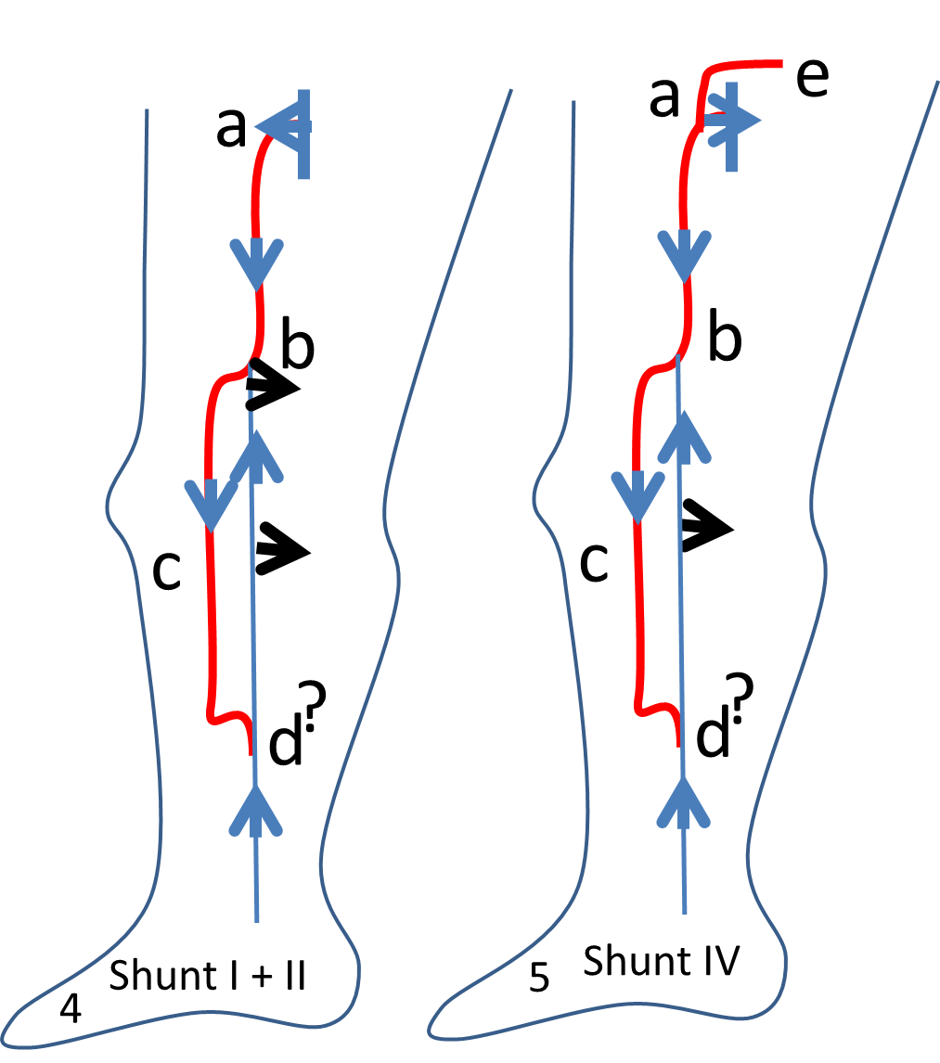
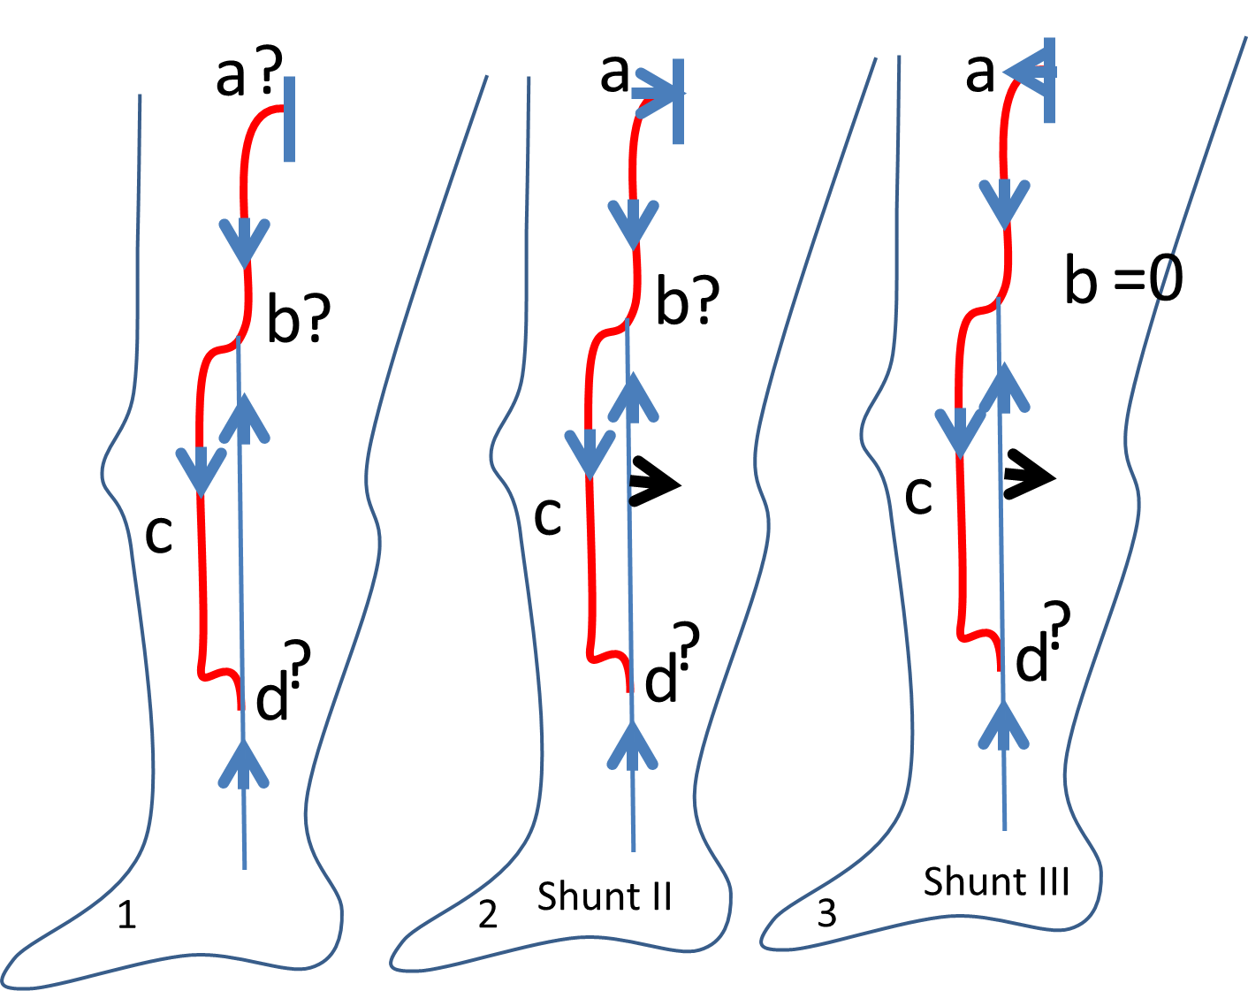
Diagnosis: (1) Reflux GSV mid-thigh then tributary. Complementary data are necessary to implement an hemodynamic and hemodynamic tretment (CHIVA)
SFJ Valsalva + or - ?
Intermediate perforator re-entry in b?
Terminal re-entry : d?

Slide 2
p
Diagnosis:
(2) Shunt II if terminal valve comptent ( Valsalva -) . Treatment: disconnection in b (3) Shunt III if terminal valve incompetent ( Valsalva +) and absence of perforator b. Treatment: CHIVA 2 steps disconnection b then a when secondary reflux( (80% of the cases) or a + b disconnection + devalvulation down to the perforator p
(4) Shunt I + II: terminal valve incompetent ( Valsalva +) and presence of intermediate perforator b. Treatment: a + b disconnection
(5) Shunt IV: Valsalva (-)terminal valve but (e) valsalva + (point I or O) : treatment: e + b disconnection

