Slide 1
Minimally-invasive surgical procedure for pelvic leak points in women R. Delfrate, M. Bricchi, F. Quadrozzi, C. Franceschi° Surgery Unit Figlie di San Camillo Hospital, Italy ° Angiology Consultant Saint Joseph Hospital, Paris, France
haemodynamicsdelfrate.com

Slide 2
January 2003-february 2016
4209 surgical treatment for primitive varicose veins as encoded by the chiva strategy
305
female and male varicose veins of the lower limbs of pelvic origin with well defined parietal pelvic escape point:
7.2%

Slide 3
Varicose veins of the lower limbs of pelvic origin
Thanks to Claude Franceschi an anatomic systematization had been done and so 6 well defined parietal anatomic points of interconnection between the pelvic and parietal vessels are today known: the pelvic escape points ( PLP ), the PP and the IP beeing the more frequently detected
This knowledge had provided a mini-invasive possibilty of surgical mini-invasive treatment under local anaesthesia thanks to the echoduplex identification and haemodynamic assessement

Slide 4
Selection criteria for surgical treatment
Symptomatic primitive varicose veins
Asymptomatic but clearly visible and widespread varicose veins ( request of treatment by the patient )
Reflux caused by the valsalva manoeuvre, detected at the escape point and trasmitted distally
Absence of an open vicarious shunt ( pelvic congestion syndrome)

Slide 5
Our experience in surgical minimally-invasive female parietal treatment of Pelvic Leak Points (PLP)
Shunts type IV an V according to the Teupitz CHIVA classification*
250
surgical procedures
with at least 1 year follow up158 PP, 88 IP, 4 CP
Follow up from 12 to 92 months
Mean follow up 30.51 months
*Phlebology 2003; 18:158-166

Slide 6
The group of controlled patients is homogeneous both for surgeon and for controllers
All the cecks have been performed with the same doppler ultrasound using the same linear probe ( 10-18 MHz )
With the patient in standing position the valsalva manoeuvre was used both for the diagnosis and to highlight a recurrence . The PRF has always been adjusted between 0.75 and 1 Khz , capable of detecting even low speed of reflux from 0.05 to 0.10 m/s

Slide 7
Surgical minimally-invasive female parietal treatment of Pelvic Leak Points (IP,PP,CP)
Among all the controlled PLP no reflux redo was detected in 245 procedures (98%) where the PP were 155, the IP 87, the CP 3
Pelvic leak reflux redo was detected in 5 procedures (2%) where PP =3 (1,2%), IP =1 (0.4%), CP 1(0.4%).
No major complications (deep vein thrombosis, pulmonary thromboembolism), or death occurred
No subcutaneous inguinal or perineal bruises, only one inguinal bleeding (immediate surgical exploration of the inguinal canal under local anaesthesia), neuralgia, wound infection or superficial phlebitis

Slide 8
Surgical minimally-invasive female parietal treatment of Pelvic Leak Points (IP,PP,CP)
Taking into separate consideration each PLP the recurrence rate was:
1.89% PP
1.13% IP
25% CP
Only in one patient with a PP symptomatic reflux recurrence a redo surgery was done; sclerotherapy for others

Slide 9
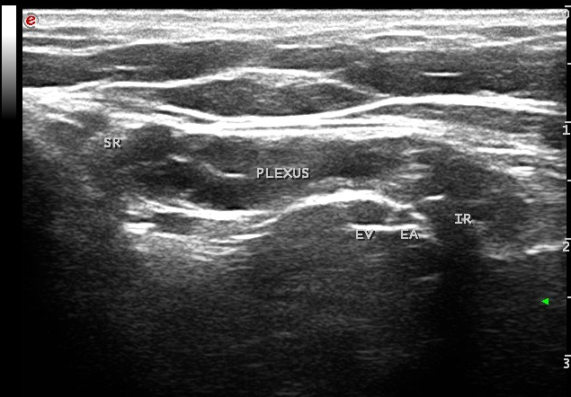
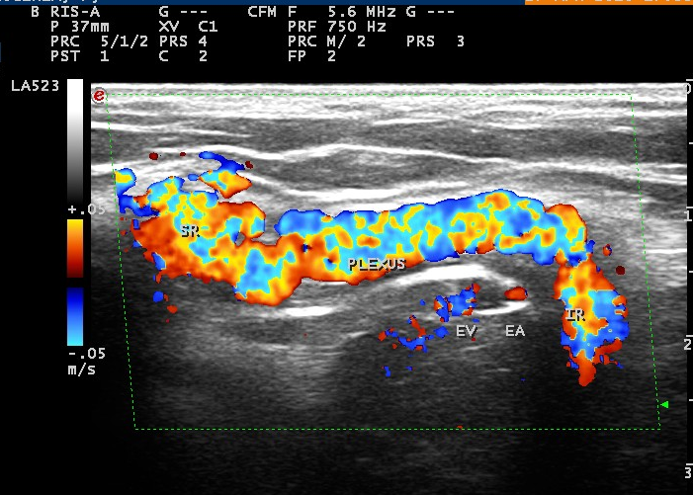
Female I point
Echoduplex identification and haemodynamic assessement thanks to the Valsalva manoeuvre
The preoperative B-Mode marking allows a minimally-invasive surgical treatment
Valsalva manoeuvre:
reflux from the pelvis to the subcutaneous veins and lower limbs passing through the inguinal canal and it’s subcutaneous ring towards the veins of the lower limbs

Slide 10
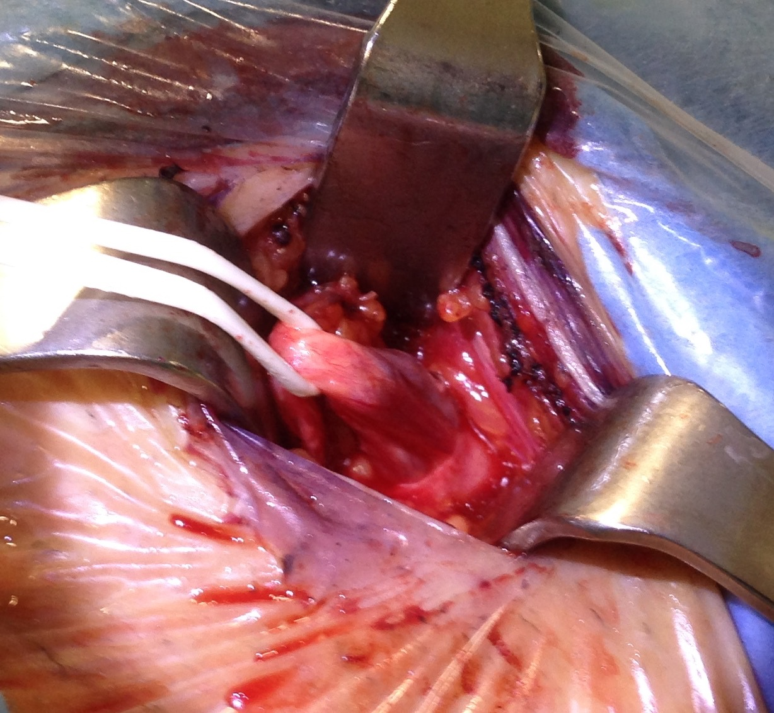
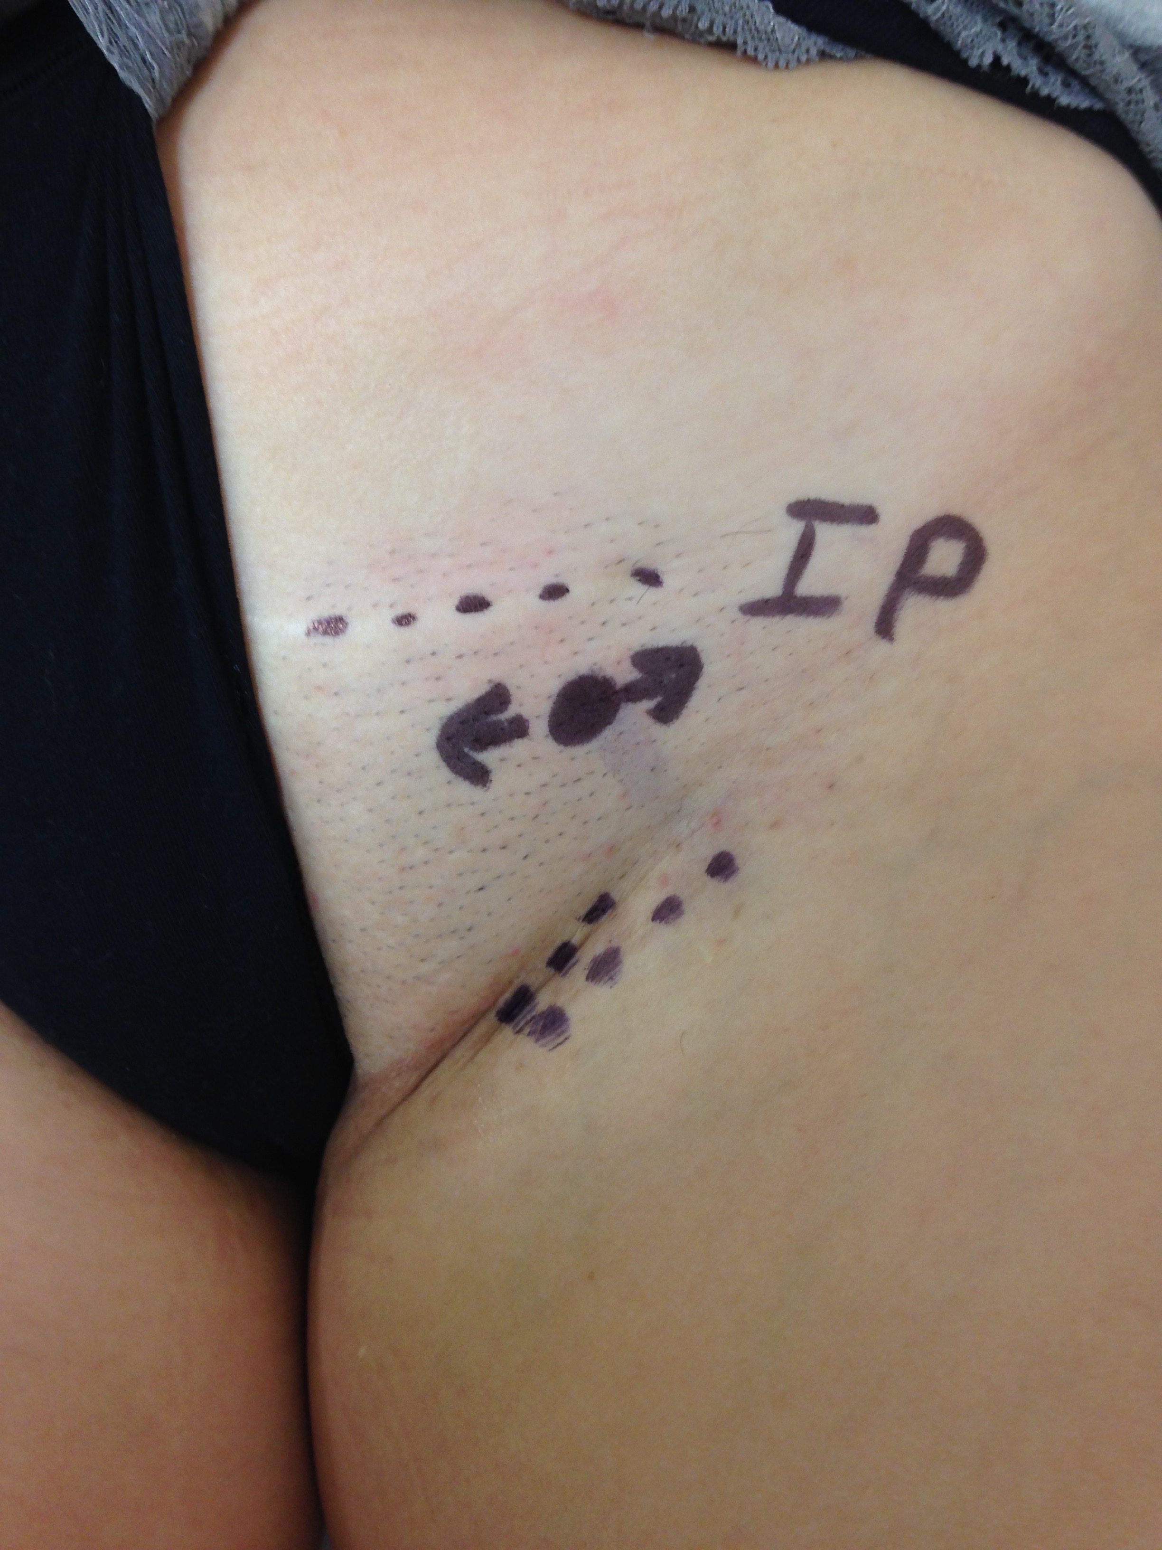
Minimally-invasive surgical female I leak point treatment for symptomatic or widespread and visible varicose veins of the lower limbs
venous plexus of the round ligament on a vessel loop

Slide 11
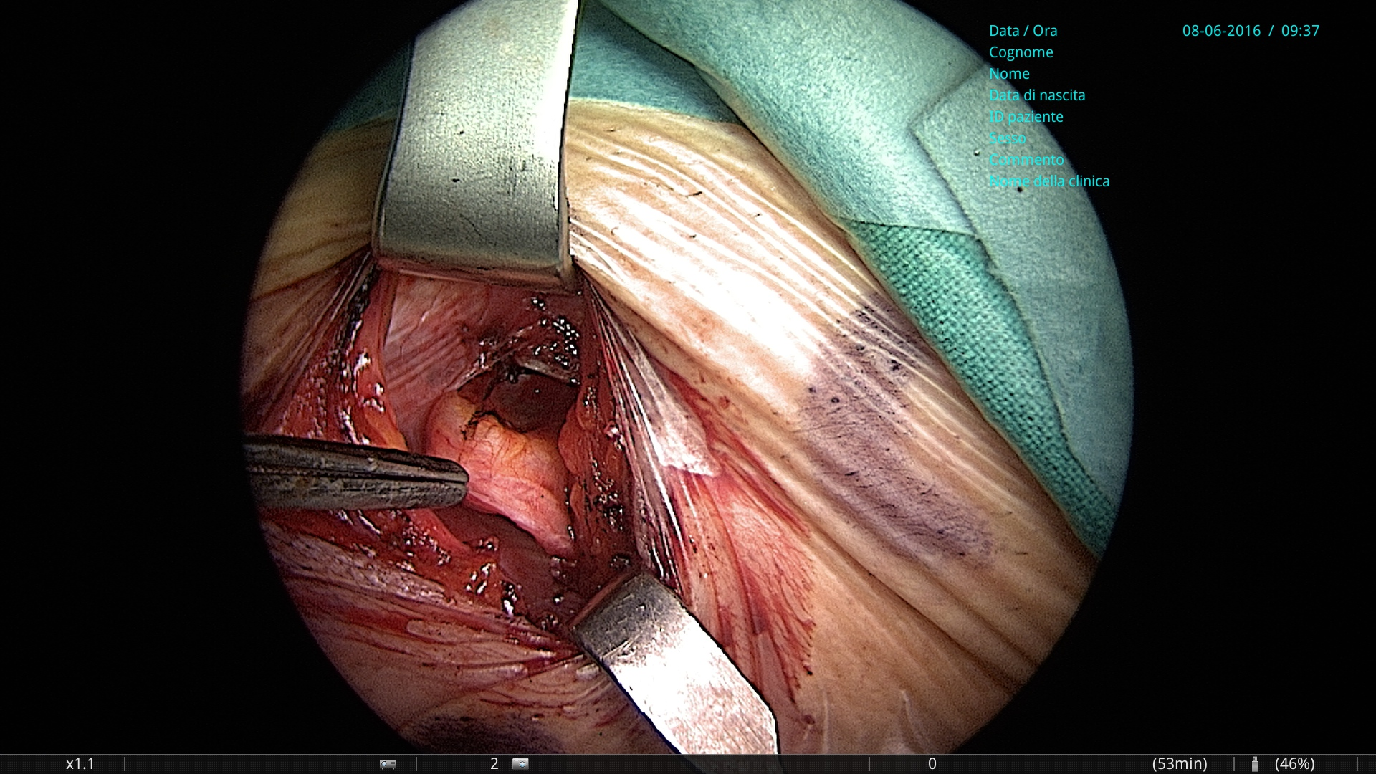
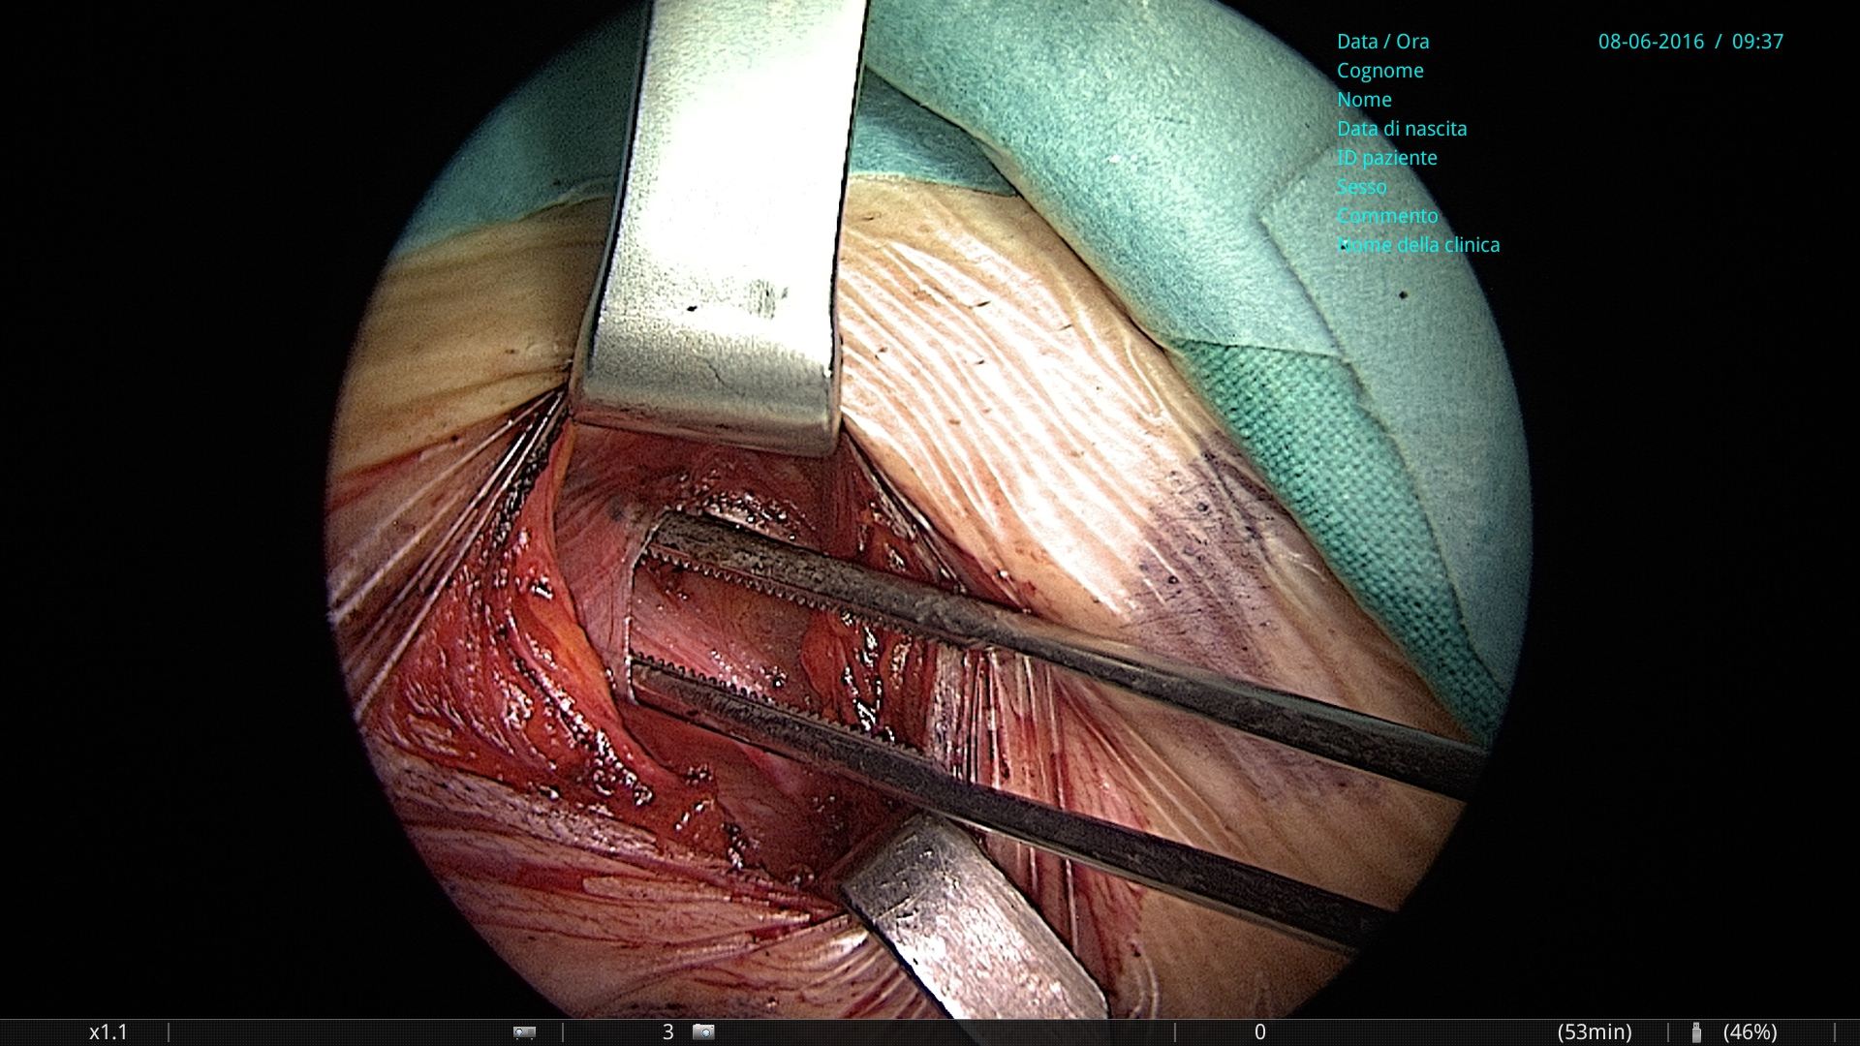
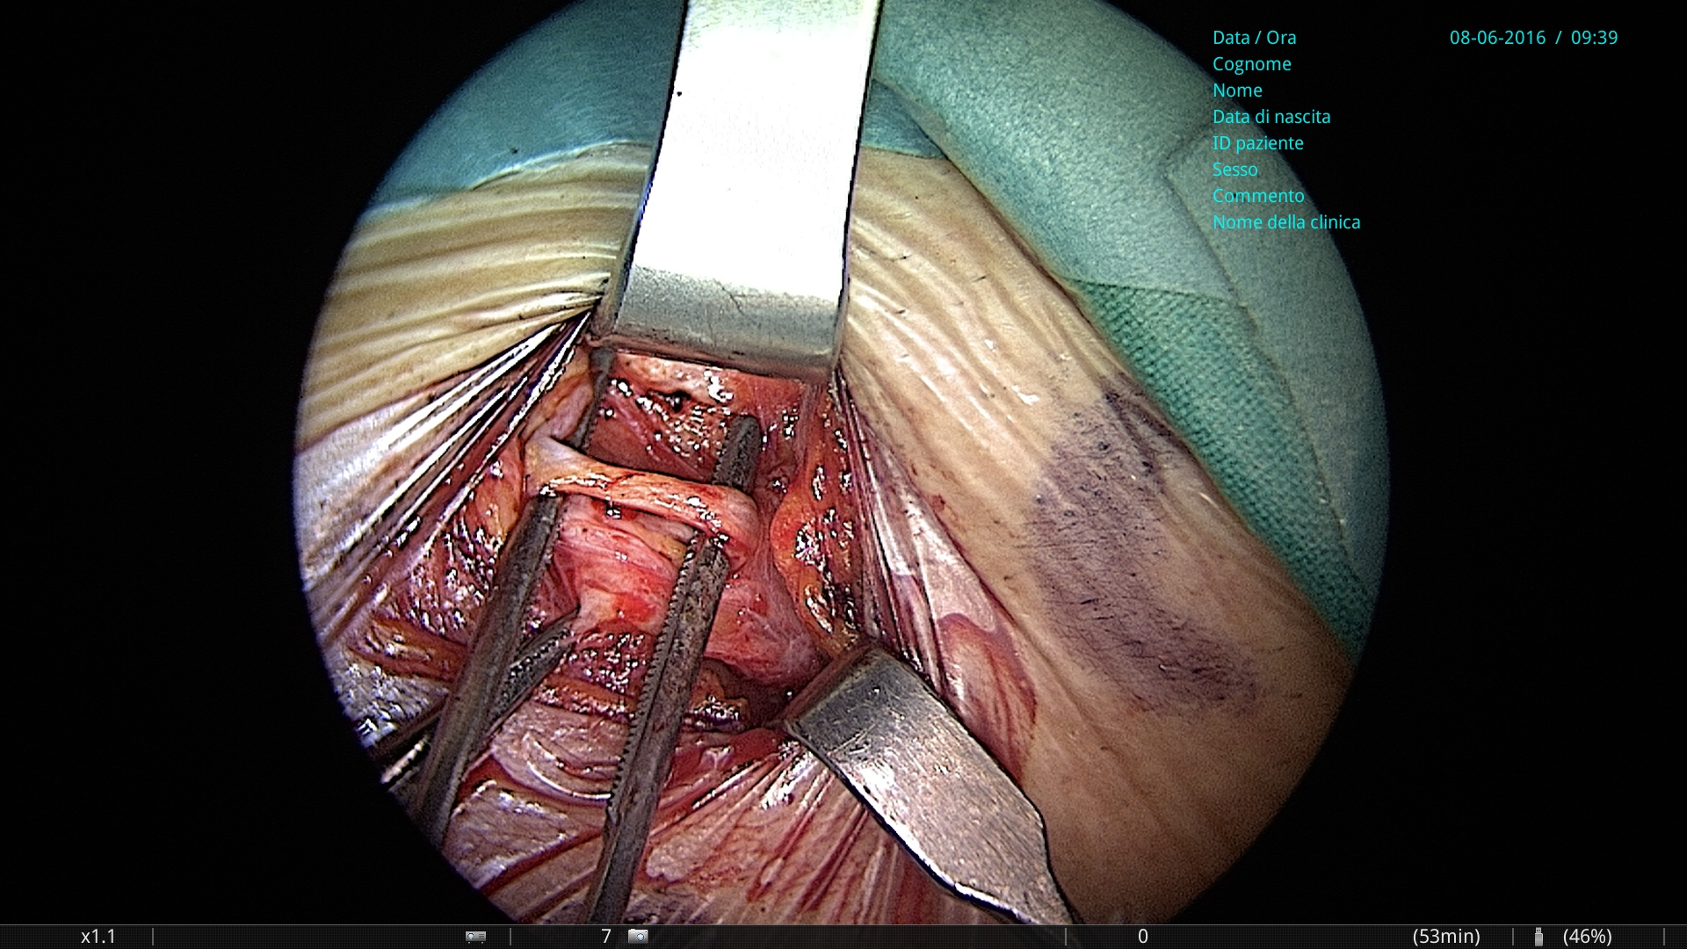
Genitocrural nerve on the surgical forceps
Subcutaneous
ring of the
inguinal
canal
The venous plexus of the round ligament below
the nerve

Slide 12
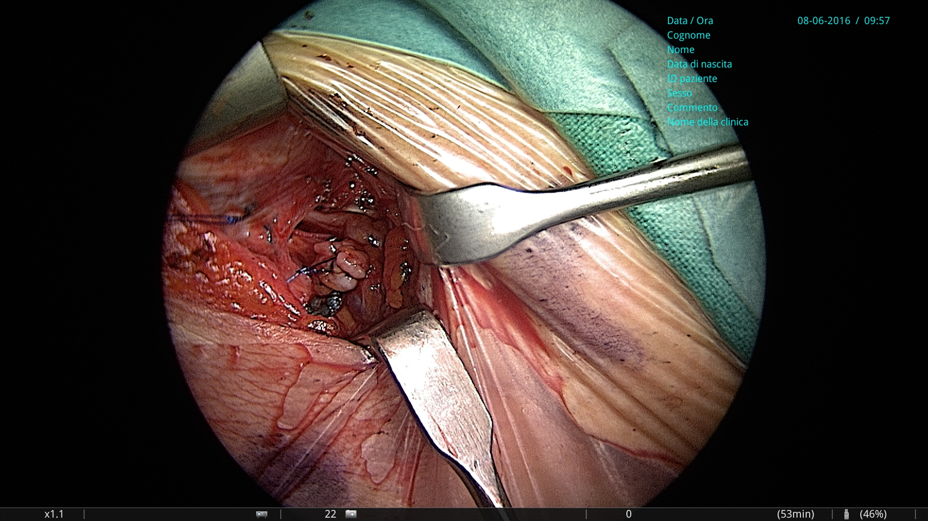
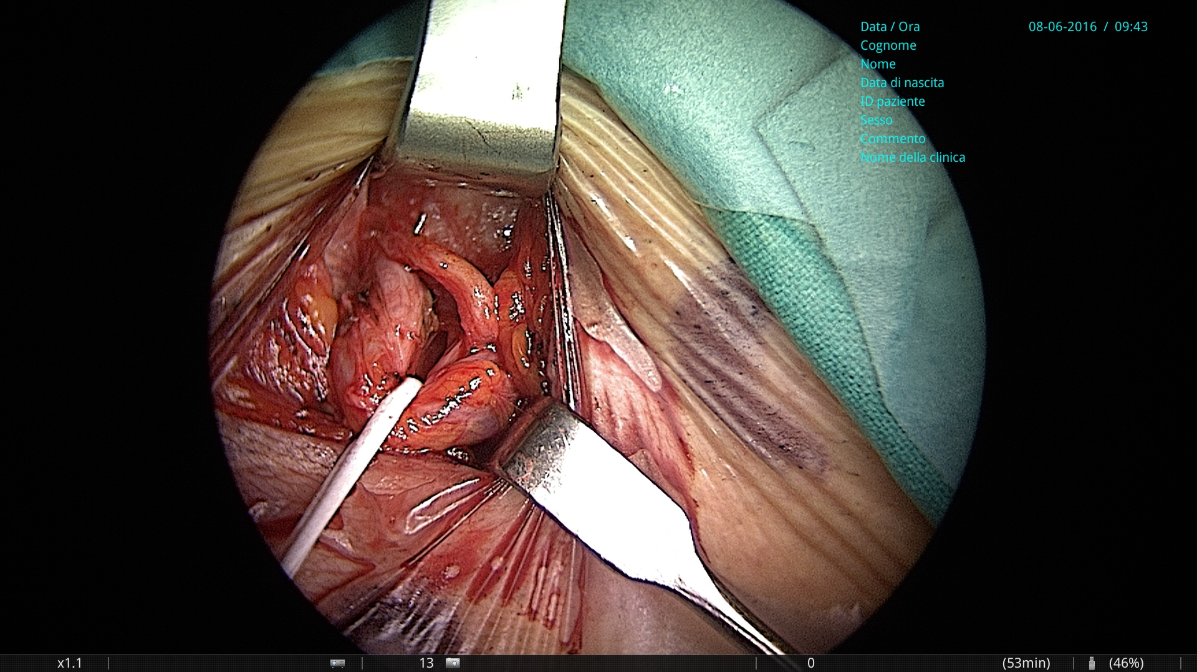
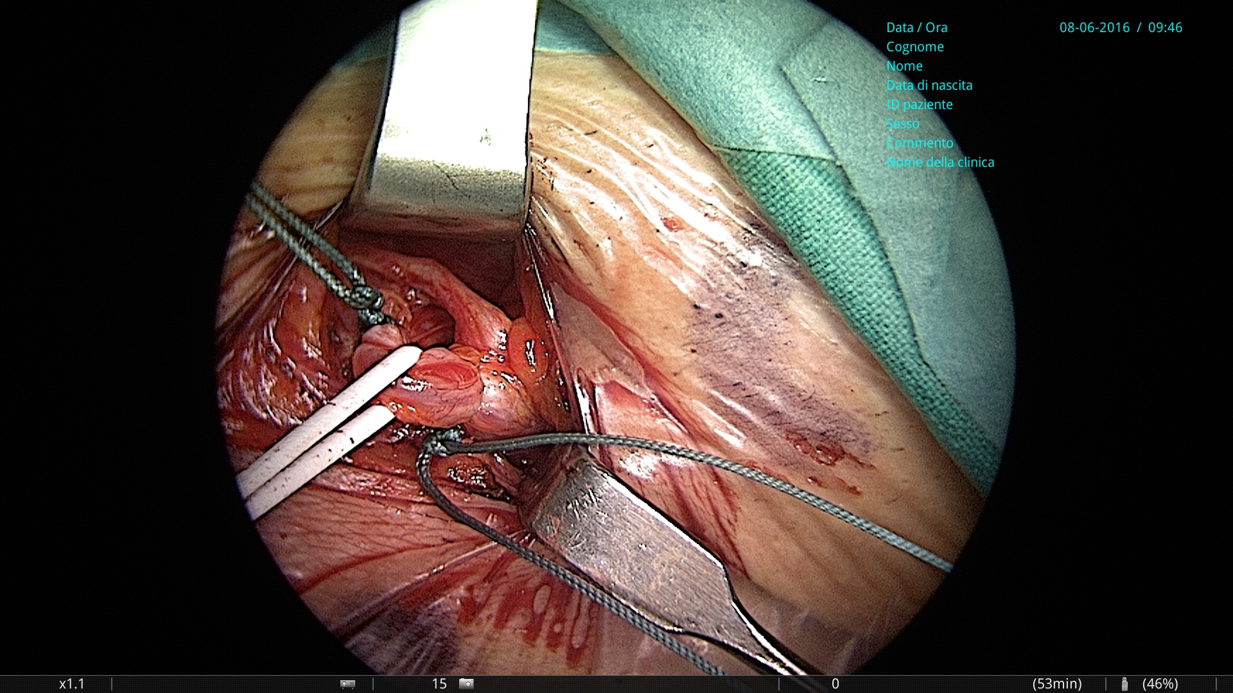
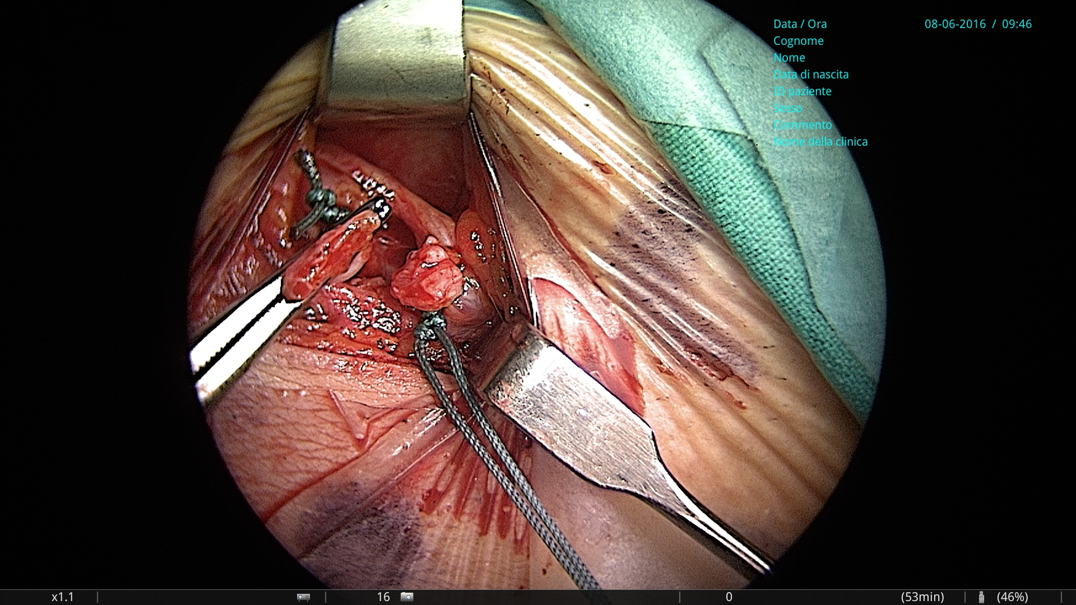
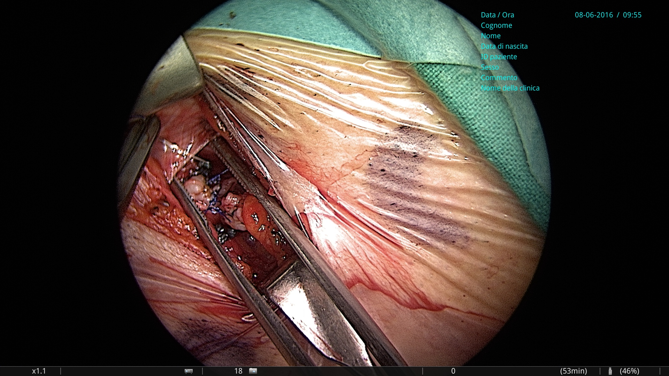
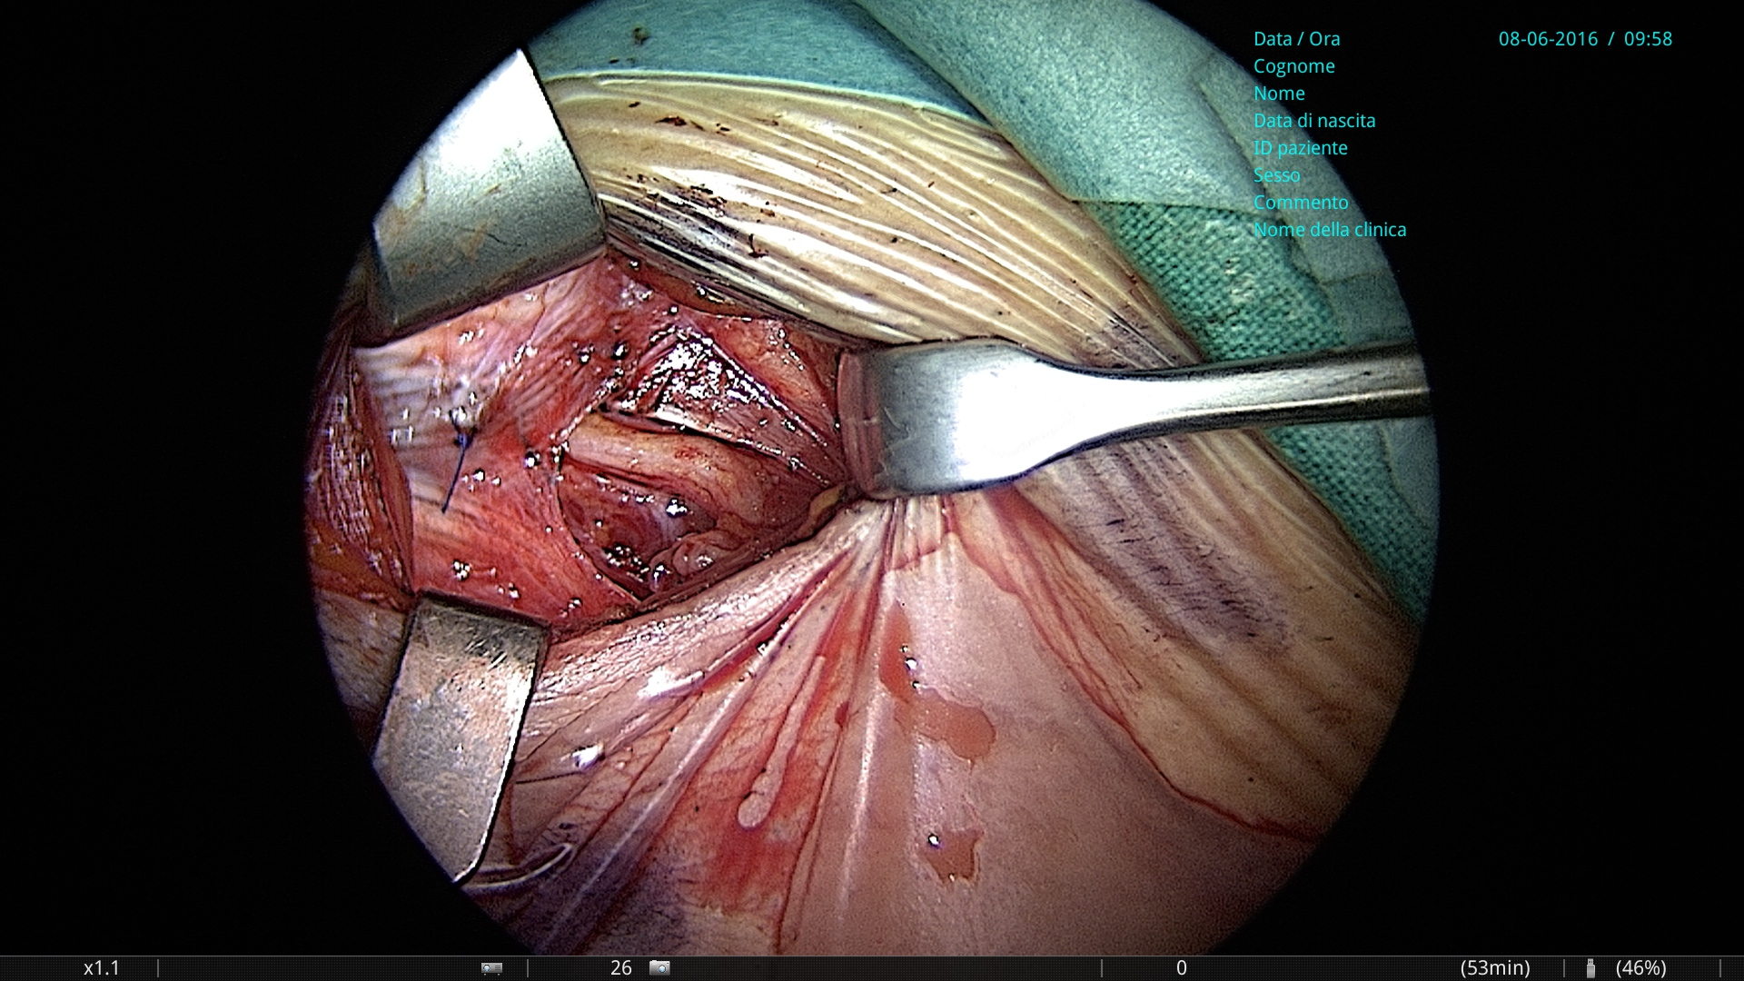
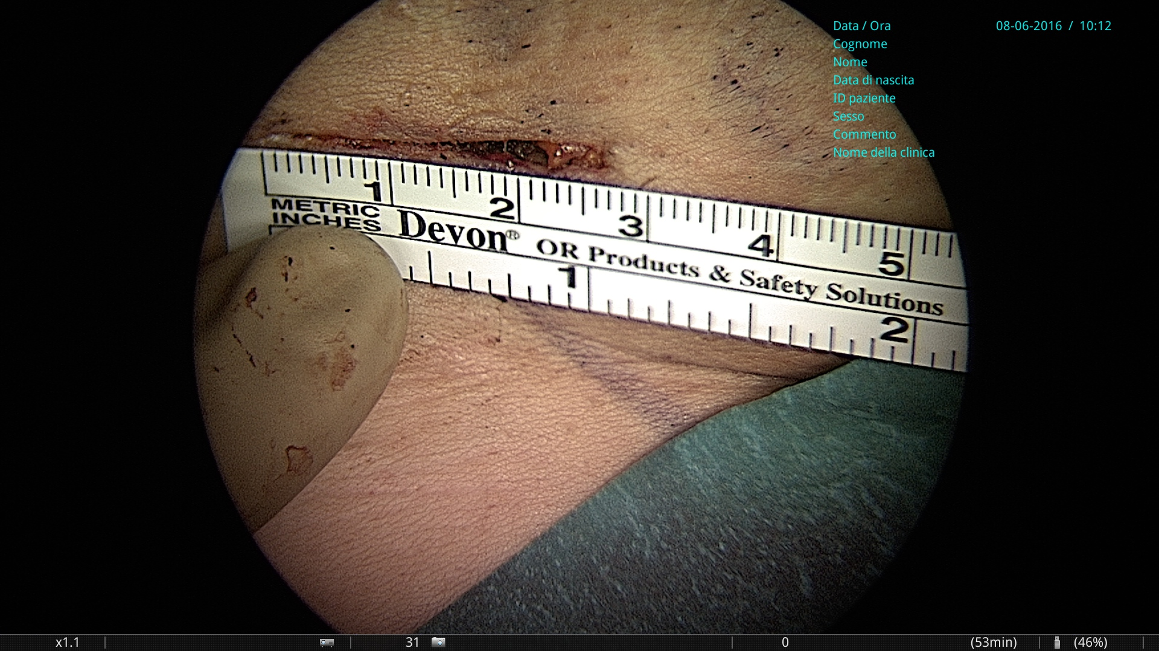
the venous plexus of the round ligament on a vessel loop with the genitocrural nerve previously isolated visible above it
Division and stump ligation of the refluxing vein with non-absorbable braided coated suture and additional polypropylene 5 zero monofilament transfixed suture, positioning the stump of round ligament inside the inguinal canal, suturing it with a polypropylene stitch to the fascia of the oblique external muscle

Slide 13
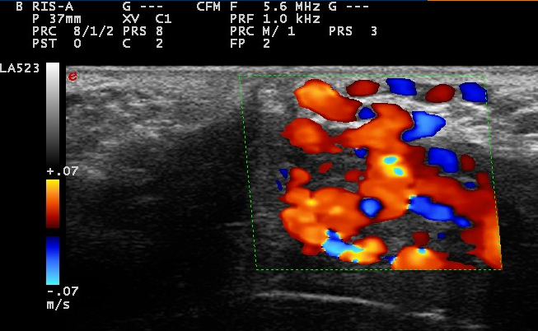
Left P point
Female P point
Echoduplex identification and haemodynamic assessement thanks to the Valsalva manoeuvre
The preoperative B-Mode marking allows a minimally-invasive surgical treatment
Valsalva manoeuvre
Reflux from the internal pudendal vein passing through the vulvar plexuses and labial veins into the veins of the lower limbs

Slide 14
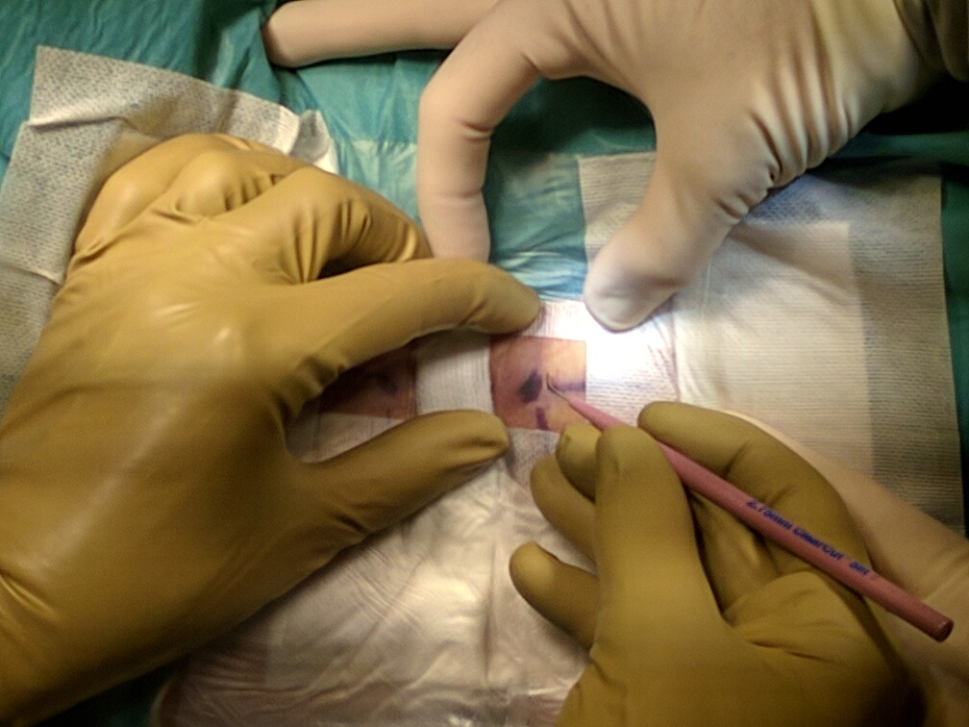
PP minimally-invasive surgical treatment
Gynecological position
Litle skin incision ( 10-12 mm)
refined preoperative B-Mode marking

Slide 15
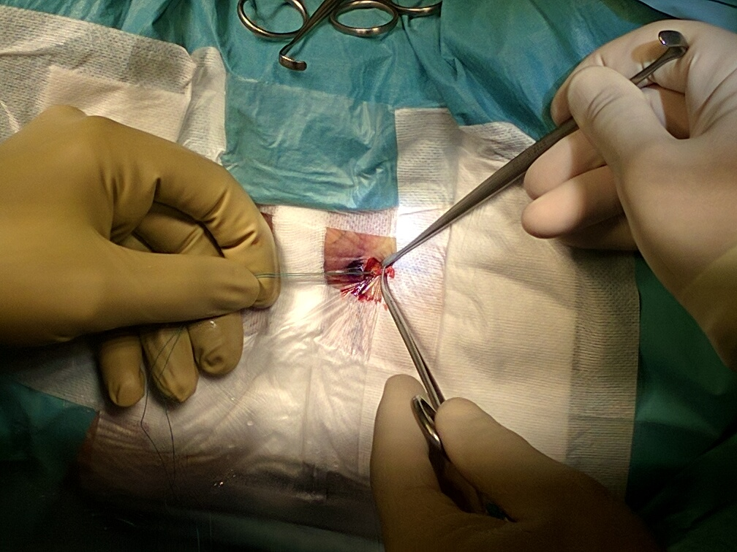
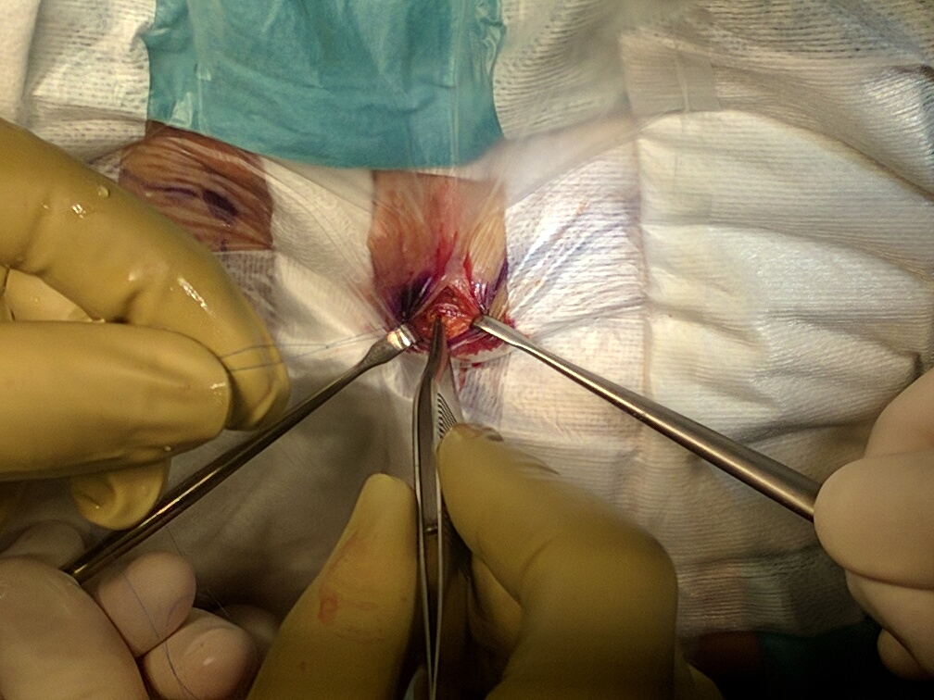
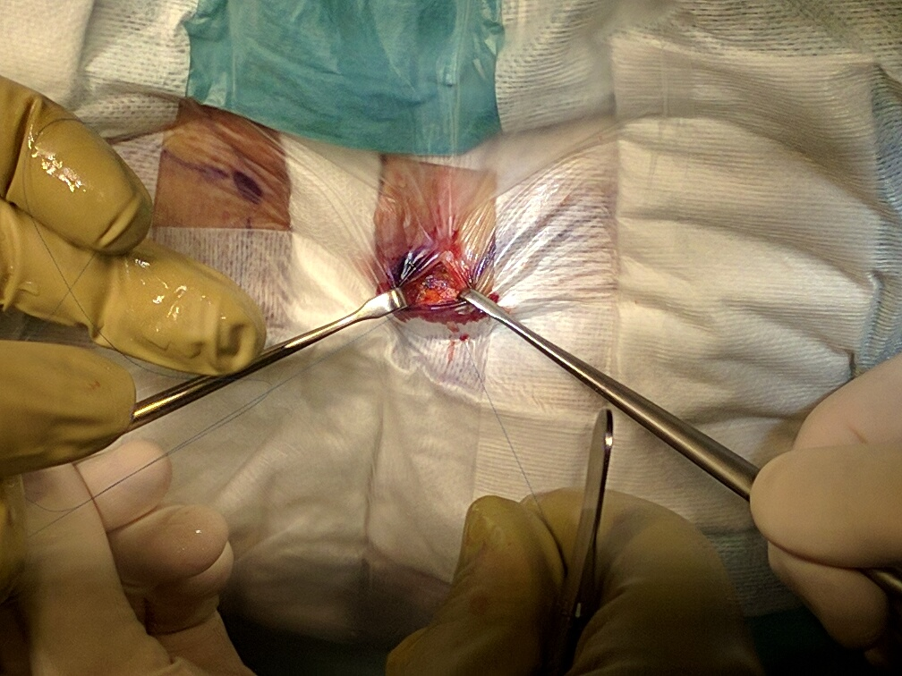
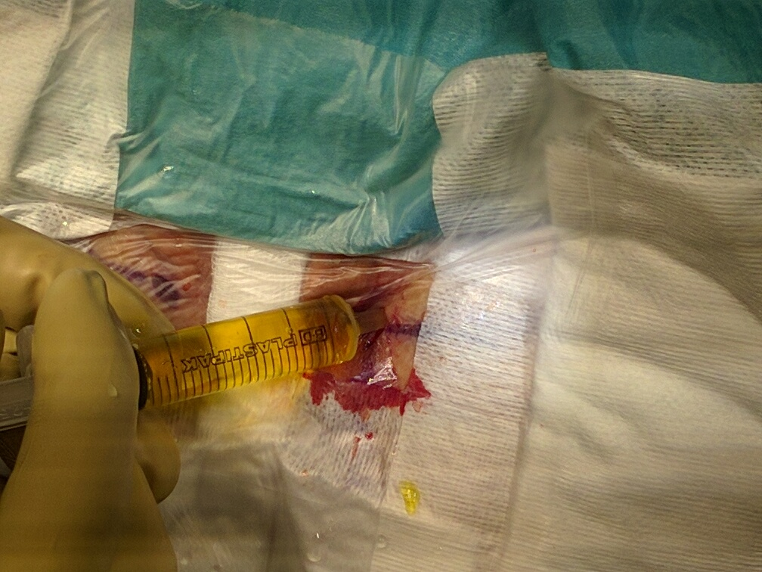
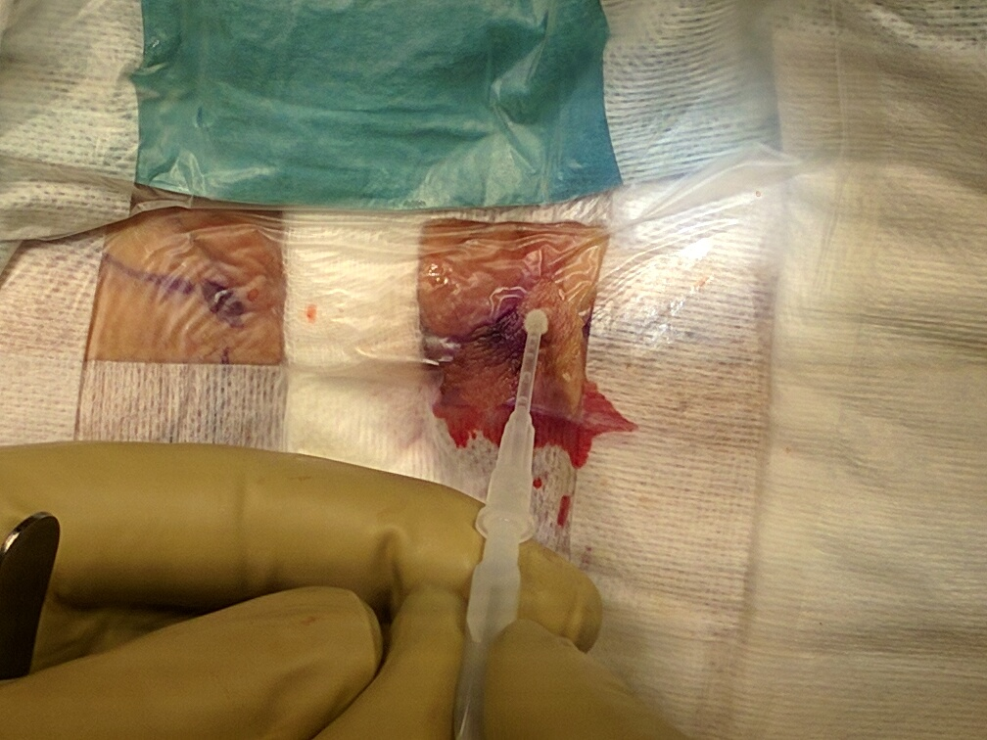
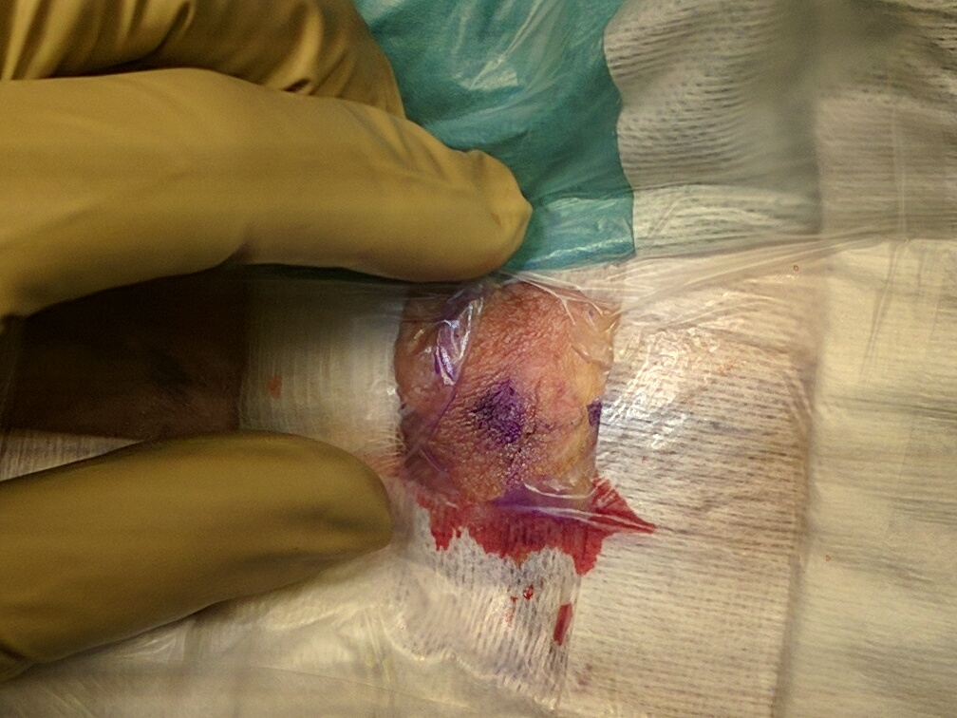
The labial vein has been ligated and the stump is in the vulva.
The tip of the surgical forceps enter the fascia hole and a polypropylene 6 zero stich is ready to be tied to close it
Washing the surgical field with rifampicine solution
Cyanoacrylate adhesive paste
The final result
Posterior labial vein ligation close tu the fascia hole

Slide 16
Conclusions
A peripheral parietal mini-invasive surgical therapy to treat reflux of pelvic origin responsible of varicose veins of the lower limbs in absence of pelvic congestion syndrome is possible
The surgical procedures need only a local anaesthesia with low surgical risk and low percentage of complications
Recurrences are low for the IP and PP treatment, high for the CP ( ligation not close to the fascia hole to avoid nervous injuries )
The accurate ultrasound assessment of each specific pelvic leak as well as a special minimally invasive surgical technique (non-absorbable suture of vein stumps and fascias)s seems to be the key for satisfactory outcomes

