Slide 1
CHIVA Combourg 2004
Claude Franceschi
VEINES PERFORANTES
PERFORATORS
Anatomy: R is réseau in French, N is Network
Venous segments of variable number, topography and anatomical configuration, communicating the superficial network (R2 and R3) with the deep network (R1) by perforating fascia and aponeurosis, with the exception of the saphenofemoral and saphenopopliteal junctions of the saphenofemoral junction and the penetrations of the perineal veins, clitoral veins and round ligament into the pelvis.

Slide 2
Main collectors R2, R3 extending to deep network R1 through aponeurosis:
sapheno-femoral and popliteal junctions
P,I,C, SG,IG, O points
Perforators linking R2 and R3 to deep network R1 through aponeurosis as accessory collectors
Centerd Perforators
Off-Centerd Perforators

Slide 4
VEINES PERFORANTES
PERFORATORS
Physiology:
Accessory drainage routes from the superficial network (R2 and R3) with the deep network (R1). The saphenofemoral and saphenopopliteal junctions of the saphenofemoral crosses and the penetrations of the perineal, clitoral and round ligament veins into the pelvis are the main drainage routes.

Slide 5
Main collectors R2, R3 extending to deep network R1 through aponeurosis:
sapheno-femoral and popliteal junctions
P,I,C, SG,IG, O points
Perforators linking R2 and R3 to deep network R1 through aponeurosis as accessory collectors
Centerd Perforators
Off-Centerd Perforators

Slide 6
VEINES PERFORANTES
PERFORATORS
Hémodynamique:
Sens du flux: Le sens du flux est déterminé par les variations relatives des pressions latérales de part et d’autre des perforantes, à savoir du gradient de pression profond-superficiel et de la continence des valvules.
Sens physiologique: Antérograde ou Nul.
Le sens est antérograde quand la pression latérale profonde R1est inférieure à la pressions latérale superficielle R2 ou R3.
L’inversion du gradient de pression tend à inverser le sens du flux mais il entraîne la fermeture des valvules qui à leur tour empêchent le reflux (flux nul).

Slide 7
VEINES PERFORANTES
PERFORATORS
Hemodynamics:
Direction of flow:
The direction of flow is determined by the relative variations in lateral pressures on either side of the perforators, namely the deep-superficial pressure gradient and valve continence.
Physiological sense:
Anterograde or None. The direction is anterograde when the deep lateral pressure R1 is lower than the superficial lateral pressure R2 or R3. The reversal of the pressure gradient tends to reverse the direction of the flow but it causes the valves to close which in turn prevents reflux (zero flow).

Slide 8
Flow direction according to the pressure gradient between superficial SP and deep veins DP in competent perforators
SP
DP
SP
DP
SP
DP

Slide 9
Systolic Flow direction according to the connection angle

Slide 10
VEINES PERFORANTES
PERFORATORS
Hemodynamics:
Direction of flow:
Retrograde direction NON-physiological:
The inversion of the pressure gradient reverses the direction of flow if the valves are absent or incontinent.
The variations in direction are zero, anterograde and retrograde in the case of perforating incontinence according to the variations and inversions of the pressure gradients.
The size does not prejudge the direction of the flow

Slide 11
Flow direction according to the pressure gradient between superficial SP and deep veins DP in incompetent perforators
SP
DP
SP
DP
SP
DP

Slide 12
Systolic Flow direction according to the connection angle

Slide 13
VEINES PERFORANTES
PERFORATORS
Hemodynamics:
Amount of flow:
Regardless of the direction, the amount of flux increases with the value of the pressure gradient but decreases with the caliber (resistance).
The flux may remain negligible or non-existent if the gradient is low and/or if the perforator is long and/or of small caliber.
The caliber may increase with the effect of the pressure gradient, but gradually.

Slide 14
Flow quantity according to the gradient pressure and the perforator width-length
Q = (SP-DP).r⁴/8l.µ
SP
DP
SP
DP
SP
DP
Q
r
l

Slide 15
PERFORATORS
Hemodynamics:
Flow composition:
Physiological:
The flow through the perforator consists of blood from superficial tissues corresponding to its physiological drainage territory.
NON-physiological:
The physiological flow may be overloaded by flows from other origins and destinations.

Slide 16
Flow components
Physiologic: flow from Its own superficial drained territory.

Slide 17
VEINES PERFORANTES
PERFORATORS
Hemodynamics:
Flow Composition:
NON-Physiological: Physiological flow may be overloaded by flows from other sources and destinations.
1- Flow draining from other territories, superficial and/or deep (vicarious open shunts or by bypass)
2-Recirculation flow (closed circuit) of closed shunts.

Slide 18
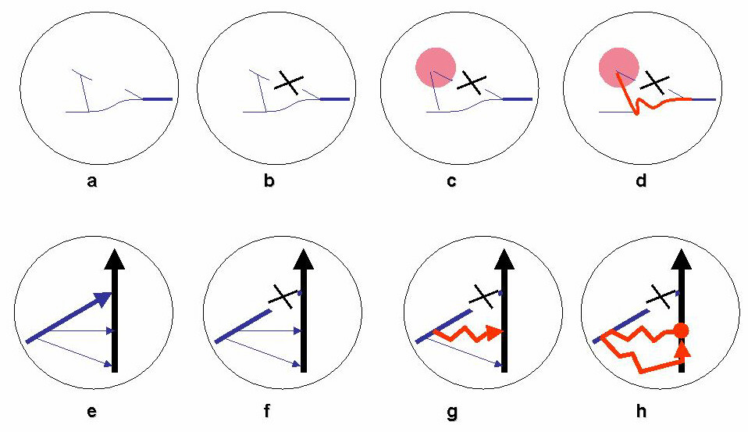
Flow components
NOT Physiologic: flow from other territories in addition to Its own superficial drained territory.
OPEN VICARIOUS SHUNTS

Slide 19
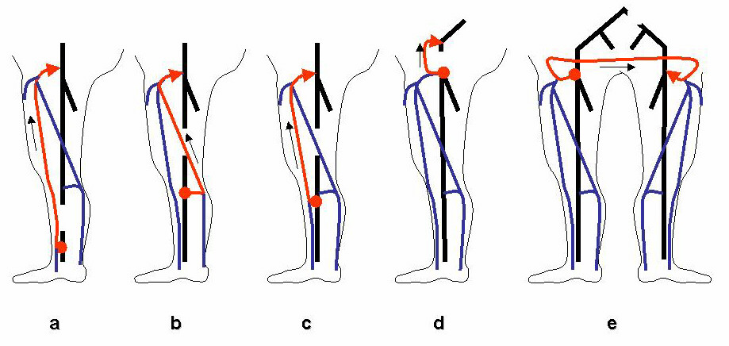
Flow components
NOT Physiologic: flow from other territories in addition to Its own superficial drained territory.
Flow components
NOT Physiologic: flow from other territories in addition to Its own superficial drained territory.
OPEN VICARIOUS SHUNTS

Slide 20
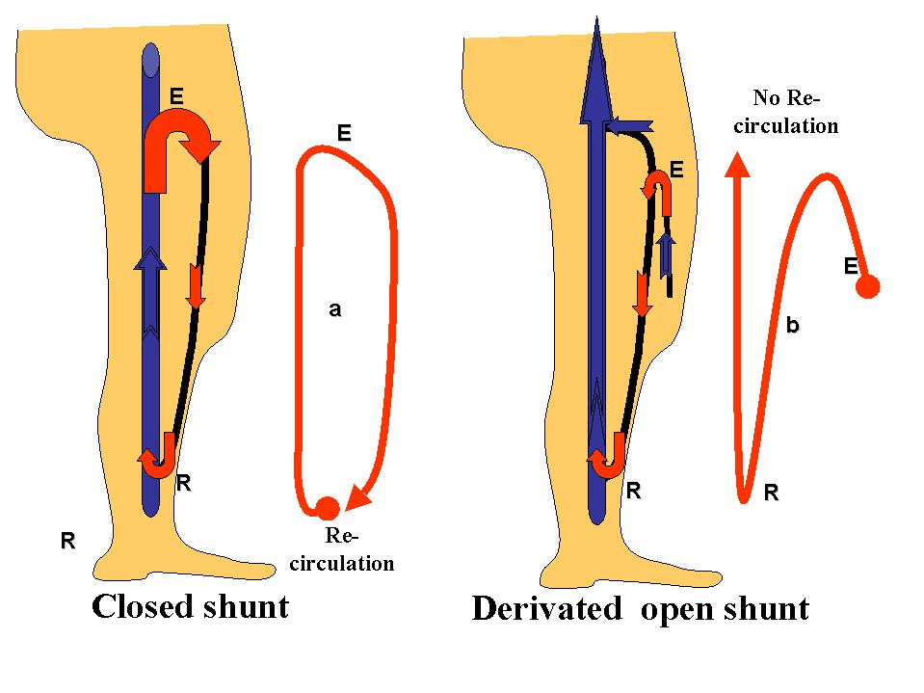
Flow components
NOT Physiologic: flow from other territories in addition to Its own superficial drained territory.
OPEN DERIVATED SHUNTS

Slide 21
Flow components
NOT Physiologic: flow from other territories in addition to Its own superficial drained territory.
CLOSED SHUNTS

Slide 22
VEINES PERFORANTES
PERFORATORS
Hemodynamics:
Flow energy:
Physiological: Flow rate provided by residual pressure: variations according to arterial and capillary resistance (thermoregulation: external heat, internal heat (walking, sport)
NON-physiological:
1-Excess residual pressure: vicarous open shunts
2-Valvulomuscular pump pressure: deep-superficial, open vicarious and closed shunts

Slide 23
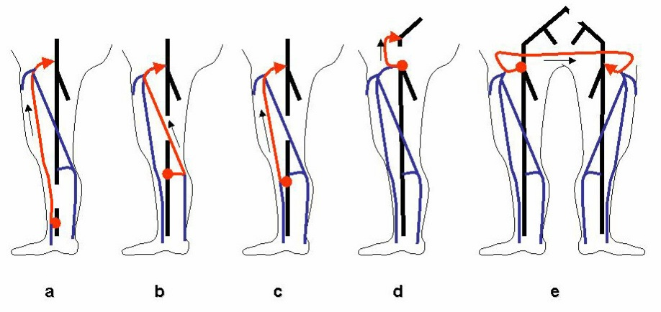
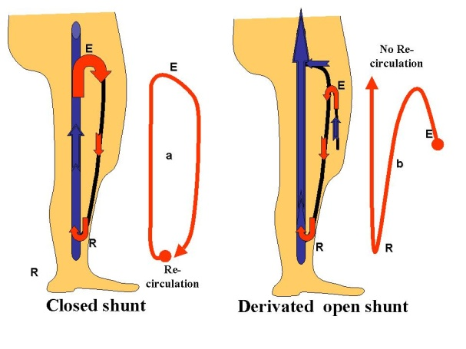
Flow energy
Physiologic:
Drainage Residual pressure of its own territory increased by physiological micro-circulation resistances reduction: heat, walking, sport
NOT physiologic:
Excess of residual pressure : open vicarious shunts and systolic Valvulo-muscular pump energy
Diastolic Valvulo-muscular pump energy in open derivated shunts and vicarious closed shunts

Slide 24
VEINES PERFORANTES
PERFORATORS
Functions
Physiologic:
Accessory physiologic Drainage when the flow increases because of arteriolo-capillary resistances réduction ( thermoregulation: external heat, internal heat ( walking, sport)

Slide 25
VEINES PERFORANTES
PERFORATORS
NON-physiological functions:
1-Favorable: Partial or total correction of a functional or organic obstruction of the physiological drainage pathways by creating leakage and re-entry points of the vicarious open shunts.
2-Unfavourable: Decompensation of valve incontinence by creation of leakage and re-entry points of closed or open shunts by bypass, responsible for varicose veins and drainage disorders due to the lack of dynamic fractionation of hydrostatic pressure.

Slide 26
VEINES PERFORANTES
PERFORATORS
Fonctions
Not physiologic:
1-Favourable:Drainage improvement thanks to leak and re-entry points of vicarious shunts..

Slide 27
VEINES PERFORANTES
PERFORATORS
Functions
Not physiologic:
2-Unfavorable: Escape and re-enty points of closed shunts or derivated open shunts leading to varices and trophic disorders

