Slide 1
COMPRESSION
Hemodynamic Rational
Claude Franceschi

Slide 2
COMPRESSION
Positive clinical effects in venous and lymphatic diseases are today indisputable

Slide 3
BUT
COMPRESSION
Pathophysiological Interpretation
Techniques
Indications
Are still today disputed

Slide 4
Leg COMPRESSION
1-Hemodynamic concept of venous drainage
2-Hemodynamic effects of compression
3-Means and compression techniques features and their specific hemodynamic effects
4-Proposals for rational hemodynamic compression

Slide 5
Leg COMPRESSION
Positive clinical effects
By the mean of drainage improvement in :
    Edema Volume reduction
    Ulcer and wounds healing
    Pain relieve
    in
Venous insufficiency
Lymphatic insufficiency
By the mean of stasis reduction in:
Phlebitis treatment and prevention

Slide 6
1-Hemodynamic concept of venous drainage
Hemodynamics can be defined as:
  the physical factors that govern blood flow which are the same physical factors that govern the flow of any fluid, and are based on a fundamental law of physics.

Slide 7
TRANS-MURAL PRESSURE (TMP)
is the hemodynamic key point of the venous drainage because it determines the transfer of fluids and their components from the tissue into the venous bed.
VENOUS DISEASE?
Just THINK TMP!
TMP
IVP
EVP

Slide 8
TRANS-MURAL PRESSURE (TMP)
HEMODYNAMIC CORRECTION OF TMP EXECSS.
TMP = IVP-EVP
DECREASE IVP by :
COMPESSION
Increasing physiological EVP with external ARTIFICIAL means
TMP
Compression
IVP
EVP
Resulting lower TMP

Slide 9
TRANS-MURAL PRESSURE (TMP)
Is the resulting static pressure from the opposite Extra-venous ( EVP) and Intra-venous (IVP) static (potential) pressures against:
- the wall of the veins and
- venous end of the capillaries.
TMP = IVP-EVP
TMP
IVP
EVP

Slide 10
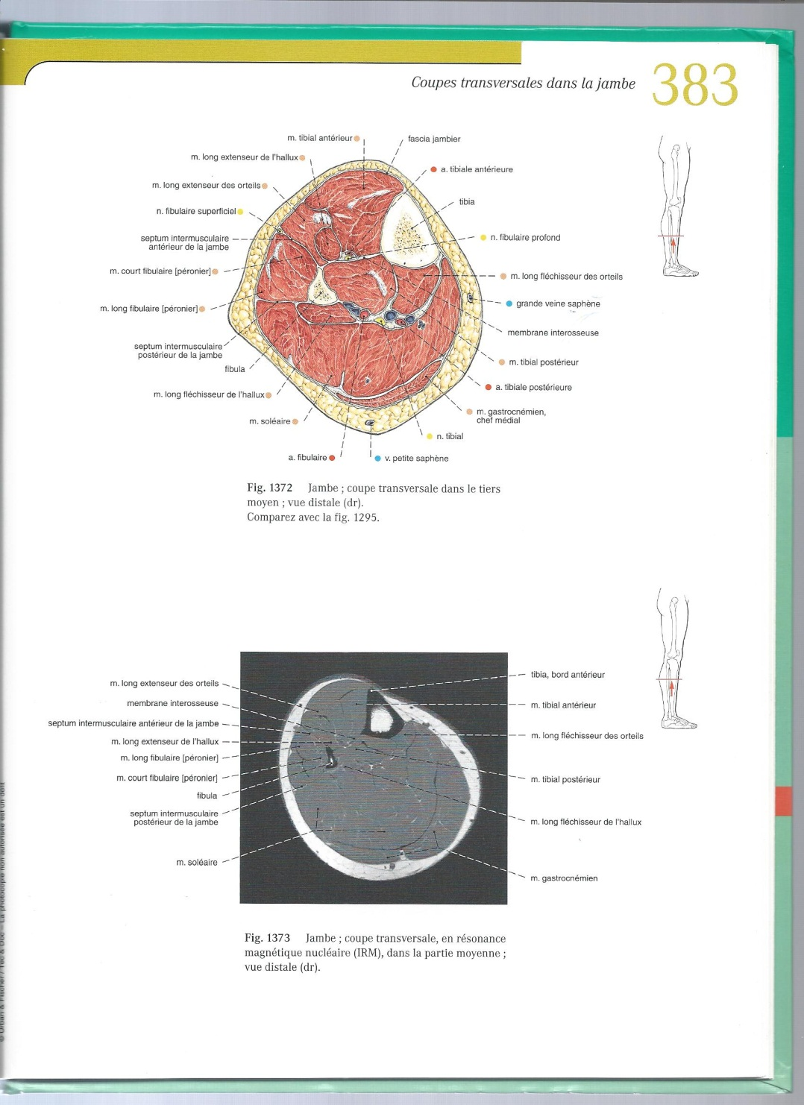
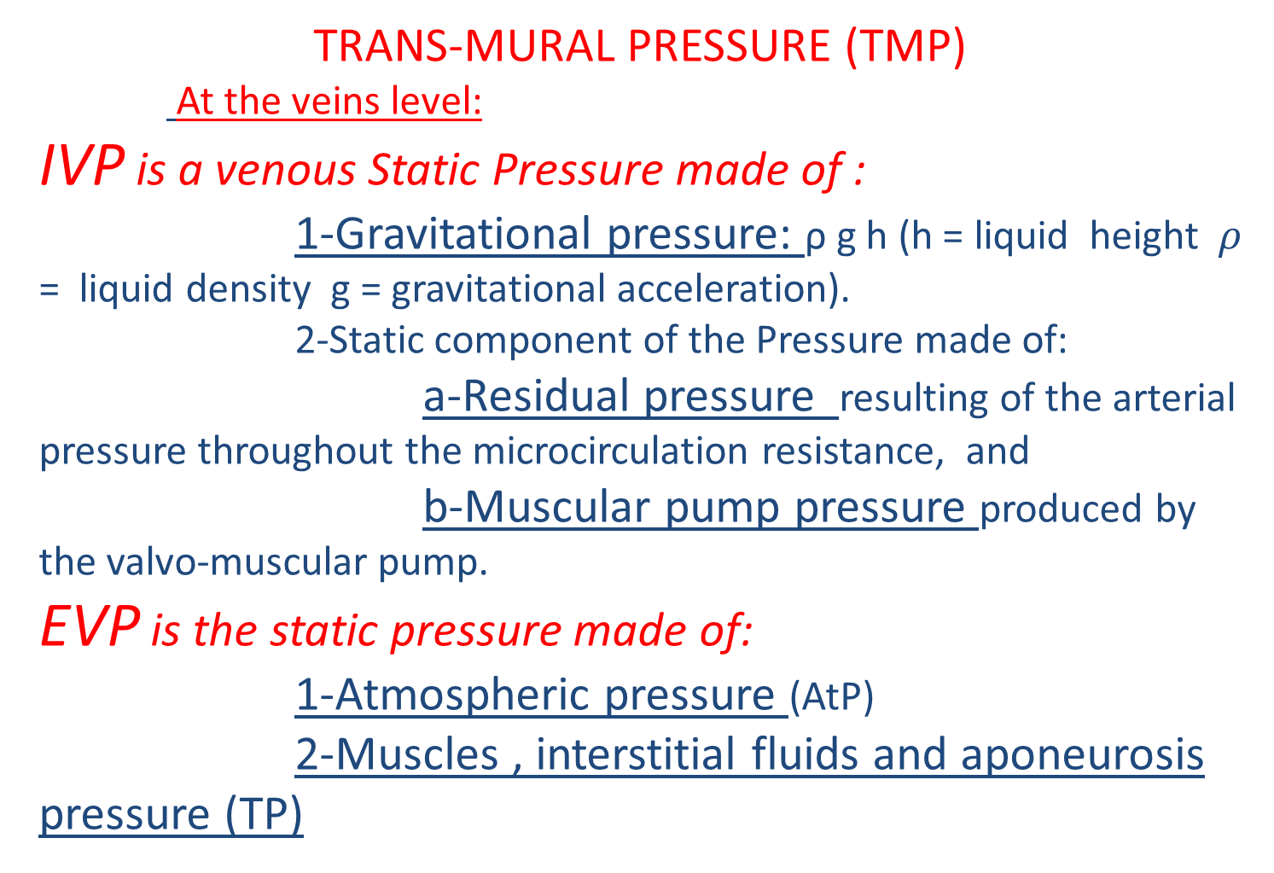
TRANS-MURAL PRESSURE (TMP)
At the veins level:
IVP is a venous Static Pressure made of :
    1-Gravitational pressure: ρ g h (h = liquid height$ρ$ = liquid density g = gravitational acceleration).
    2-Static component of the Pressure made of:
    a-Residual pressure resulting of the arterial pressure throughout the microcirculation resistance, and
    b-Muscular pump pressure produced by the valvo-muscular pump.
    EVP is the static pressure made of:
    1-Atmospheric pressure (AtP)
    2-Muscles , interstitial fluids and aponeurosis pressure (TP)

Slide 11
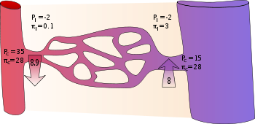
TRANS-MURAL PRESSURE (TMP)
At the level of the venous end of the capillaries :
IVP is a venous Static Pressure made of :
)
    VENOUS IVP + Osmotic plasma pressure (OPP)
    VENOUS EVP + Osmotic Interstitium pressure (OIP)

Slide 12
TRANS-MURAL PRESSURE (TMP)
HEMODYNAMIC CORRECTION OF TMP EXECSS.
TMP = IVP-EVP
        1-DECREASE IVP and/or
        2-INCREASE EVP
TMP
IVP
EVP

Slide 13
TRANS-MURAL PRESSURE (TMP)
HEMODYNAMIC CORRECTION OF TMP EXECSS.
TMP = IVP-EVP
DECREASE IVP by :
1- Gravitational Pressure(GP) Decrease and/or
2 - If Valve incompetence:
a-Incompetent Valve repair or new valve
b-Closed shunts disconnection + Column fractionning (CHIVA)
3 – if obstacle: By-pass or liberation
TMP
IVP
EVP
Resulting lower TMP

Slide 14
TRANS-MURAL PRESSURE (TMP)
HEMODYNAMIC CORRECTION OF TMP EXECSS.
TMP = IVP-EVP
DECREASE IVP :
1- Decrease Gravitational Pressure: POSTURAL TREATMENT: The more the foot is elevated, the less the Gravitational Pressure (GP)
Ankle GP
+
0
_

Slide 15
TRANS-MURAL PRESSURE (TMP)
HEMODYNAMIC CORRECTION OF TMP EXECSS.
TMP = IVP-EVP
DECREASE IVP by :
2 - If Valve incompetence:
a-Incompetent Valve repair or new valve
b-Closed shunts disconnection + Column fractionning (CHIVA)

Slide 16
TRANS-MURAL PRESSURE (TMP)
HEMODYNAMIC CORRECTION OF TMP EXECSS.
TMP = IVP-EVP
DECREASE IVP by :
3 – if obstacle: By-pass or liberation

Slide 17
TRANS-MURAL PRESSURE (TMP)
HEMODYNAMIC CORRECTION OF TMP EXECSS.
TMP = IVP-EVP
COMPESSION
.
TMP = IVP-EVP
Decrease the TMP by the mean of Increasing physiological EVP with external ARTIFICIAL means
TMP
IVP
EVP

Slide 18
TRANS-MURAL PRESSURE (TMP)
HEMODYNAMIC CORRECTION OF TMP EXECSS.
TMP = IVP-EVP
DECREASE IVP by :
COMPESSION
Increasing physiological EVP with external ARTIFICIAL means
TMP
Compression
IVP
EVP
Resulting lower TMP

Slide 19
IVP IMPORTANT PhysolologicaI variations according to posture and muscular pump activity
Ankle Pressure
90 mm Hg
30 mm Hg
Normal
+
15 mm Hg
0
-
Standing Pathogenic!!!
Starting
Walking
PUMP!!!
Stopping
Lying
- 40 mm Hg
Declive

Slide 20
EXCESSIVE and PATHOGNENIC TMP due to IVP excess in STANDING STILL POSTION in NORMAL INDIVIDUALS :
Compression indicated in people standing still for long periods of time
Ankle Pressure
90 mm Hg
30 mm Hg
Normal
+
15 mm Hg
0
-
Standing Pathogenic!!!
Starting
Walking
PUMP!!!
Stopping
Lying
- 40 mm Hg
Declive

Slide 21
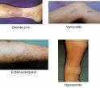
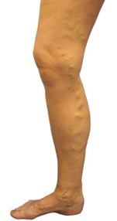
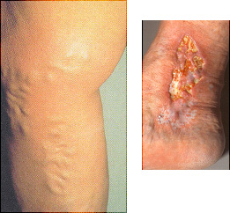

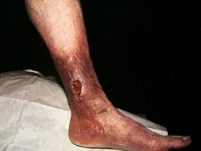
Oedema, Varices,Trophiques Changes , Ulcer
When related to venous insufficency
Are caused by a TMP excess

Slide 22
CAUSES FOR TMP EXCESS
1- VALVULAR INCOMPETENCE and/or Muscle inactivity
Impairment of Dynamic Fractionning of the Hydrostatic Pressure DFHSP
2- OBSTACLE to the FLOW
Excess of RESIUAL PRESSURE

Slide 23
VALVO-Muscular pump impairment: valve incompetence and/or Muscle inactivity
Impairment of Dynamic Fractionning of the Hydrostatic Pressure DFHSP
Ankle Pressure
90 mm Hg
Severe VI
Moderate VI
30 mm Hg
Normal
+
15 mm Hg
0
-
Standing at rest
Starting
Walking
PUMP!!!
Stopping
Lying
- 40 mm Hg
Declive

Slide 24
Surprisingly DIFFERENCE NORMAL/PATHOLOGIC ONLY when walking!
Ankle Pressure
90 mm Hg
SevereVI
Moderate VI
30 mm Hg
Normal
+
15 mm Hg
0
-
Standing at rest
Starting
Walking
PUMP!!!
Stopping
Lying
- 40 mm Hg
Declive

Slide 25
So in valve incompetence : COMPRESSION WHEN WALKING in proportion to valve incompetence
Ankle Pressure
90 mm Hg
Severe VI
Moderate VI
30 mm Hg
Normal
+
15 mm Hg
0
-
Standing at rest
Starting
Walking
PUMP!!!
Stopping
Lying
- 40 mm Hg
Declive

Slide 26
OBSTACLE TO THE FLOW: Excess of Residual Pressure added to Gravitational Pressure
Ankle Pressure
90 mm Hg
Obstacle
30 mm Hg
Normal
+
15 mm Hg
0
-
Standing at rest
Starting
Walking
Stopping
Lying
- 40 mm Hg
Declive

Slide 27
OBSTACLE TO THE FLOW: Permanent TMP excess: so permanent COMPRESSION
Ankle Pressure
90 mm Hg
Obstacle
30 mm Hg
Normal
+
15 mm Hg
0
-
Standing at rest
Starting
Walking
Stopping
Lying
- 40 mm Hg
Declive

Slide 28
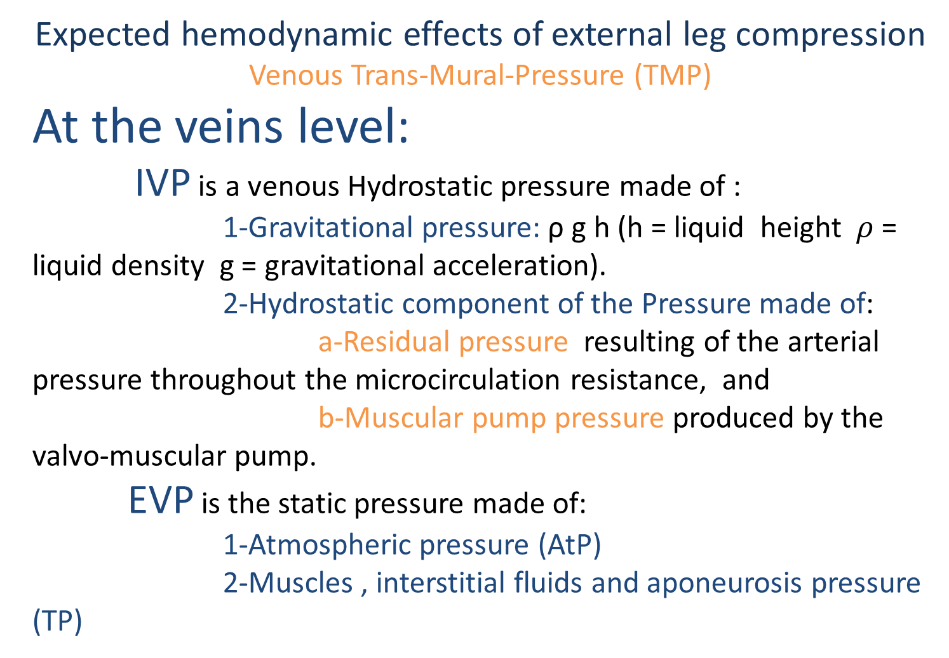
Expected hemodynamic effects of external leg compression
Venous Trans-Mural-Pressure (TMP)
At the veins level:
IVP is a venous Hydrostatic pressure made of :
    1-Gravitational pressure: ρ g h (h = liquid height$ρ$ = liquid density g = gravitational acceleration).
    2-Hydrostatic component of the Pressure made of:
    a-Residual pressure resulting of the arterial pressure throughout the microcirculation resistance, and
    b-Muscular pump pressure produced by the valvo-muscular pump.
    EVP is the static pressure made of:
    1-Atmospheric pressure (AtP)
    2-Muscles , interstitial fluids and aponeurosis pressure (TP)

Slide 29
Ankle Pressure
severe
Incompetence
moderate
Normal
+
0
-
Standing at rest
Starting
Walking
Stopping
Supine
Declivity

Slide 30
Ankle Pressure
Obstacle
Venous Claudication
Normal
+
0
-
Standing at rest
Starting
Walking
Stopping
Supine
Declivity

Slide 31
TRANS-MURAL PRESSURE (TMP)
HEMODYNAMIC CORRECTION OF TMP EXECSS.
TMP = IVP-EVP
        1-DECREASE IVP and/or
        2-INCREASE EVP
TMP
IVP
EVP

Slide 32
TRANS-MURAL PRESSURE (TMP)
HEMODYNAMIC CORRECTION OF TMP EXECSS.
TMP = IVP-EVP
INCREASE EVP
WHEN?
1-When EVP is too low
2-When IVP is too high

Slide 33
TRANS-MURAL PRESSURE (TMP)
HEMODYNAMIC CORRECTION OF TMP EXECSS.
TMP = IVP-EVP
INCREASE EVP
WHEN?
1-When EVP is too low: Too low ath.P (altitude, Plane)

Slide 34
TRANS-MURAL PRESSURE (TMP)
HEMODYNAMIC CORRECTION OF TMP EXECSS.
TMP = IVP-EVP
INCREASE EVP
WHEN?
2-When IVP is too high:
-Valve incompetence and/or
- Obstacle to the flow
NOT reductible or only partially reduced by hemodynamic treatments previously explained

Slide 35
TRANS-MURAL PRESSURE (TMP)
HEMODYNAMIC CORRECTION OF TMP EXECSS.
TMP = IVP-EVP
INCREASE EVP
HOW?

Slide 36
TRANS-MURAL PRESSURE (TMP)
HEMODYNAMIC CORRECTION OF TMP EXECSS.
TMP = IVP-EVP
INCREASE EVP by :
COMPESSION
Increasing physiological EVP with external ARTIFICIAL means
TMP
Compression
IVP
EVP
Resulting lower TMP

Slide 37
COMPRESSION: DEFINITION
Pressure resulting from action-reaction at the interface (contact) of 2 bodies

Slide 38
Expected hemodynamic effects of external leg compression
    External Compression reduces TMP by increasing the static components of the EVP at both levels: Veins and venous end of the capillaries
EVP
Compression
V
Tissues

Slide 39
LEG COMPRESSION RATIONNAL
Pressure compression exerted against the leg surface
Homogeneous (isostatic) or Heterogeneous (heterostatic) according to :
Compression technique
Leg geometry
Pressure compression transmitted from surface to depth
according to:
Bulk modulus of leg structures
Euler–Cauchy stress principle
Continuum mechanics deals with deformable bodies. The stresses considered in continuum mechanics are only those produced during the application of external forces and the consequent deformation of the body

Slide 40
External Compression
Doesn’t change the the IVP , except if if block or stenotic narrowing ( heodynamically significative) of:
Capillaries
Venous end (Pulsatility)
Arterial end
Veins
Antegrade: deep, superficial, OVS
Closed shunts, ODS

Slide 41
External Compression
Non stenotic narrowing
Reduces the volume
Increases velocity
DOESN’T increase IVP ( SP, DP) nor Volume flow
REDUCES TMP : Increases EVP
SP
DP
SP
DP

Slide 42
External Compression
Capillary venous end or veins Stenotic narrowing
Reduces the volume
Increases velocity
DECREASES IVP ( SP, DP) and DECREASES Volume flow
INCREASES Arterial capillary end lateral pressure (TMP) : favors arterial tissue feeding PULSATILITY ↗ . BUT IF > arterial pressure = ISCHEMIA
REDUCES TMP : Increases EVP

Slide 43
LOCAL External Compression
Veins Stenotic narrowing in CLOSED SHUNTS
Muscular Pump Diastole
Reduces the volume
DECREASES IVP ( SP, DP) and DECREASES Volume flow
REDUCES TMP : Increases EVP

Slide 44
Bulk modulus
Pressure transmission
V
External Compression
Tissues

Slide 45
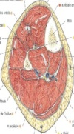
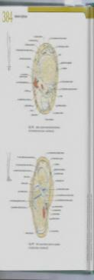
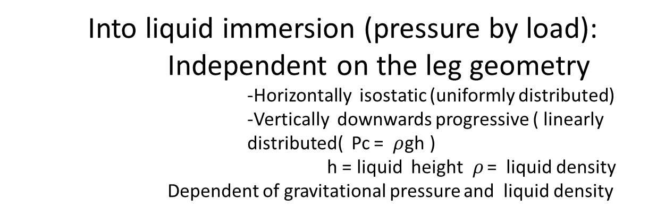
LEG COMPRESSION FEATURES ACCORDING TO THE PHYSICAL MEANS
Into liquid immersion (pressure by load):
Independent on the leg geometry
    -Horizontally isostatic (uniformly distributed)
    -Vertically downwards progressive ( linearly distributed( Pc = $ρ$gh )
    h = liquid height$ρ$ = liquid density
    Dependent of gravitational pressure and liquid density
    Downwards vertically progressive
Pc
Liquid
    Horizontally isostatic

Slide 46
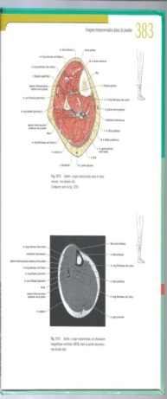

LEG COMPRESSION FEATURES ACCORDING TO THE PHYSICAL MEANS
Pneumatic compression (pressure by fluid density):
Independent on the leg geometry : uniformly distributed.
    -Horizontally isostatic
    -Vertically isostatic
    Dependent of the inflation pressure
    Independent of gravitational pressure and density
Pc
Gaz cuff pressure
    Horizontally isostatic

Slide 47
LEG COMPRESSION FEATURES ACCORDING TO THE PHYSICAL MEANS
Pressure compression Pc exerted against the leg surface:
Bandage compression: LAPLACE’S LAW
Pressure = F/wR = F/R when b=1cm
P: hPascal
F: cNewton
w= bandage width
R= cylinder radius
1mmHg = 1,333 hPa = 1,359 cm water depth = 0,00131 atm
F
R
F
P
w

Slide 48
LEG COMPRESSION FEATURES ACCORDING TO THE PHYSICAL MEANS
Bandage compression:
Dependent on the leg circularity
Dependent of bandaging strength
Dependent of leg mid diameter : Starling Law
F1
F1
F1
F1
F3≈0
F1
F1
F1
F1
F2=0
F4=+
F5=++
Bandaging ( force) strength =F1
Resulting compression ( Force) pressure: F5>F4>F3>F2
Depends on the arc angle where applied
Circular :
homogeneous transmitted pressure
Non Circular :
heterogeneous transmitted pressure

Slide 49
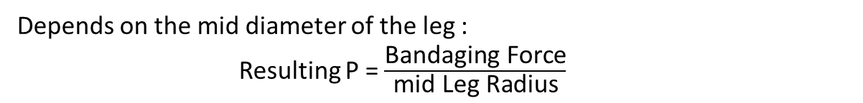
LEG COMPRESSION FEATURES ACCORDING TO THE PHYSICAL MEANS
Bandage compression:
Dependent on the leg circularity
Dependent of bandaging strength
Dependent of leg mid diameter : Starling Law
Bandaging ( force) strength =F1
Resulting compression ( Force) pressure: F2>F3
Depends on the mid diameter of the leg :
Resulting P = $\frac{\text{Bandaging} \text{Force}}{\text{mid} \text{Leg} \text{Radius}}$
F1
F1
F3
F1
F1
F2
Circular :
homogeneous transmitted pressure

Slide 50
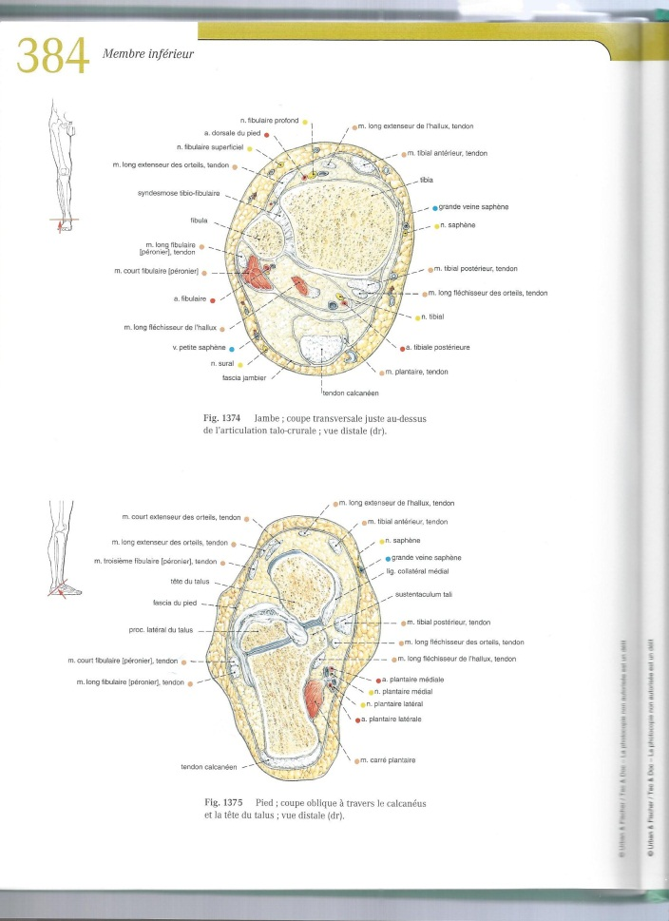
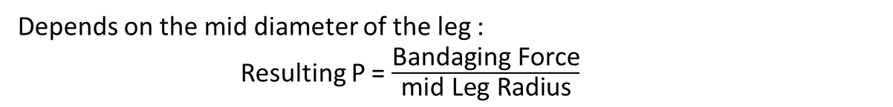
LEG COMPRESSION FEATURES ACCORDING TO THE PHYSICAL MEANS
Bandage compression:
Dependent on the leg circularity
Dependent of bandaging strength
Dependent of leg mid diameter : Starling Law
Bandaging ( force) strength =F1
Resulting compression ( Force) pressure: F2>F3
Depends on the mid diameter of the leg :
Resulting P = $\frac{\text{Bandaging} \text{Force}}{\text{mid} \text{Leg} \text{Radius}}$
F3
F2
Non Circular :
heterogeneous transmitted pressure eg ankle

Slide 51
LEG COMPRESSION FEATURES ACCORDING TO THE PHYSICAL MEANS
Bandage compression:
Dependent on the leg circularity
Dependent of bandaging strength
Dependent of leg mid diameter : Starling Law
For more homogenous compression:
Circularization of the leg with additional dressing

Slide 52
LEG COMPRESSION HEMODYNAMIC EFFECTS AND PHYSIOLOGICAL CONSEQUENCES
Bandage compression:
Dependent on the leg circularity
Dependent of bandaging strength
Dependent of leg mid diameter : Starling Law
For more wanted heterogeneous compression:
Addition of small angle arc material

Slide 53
LEG COMPRESSION HEMODYNAMIC EFFECTS AND PHYSIOLOGICAL CONSEQUENCES
Bandage compression:
Dependent on the leg circularity
Dependent of bandaging strength
Dependent of leg mid diameter : Starling Law
For more wanted heterogeneous compression:
Unwanted local compression ie pedal or tibial arteries pathway

Slide 54
Bulk modulus
Pressure transmission
V
External Compression
Tissues

Slide 55
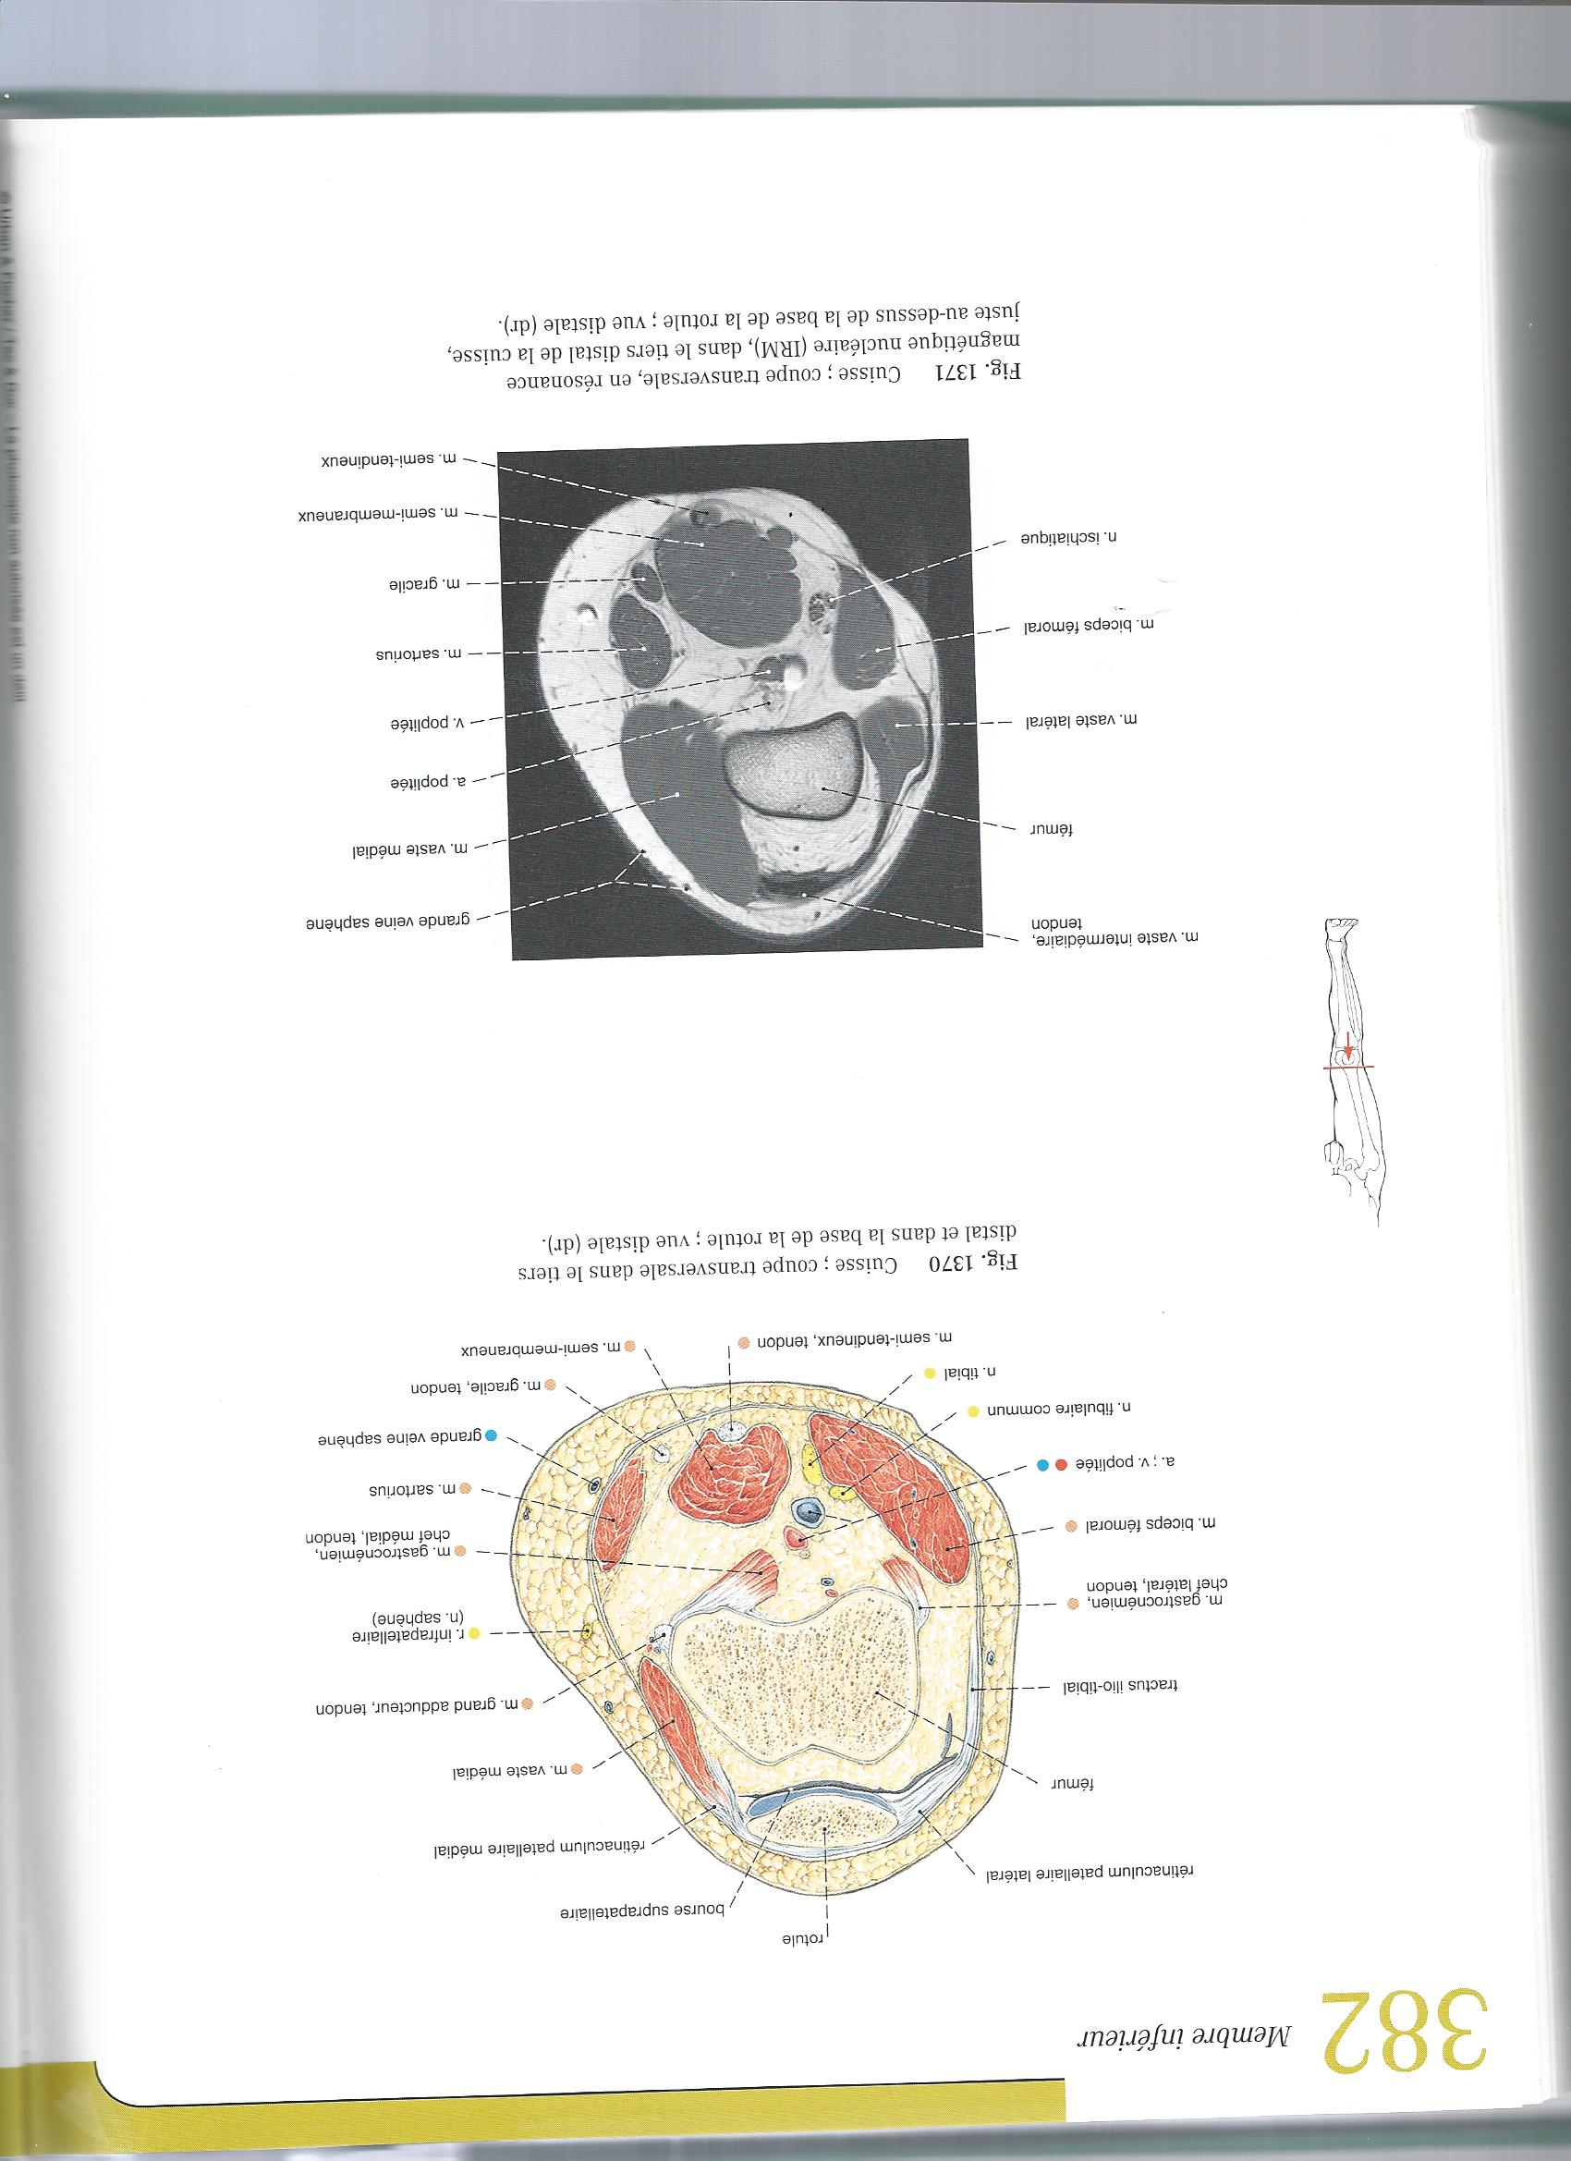
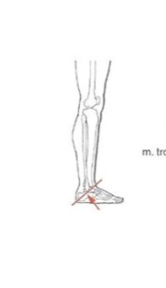
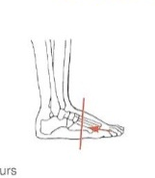

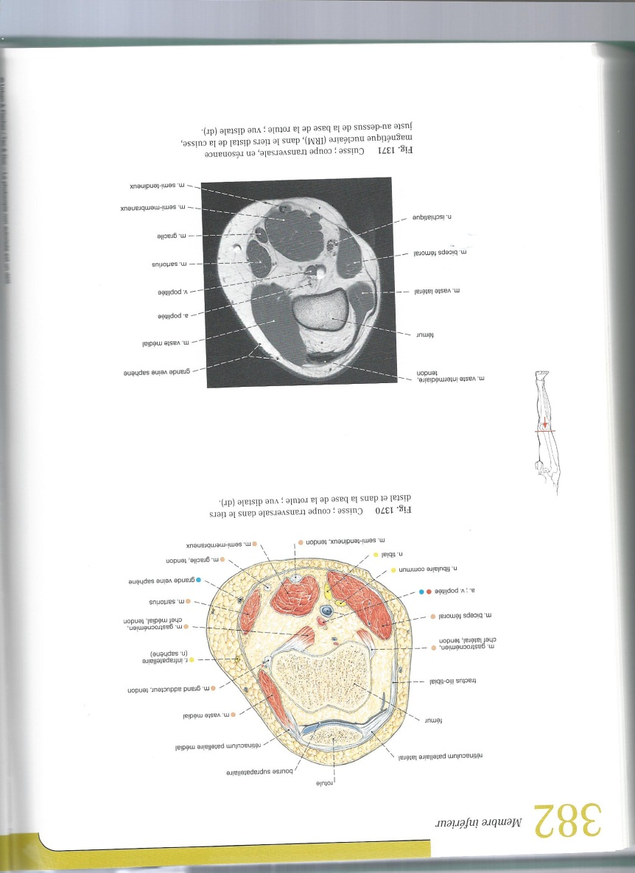

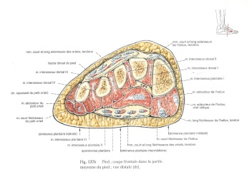
Compressive Pressure value transmitted from surface to depth depends on the elastic and the bulk modulus of the medium :
Leg components are basically heterogonous so that Elastic and Inertia Properties varies according to:
Topography: from thigh down to foot
Posture: Gravitational hydrostatic pressure
Movement: muscle volume and compressibility how much a material will compress under a given amount of external pressure
Circumference = 30 cm
Diameter = 10 cm
Circumference = 19 cm
Diameter = 6 cm
Circumference = 38 cm
Diameter = 12 cm

Slide 56
BANDAGE FEATURES
Extensibility : stretched length/unstretched length percentage. The stretching length limit is called “lock out”
Power ( strength): force required to achieve a determinate elongation although “power” is an inadequate physical term.
Elasticity: ability to resist elongation then return to its original length once the applied force has been removed.
Compression : leg superficial pressure resulting from the bandage.
Support : no compressive bandage designed to prevent change in shape and volume the leg. Although support bandage is theoretically non extensible, a limited degree of extensibility is generally preferred as it is easier to apply.
Conformability : ability to follow the contours of a limb provided by multidimensional extensibility..
Stiffness of a compression device is defined as the pressure increase induced by an increase in leg circumference of 1 cm (8) and represents the relationship between its resting and working pressures. Based on stiffness compression materials are differentiated in “elastic” and “inelastic”

Slide 57
BANDAGE EFFECTS
TMP REDUCTION
Venous blood flow is not increased but its velocity is increased and its volume (stasis) is reduced , as prevention for phlebitis.

Slide 58
BANDAGE Efficacy/SAFETY
Compression effects on arterial circulation:
Doppler at the fore-foot:
1st intermetarsal space in lying position

Slide 59
Anelastic (NON EXTENSIVE) (SUPPORT) BANDAGES
Effects on TMP
LYING
STANDING
WALKING

Slide 60
Anelastic (NON EXTENSIVE) (SUPPORT) TMP MAX pressure REDUCTION

Slide 66
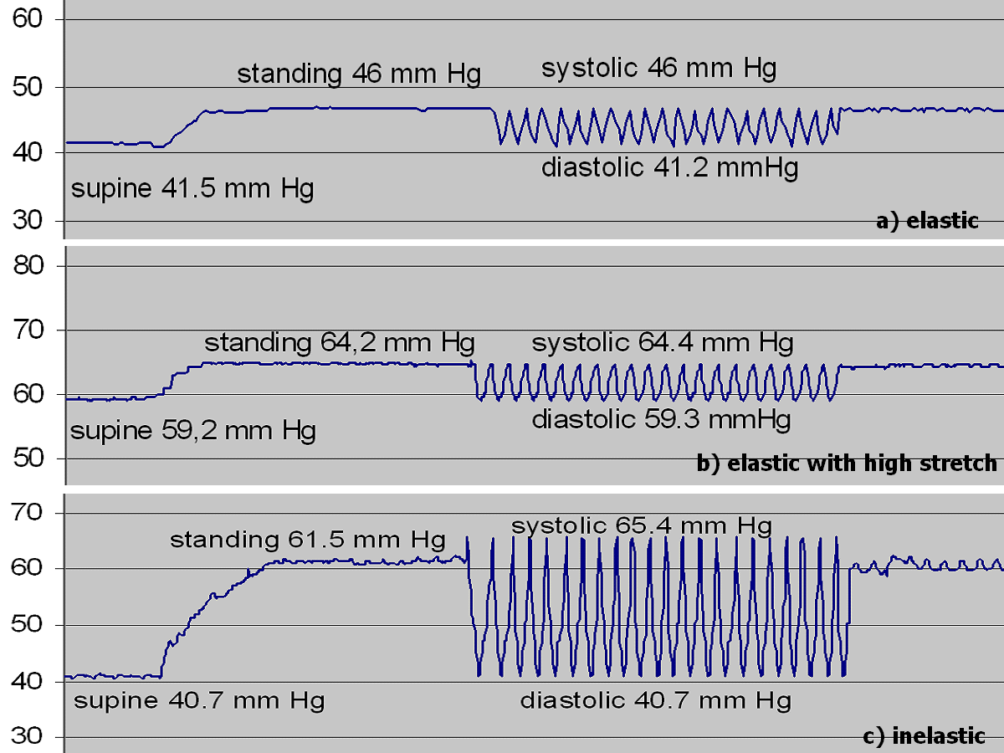
ANELASTIC NON EXTENSIVE ( static SUPPORT)
POSTURES AT REST
All the force/pressure is stored by the leg so that , only variations of leg and vessels internal pressure will change the TMP
Intra-V pressure Gravity
TMP = (EVP + Compression) - IVP
Calf volume
Anelastic compression
+
0
_

Slide 67
ANELASTIC NON EXTENSIVE ( static SUPPORT)
WALKING
Calf SYSTOLE increases mid calf diameter an presses against the inextensible bandage THUS increasing the compression pressure and DIASTOLE decreases the calf volume , THUS the compression pressure drops
Compression pressure

Slide 68
ANELASTIC NON EXTENSIVE ( static SUPPORT)
WALKING
Calf SYSTOLE increases mid calf diameter an presses against the inextensible bandage THUS increasing the compression pressure and DIASTOLE decreases the calf volume , THUS the compression pressure drops
Sub Anelastic pressure
TMP = (EVP + Compression) - IVP

Slide 69
ELASTIC (EXTENSIVE )BANDAGES
Effects on TMP
LYING
STANDING
WALKING

Slide 70
ELASTIC EXTENSIVE BANDAGES
Deliver the a POTENTIAL FORCE at the moment of bandaging
All the force/pressure is stored by BOTH the leg and the bandage ( potential force : Hooks hysteresis phase).
Elastic compression
Ankle/Ankle TMP
AnElastic compression
Elastic compression

Slide 71
ELASTIC EXTENSIVE BANDAGES
BANDAGES
Deliver the FORCE at the moment of bandaging and LATER
So, the EFFECT on TMP increases when not necessary in Normal and Incompetent
Veins, may be DANGEROUS: Ischemia
Non Elastic compression
Ankle/Ankle TMP
Non Elastic compression
Elastic compression

Slide 72
Inelastic compression preferable to elastic. It is efficient and not dangerous in supine position and better than elastic in upright position.

Slide 73
BANDAGING
Proposals

Slide 74
Normal Individuals
Light elastic compression
Moderate Valve Incompetence
Light/ Moderate elastic compression
Moderate Venous Obstacle
AV Fistule
Light/ Moderate elastic compression
Phlebitis prevention
Light elastic compression

Slide 75
Sever venous incompetence and/or Importante Obstacle and/or AV Fistule ( Doppler venous pressure measurement)
Non elastic compression
NON ELASTIC COMPRESSION permits a STRONGER COMPRESSION
so MORE EFFICIENT and
LESS DANGEROUS THAN ELASTIC
PROCEDURE
Draining posture for 2 hours + or - elastic compression
Replace elastic compression by non elastic bandage
Then
Check the forefoot arterial pressure with Doppler

Slide 76
Arteropathy IV ^{th} stage :
Thanks to Gravitational Pressure, Seating posture increases foot arterial pressure, relieves pain and helps for gangrene healing
non elastic light bandaging prevents stasis edema
Check the forefoot arterial pressure with Doppler

Slide 77
Extra Systolic Calf Pump
Non elastic air/fluid bag beneath non elastic compression when walking

Slide 78
VENOUS DISEASE?
Just THINK TMP!
TMP
IVP
EVP
For the diagnosis, and for the treatment

Slide 79
The degree of narrowing depends on the body position and the amount of compression pressure.
At the same time the reduction of venous calibre leads to an increase of venous blood flow velocity, demonstrable by measuring the mean transit time to the groin after injection of radio-tracers into a dorsal foot vein and by Doppler and Duplex investigations . Flow VELOCIY Yes but not flow VOLUME
In the upright position, pressures of 70-80 mm Hg are necessary to counteract the standing intravenous pressure and to achieve a reduction of the venous diameter, clearly shown by phlebography (30), Duplex (21,31) and, recently, by MRI (32-34). To compress the femoral vein at thigh level in upright position a minimal pressure of 60 mmHg is required (20). Surprisingly it could be shown that in the prone and in the standing position compression may lead to a more pronounced narrowing of deep than of superficial veins, probably due to a shift of the muscle compartments (32-34).

Slide 80
Stiffness in vivo can be assessed by measuring the pressure under a compression product at the B1 point and by calculating a “Static Stiffness Index (SSI)”, subtracting the supine from the standing pressure, (13,14). The B1 point is defined by the transition of the muscular into the tendinous part of the part of the medial gastrocnemius muscle, showing the biggest increase of the leg circumference by dorsiflexion. As a cut-off between elastic and inelastic material a value of 10 was proposed (12). Elastic material is characterized by values lower than 10; inelastic by values higher than 10. Other parameters of stiffness correlating with SSI are the maximal pressure achieved during exercise, pressure peaks, and pressure amplitudes during walking (the difference between systolic and diastolic pressure) (15).

Slide 81
Conclusions (Partsh)
As can be demonstrated in many experimental studies, most of them corresponding to level 1 evidence (Grade A), compression has positive effects on the impaired venous hemodynamic in patients with chronic venous disease causing:
• narrowing of superficial and deep veins, depending on body position and exerted pressure
• an increase of venous blood velocity
• a reduction/abolition of venous reflux
• an improvement/normalization of the venous pumping function and, consequently,
• a reduction/ normalization of ambulatory venous hypertension and an improvement of microcirculation.
Compression is able to counteract the hemodynamic impairment of CVD if the exerted interface pressure is higher than the intravenous pressure. The ideal compression device should therefore exert a low resting pressure (well tolerated at rest and during night time) combined with high standing and working pressure.

Slide 82
Pump like effect bandaging
non elastic light bandaging prevents stasis edema
Check the forefoot arterial pressure

Slide 83
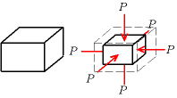

Pressure compression transmitted from surface to depth
according to COMPRESSIBILITY:
Bulk modulus of leg structures
Bulk Elastic Properties
The bulk elastic properties of a material determine the COMPRESSIBILTY how much it will compress under a given amount of external pressure. The ratio of the change in pressure to the fractional volume compression is called the bulk modulus of the material . Therefore, leg content being an anisotropic solid one must use the full generalized Hooke's law.
Varies according to the leg level: mid thigh, mid calf, ankle , foot
Circumference = 30 cm
Diameter = 10 cm
Circumference = 19 cm
Diameter = 6 cm
Circumference = 38 cm
Diameter = 12 cm

Slide 84
Extensible and non-extensible Leg Compression and Support setting (non extensible bandages)
Why? TMP reduction by external pressure enhancement
How? External strain: Water, mercury, air, elastic compression, non elastic bandage compression: different strain features
Sub-compression pressure axial transmission in the leg:
Heterogeneous bulk modulous of the leg components supposed to transmit the superficial compression pressure.
Where?
Superficial location: Foot, ankle, leg, thigh
Effective Depth pressure transmission
Ulcer: why superficial and not « deep »
Necrosis affects only skin in venous insufficiency ( except in case of phlegmatia cerulea), in contrast with arterial insufficiency ( skin and muscles…)

Slide 85
Expected hemodynamic effects of external leg compression
    The magnitude of this pressure transmission from the surface ( skin) to the deep structures of the leg depends on their pressure conductance and bulk modulus.
Compression reduces TMP Extra-venous Pressure (EVP) enhancement.
Correction of the venous
How? External compression Increases the extra-vascular pressure of the skin and the underlying tissues pressure and narrows the veins thanks to TMP decrease because :
TMP = Intra-venous pressure (IVP) – Extra-venous Pressure (EVP)
l strain: Water, mercury, air, elastic compression, non elastic bandage compression: different strain features
Sub-compression pressure axial transmission in the leg:
Heterogeneous bulk modulous of the leg components supposed to transmit the superficial compression pressure.
Where?
Superficial location: Foot, ankle, leg, thigh
Effective Depth pressure transmission
Ulcer: why superficial and not « deep »
Necrosis affects only skin in venous insufficiency ( except in case of phlegmatia cerulea), in contrast with arterial insufficiency ( skin and muscles…)

Slide 86
For an anisotropic solid such as wood or paper, these three moduli do not contain enough information to describe its behaviour, and one must use the full generalized Hooke's law.
Bulk Elastic Properties
The bulk elastic properties of a material determine how much it will compress under a given amount of external pressure. The ratio of the change in pressure to the fractional volume compression is called the bulk modulus of the material.

Slide 87
MODULE D’ELASTICITE ISOSTATIC
The bulk modulus (K) of a substance measures the substance's resistance to uniform compression. It is defined as the pressure increase needed to decrease the volume by a factor of 1/e. Its base unit is the pasc
al.^{[1]}
he bulk modulus K>0 can be formally defined by the equation:
where P is pressure, V is volume, and ∂P/∂V denotes the partial derivative of pressure with respect to volume. The inverse of the bulk modulus gives a substance's compressibility.
Other moduli describe the material's response (strain) to other kinds of stress: the shear modulus describes the response to shear, and Young's modulus describes the response to linear stress. For a fluid, only the bulk modulus is meaningful. For an anisotropic solid such as wood or paper, these three moduli do not contain enough information to describe its behaviour, and one must use the full generalized Hooke's law.
Pressures of about 40 mmHg at the ankle are widely quoted in the literature for the prevention or treatment of venous leg ulcers, but some authorities recommend values significantly higher than this

Slide 88
Sub-bandage pressure may be calculated using a using a simple formula derived from the Laplace equation as follows;
P = (TN x 4630) / CW
where P = pressure (in mmHg)
T = bandage tension (in kgf)
C = circumference of the limb (in cm)
W = bandage width (in cm)
N = number of layers applied
Sub-bandage pressure is therefore directly proportional to bandage tension but inversely proportional to the radius of curvature of the limb to which it is applied

Slide 89
The extensibility of a bandage, determines the change in length that is produced when the bandage is subjected to an extending force. Extensibility is usually expressed in the form of a percentage which relates the stretched to the unstretched length. It may be measured using a constant rate of traverse machine such as an Instron, which extends the bandage at a predetermined rate whilst recording the tension developed within it. If the construction of the bandage is such that when it is stretched past a given point the textile components prevent further extension, even though the elastomeric fibres may not have reached the limit of their elasticity, lock out is said to have occurred.
Power or modulus determines the force that is required to bring about a specified increase in bandage length. The greater the power, the larger the force that is required.
Elasticity determines the ability of bandage subjected to an extending force in the manner described above, to resist any change in length and return to its original length once the applied force has been removed.
Compression implies the deliberate application of pressure in order to produce a desired clinical effect. It is usually achieved by the use of elasticated stockings or an appropriate bandage, and is most commonly used to control oedema and reduce swelling in the treatment of venous disorders of the leg.
Support may be defined as the retention and control of tissue without the application of compression, and is usually provided to prevent the development of a deformity or a change in shape of a tissue mass due to swelling or sagging. Although non extensible bandages can be used for this purpose, a product with a limited degree of extensibility is generally preferred as it is easier to apply.
Conformability of a bandage determines its ability to follow the contours of a limb and is governed largely by the density and extensibility of the fabric, the more open and extensible the structure, the more conformable the product is likely to be. As a general rule, knitted bandages tend to be more comfortable than woven ones.

Slide 90
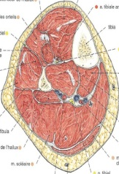
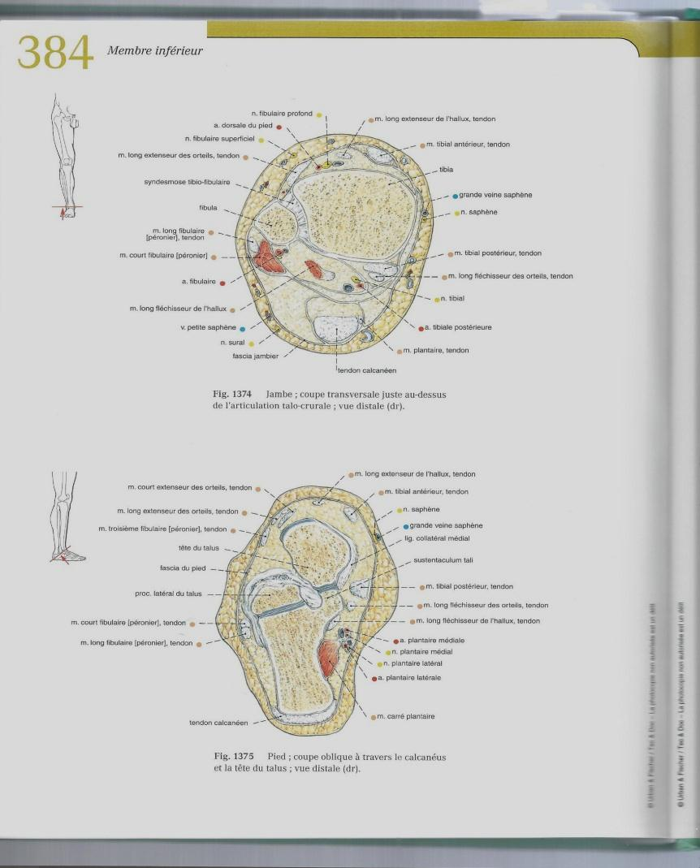
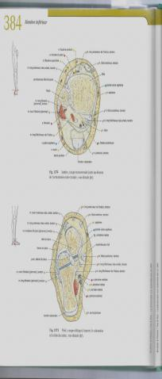

Slide 92

Circumference = 30 cm
Diameter = 10 cm
Circumference = 19 cm
Diameter = 6 cm

Slide 93
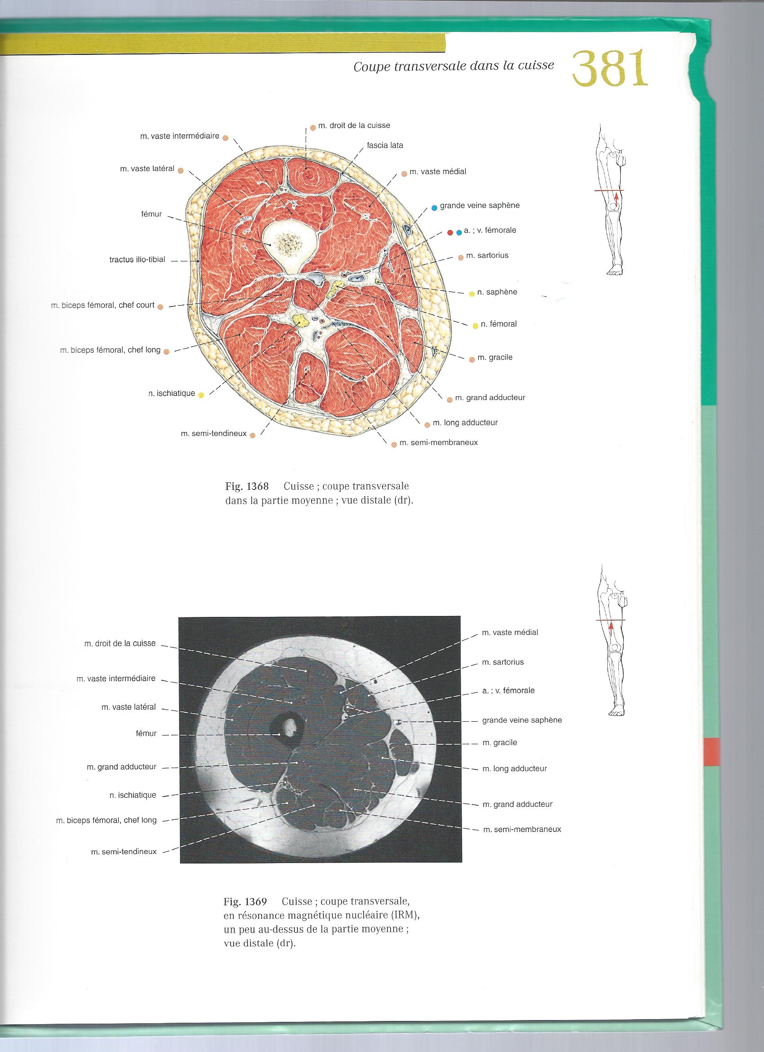
Circumference = 49 cm
Diameter = 16 cm

Slide 94
Circumference = 38 cm
Diameter = 12 cm

Slide 95
Circumference = 30 cm
Diameter = 10 cm

Slide 96

Circumference = 19 cm
Diameter = 6 cm

Slide 97


Slide 98
.
Compression reduces TMP Extra-venous Pressure (EVP) enhancement.
Correction of the venous
How? External compression Increases the extra-vascular pressure of the skin and the underlying tissues pressure and narrows the veins thanks to TMP decrease because :
TMP = Intra-venous pressure (IVP) – Extra-venous Pressure (EVP)
l strain: Water, mercury, air, elastic compression, non elastic bandage compression: different strain features
Sub-compression pressure axial transmission in the leg:
Heterogeneous bulk modulous of the leg components supposed to transmit the superficial compression pressure.
Where?
Superficial location: Foot, ankle, leg, thigh
Effective Depth pressure transmission
Ulcer: why superficial and not « deep »
Necrosis affects only skin in venous insufficiency ( except in case of phlegmatia cerulea), in contrast with arterial insufficiency ( skin and muscles…)

Slide 99
Three factors affect the movement of water be-tween body water compartments.
The previous chapter took a brief look at the factors which influence thedistribution of water between compartments. These factors are hydrostaticpressure, osmotic pressure and membrane characteristics.
Hydrostatic pressure
is a force generated by water. Hydrostatic pres-sure pushes water out of a compartment.
Osmotic pressure
is a force exerted by solutes. Osmotic pressure draws water into a compartment. This force is dependent only on the concentra-tion of particles (osmolality) in solution.
Membrane characteristics
affect the ability of water and solute to move between compartments.
This chapter focuses on how these factors are incorporated into Starling’slaw. Starling’s law governs fluid shifts between compartments and can be used to understand all fluid accumulations, including peripheral edema, pleural effusions and ascites.

Slide 100
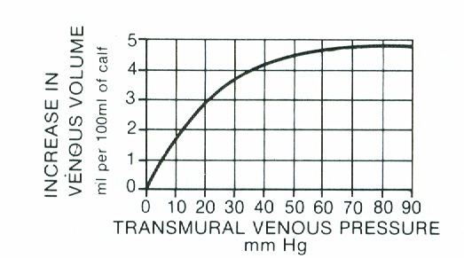

Slide 101
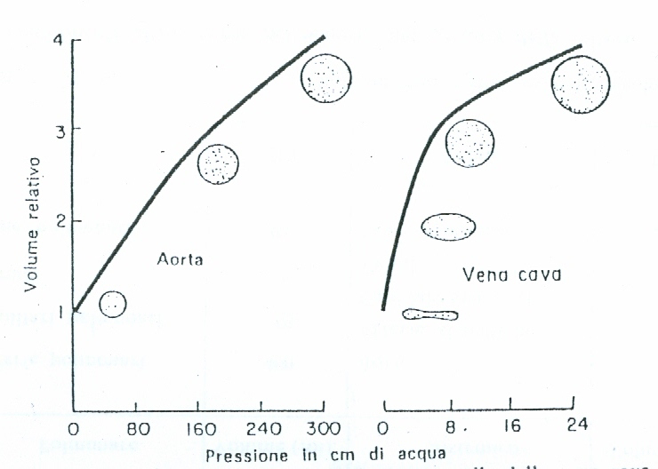
E = P + gh + 1/2v2 = cost

Slide 102
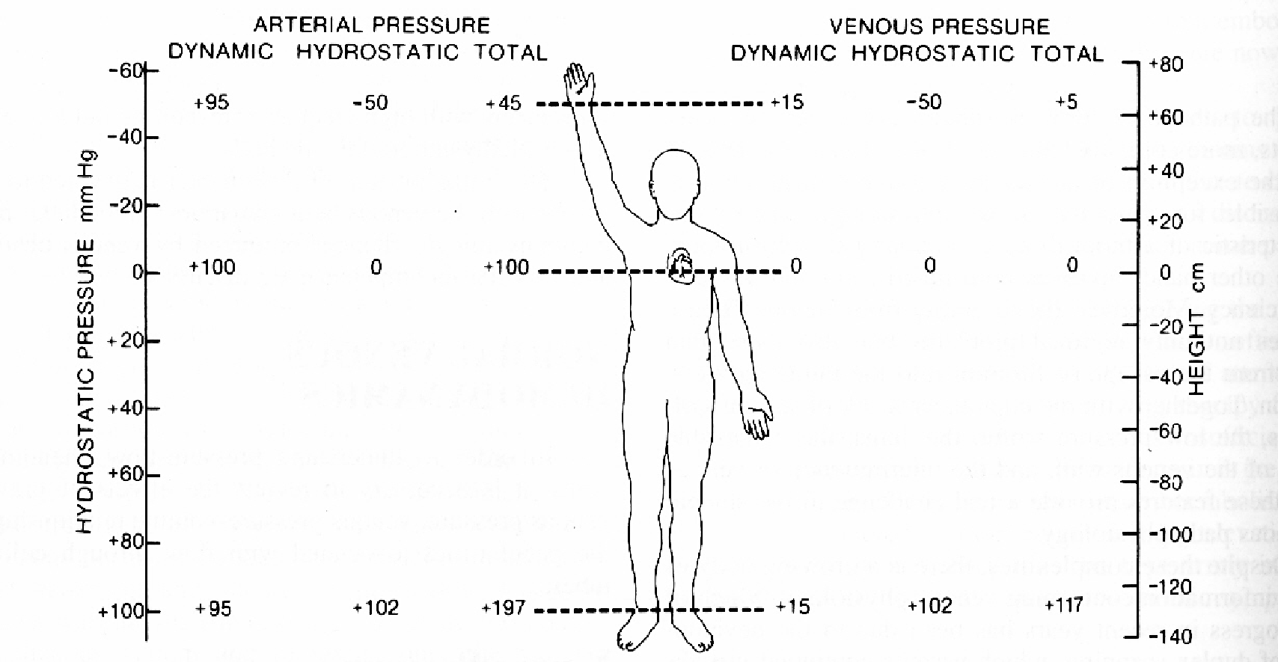

Slide 103
Expected hemodynamic effects of external leg compression
Hemodynamics can be defined as the physical factors that govern blood flow
Solid mechanics is the branch of mechanics, physics, and mathematics that concerns the behavior of solid matter under external action

Slide 104

Static compression
One the

Slide 105
Venous Trans-Mural-Pressure (TMP) excess is responsible for tissue drainage impairment ( pain, edema, trophic changes, ulcer ) and vein dilatation.
TMP is the resulting static pressure from the opposite Extra-venous ( EVP) and Intra-venous IVP) static (potential) pressures against the wall of the veins and venous end of the capillaries.
TMP = IVP-EVP
COMPRESSION reduces TMP by increasing EVP
TMP
IVP
EVP

Slide 106
Expected hemodynamic effects of external leg compression
Venous Trans-Mural-Pressure (TMP)
At the veins level:
IVP is a venous Hydrostatic pressure made of :
    1-Gravitational pressure: ρ g h (h = liquid height$ρ$ = liquid density g = gravitational acceleration).
    2-Hydrostatic component of the Pressure made of:
    a-Residual pressure resulting of the arterial pressure throughout the microcirculation resistance, and
    b-Muscular pump pressure produced by the valvo-muscular pump.
    EVP is the static pressure made of:
    1-Atmospheric pressure (AtP)
    2-Muscles , interstitial fluids and aponeurosis pressure (TP)
IVP
TMP
EVP

Slide 107
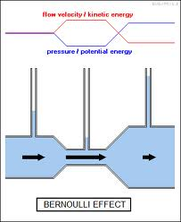
Thus an increase in the speed of the fluid occurs proportionately with an increase in both its dynamic pressure and kinetic energy, and a decrease in its static pressure andpotential energy. If the fluid is flowing out of a reservoir the sum of all forms of energy is the same on all streamlines because in a reservoir the energy per unit volume (the sum of pressure and gravitational potential ρ g h) is the same everywhere.^{[4]}.

Slide 108
COMPRESSION: DEFINITION
Pressure resulting from action-reaction at the interface (contact) of 2 bodies

Slide 109

Hemodynamics can be defined as the physical factors that govern blood flow.
These are the same physical factors that govern the flow of any fluid,
and are based on a fundamental law of physics, namely Ohm's Law,
which states that:
current (I) equals the voltage difference (ΔV) divided by resistance (R).
In relating Ohm's Law to fluid flow,
the voltage difference is the pressure difference (ΔP;
sometimes called driving pressure, perfusion pressure, or pressure gradient),
the resistance is
the resistance to flow (R) offered by the blood vessel and its interactions
with the flowing blood, and the current is the blood flow (F).
This hemodynamic relationship can be summarized by:
For the flow of blood in a blood vessel, the ΔP is
the pressure difference between any two points along a given length of the vessel.
When describing the flow of blood for an organ,
the pressure difference is generally expressed as
the difference between the arterial pressure (P_{A}) and venous pressure (P_{V}).
For example, the blood flow for the kidney is determined
by the renal artery pressure, renal vein pressure, and renal vascular resistance.

Slide 110
Compressive Pressure value transmitted from surface to depth depends on the elastic and inertial properties of the medium :
Elastic Properties ( Bulk modulus): compressibility
how much a material will compress under a given amount of external pressure
Inertia Properties: a material will resist in its motion under a given external pressure
Compressibility
Inertia

Slide 111
Expected hemodynamic effects of external leg compression
Venous Trans-Mural-Pressure (TMP)
At the venous end of the capillaries:
    IVP is made of: : ρ g h + HDP + Osmotic plasma pressure (OPP)
    EVP is made of: TP + AtP + Osmotic Interstitium pressure (OIP)
    a-Residual pressure resulting of the arterial pressure throughout the microcirculation resistance, and
    b-Muscular pump pressure

Slide 112
Expected hemodynamic effects of external leg compression
Venous Trans-Mural-Pressure (TMP)
At the venous end of the capillaries:
Starling equation
([P_{c} − P_{i}] − σ[π_{c} − π_{i}]) is the net driving force,
K_{f} is the proportionality constant, and
J_{v} is the net fluid movement between compartments
According to Starling's equation, the movement of fluid depends on six variables:
Capillary hydrostatic pressure ( P_{c} ), Interstitial hydrostatic pressure ( P_{i} )
Capillary oncotic pressure ( π_{c} ),Interstitial oncotic pressure ( π_{i} )
Filtration coefficient ( K_{f} ): constant of proportionality regarding the capillary permeability (product of capillary surface area and capillary hydraulic conductance).
Reflection coefficient ( σ) Corrects the ineffectiveness of some of the oncotic pressure gradient(0 up to 1).

Slide 113
On peut combiner les effets de contention et de compression par exemple en superposant une bande inextensible et une bande de grande extensibilité (technique dite du double bandage)
ALa dégressivité de pression est le deuxième élément important car la compression, outre son action au niveau du gradient de pression transmural capillaroveinulaire, doit, sous peine d’annuler sa première action, améliorer l’hémodynamique veineuse du membre.
l’European Committee of Standardization propose cette classification :
– classe I (de 15 à 21 mmHg) ;
– classe II (de 23 à 32 mmHg) ;
– classe III (de 34 à 46 mm Hg) ;
– classe IV (au-delà de 49 mmHg).
On remarque que ces valeurs de pression sont nettement supérieures aux valeurs françaises, la classe I européenne équivalant à une classe II française

