Slide 1
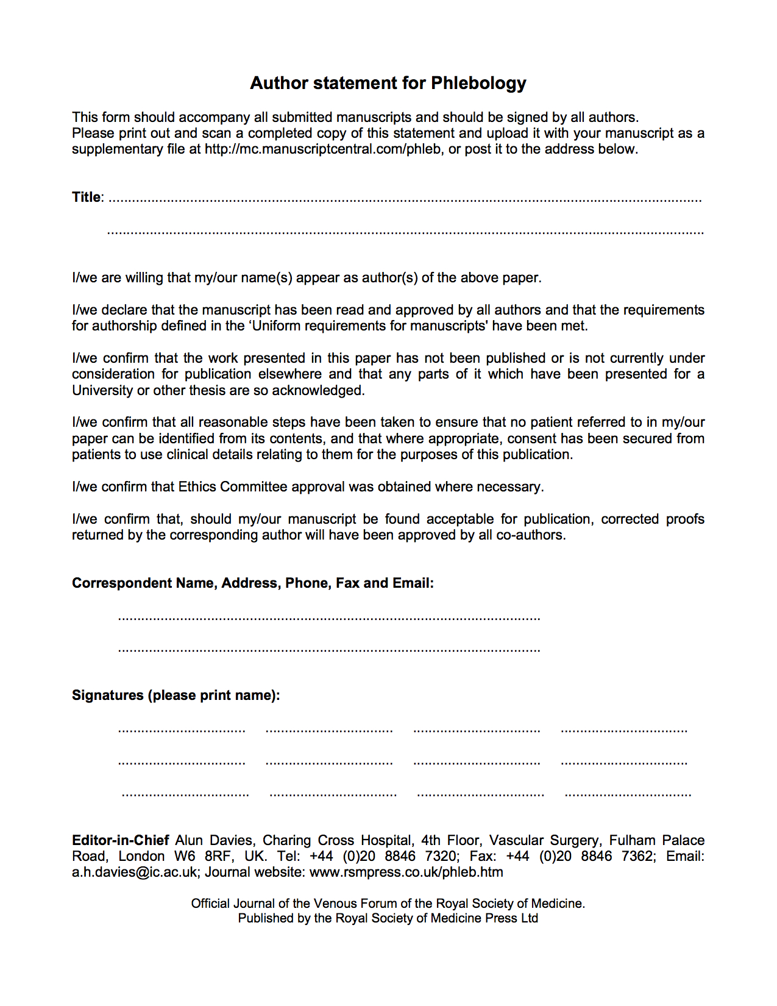
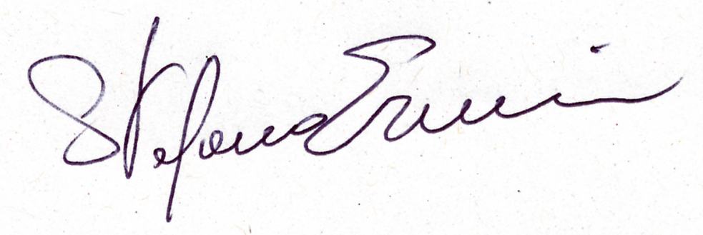
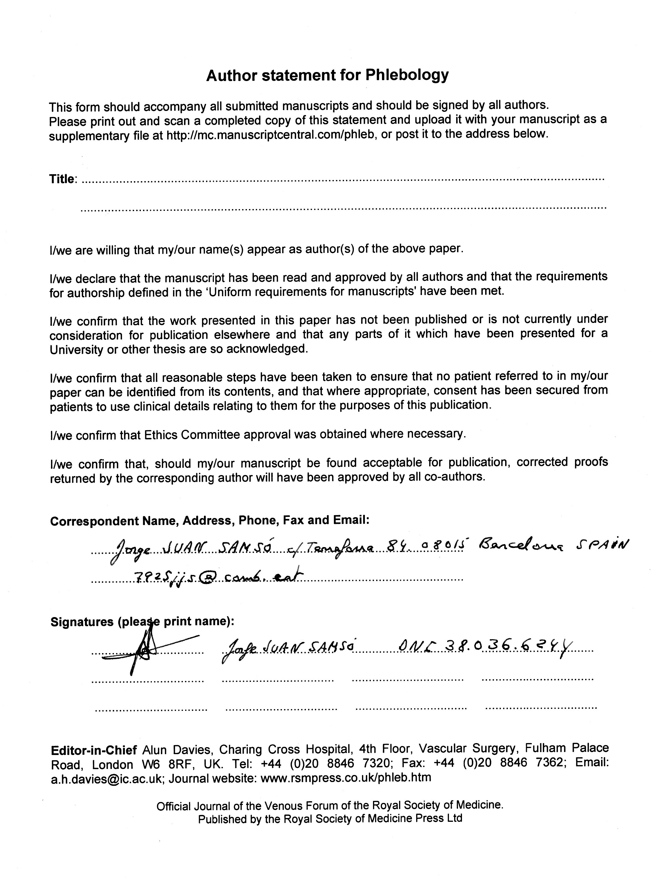

Additional information and comments to the article review citing CHIVA
PHLEB-12-076.
Claude Franceschi Hopital Saint Joseph Paris France claude.franceschi@wanadoo.fr
Tel: 0033687811610
Stefano Ermini
Erika Mendoza
Oriol Pares
Jorge Juan
Massimo Cappelli
Claude Franceschi
Paolo Zamboni
Roberto Cuaranta
Amine Bahnini
Fausto Passariello
Roberto Delfrate
…………………..

Slide 2

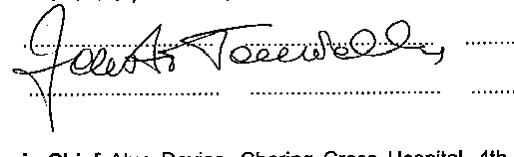

Slide 3


