Slide 1
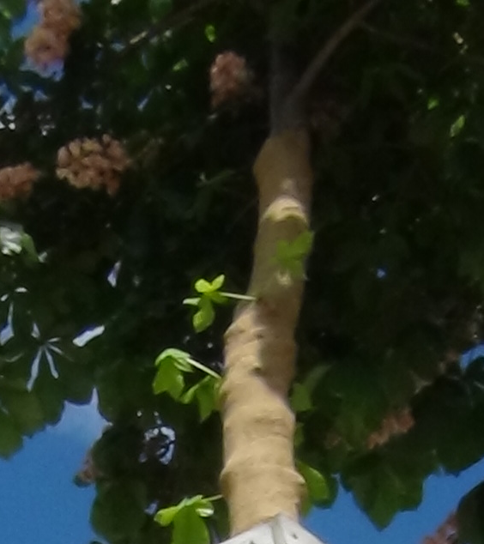
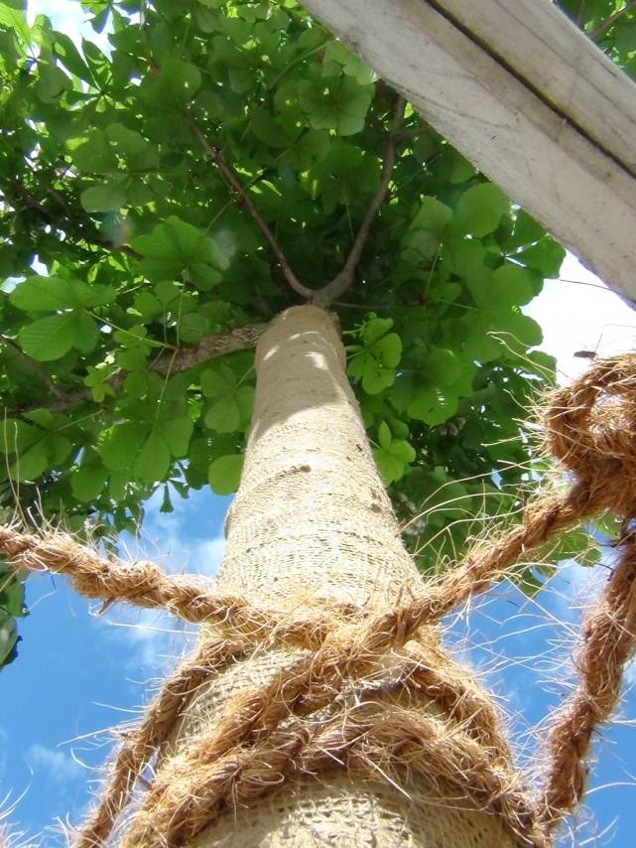
COMPRESSION
Hemodynamic Rational
Claude Franceschi

Slide 2
COMPRESSION
Positive clinical effects in venous and lymphatic diseases are today indisputable

Slide 3
BUT
COMPRESSION
Pathophysiological Interpretation
Techniques
Indications
Are still today disputed

Slide 4
Leg COMPRESSION
1-Hemodynamic concept of venous drainage
2-Hemodynamic effects of compression
3-Means and compression techniques features and their specific hemodynamic effects
4-Proposals for rational hemodynamic compression

Slide 5
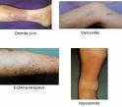
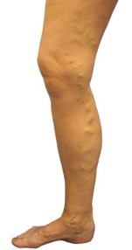
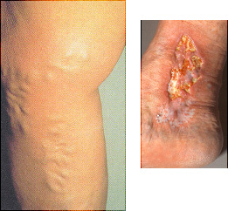

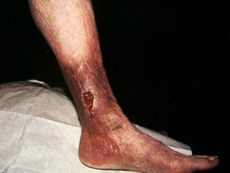
Oedema, Varices,Trophiques Changes , Ulcer
When related to venous insufficency
Are caused by a TMP excess

Slide 6
Leg COMPRESSION
Positive clinical effects
By the mean of drainage improvement in :
    Edema Volume reduction
    Ulcer and wounds healing
    Pain relieve
    in
Venous insufficiency
Lymphatic insufficiency
By the mean of stasis reduction in:
Phlebitis treatment and prevention

Slide 7
1-Hemodynamic concept of venous drainage
Hemodynamics can be defined as:
  the physical factors that govern blood flow which are the same physical factors that govern the flow of any fluid, and are based on a fundamental law of physics.

Slide 8
TRANS-MURAL PRESSURE (TMP)
is the hemodynamic key point of the venous drainage because it determines the transfer of fluids and their components from the tissue into the venous bed.
VENOUS DISEASE?
Just THINK TMP!
TMP
IVP
EVP

Slide 9
TRANS-MURAL PRESSURE (TMP)
Is the resulting static pressure from the opposite Extra-venous ( EVP) and Intra-venous (IVP) static (potential) pressures against:
- the wall of the veins and
- venous end of the capillaries.
TMP = IVP-EVP
TMP
IVP
EVP

Slide 10
TRANS-MURAL PRESSURE (TMP)
HEMODYNAMIC CORRECTION OF TMP EXECSS.
TMP = IVP-EVP
COMPESSION DECREASES TMP by :
Increasing physiological EVP with external ARTIFICIAL means
TMP
Compression
IVP
EVP
Resulting lower TMP

Slide 11
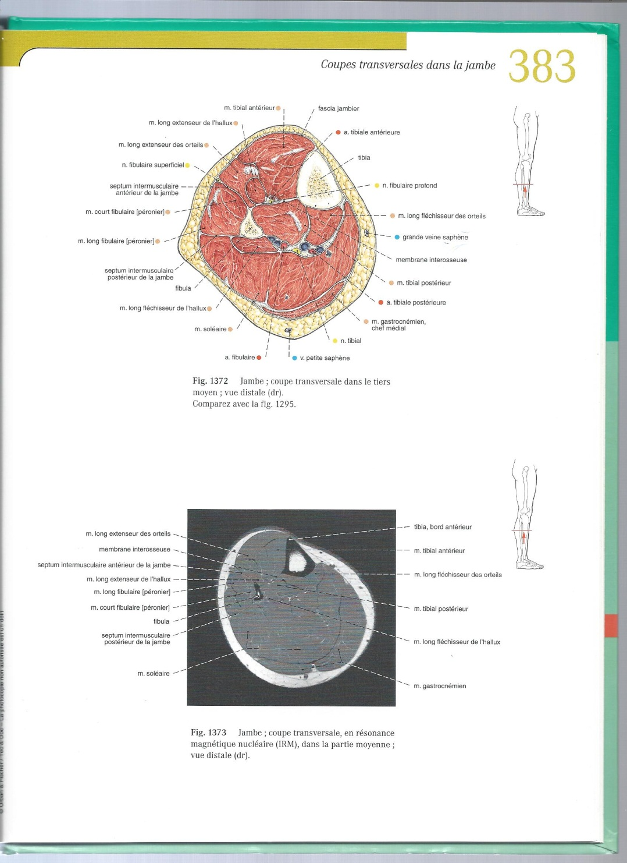
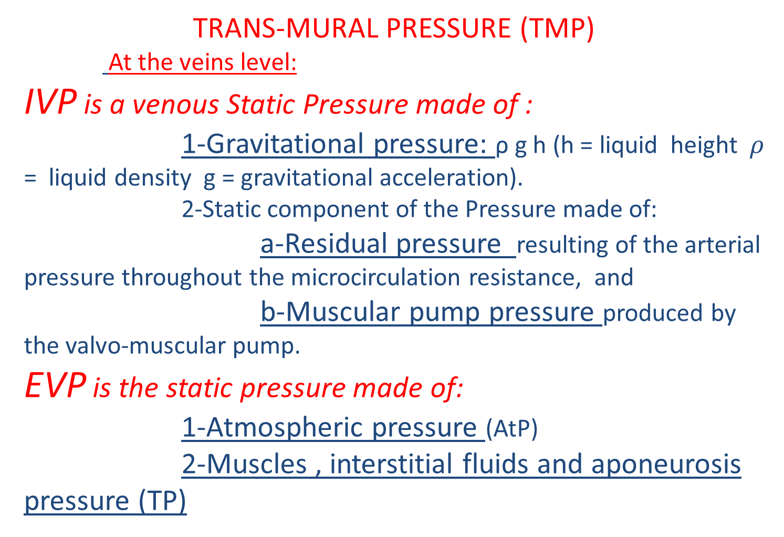

Slide 12
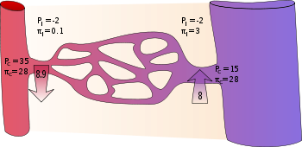
TRANS-MURAL PRESSURE (TMP)
At the level of the venous end of the capillaries :
IVP is a venous Static Pressure made of :
)
    VENOUS IVP + Osmotic plasma pressure (OPP)
    VENOUS EVP + Osmotic Interstitium pressure (OIP)

Slide 13
TRANS-MURAL PRESSURE (TMP)
HEMODYNAMIC CORRECTION OF TMP EXECSS.
TMP = IVP-EVP
        1-DECREASING IVP and/or
        2-INCREASING EVP
TMP
IVP
EVP

Slide 14
TRANS-MURAL PRESSURE (TMP)
HEMODYNAMIC CORRECTION OF TMP EXECSS.
TMP = IVP-EVP
DECREASING IVP

Slide 15
TRANS-MURAL PRESSURE (TMP)
HEMODYNAMIC CORRECTION OF TMP EXECSS.
TMP = IVP-EVP
DECREASING IVP :
1- Decrease Gravitational Pressure: POSTURAL TREATMENT: The more the foot is raised, the less the Gravitational Pressure (GP)
Ankle GP
+
0
_

Slide 16
TRANS-MURAL PRESSURE (TMP)
HEMODYNAMIC CORRECTION OF TMP EXECSS.
TMP = IVP-EVP
DECREASING IVP by :
2 - If Valve incompetence:
a-Incompetent Valve repair or new valve
b-Closed shunts disconnection + Column fractionning (CHIVA)

Slide 17
TRANS-MURAL PRESSURE (TMP)
HEMODYNAMIC CORRECTION OF TMP EXECSS.
TMP = IVP-EVP
DECREASING IVP by :
3 – if obstacle: By-pass or liberation
4 – if AV Fistule: disconnecion

Slide 18
TRANS-MURAL PRESSURE (TMP)
HEMODYNAMIC CORRECTION OF TMP EXECSS.
TMP = IVP-EVP
INCREASING EVP by COMPESSION

Slide 19
TRANS-MURAL PRESSURE (TMP)
HEMODYNAMIC CORRECTION OF TMP EXECSS.
TMP = IVP-EVP
COMPESSION
Increasing physiological EVP with external ARTIFICIAL means
TMP
Compression
IVP
EVP
Resulting lower TMP

Slide 20
CAUSES FOR TMP EXCESS
1- VALVULAR INCOMPETENCE and/or Muscle inactivity
Impairment of Dynamic Fractionning of the Hydrostatic Pressure DFHSP
2- OBSTACLE to the FLOW
Excess of RESIUAL PRESSURE
3- AV Fistule

Slide 21
TRANS-MURAL PRESSURE (TMP)
HEMODYNAMIC CORRECTION OF TMP EXECSS.
TMP = IVP-EVP
INCREASING EVP
WHEN?
1-When EVP is too low
2-When IVP is too high

Slide 22
TRANS-MURAL PRESSURE (TMP)
HEMODYNAMIC CORRECTION OF TMP EXECSS.
TMP = IVP-EVP
INCREASE EVP
WHEN?
1-When EVP is too low: Too low ath.P (altitude, Plane)

Slide 23
TRANS-MURAL PRESSURE (TMP)
HEMODYNAMIC CORRECTION OF TMP EXECSS.
TMP = IVP-EVP
INCREASE EVP
WHEN?
2-When IVP is too high:
-Valve incompetence and/or
- Obstacle to the flow
NOT reductible or only partially reduced by hemodynamic treatments previously explained

Slide 24
IVP IMPORTANT PhysolologicaI variations according to posture and muscular pump activity
Ankle Pressure
90 mm Hg
30 mm Hg
Normal
+
15 mm Hg
0
-
Standing Pathogenic!!!
Starting
Walking
PUMP!!!
Stopping
Lying
- 40 mm Hg
Declive

Slide 25
EXCESSIVE and PATHOGNENIC TMP due to IVP excess in STANDING STILL POSTION in NORMAL INDIVIDUALS :
Compression indicated in people standing still for long periods of time
Ankle Pressure
90 mm Hg
30 mm Hg
Normal
+
15 mm Hg
0
-
Standing Pathogenic!!!
Starting
Walking
PUMP!!!
Stopping
Lying
- 40 mm Hg
Declive

Slide 26
VALVO-Muscular pump impairment: valve incompetence and/or Muscle inactivity
Impairment of Dynamic Fractionning of the Hydrostatic Pressure DFHSP
Ankle Pressure
90 mm Hg
Severe VI
Moderate VI
30 mm Hg
Normal
+
15 mm Hg
0
-
Standing at rest
Starting
Walking
PUMP!!!
Stopping
Lying
- 40 mm Hg
Declive

Slide 27
Surprisingly DIFFERENCE NORMAL/PATHOLOGIC ONLY when walking!
Ankle Pressure
90 mm Hg
SevereVI
Moderate VI
30 mm Hg
Normal
+
15 mm Hg
0
-
Standing at rest
Starting
Walking
PUMP!!!
Stopping
Lying
- 40 mm Hg
Declive

Slide 28
So in valve incompetence : COMPRESSION WHEN WALKING in proportion to valve incompetence
Ankle Pressure
90 mm Hg
Severe VI
Moderate VI
30 mm Hg
Normal
+
15 mm Hg
0
-
Standing at rest
Starting
Walking
PUMP!!!
Stopping
Lying
- 40 mm Hg
Declive

Slide 29
OBSTACLE TO THE FLOW: Excess of Residual Pressure added to Gravitational Pressure
Ankle Pressure
90 mm Hg
Obstacle
30 mm Hg
Normal
+
15 mm Hg
0
-
Standing at rest
Starting
Walking
Stopping
Lying
- 40 mm Hg
Declive

Slide 30
OBSTACLE TO THE FLOW: Permanent TMP excess: so permanent COMPRESSION
Ankle Pressure
90 mm Hg
Obstacle
30 mm Hg
Normal
+
15 mm Hg
0
-
Standing at rest
Starting
Walking
Stopping
Lying
- 40 mm Hg
Declive

Slide 31
Ankle Pressure
Obstacle
Venous Claudication
Normal
+
0
-
Standing at rest
Starting
Walking
Stopping
Supine
Declivity

Slide 32
TRANS-MURAL PRESSURE (TMP)
HEMODYNAMIC CORRECTION OF TMP EXECSS.
TMP = IVP-EVP
INCREASE EVP
HOW?

Slide 33
TRANS-MURAL PRESSURE (TMP)
HEMODYNAMIC CORRECTION OF TMP EXECSS.
TMP = IVP-EVP
COMPESSION
Increasing physiological EVP with external ARTIFICIAL means
TMP
Compression
IVP
EVP
Resulting lower TMP

Slide 34
COMPRESSION: DEFINITION
Pressure resulting from action-reaction at the interface (contact) of 2 bodies

Slide 35
Expected hemodynamic effects of external leg compression
    External Compression reduces TMP by increasing the static components of the EVP at both levels: Veins and venous end of the capillaries
EVP
Compression
V
Tissues

Slide 36
LEG COMPRESSION RATIONNAL
Pressure compression exerted against the leg surface
Homogeneous (isostatic) or Heterogeneous (heterostatic) according to :
Compression technique
Leg geometry

Slide 37
LEG COMPRESSION RATIONNAL
Pressure compression transmitted from surface to depth
according to:
Bulk modulus of leg structures
Euler–Cauchy stress principle
Continuum mechanics deals with deformable bodies. The stresses considered in continuum mechanics are only those produced during the application of external forces and the consequent deformation of the body

Slide 38
Bulk modulus
Pressure transmission
V
External Compression
Tissues

Slide 39
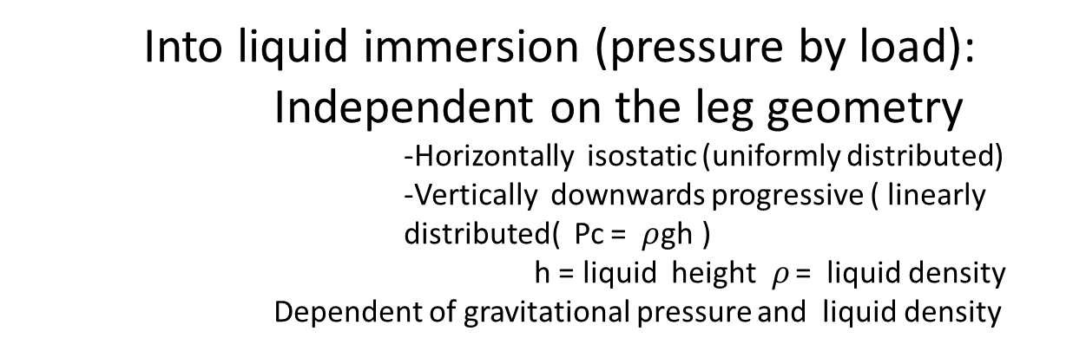
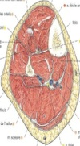
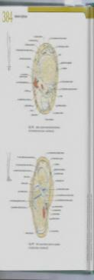
LEG COMPRESSION FEATURES ACCORDING TO THE PHYSICAL MEANS
    Downwards vertically progressive
Pc
Liquid
    Horizontally isostatic

Slide 40
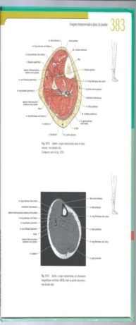

LEG COMPRESSION FEATURES ACCORDING TO THE PHYSICAL MEANS
Pneumatic compression (pressure by fluid density):
Independent on the leg geometry : uniformly distributed.
    -Horizontally isostatic
    -Vertically isostatic
    Dependent of the inflation pressure
    Independent of gravitational pressure and density
Pc
Gaz cuff pressure
    Horizontally isostatic

Slide 41
LEG COMPRESSION FEATURES ACCORDING TO THE PHYSICAL MEANS
Pressure compression Pc exerted against the leg surface:
Bandage compression: LAPLACE’S LAW
Pressure = F/wR = F/R when b=1cm
P: hPascal
F: cNewton
w= bandage width
R= cylinder radius
1mmHg = 1,333 hPa = 1,359 cm water depth = 0,00131 atm
F
R
F
P
w

Slide 42
LEG COMPRESSION FEATURES ACCORDING TO THE PHYSICAL MEANS
Bandage compression:
Dependent on the leg circularity
Dependent of bandaging strength
Dependent of leg mid diameter : Starling Law
F1
F1
F1
F1
F3≈0
F1
F1
F1
F1
F2=0
F4=+
F5=++
Bandaging ( force) strength =F1
Resulting compression ( Force) pressure: F5>F4>F3>F2
Depends on the arc angle where applied
Circular :
homogeneous transmitted pressure
Non Circular :
heterogeneous transmitted pressure

Slide 43
LEG COMPRESSION FEATURES ACCORDING TO THE PHYSICAL MEANS
Bandage compression:
Dependent on the leg circularity
Dependent of bandaging strength
Dependent of leg mid diameter : Starling Law
For more homogenous compression:
Circularization of the leg with additional dressing

Slide 44
LEG COMPRESSION HEMODYNAMIC EFFECTS AND PHYSIOLOGICAL CONSEQUENCES
Bandage compression:
Dependent on the leg circularity
Dependent of bandaging strength
Dependent of leg mid diameter : Starling Law
For more wanted heterogeneous compression:
Addition of small angle arc material

Slide 45
LEG COMPRESSION HEMODYNAMIC EFFECTS AND PHYSIOLOGICAL CONSEQUENCES
Bandage compression:
Dependent on the leg circularity
Dependent of bandaging strength
Dependent of leg mid diameter : Starling Law
For more wanted heterogeneous compression:
Unwanted local compression ie pedal or tibial arteries pathway

Slide 46
BANDAGE FEATURES
Extensibility : stretched length/unstretched length percentage. The stretching length limit is called “lock out”
Power ( strength): force required to achieve a determinate elongation although “power” is an inadequate physical term.
Elasticity: ability to resist elongation then return to its original length once the applied force has been removed.
Compression : leg superficial pressure resulting from the bandage.
Support : no compressive bandage designed to prevent change in shape and volume the leg. Although support bandage is theoretically non extensible, a limited degree of extensibility is generally preferred as it is easier to apply.
Conformability : ability to follow the contours of a limb provided by multidimensional extensibility..

Slide 47
BANDAGE EFFECTS
TMP REDUCTION
Venous blood flow is not increased but its velocity is increased and its volume (stasis) is reduced , as prevention for phlebitis.

Slide 48
BANDAGE Efficacy/SAFETY
Compression effects on arterial circulation:
Doppler at the fore-foot:
1st intermetarsal space in lying position

Slide 49
NON EXTENSIVE (SUPPORT) BANDAGES
Effects on TMP
LYING
STANDING
WALKING

Slide 50
NON EXTENSIVE ( static)(SUPPORT) BANDAGES
Deliver the FORCE at the moment of bandaging
All the force/pressure is stored by the leg so that , only variations of leg and vessels internal pressure will change the TMP
Non Elastic compression
Ankle/Ankle TMP
Non Elastic compression
+
0
_

Slide 51
NON EXTENSIVE ( static)(SUPPORT) BANDAGES
Deliver the FORCE at the moment of bandaging
So ONLY when necessary according to the posture In Normal and Incompetent
Veins
Non Elastic compression
Ankle/Ankle TMP
Non Elastic compression
+
0
_

Slide 52
EXTENSIVE BANDAGES
Effects on TMP
LYING
STANDING
WALKING

Slide 53
EXTENSIVE BANDAGES
BANDAGES
Deliver the FORCE at the moment of bandaging and LATER
All the force/pressure is stored by BOTH the leg and the bandage ( potential force : Hooks hysteresis phase).
Non Elastic compression
Ankle/Ankle TMP
Non Elastic compression
Elastic compression

Slide 54
EXTENSIVE BANDAGES
BANDAGES
Deliver the FORCE at the moment of bandaging and LATER
So, the EFFECT on TMP increases when not necessary in Normal and Incompetent
Veins, may be DANGEROUS: Ischemia
Non Elastic compression
Ankle/Ankle TMP
Non Elastic compression
Elastic compression

Slide 55
BANDAGING
Proposals

Slide 56
Normal Individuals
Light elastic compression
Moderate Valve Incompetence
Light/ Moderate elastic compression
Moderate Venous Obstacle
AV Fistule
Light/ Moderate elastic compression
Phlebitis prevention
Light elastic compression

Slide 57
Sever venous incompetence and/or Importante Obstacle and/or AV Fistule ( Doppler venous pressure measurement)
Non elastic compression
NON ELASTIC COMPRESSION permits a STRONGER COMPRESSION
so MORE EFFICIENT and
LESS DANGEROUS THAN ELASTIC
PROCEDURE
Draining posture for 2 hours + or - elastic compression
Replace elastic compression by non elastic bandage
Then
Check the forefoot arterial pressure with Doppler

Slide 58
Arteropathy IV ^{th} stage :
Thanks to Gravitational Pressure, Seating posture increases foot arterial pressure, relieves pain and helps for gangrene healing
non elastic light bandaging prevents stasis edema
Check the forefoot arterial pressure with Doppler

Slide 59
Extra Systolic Calf Pump
Non elastic air/fluid bag beneath non elastic compression when walking

Slide 60
VENOUS DISEASE?
Just THINK TMP!
TMP
IVP
EVP
For the diagnosis, and for the treatment

Slide 61
Oedema, Varices,Trophiques Changes , Ulcer
When related to venous insufficency
Are caused by a TMP excess

Slide 63
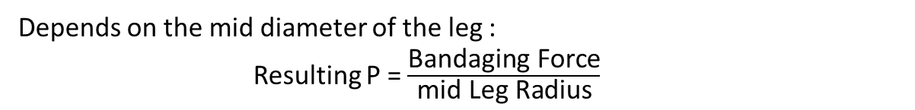
LEG COMPRESSION FEATURES ACCORDING TO THE PHYSICAL MEANS
Bandage compression:
Dependent on the leg circularity
Dependent of bandaging strength
Dependent of leg mid diameter : Starling Law
Bandaging ( force) strength =F1
Resulting compression ( Force) pressure: F2>F3
F1
F1
F3
F1
F1
F2
Circular :
homogeneous transmitted pressure

Slide 64
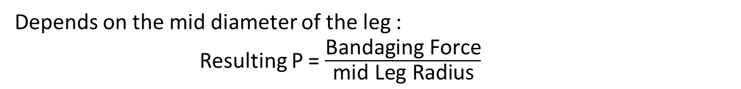
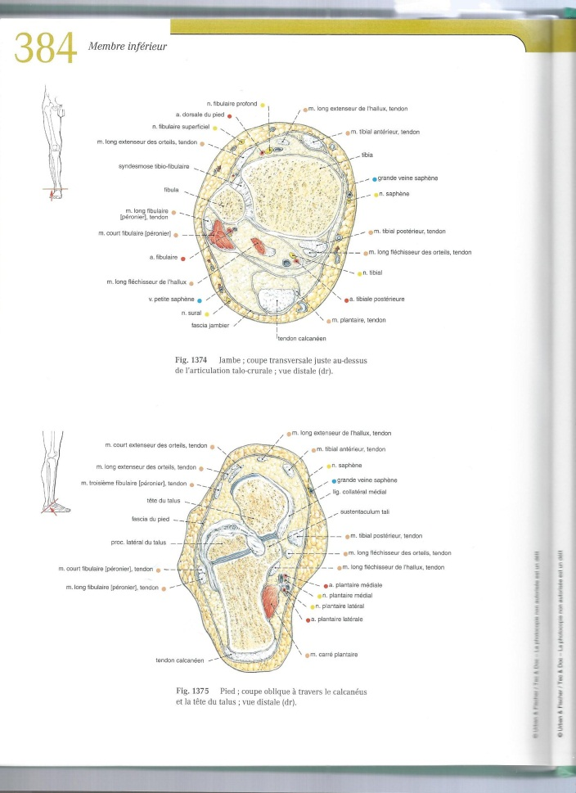
LEG COMPRESSION FEATURES ACCORDING TO THE PHYSICAL MEANS
Bandage compression:
Dependent on the leg circularity
Dependent of bandaging strength
Dependent of leg mid diameter : Starling Law
Bandaging ( force) strength =F1
Resulting compression ( Force) pressure: F2>F3
F3
F2
Non Circular :
heterogeneous transmitted pressure eg ankle

Slide 65
Bulk modulus
Pressure transmission
V
External Compression
Tissues

Slide 66
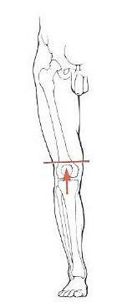
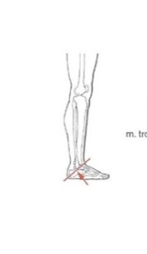
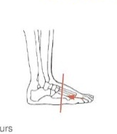



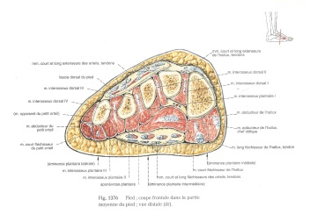
Compressive Pressure value transmitted from surface to depth depends on the elastic and the bulk modulus of the medium :
Leg components are basically heterogonous so that Elastic and Inertia Properties varies according to:
Topography: from thigh down to foot
Posture: Gravitational hydrostatic pressure
Movement: muscle volume and compressibility how much a material will compress under a given amount of external pressure
Circumference = 30 cm
Diameter = 10 cm
Circumference = 19 cm
Diameter = 6 cm
Circumference = 38 cm
Diameter = 12 cm

