Slide 1
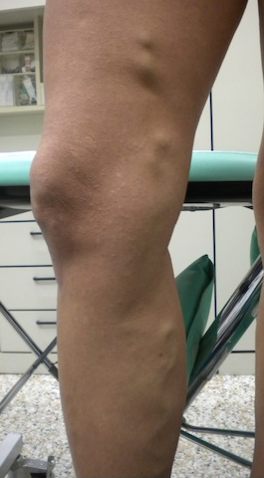
Which Kind of Hemodynamic Pattern can give origin to this GSV thigh tributhary ?
Deep Veins
Giacomini
Competent
GSV
Incompetent
SSV

Slide 2
1° variable aspect :
The escape point can exists or not
The escape point location
Whithout escape point
Whit an escape point ( SFJ)

Slide 3
With Escape Point
Incompetent SFJ
Pelvic escape point

Slide 4
2° variable aspect :
The saphenous axe below the tributary origin ( competent/incompetent/absent)
Incompetent
Absent
(US not detected)
Competent

Slide 5
Possibilities without escape point (negative Valsalva)
Shunt Type 2
Without Saphenous Incompetence
With Saphenous Incompetence
With Competent GSV below the tributary
With Incompetent GSV below the tributary
Shunt Type 2A
Shunt Type 2B
Shunt Type 2C

Slide 6
Possibilities with a refluxing SFJ - Terminal valve incompetent
(positive Valsalva)
Shunt Type 3
Shunt Type 1 + 2

Slide 7
Variables of Shunt Type 3
Shunt Type 3/a
Shunt Type 3/b
Shunt Type 3/c

Slide 8
Pelvic escape point
Shunt Type 4 +II
Shunt Type 5

Slide 9
Muscle Contractive Centripetal Flow in the Giacomini Vein that feeds a centrifugal flow in the GSV during the relaxation phase

