Slide 1
CHIVA TERMINOLOGY
Dr. Jorge Juan

Slide 2
CHIVATERMINOLOGY : History
1988: Franceschi: Description CHIVA
1995: Chateau Gontiers-París: terminological dilemma
1996: CHIVA Meeting Montanyà (Barcelona)
1998: CHIVA Meeting Rosario (Argentina)
2002: CHIVA Meeting Teupitz (Germany)
2010: Vasculab Meeting (Naples)
2016: CHIVA Meeting Cremona (Italia)

Slide 3
CONCEPT OF SHUNT
R 1
Veno-venous diversion characterized by an escape point and re-entry point
R 2
R 3
Franceschi 1988
R 2
R 3
R 1

Slide 4
CLASIFICATION OF THE VENO-VENOUS SHUNTS
SHUNT TYPE 1
SHUNT TYPE 2
SHUNT TYPE 3
SHUNT TYPE 4
Franceschi 1988

Slide 5
Issues
CONCEPT of SHUNT
SHUNT TYPE 0
SAFENOUS ARCH: I. ostial v.s. I. paraostial
SHUNT TYPE 2: Safenous retrograde flow
MIXTE SHUNTS
SHUNT TYPE 4: Catchall
Franceschi 1988

Slide 6
ISSUE: Shunt type 0
R 1
Sometimes, there is a segmental safenous diastolic reflux with re-etry deep veins through a re-entry perforator.
This condition may be reversible
R 3
R 2

Slide 7
CONCEPT OF SHUNT
R 1
R 3
Veno-venous flow diversion with direction contrary to physiological
R 2
Teupitz 2002

Slide 8
CLASIFICATION OF THE VENO-VENOUS SHUNTS
Physiological
WITHOUT ESCAPE POINT
Comet Term Valve
Post-CHIVA
SHUNT I
SHUNT
SHUNT II
SHUNT III
SHUNT I+II
DIASTOLIC
WITH ESCAPE POINT
SHUNT IV
SHUNT IV + II
SHUNT V
SHUNT VI
OPEN VICARIOUS SHUNT
( SYSTOLIC and DIASTOLIC)
Teupitz 2002

Slide 9
OPEN SHUNT WITHOUT ESCAPE POINT :
SHUNT TYPE 0
As related to the draining volume flow, both conditions are similar.
R 1
R 1
R 3
R 3
R 2
≃
R 2

Slide 10
SHUNT ABIERTO SIN PUNTO DE FUGA: SHUNT TIPO 0
Los parámetros de función de bomba¹ de ambos
sistemas son similares.
≃
1.- Zamboni. P, et al. Reflux Elimination Without any Ablation or Disconnection of the Saphenous Vein. A Haemodynamic Model for Venous Surgery. Eur J Vasc Endovasc Surg 2001; 21:361-369

Slide 11
SHUNT ABIERTO SIN PUNTO DE FUGA:
SHUNT TIPO 0
Un sistema retrógrado sin punto de fuga con drenaje por perforante de safena es hemodinámicamente estable.²
ambos son sistemas drenantes.
≃
2.- Cappelli. M et al. Ambulatory conservative hemodynamic management of varicose
veins: critical analysis of results at 3 years. Ann Vasc Surg. 2000 Jul;14(4):376-84.

Slide 12
RETROGRADE DRAINAGE OF THE GSV
A Great Safenous Vein may reflux through a re-entry perforator
If this reflux enters into the Deep Venous System through a perforator, it behave as a draining system.

Slide 13
RETROGRADE DRAINAGE OF THE GSV
This is the reason why a segmental safenous reflux is not pathological.

Slide 14
CHIVA AND SHUNT TYPE 0
Consequently CHIVA is usually based on the achievement of sunts type 0.

Slide 15
OPEN SHUNT WITHOUT ESCAPE POINT :
SHUNT TYPE 0
R 3
R 3
R 1
R 1
R 1
R 3
R 2
R 2
R 2
R 3
R 2
R 1

Slide 16
SHUNT TYPE 1
R 1
Main escape point R1 R2
Re-entry into the Deep venous system without collateral interposition
It is a Closed Shunt
Activated by the diastole
R 2
R 1
R 2
R 1

Slide 17
SHUNT TYPE 2
R 1
Main escape point al R1 R2
Open or closed
Activated by the diastole
R 2
R 3
R 2
R 3
R 1

Slide 18
SHUNT TYPE 2
CLOSED
OPEN
R 1
R 1
R 1
R 2
R 2
R 2
R 3
R 4T
R 4L
R 2
R 4L
R 2
R 2
R 4T
R 2
R 2
R 3
R 1

Slide 19
SHUNT TYPE 2 A (without saphenous incompetence )
R 1
R 1
R 1
R 2
R 2
R 2
R 3
R 4T
R 4L
R 2
R 4L
R 2
R 2
R 4T
R 2
R 2
R 3
R 1

Slide 20
SHUNT TYPE 2 B (with proximal saphenous incompetence and without saphenous re-entry)
R 1
R 1
R 1
R 2
R 2
R 2
R 3
R 4T
R 4L
R 2
R 4L
R 2
R 2
R 4T
R 2
R 2
R 3
R 2

Slide 21
SHUNT TYPE 2 C (with proximal saphenous incompetence and saphenous re-entry)
R 1
R 2
R 3
R 2
R 3
R 1

Slide 22
SHUNT TYPE 1+2
R 1
R 2
It is a combination of shunt type 1 and shunt type 2.
Closed shunt.
Activated by the diastole
R 3

Slide 23
SHUNT TYPE 3
R 1
Main escape point R1 R2
Re-entry into deep venous system through an interposed tributary.
It is a closed shunt
It is activated by the diastole
It is the most frequent
R 2
R 3
R 1
R 2
R 3
R 1

Slide 24
SHUNT TYPE 3
R 1
R 1
R 2
R 2
R 4L
R 3
R 1
R 2
R 3
R 1
R 1
R 2
R 4L
R 1

Slide 25
SHUNT TYPE 3
R 1
R 1
R 2
R 2
R 4L
R 4T
R 1
R 1
R 2
R 4T
R 2
R 1
R 1
R 2
R 4L
R 2
R 3
R 1

Slide 26
SHUNT TYPE 4
R 3
PELVIC SHUNT ( ps)
Escape point R1 R3 R2
Drainage through a safenous perforator without interposed tributary
It is a closed shunt
It is activated by the diastole
R 1
R 2
R 1
R 3
R 2
R 1
Notes:
E’ in genere in relazione con uno SHUNT PELVICO

Slide 27
SHUNT TYPE 4
PERFORATOR (p )
R 3
R 3
PELVIC SHUNT ( ps)
R 1
R 1
R 2
R 2
R 1
R 3
R 2
R 1
Notes:
E’ in genere in relazione con uno SHUNT PELVICO

Slide 28
SHUNT TYPE 4+2
R 3
PELVIC SHUNT ( ps)
R 1
It is a combination of shunt type 4 and shunt type type 2
R 2

Slide 29
SHUNT TYPE 5
R 3
SHUNT PELVICO ( s p )
Escape point R1 R3 R2
Drainage through an interposed tributary
It is a closed shunt
It is activated by the diastole
R 1
R 2
R 3
R 1
R 3
R 2
R 3
R 1
Notes:
E’ in genere in relazione con uno SHUNT PELVICO

Slide 30
SHUNT TYPE 5
PERFORATOR(p )
R 3
R 3
PELVIC SHUNT ( ps)
R 1
R 1
R 2
R 2
R 3
R 3
R 1
R 3
R 2
R 3
R 1
Notes:
E’ in genere in relazione con uno SHUNT PELVICO

Slide 31
SHUNT TYPE 6
R 1
R 2
It is an extrasafenous shunt.
May be open or closed
Activated by the diastole
R 2
R 3
R 1 R 3 R1
Notes:
E’ IL REFLUSSO DA PERFORANTE ISOLATA

Slide 32
SHUNT TYPE 6
R 1
R 1
R 2
R 2
R 2
R 2
R 3
R 3
R 1 R 3 R2
R 1 R 3 R1
Celosed
Open
Notes:
E’ IL REFLUSSO DA PERFORANTE ISOLATA

Slide 33
ViCARIOUS OPEN SHUNT
R 1
Deep venous block
R 2
Activatd by systole and disatole
R 1
R 2
R 1

Slide 34
VENO-VENOUS SHUNTS:
Differential diagnosis
Shunt type 0 vs. Shunt type 1and Shunt tipo 4
Shunt type 2B vs. Shunt type 3 and Shunt type 5
Shunt type 2C vs Shunt type1+2 and Shunt type 4+2

Slide 35
VENO-VENOUS SHUNTS:
Differential diagnosis
Shunt type 0 vs. Shunt type 1 and Shunt type 4
R 3
R 3
R 1
R 1
R 1
R 2
R 2
R 2
Shunt type 0
Shunt type1
Shunt type 4

Slide 36
VENO-VENOUS SHUNTS:
Differential diagnosis
Shunt type 2B vs. Shunt type 3 and Shunt type 5
R 1
R 1
R 1
R 1
R 2
R 2
R 2
R 2
R 3
R 3
R 3
R 3
Shunt type 2B
Shunt type 3
Shunt type 5

Slide 37
VENO-VENOUS SHUNTS:
Differential diagnosis
Shunt type 2C vs Shunt type1+2 y Shunt type4+2
R 1
R 1
R 1
R 2
R 2
R 2
R 3
R 3
R 3
Shunt type 2B
Shunt type1+2
Shunt type 4+2

Slide 38
VENO-VENOUS SHUNTS
Type of shunt knowledge :
Allows the hemodynamic classification of the varices.
Offers the posiibilities of hemodynamic treatments.
Give the prognosis of these treatments.

Slide 39
CLASIFICATION OF THE VENO-VENOUS SHUNTS
Physiological
WITHOUT ESCAPE POINT
Comet Term Valve
Post-CHIVA
SHUNT I
SHUNT
SHUNT II
SHUNT III
SHUNT I+II
DIASTOLIC
WITH ESCAPE POINT
SHUNT IV
SHUNT IV + II
SHUNT V
SHUNT VI
OPEN VICARIOUS SHUNT
( SYSTOLIC and DIASTOLIC)
Teupitz 2002

Slide 40
CHIVA STRATEGY Basic Principles
Segmentation of the pressure column.
R2
R1
R4
R3
C. Franceschi 1988.

Slide 41
CHIVA STRATEGY Basic Principles
Segmentation of the pressure column.
Veno-venous shunts disconnection.
R2
R1
R4
R3
C. Franceschi 1988.

Slide 42
CHIVA STRATEGY Basic Principles
Segmentation of the pressure column.
Veno-venous shunts disconnection.
Preservation of the re-entry perforators
R2
R1
R4
R3
C. Franceschi 1988.

Slide 43
CHIVA STRATEGY Basic Principles
Segmentation of the pressure column.
Veno-venous shunts disconnection.
Preservation of the re-entry perforators
Ablation of the no draining R3 or R4.
R2
R1
R4
R3
C. Franceschi 1988.

Slide 44
CHIVA: 1 CONCEPTO
Aplicación de los principios de la estrategia CHIVA en un solo tiempo, generando un sistema drenado.

Slide 45
CHIVA 1:
SHUNT TYPE 1
R 1
R 2

Slide 46
CHIVA 1
SHUNT TYPE 2
R 1
R 2
R 3

Slide 47
CHIVA 1
SHUNT TYPE 1+2
R 1
R 2
R 3

Slide 48
CHIVA 1
SHUNT TYPE 3
R 1
R 2
R 3

Slide 49
CHIVA 1
OTHER TYPES OF SHUNTS
R 3
R 1
Eligible when the escape point is accesible.
R 2

Slide 50
CHIVA 2: CONCEPT
Implementation of the CHIVA strategy principles in 2 steps by providing a draining system. (Mainly eligible in shunt type 3 ).

Slide 51
CHIVA 2
SHUNT TIYPE 3
R 1
1 Step: Discionnection of the escape point R2-R3.
R 2
-collapse of R3
-Drainage through a safenous perforator
R 3
2 Step: Disconnection of the escape point R1-R2.

Slide 52
CHIVA 1+2: CONCEPT
Implementation of the CHIVA strategy principles in 1 step by providing a NO draining system. (Shunt tipo 3).

Slide 53
CHIVA 1+2
SHUNT TYPE 3
R 1
R 2
Disconnection at the same time of both escape points R1-R2 and R2-R3
R 3

Slide 54
Devalvulation:Purpose
Achieves a 1 step surgical strategy in shunt type 3 that favors a drainage through a saphenous perforator
D

Slide 55
DEVALVULATION: TYPES
R 1
R 1
R 1
R 2
R 2
R 2
D
R 4L
R 3
R 3
D
D
TYPE A
TYPE B
TYPE C

Slide 56
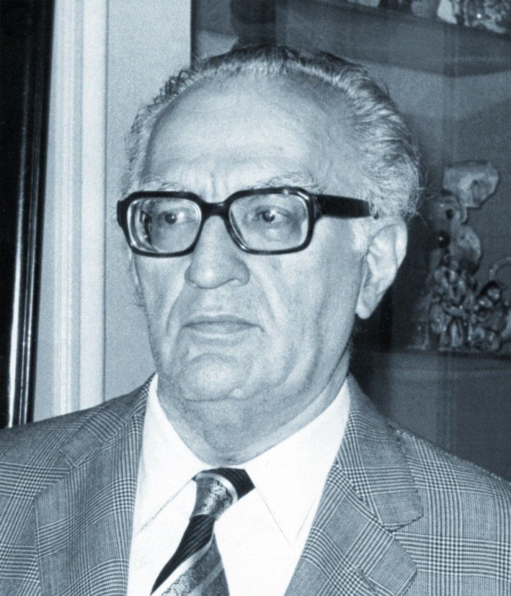
“Teaching is classifying and repeating”
Prof. Piulachs (1908-1976)

