Slide 1
The Saphenous Axe Fragmentation

Slide 2
What is the Fragmentation of the saphenous axe ?
It is the interruption of an incompetent saphenous axe below a re-entry perforator. This creates a reduction of the hydrodynamic energy ( flow rate, velocity and hydrostatic pressure, interruption of a secondary shunt, if one exists) in the ankle region.

Slide 3
P=dgh

Slide 4
P=dgh
Secondary
Shunt VV

Slide 5
Perché diminuisce la portata?
Portata volumetrica : A x V
Se il volume di riempimento si riduce ( Shunt Chiuso-> Aperto) la Velocità si riduce
V dipende anche dalla pompa muscolare. A si riduce in un secondo momento.
Se il gradiente di pressione ( H ) si riduce, la portata si riduce
Gradiente di Pressione
Portata

Slide 6
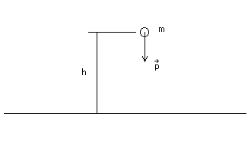
Perché diminuisce la velocità?
Energia Potenziale Grav
Energia Cinetica
Mgh 1/2mv²
Se h diminuisce , v diminuisce
L'energia potenziale gravitazionale è l'energia che un corpo possiede per il semplice motivo di essere in una certa posizione all'interno di un campo gravitazionale in relazione ad un punto di riferimento
The gravitational potential energy is the energy that a body has for the simple reason of being in a certain position within a gravitational field in relation to a reference point

Slide 7
Indications
Reduction of the hydrodynamic energy, responsible for the development of CVI , oedema and skin changes.
Useful for treatment or prevention of these complications

Slide 8
When can this haemodynamic procedure be performed ?
Generally only in the LSV, because the SSV has a short hydrostatic column and the fragmentation is useless
When the LSV is incompetent from the groin to the ankle , shunt 0, shunt 1 , shunt 1+2, shunt 2+1 and shunt 4 (*)
Shunt 1 & 1+2
Shunt 2+1
Shunt 0
Shunt IV

Slide 9
When can this haemodynamic procedure be performed ?
When a valid re-entry perforator exists
This procedure is generally associated with the escape point treatment.
Escape Point Treatment
Re-Entry Perforator
Far from hypodermitis
area
Fragmentation

Slide 10
How can I assess the reduction of energy that I gain with the treatment of the escape point only ?
Velocity and flow volume are related , i can see if the diastolic speed decrease after the escape point treatment, or after compression of the saphenous axe in the upper third of the thight.
Because : Flow rate= Tube Section x Velocity , if I close the shunt, the flow rate decrease and velocity also because the tube section immidiately dosen’t change.
This is not simple to verify.
Questa è solo una cosa teorica , io non l’ho mai fatto.
Questa slide secondo me è da togliere

Slide 11
Haemodynamic check-up of the saphenous axe above the interruption
Evaluation of the perforator caliber in relation to the saphena caliber
Evaluation of the angle of insertion of the perforator in the saphenous axe

Slide 12
Haemodinamic check-up of the perforator vein
The perforator runs like e Terminal Perforator
The perforator runs like a non Terminal Perforator
The haemodynamic pattern depends
Systole:
Static pressure in the upper saphena
Aspirative gradient in the deep veins
Systolic flux in the lower saphena
Diastole:
Kinetic energy in the upper saphena
Caliper of the lower saphena
Angle of insertion in the saphenous axe
Usually during diastole the perforator reflux

Slide 13
Haemodinamic check-up of the perforator vein
Effect of the sapheous axe terminalization on the Haemodinamic behavior of the perforator
Dyastolic Events
Mgh + ½ mv2= C
Mgh + ½ mv2= C

Slide 14
Haemodinamic check-up of the perforator vein
Effect of the sapheous axe terminalization on the Haemodinamic behavior of the perforator
Systolic Events

Slide 15
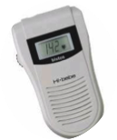
Haemodynamic check-up of the saphenous axe above the interruption
Test of the re-entry validity (if the leg is large, compression of the Saphena below the perforator with the ecographic probe and realization of a dynamic test in the saphenous axe with a pencil doppler )
1 Saphenous axe compression
2 Pencil Doppler
3 Dynamic Test
Risk of thrombosis if the flow rate of the perforator is not sufficient to the saphenous drainage.

Slide 16
If the perforator is smaller, can the flow rate be improved ?
Yes, but not with an elastic stocking .
This is only possible with a bandage and an excentric compression below the perforator.
If the patient presents an active venous ulceration , the operation can be postponed and during the treatment of the ulcer with the bandage the flow rate of the re-entry perforator can be improved.
Excentric
Compression
+
Elastic
Bandage

Slide 17
Does it make sense to perform the fragmentation at a later time rather than simultaneously to the treatment of the escape point ?
Sometimes yes. If the re-entry perforator chosen for the terminalization is not sufficient for the sapheous drainage , a thrombosis can occur.
Advantages:
After disconnecting the shunt upon treatment of the escape point, a saphenous caliber reduction occurs and the thrombosis will be less painful.
Between the first and the second intervention the flow rate of the perforator can be improved with an elastic bandage .
This procedure makes sense only if the ulcer cannot be healed with the dressing alone, and this rarely occurs.

Slide 18
Haemodynamic check-up of the saphenous axe BELOW the fragmentation
The retrograde dyastolic flow in the saphenous axe below the perforator must also be checked
At times this is not easily performed

Slide 19
Haemodynamic patterns of lower saphena
Without re-entry perforators
With re-entry perforators

Slide 20
Haemodynamic patterns of lower saphena
Without re-entry perforators
Without sistolic antegrade flow
With sistolic antegrade flow

Slide 21
Haemodynamic patterns of lower saphena
Without re-entry perforators
With sistolic antegrade flow
The antegrade flow is lost in the saphenous axe
The antegrade flow falls into the perforator vein

Slide 22
Haemodynamic patterns of lower saphena
With Systolic Out-Flow in the lower re-entry perforator
Whithout Systolic Out-Flow in the lower re-entry perforator
( A Re-Entry perforator present always a diastolic In-Flow )
Systolyc Flow
Diastolic Flow

Slide 23
Haemodynamic patterns of saphena below the lower perforator
Competent or incompetent
With or without Sistolyc antegrade flow

Slide 24
Haemodynamic patterns of lower saphena and development of CVI ( oedema or skin changes/ulcers )
Qui devo inserire le slide sul lavoro di sorrento

Slide 25
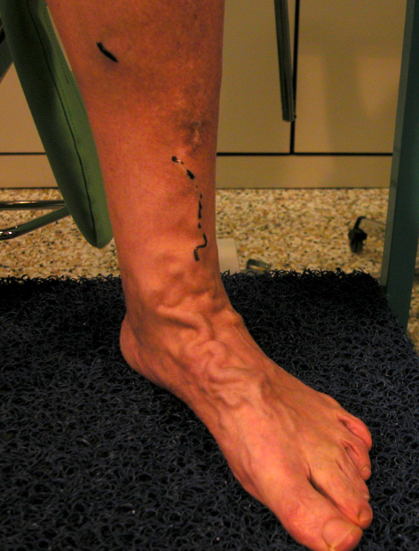
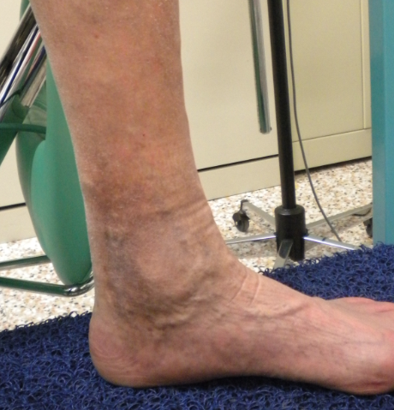
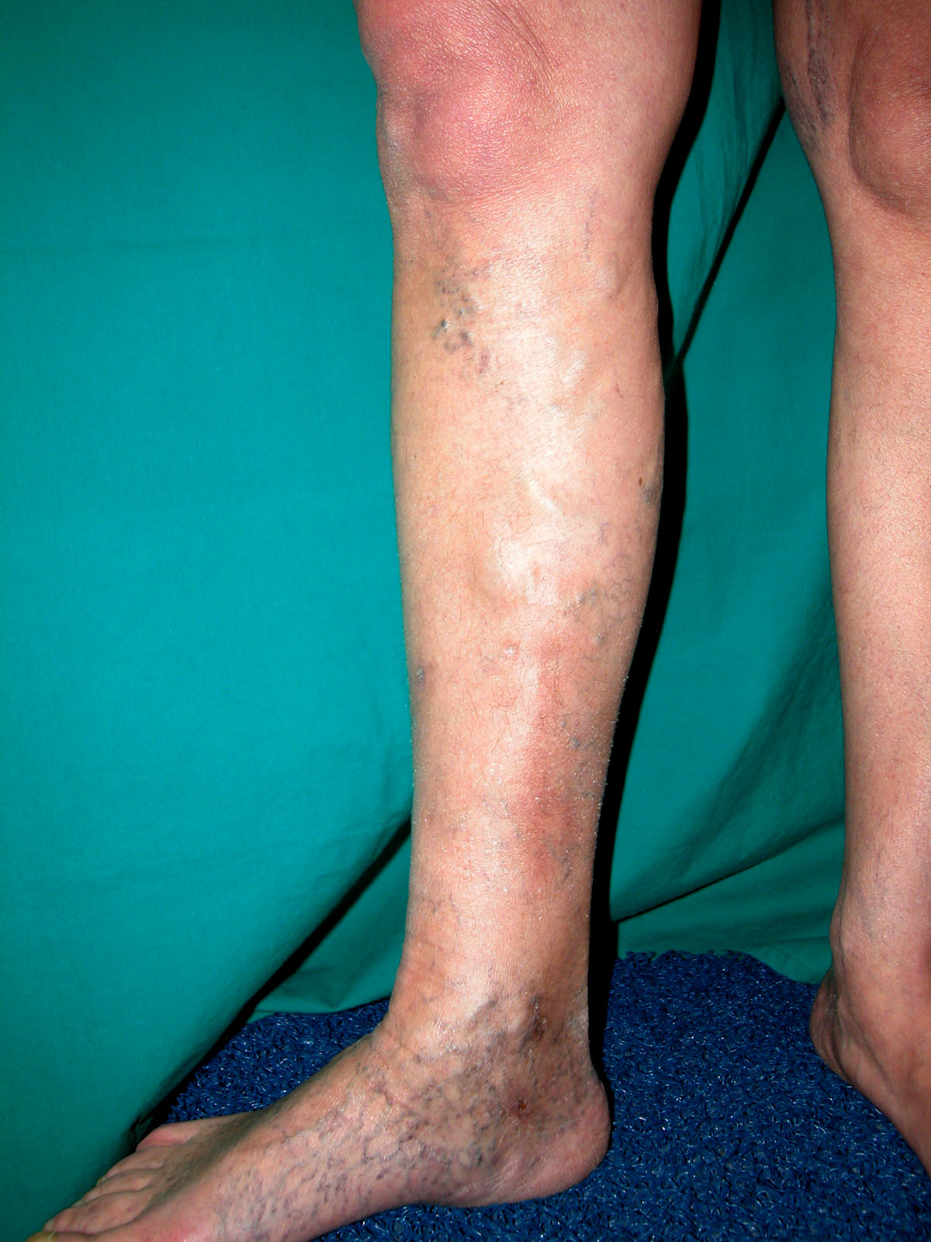
Clinical Evidence
Nothing
Swollen vein of the foot ( cosmetic request )
Oedema
Skin changes

Slide 26
Indications
Clinical evidence | With Re-Entry Perforator | With Sistolic Reflux in the perforator | With Antegrade flow in the saphena | Saphenous caliber | Indication
Nothing |  |  |  |  | No
Swollen vein of the foot |  |  |  |  | Evaluation by the Perthes test
Oedema | If Yes | If Yes | If Yes |  | Ok for skin changes prevention
Skin Changes | Yes or not | Yes or not | Yes or not |  | OK

Slide 27
Clinical Evidence
Nothing
If C = 0 Saphenous caliber is little ( generally 4-5 mm Ø )
Independently from the presence of a re-entry perforator with systolic reflux and an antegrade flow in the lower third of saphenous axe
NO Indication to Fragmentation

Slide 28
Clinical Evidence
Cosmetic request for swollen vein of the foot
Evaluation of varices disappearance with the Perthes Test with the tourniquet below the escape point and below the re-entry perforator.
Risk of thrombosis if all the re-entry point are in the dorsal vein of the foot
( anticoagulation + elastic bandage for 2 weeks )

Slide 29
Clinical Evidence
Oedema
Oedema is often associated with the absence of re-entry perforators
If exists a Re-entry perforator ( +/- sistolic reflux ) and antegrade flow in the saphenous axe
Fragmentation
Risk of thrombosis if all the re-entry point are in the dorsal vein of the foot
( anticoagulation + elastic bandage for 2 weeks )

Slide 30
Clinical Evidence
Skin Changes / Ulcers
Always Fragmentation
If There are not valid re-entry perforators , risk of thrombosis
( anticoagulation + elastic bandage for 2 weeks )

Slide 31
Incidence of skin changes/ulcers ( CVI )
and types of shunts in LSV
Number of incompetent LSV examined : 1424
 | Shunt Type I | Shunt Type I+II | Shunt Type III
Total | 63 | 172 | 515
With CVI | 15 | 24 | 81
Incidence of CVI | 23% | 33% | 15%

