Slide 1
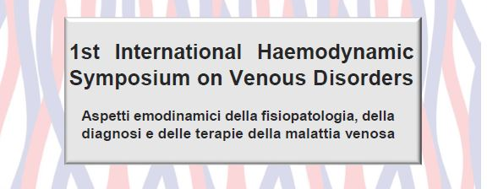
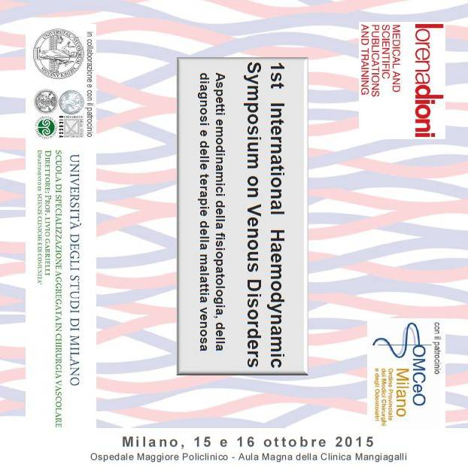
VENOUS MALFORMATION Pathophysiology, hemodynamic assessment and treatment strategy
C.FRANCESCHI R.DELFRATE A.BAHNINI C.LAURIAN M.BRICCHI CL.MASSONI A.BISDORFF

Slide 2
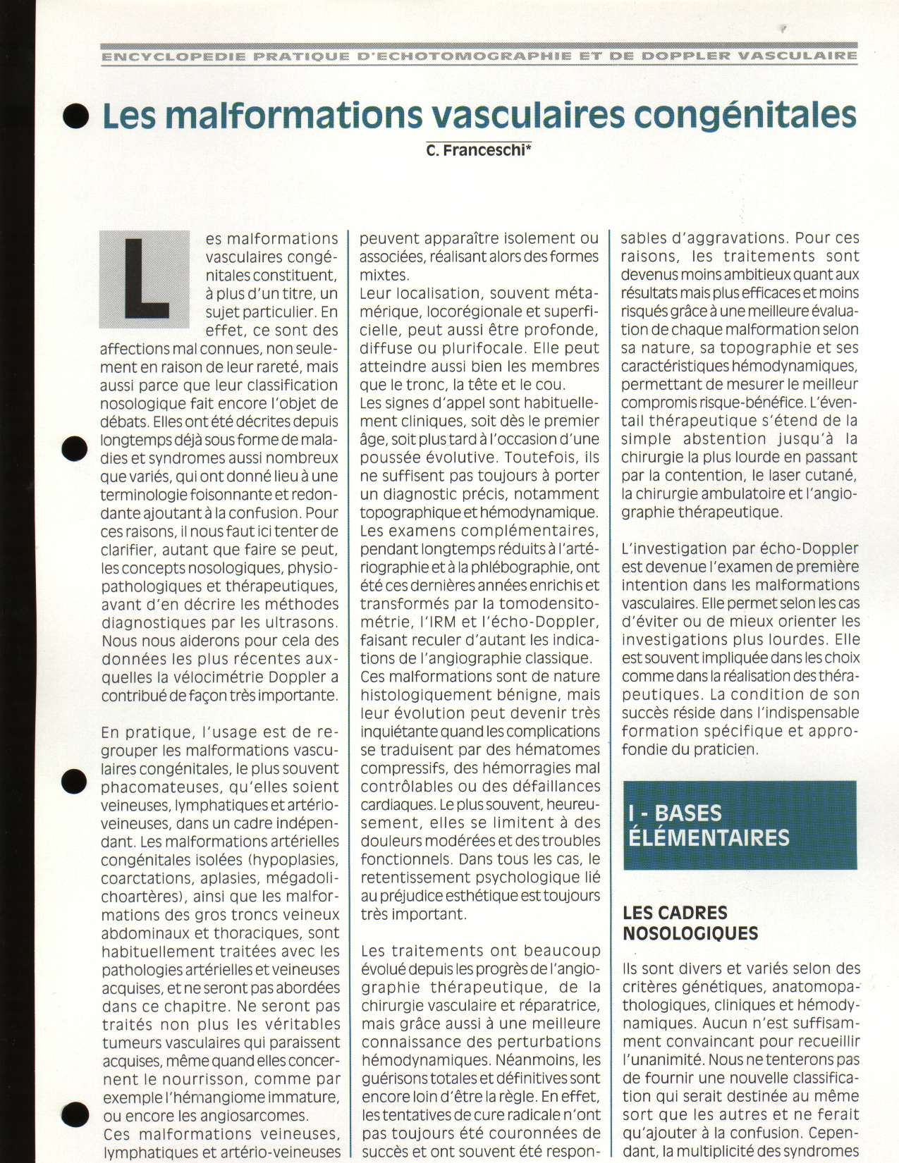
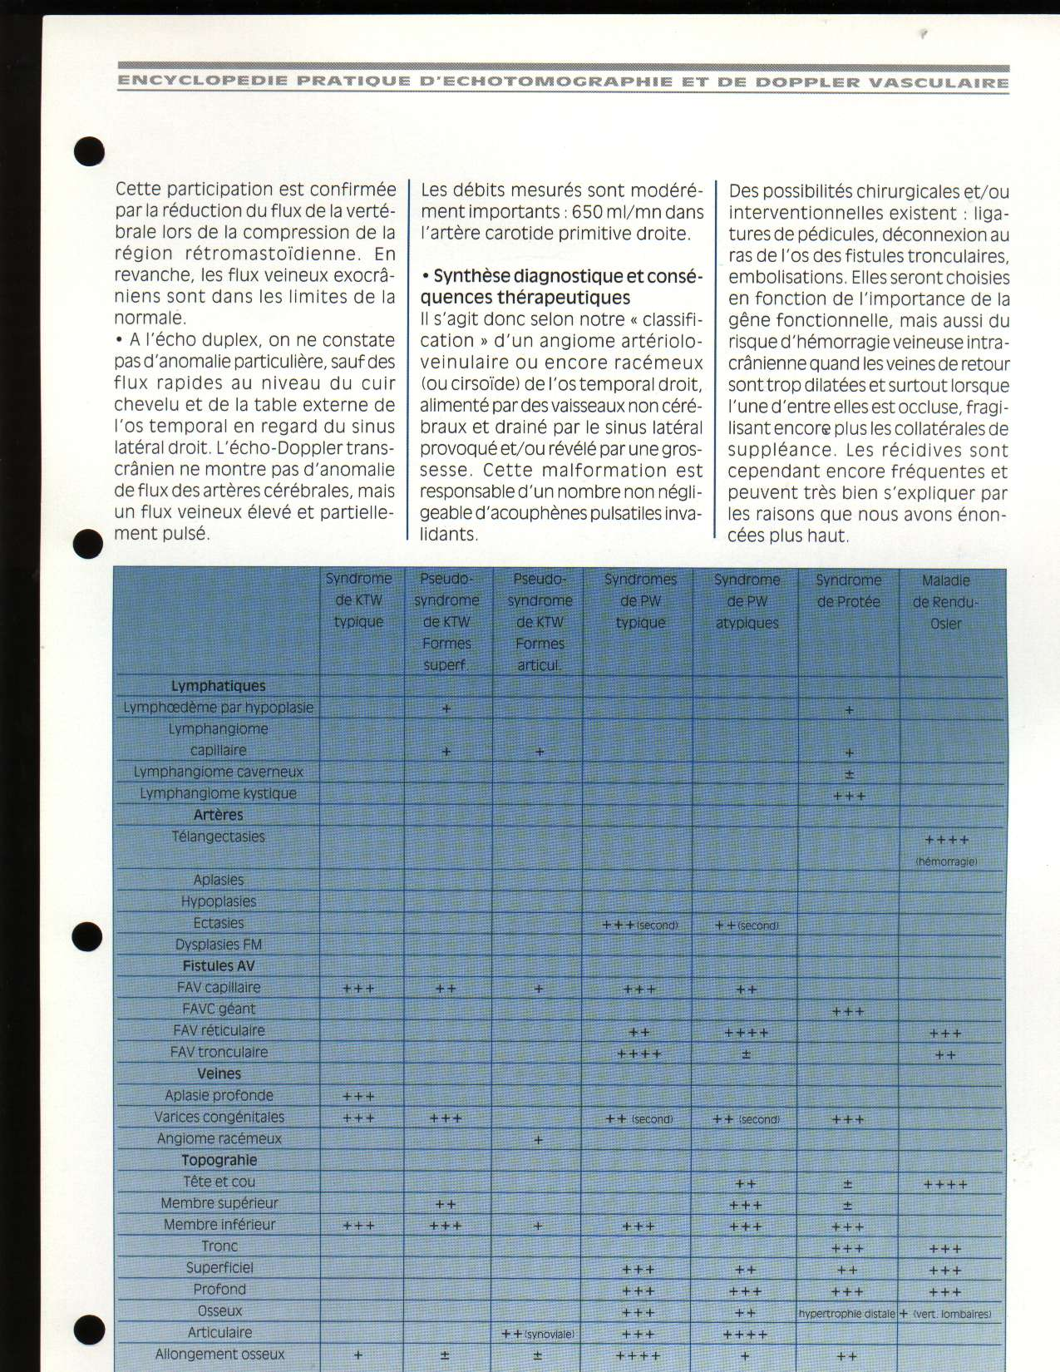
Les malformations vasculaires congénitales in Encyclopédie pratique d'échotomographie et de Doppler vasculaire. Bristol-Meyers Squibb 1995
C. FRANCESCHI

Slide 3
PATHOPHYSIOLOGAL
CLASSIFICATION

Slide 4
Vascular Malformations
Arterial
AVF
Arterio-venous
Venous
Lymphatic

Slide 5
ASSOCIATED CONGENITAL MALFORMATIONS
mesodermic and neuroectodermic
Arterial
Mesoderm
FAV
Arterio-venous
Venous
Arterio-veno-lymphatic
Veino-lymphatic
Lymphatics
NeuroEctoderm
OSTEO-MUSCULAR
DYSTROPHY
NEURO-CUTANEOUS
DYSTROPHY

Slide 6
Venous malformations
Venous
Capillaries
EXRA-TRUNCULAR
        Mega venous capillaries
        -simple
        -nodular
        -cavernous

Slide 7
Venous malformations
Venous
TRUNCULAR
        Hypoplasa
        Aplasia
        Varices
        Avalvulation.

Slide 8
Lymphatic malformations
Lymphatic
Capillaries
Microcystis
Angiokeratoma
Simple Cystis
Cavernous Cystis

Slide 9
Lymphatic malformations
Lymphatic
Troncular
Hypoplasia,
Aplasia,
Avalvulation

Slide 10
DUPLEX ULTRASOUD
Diagnosis, Mapping, Intra-operative
For long investigation , in order to avoid fainting

Slide 11
Venous malformations:
      Topography:
        Supra-aponeurotiques
        Sub- aponeurotiques
        Supra and sub-aponevrotiques .

Slide 12
Most frequent Venous Malformations
- Superficial and deep valve agenesia
True Klippel Trenaunay Weber Syndrom KTW
- Pseudo K.T.W
Congénitales varices
Various extartruncular malformation
Some associations as varices + synnovial extratruncular malformation ( Knee).

Slide 13
      Klippel-Trenaunay- Syndrome
      features:
        - No AVF
        - Inconstant lymphatic malformations
        - Varicose veins Limb hypertrophia , particularly skeletal
          (angio-osteo-hypertrophic syndrom)
        - Capillaire superficial Angioma plan (angiomatous naevus)

Slide 14
      Troncular VM

Slide 15
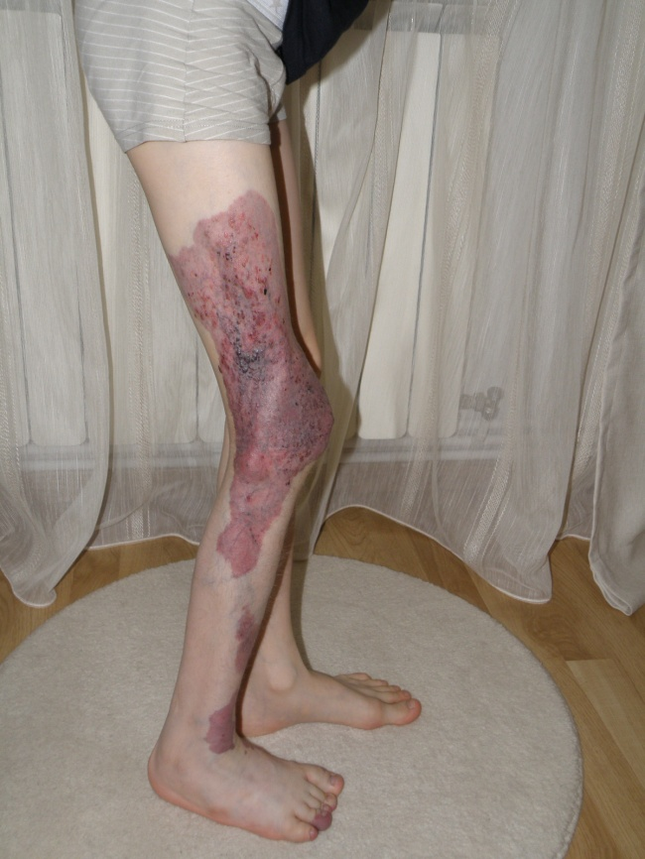
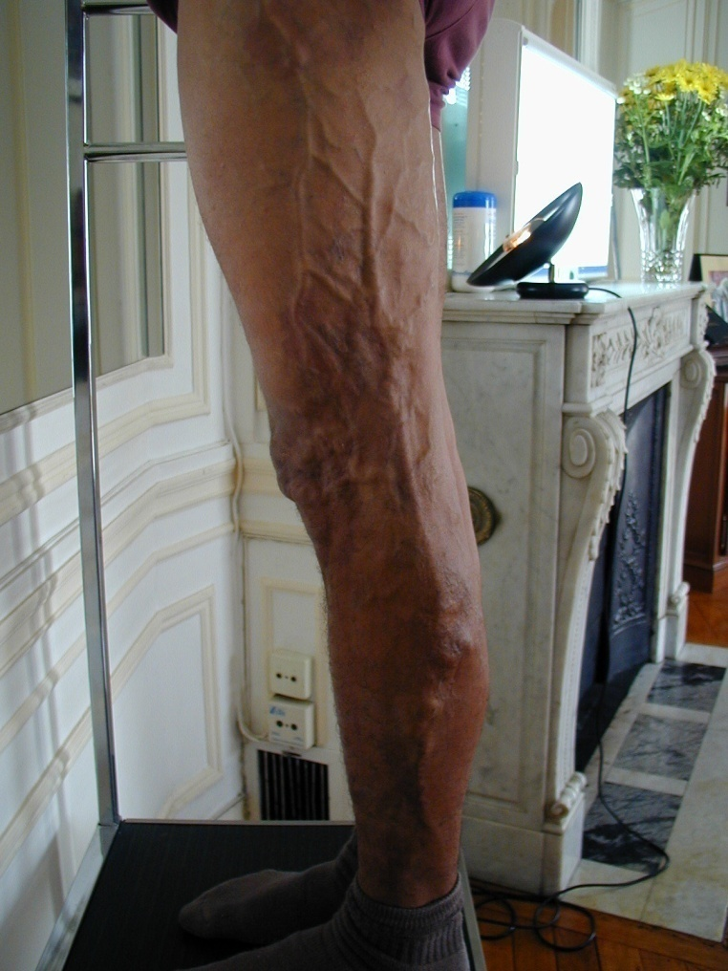
KTS

Slide 16
Pattern 1
Angioma, angiokeratoma
skin
Superf. Vein = eg Marginal vein
perforators
Deep veins
KTS ( not compensatory varices)
Cutaneous angioma : normal draining venous network

Slide 17
Pattern 2
Angioma, angiokeratoma
skin
Superf. Vein = eg Marginal vein
Re-entry perf.
perforators escape points
KTS ( not compensatory varices)
Cutaneous angioma : incompetent superficial vein: Closed shunt
Overloaded: Angioma flow + Deep flow leak ( closed circuit)

Slide 18
Pattern 2 treatment
Angioma, angiokeratoma
skin
Marginal vein
Re-entry perf.
perforators escape points
KTS ( not compensatory varices)
Disconnecting under local anesthesia the closed shunts drains and relieves the angioma and suppresses the deep overloading flow

Slide 19
Pattern 2 treatment
skin
Marginal vein
Re-entry perf.
perforators escape points
KTS ( not compensatory varices)
When angioma or angiokeratoma is absent or small and Deep veins are draining, Marginal vein destruction doesn’t lead to recurrence and the outcome is roughly similar to disconnection

Slide 20
Pattern 5
Angioma, angiokeratoma
skin
Superf. Vein = eg Marginal vein
Re-entry perf.
perforators escape points
Deep veins
Cutaneous angioma : incompetent superficial and deep veins: Despite the deep incompetence, if the Marginal vein shows a diastolic reflux ; the treatment is = pattern 2 and 4.

Slide 21
Pattern 2 treatment
Closed shunts disconnections step by step

Slide 22
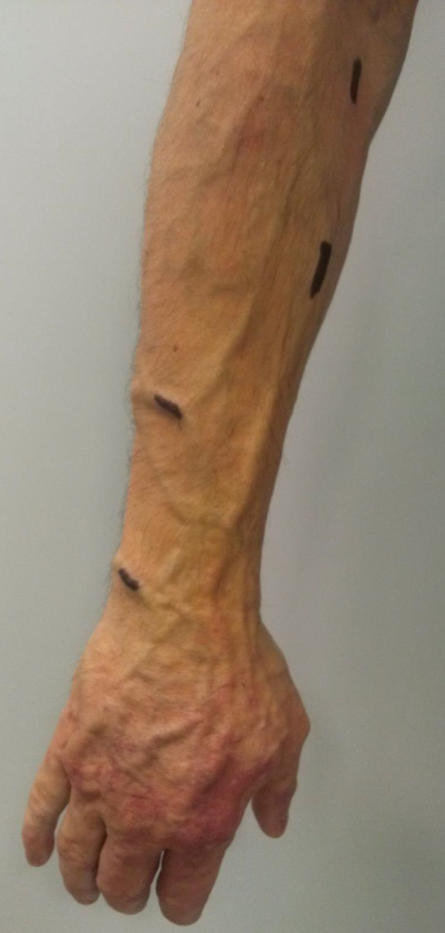
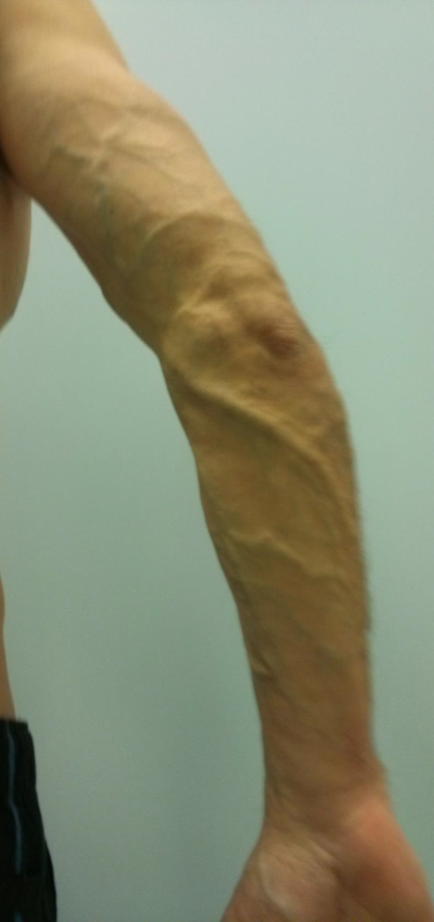
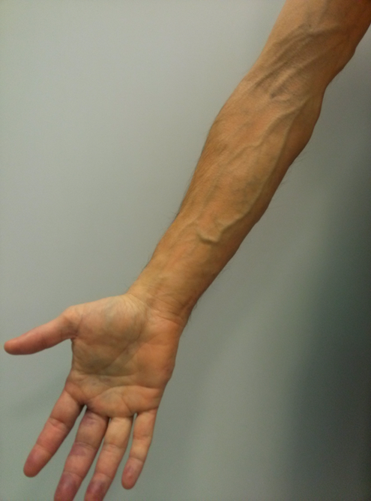
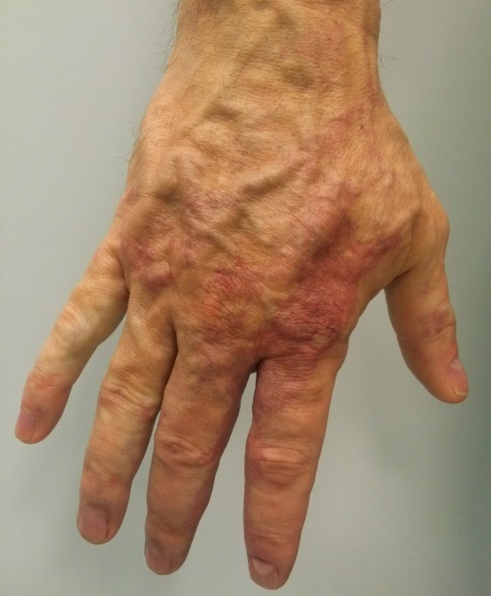
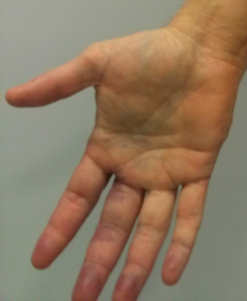
Hand : angioma + extra truncular venous malformation + varicose veins.
Forearm: Varicose veins
+ Heaviness, sweating , ulnar neuralgia

Slide 23
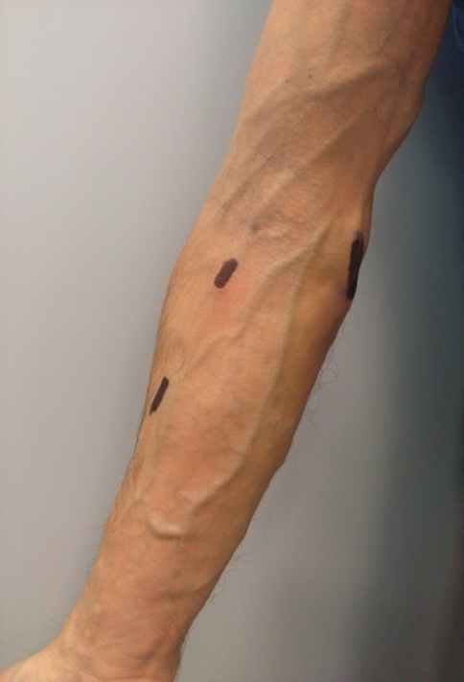
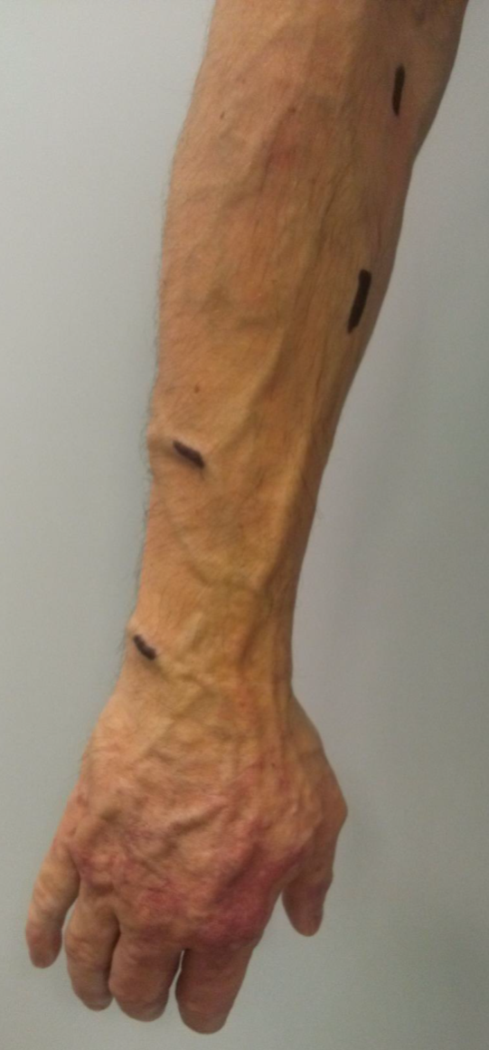
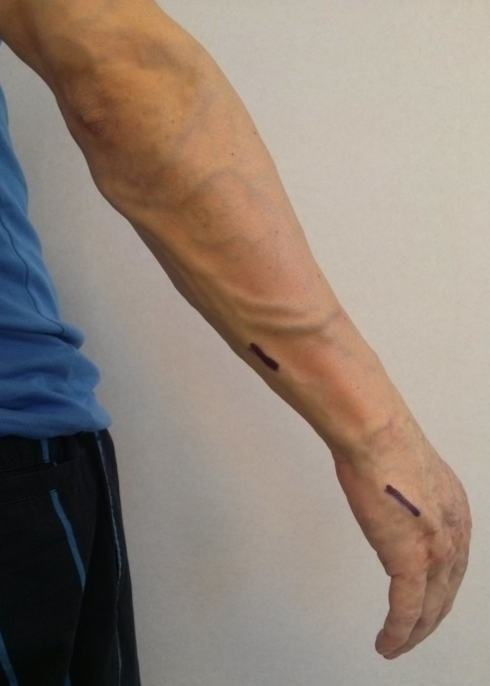
Venous Mapping+ Marking: Disconnection ( 2 cm vein excision under local anesthesia) of refluxing veins flux the competent veins (shunts escape points ). NO phlebectomy no Laser, no Sclerosant.
1st step: 1,2,3,4,5 . 2nd step ( 5 months) 6,7.
1
2
6
3
7
2
1
4
3
5
6
7

Slide 24
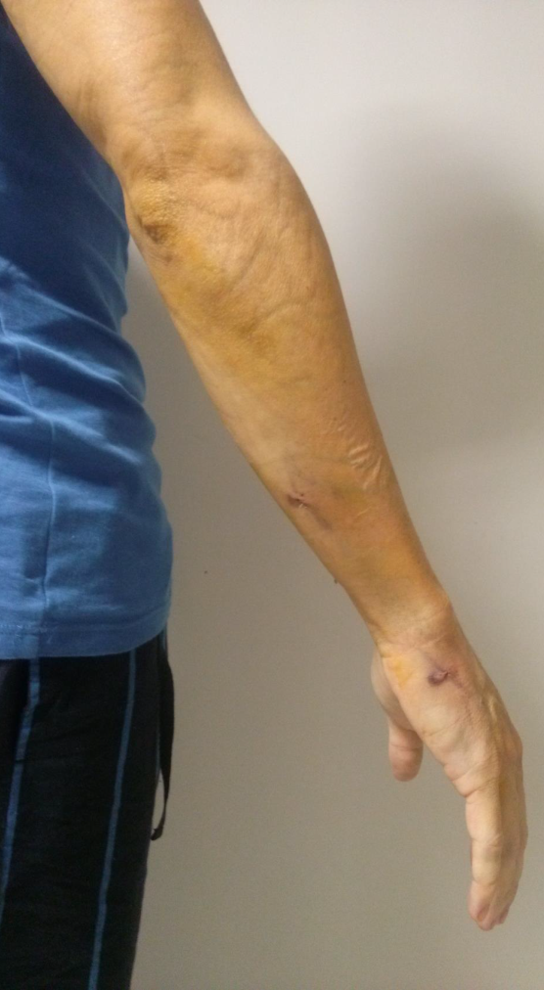
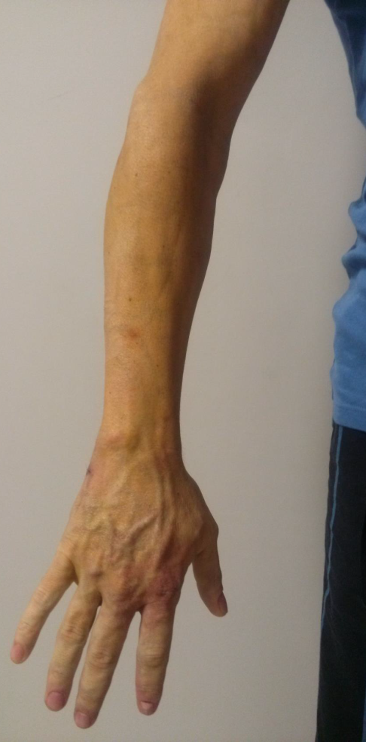
Hand : faded angioma color, collapsed varicose veins Forearm: collapsed Varicose veins
Heaviness, sweating Dramatically relieved
Ulnar neuralgia: Cured

Slide 25
Pattern 3
Angioma, angiokeratoma
skin
Marginal vein
Re-entry perf.
perf escape point
Deep vein aplasia
KTS (compensatory varices)
When the deep veins ( femoral, popliteal ) are hypoplastic and the Marginal vein plays the role of “natural” by-pass, ablating the vicarious segment is too dangerous for the leg drainage.

Slide 26
Pattern 4
Angioma, angiokeratoma
skin
Marginal vein
Closed Shunt Re-entry
Common escape point
Open V Shunt Re-entry
Deep vein aplasia
KTS (compensatory varices)
On the other hand, the Marginal vein segment is disconnected when its not involved in the vicarious effect but responsible for a closed shunt .

Slide 27
Pattern 4 treatment
Angioma, angiokeratoma
skin
Marginal vein
Closed Shunt Re-entry
Common escape point
Open V Shunt Re-entry
Deep vein aplasia
KTS (compensatory varices)
Disconnecting the closed shunts segment drains and relieves the angioma and suppresses the deep overloading flow whilst preserving the Open Vicarious segment avoids the dangerous stop of the deep and superficial draining flow and further varicose collaterals

Slide 28
Pattern 4 treatment
Closed shunts disconnections stage by stage
Preserved open vicarious shunt varicose (marginal) shunts

Slide 29
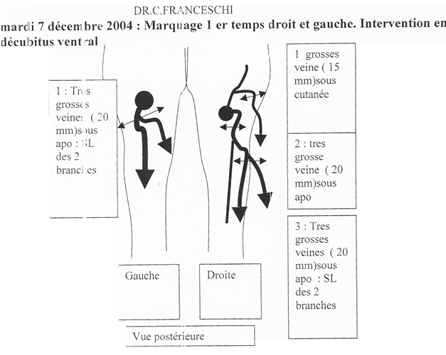
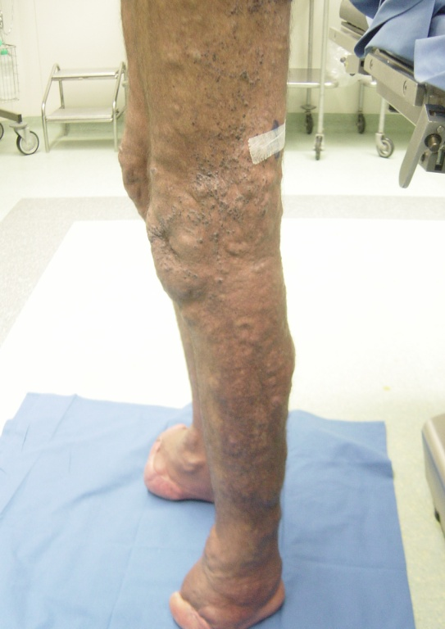
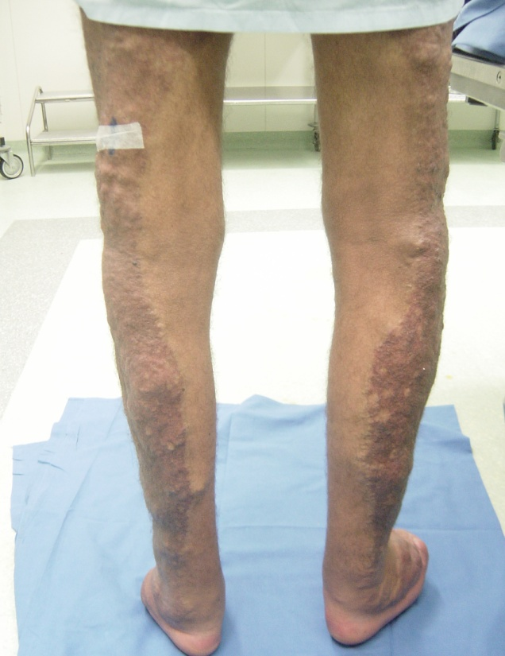

Slide 30
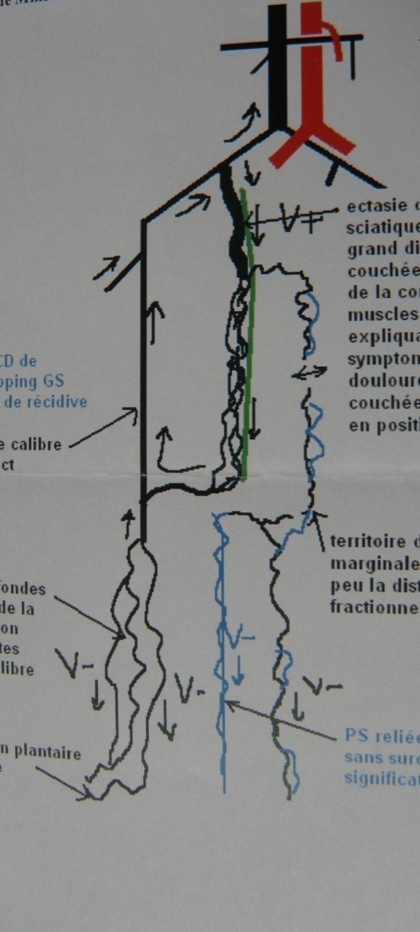
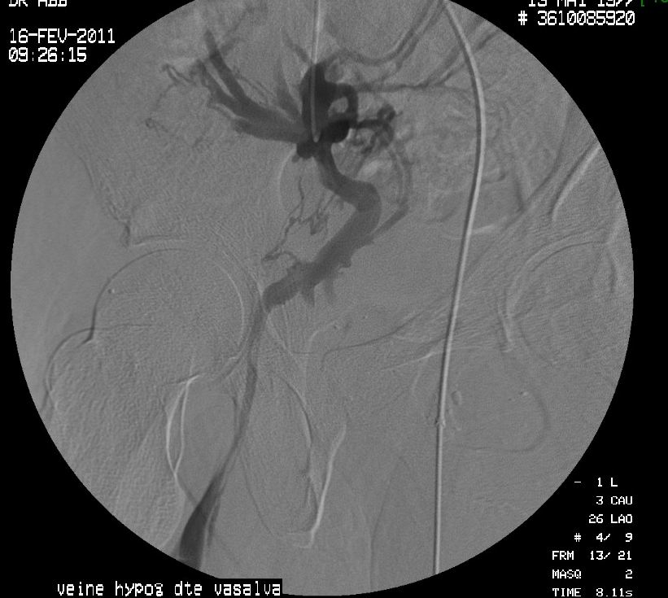
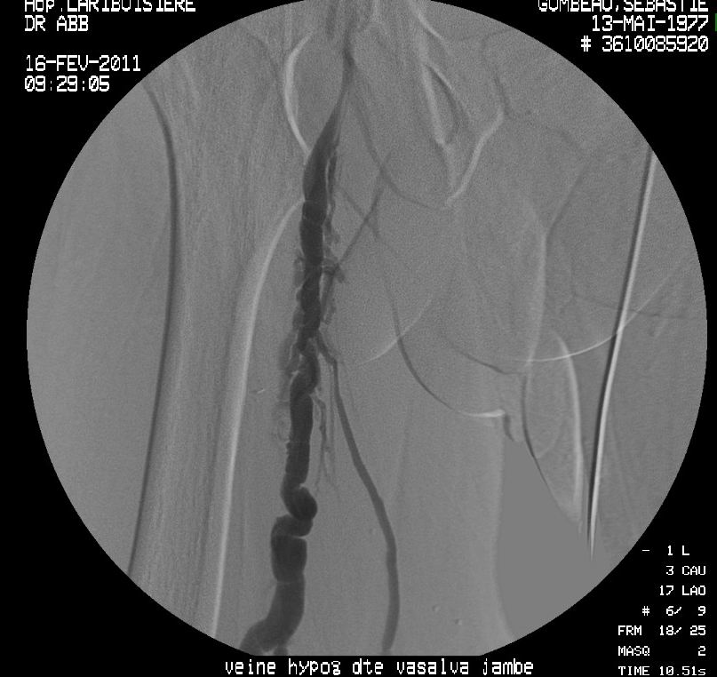
INFERIOR GLUTEAL VEIN
Duplex US mapping
INCOMPETENCE of INTERNAL ILIAC VEIN

Slide 31
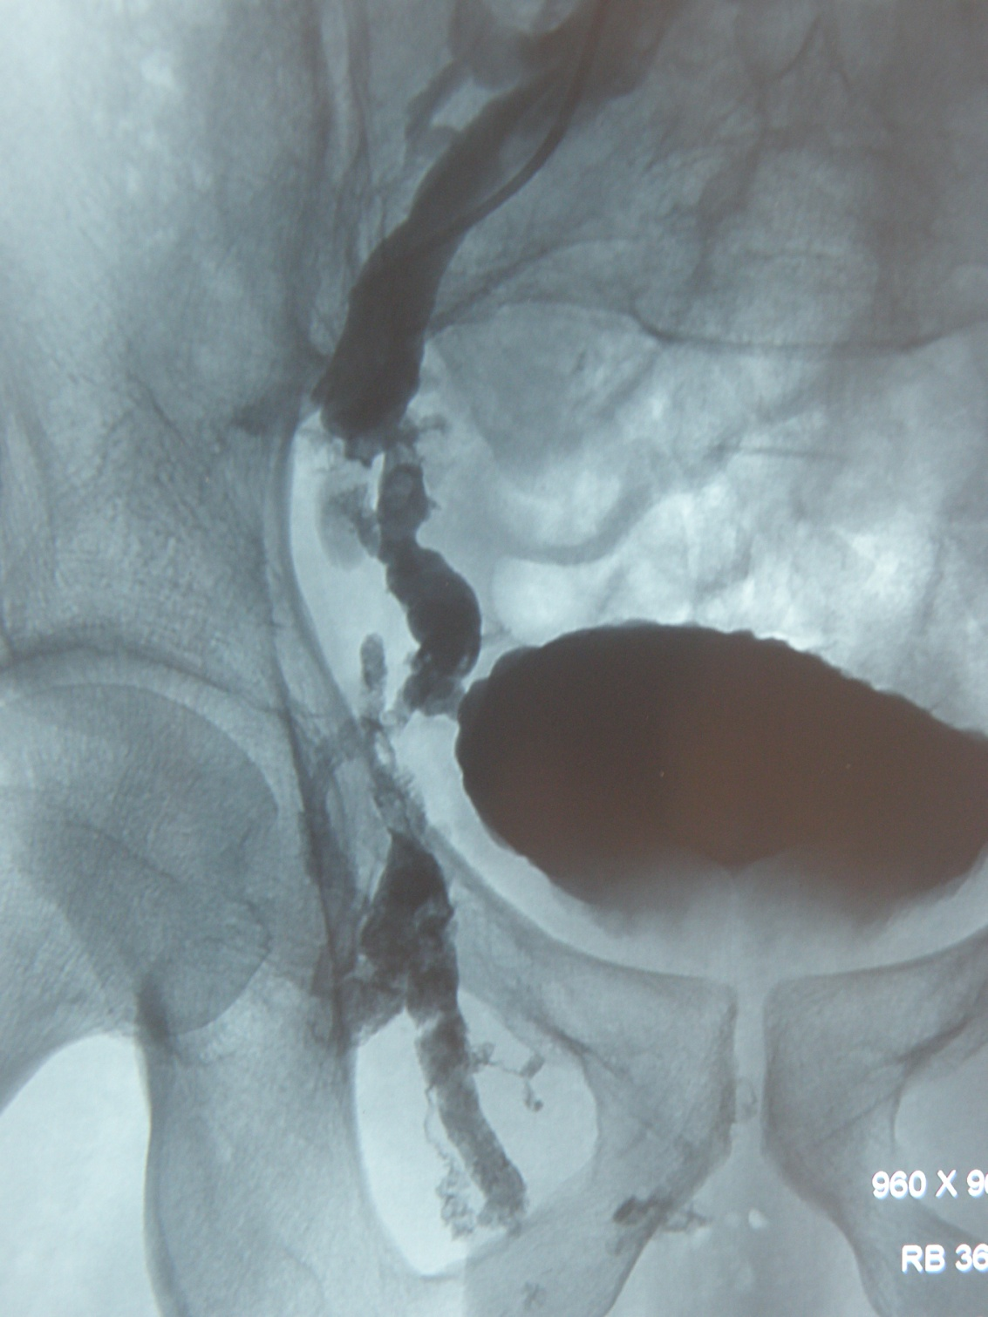
INCOMPETENCE of INTERNAL ILIAC VEIN
PRE POST EMBOLIZATION

Slide 32
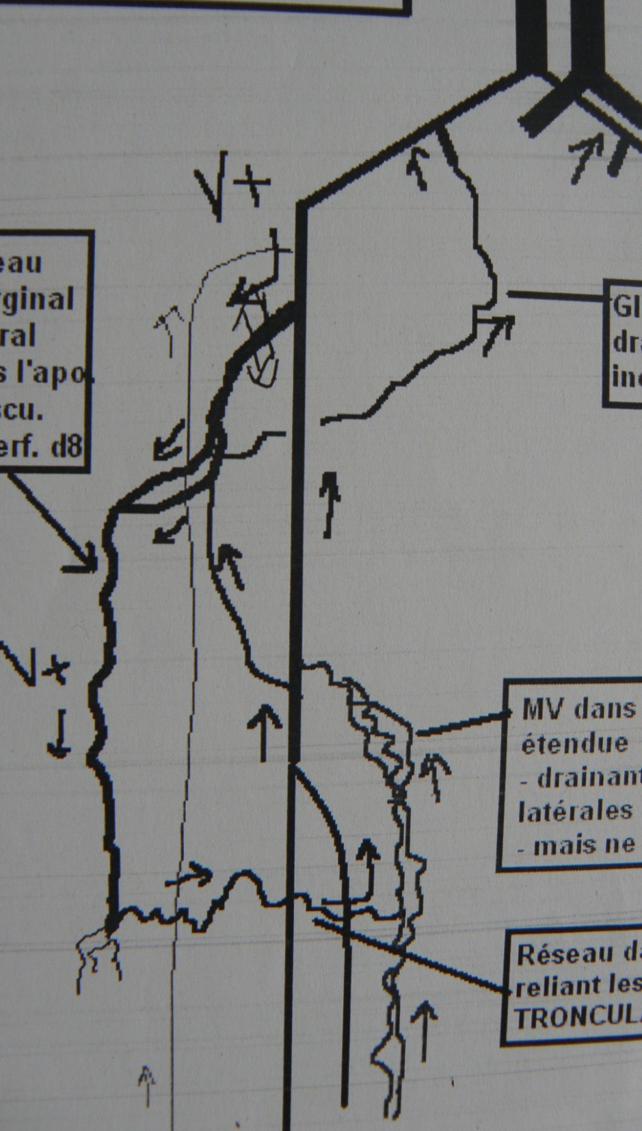
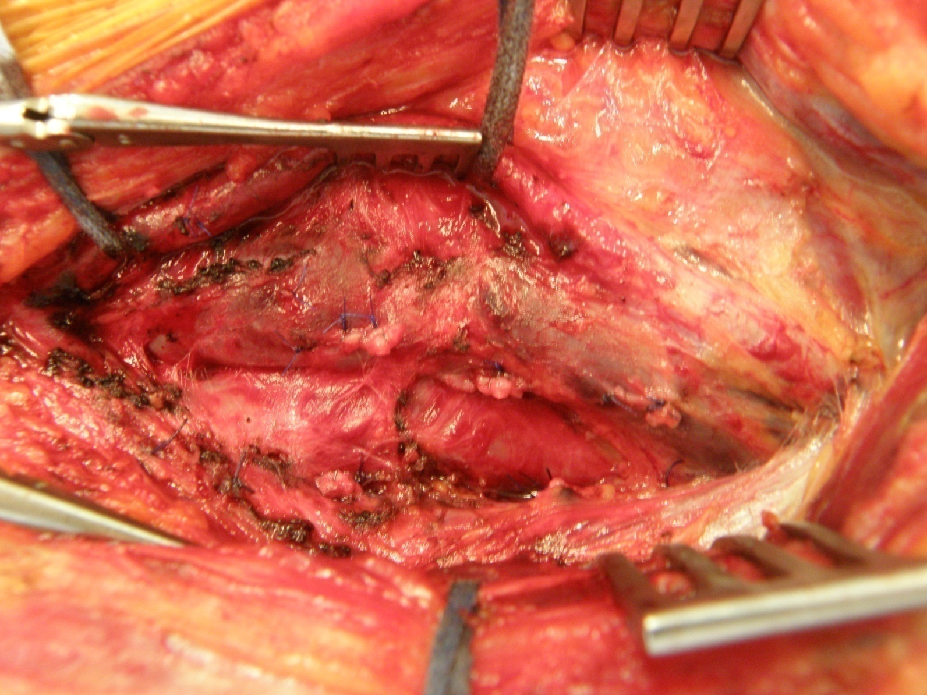
MAPPING
DEEP VEINS
RESECTION INCOMPETENT
DEEP FEMORAL VEIN
Duplex US mapping

Slide 33
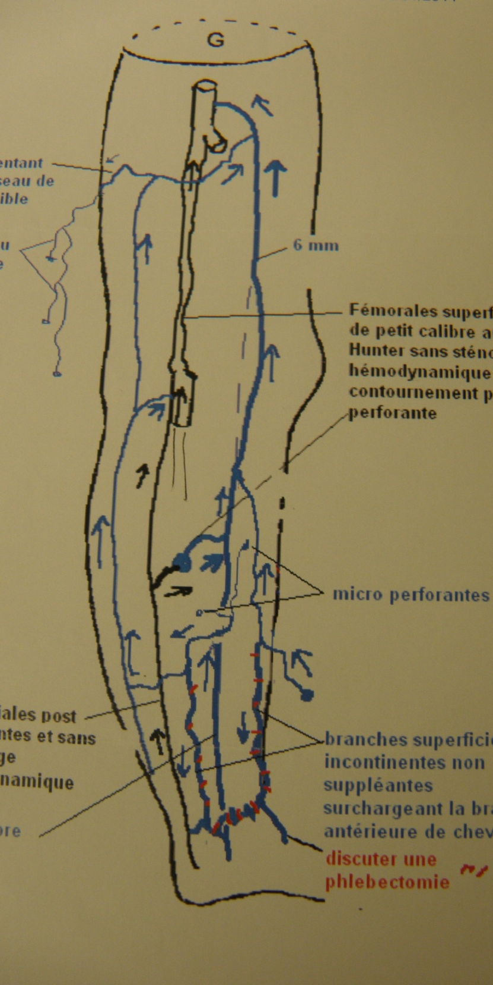
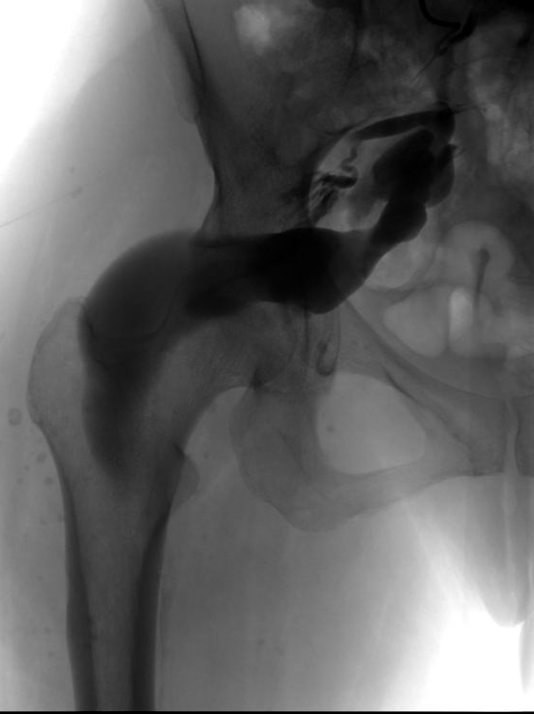
DUPLEX MAPPING
PHLEBOGRAPHY
HYPOPLASIC
SUP;FEM;VEIN
INCOMPETENT
INT . ILIAC VEIN
Duplex US mapping

Slide 34
      Extra Troncular VM

Slide 35
Extra-muscular Duplex guided Extratruncular VM excision

Slide 37
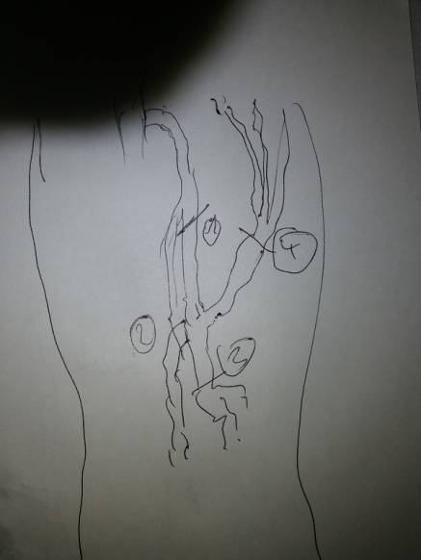
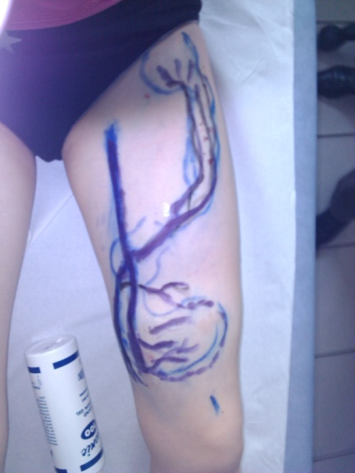
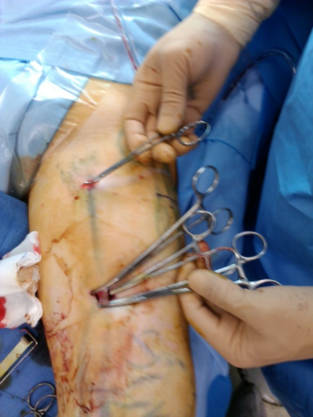
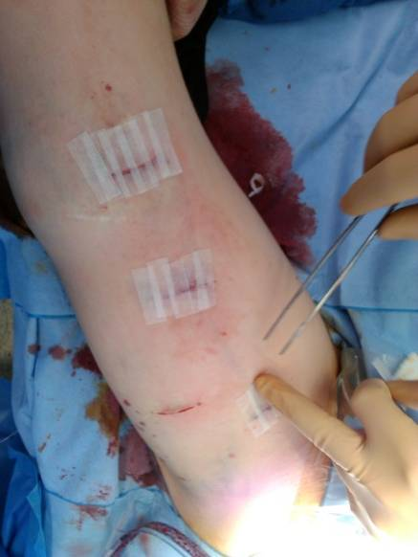

Slide 38

Intra joint VM ( knee+++) treated by synovectomy when bleeding into the joint

Slide 39
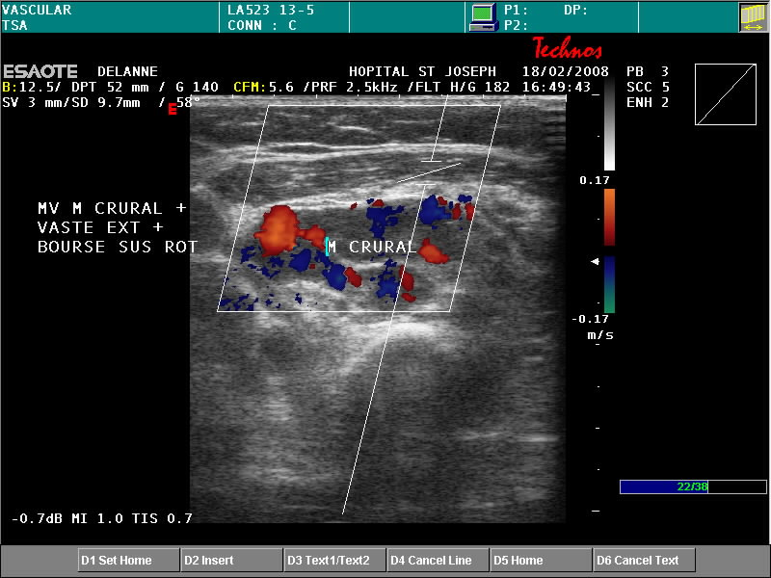
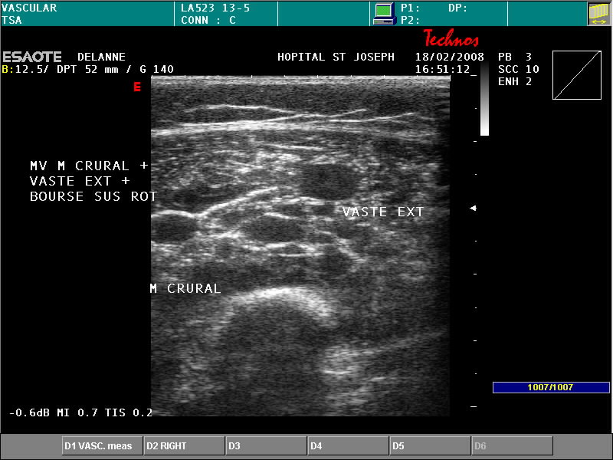

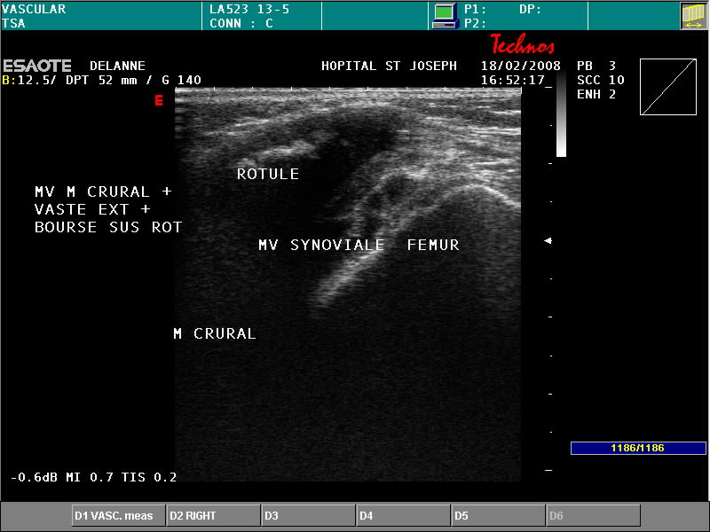
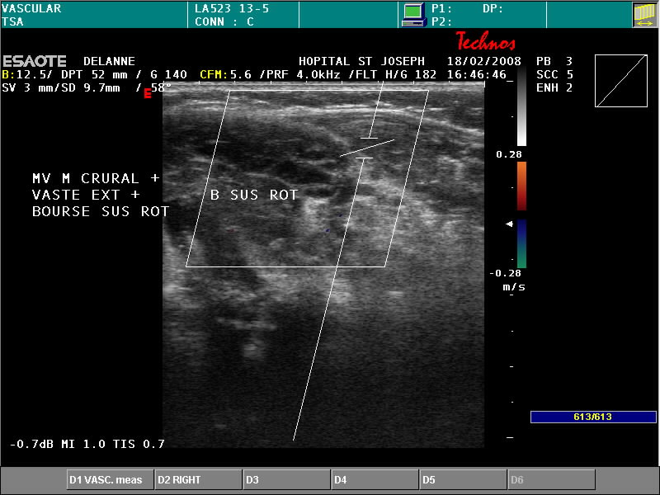
MV Genou, Crural et Vaste externe: enfant 5 ans

Slide 40
      Miscellaneous VM

Slide 41
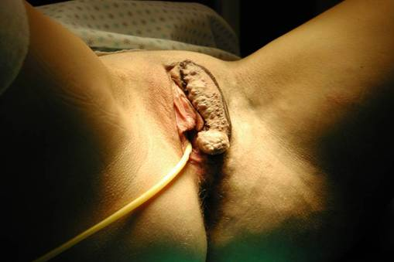
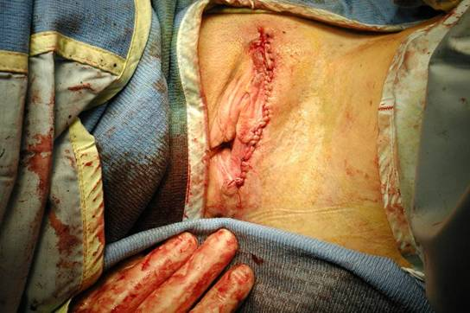
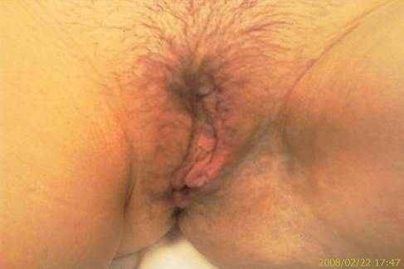

Slide 42
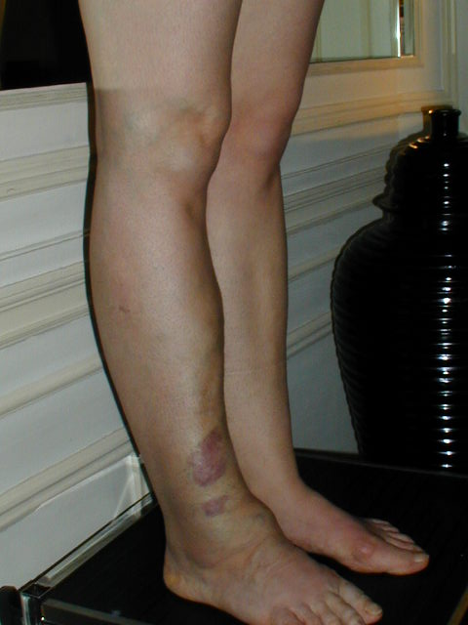
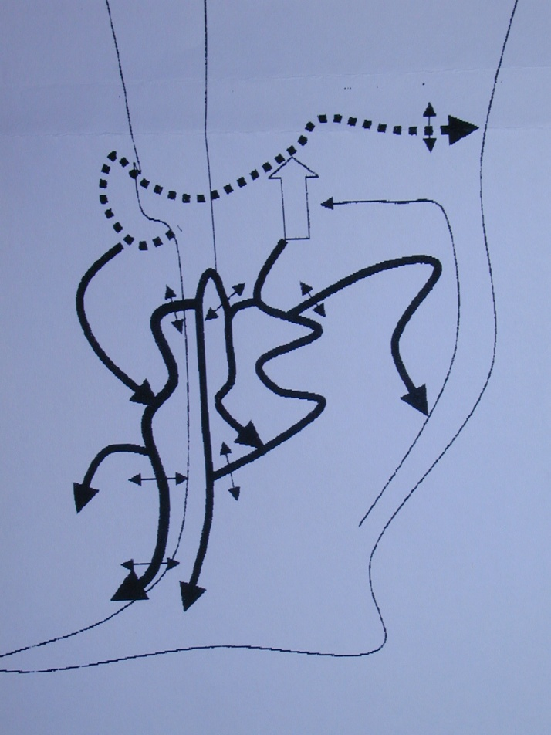

Slide 43
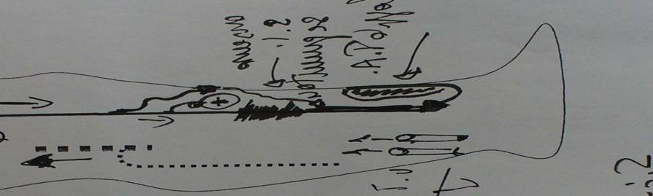
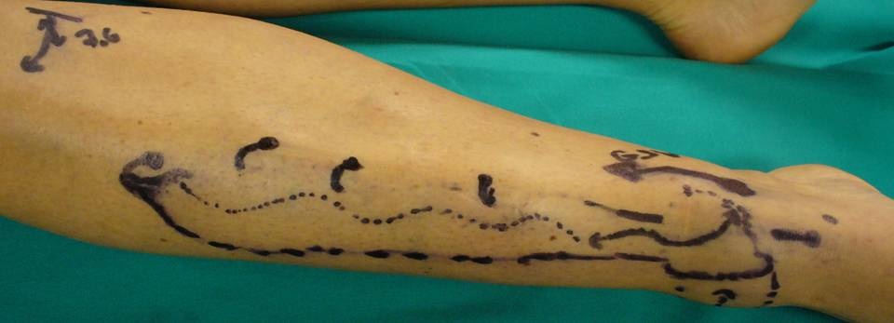
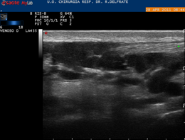
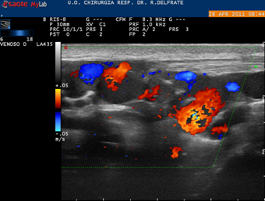
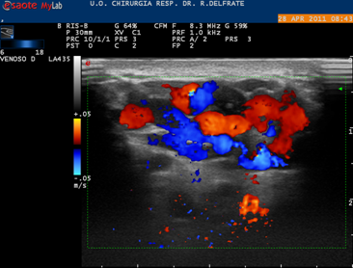
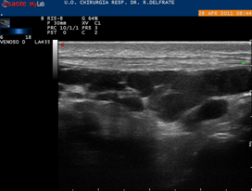
VM sub aponeurotic Ant. Tibial compartment.Previous foam treatment.Pain increased after foam (1 year) .VM unchanged

Slide 44
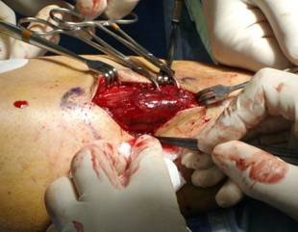
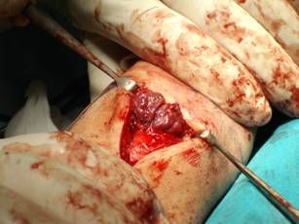
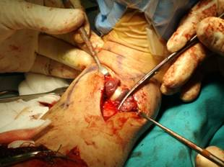
Echo guided surgical exhaustive ablation

Slide 45
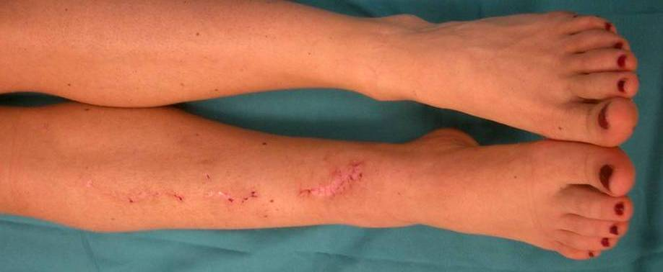



30 days post Op. Swelling dramatically reduced. No pain.

Slide 46


VM of gastrocnemius (caput mediale)

Slide 47





Slide 48





Slide 49







Duplex
MRI
Duplex marking

Slide 50





MALFORMATION VEINEUSE DU MUSCLE SOLEAIRE
Echodoppler
IRM
Marquage pré_opératoire

Slide 51





MALFORMATION VEINEUSE DU MUSCLE SOLEAIRE
EXERESE ECHOGUIDEE

Slide 52

Multiple VM of upper limb

Slide 53


Simple device permitting easy hemostasis so reducing dramatically blood loss during the operations

Slide 54
ACURATE DEEP and SUPRFICIAL IDENTICATION of EVERY PATTERN and associated ones is MANDATORY in order to ELABORATE an appropriate STRATEGY and implement the most suitable TACTIQUE.
When STRATEGY is possible and its IMPLEMENTATION is feasible, the patients are relieved and some cross the freak borders to joins the community of “normal” esthetic concerns.
If not, we prefer therapy limited to compression….. in order to avoid “incomprehensible” complications due to a misunderstood situation.

Slide 55
GRAZIE
PER L’ATTENZIONE

