Slide 1
VENOUS MALFORMATION Pathophysiology, hemodynamic assessment and treatment strategy
PART 2
C.FRANCESCHI R.DELFRATE A.BAHNINI C.LAURIAN M.BRICCHI CL.MASSONI A.BISDORFF

Slide 2
Extra Troncular VM

Slide 3
Extra-muscular Duplex guided Extratruncular VM excision

Slide 5
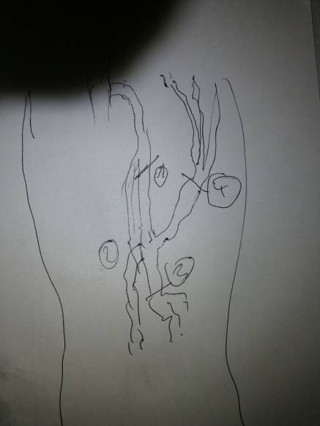
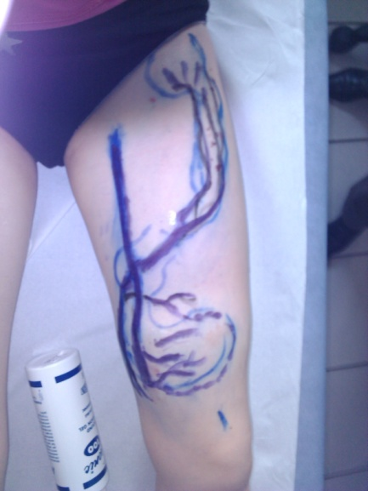
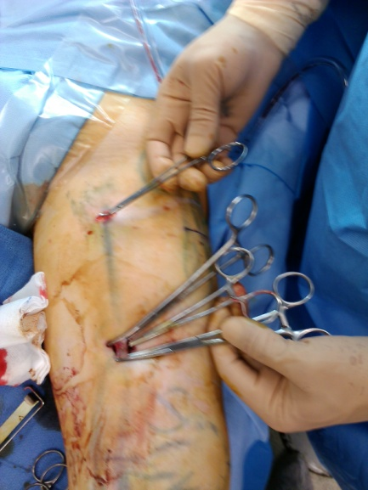
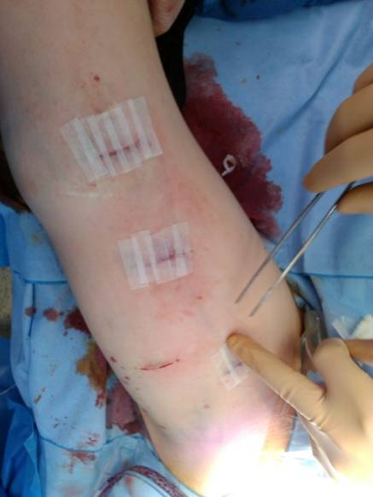

Slide 6
Intra joint VM ( knee+++) treated by synovectomy when bleeding into the joint

Slide 7
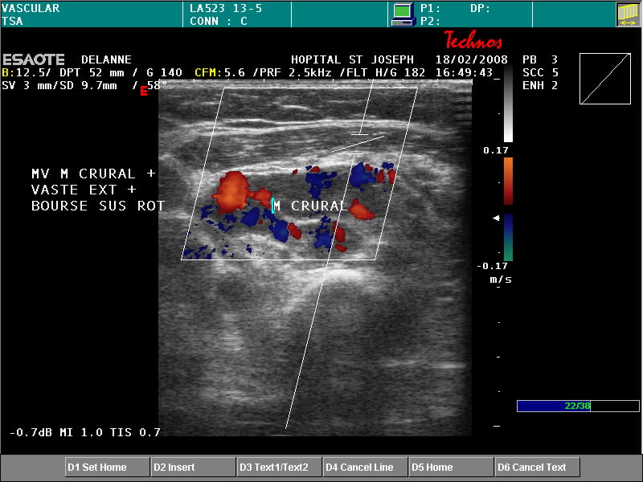
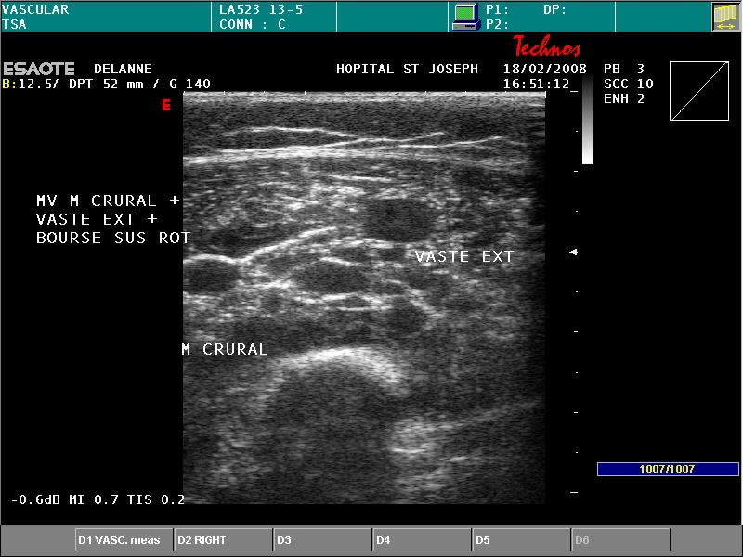
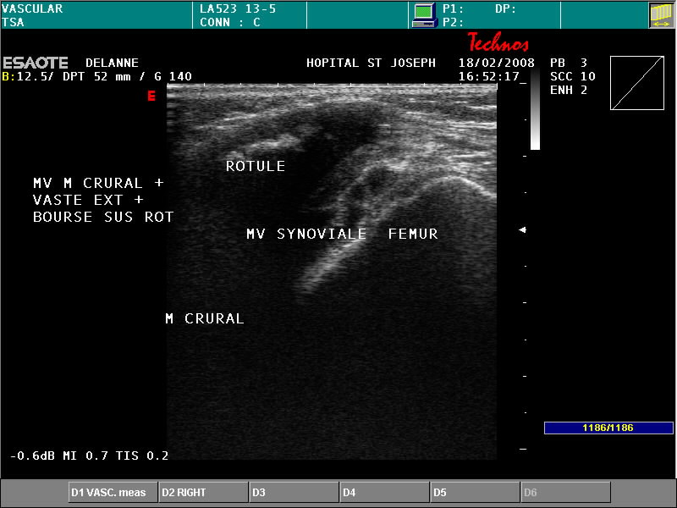
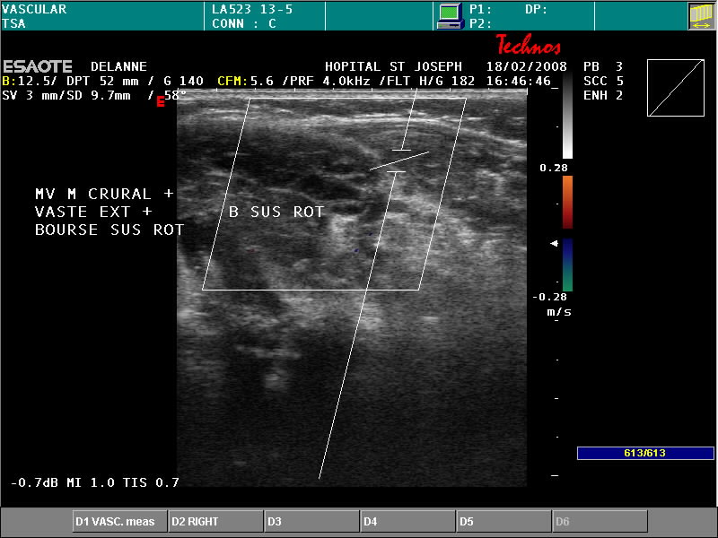
MV Genou, Crural et Vaste externe: enfant 5 ans

Slide 8
Miscellaneous VM

Slide 9
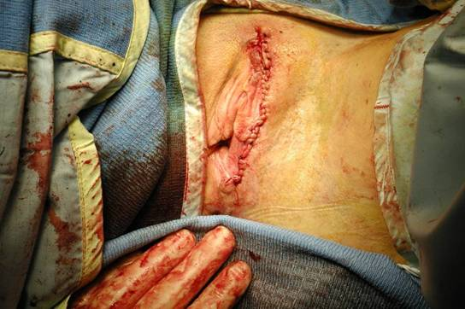

Slide 10
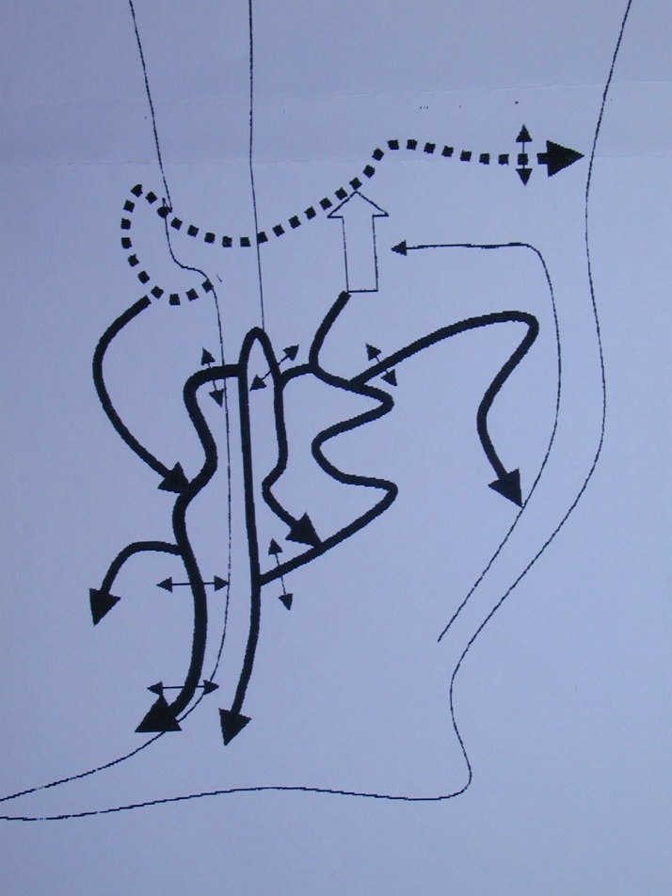

Slide 11
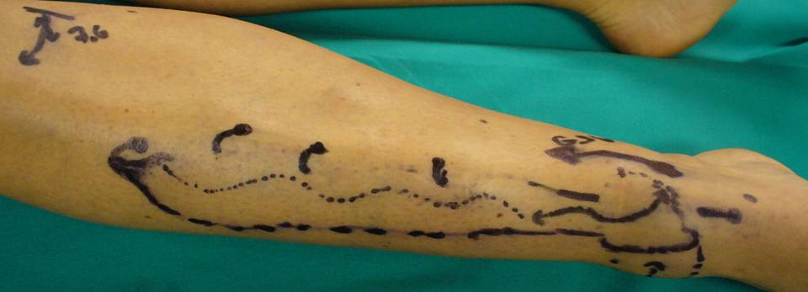
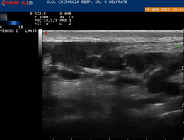
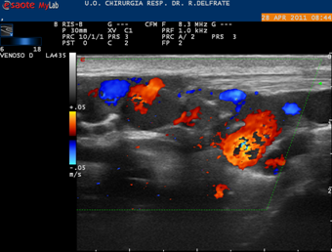
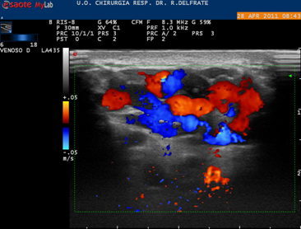
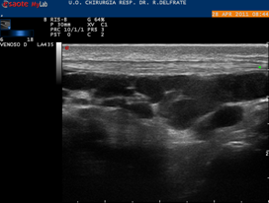
VM sub aponeurotic Ant. Tibial compartment.Previous foam treatment.Pain increased after foam (1 year) .VM unchanged

Slide 12
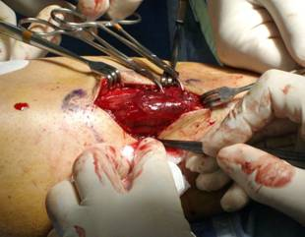
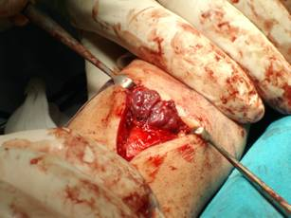
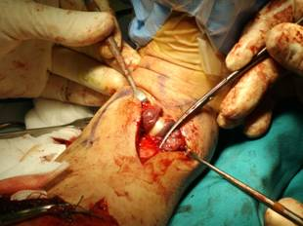
Echo guided surgical exhaustive ablation

Slide 13
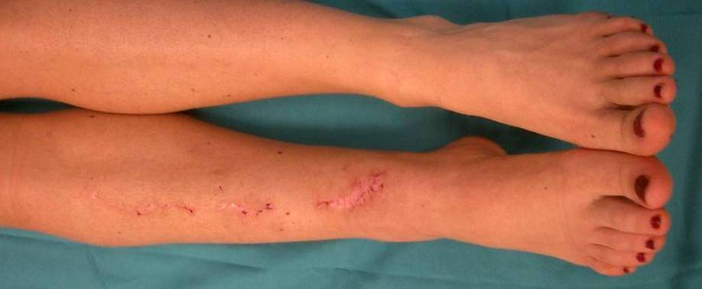
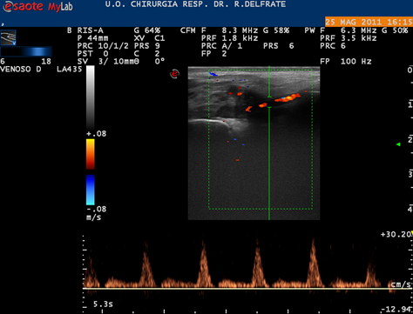
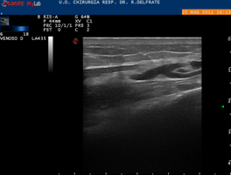
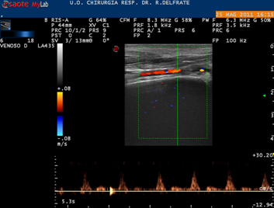
30 days post Op. Swelling dramatically reduced. No pain.

Slide 14
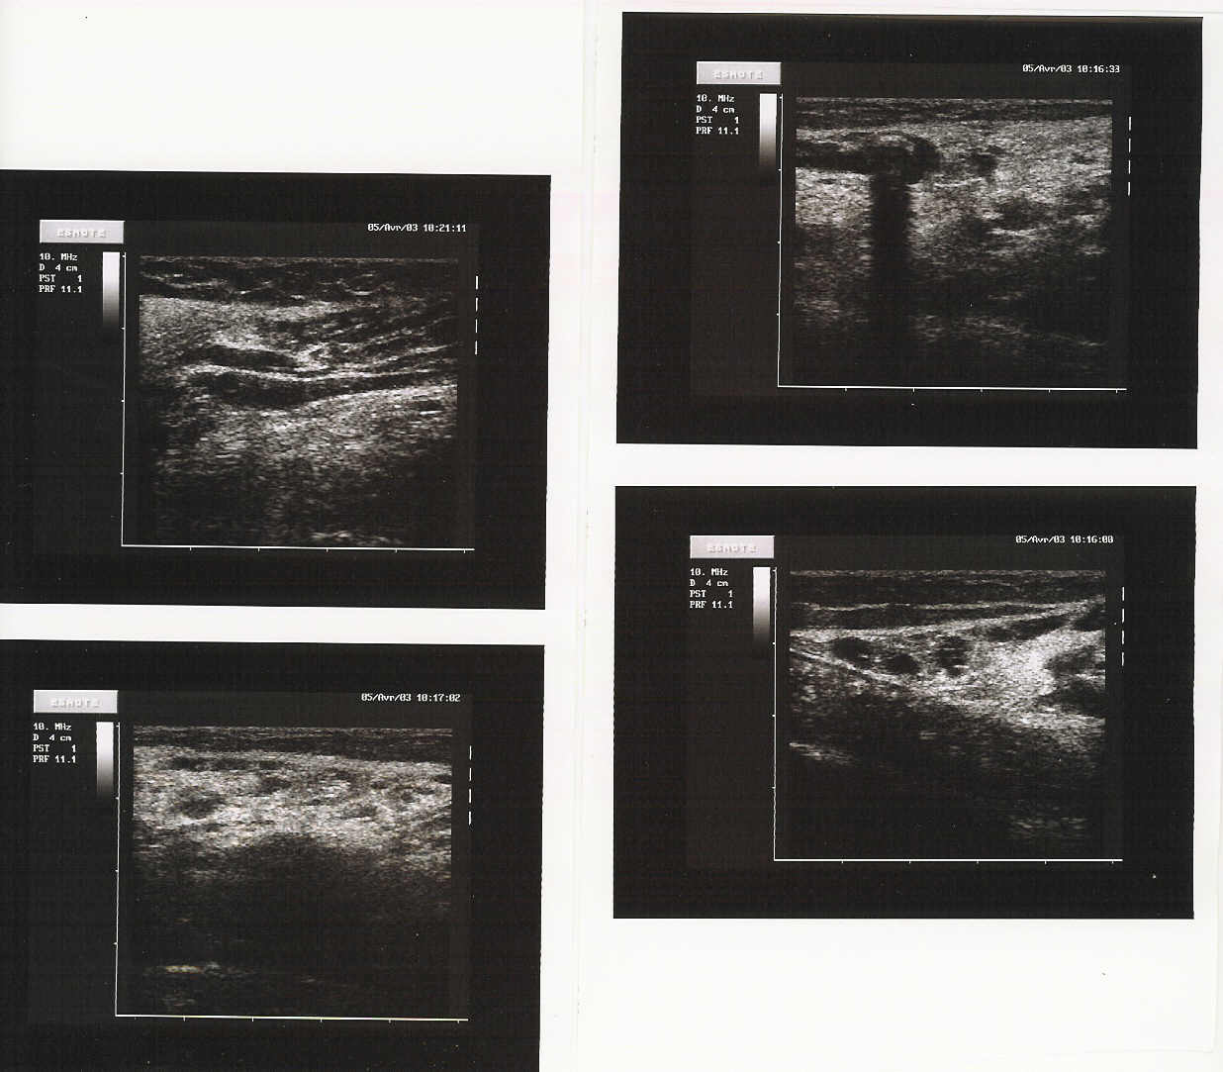
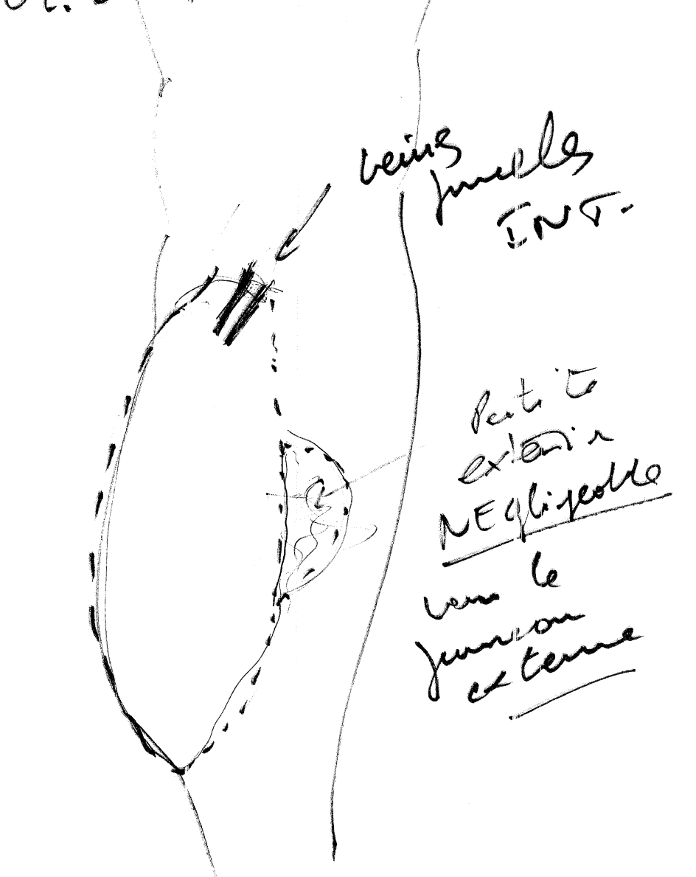
VM of gastrocnemius (caput mediale)

Slide 15
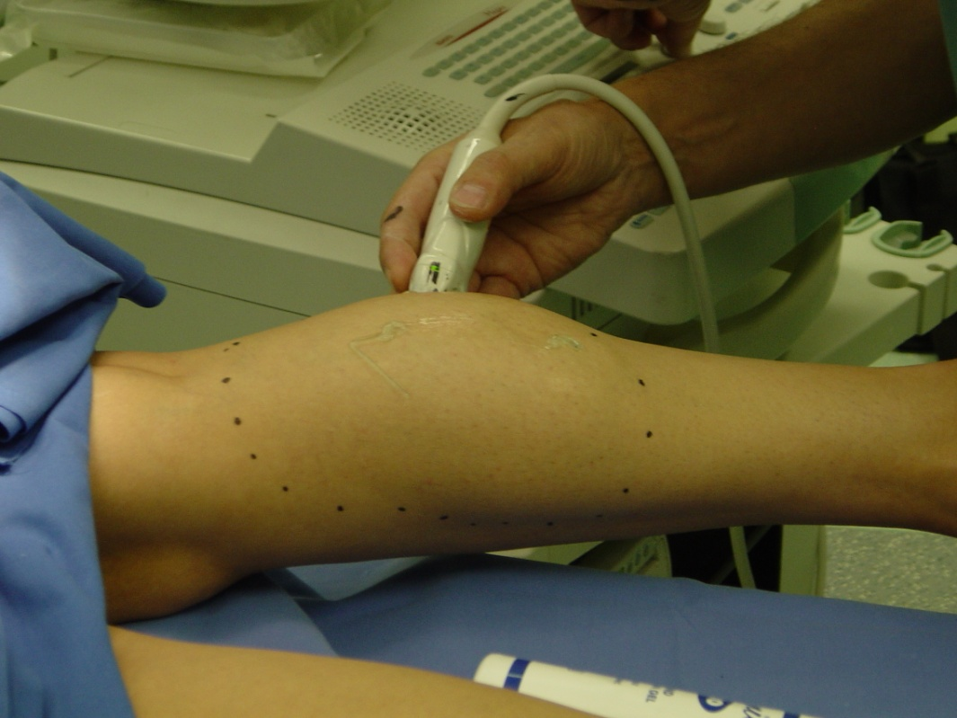
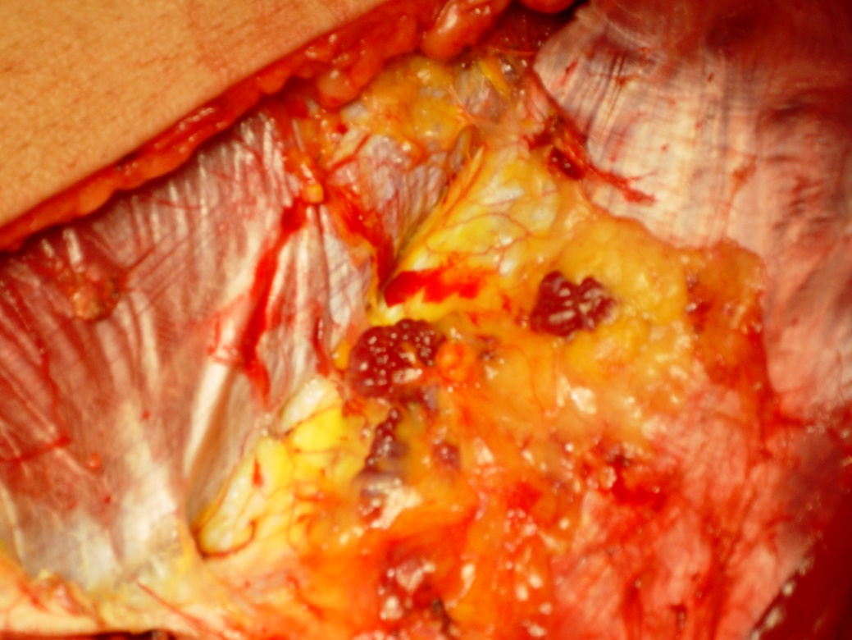
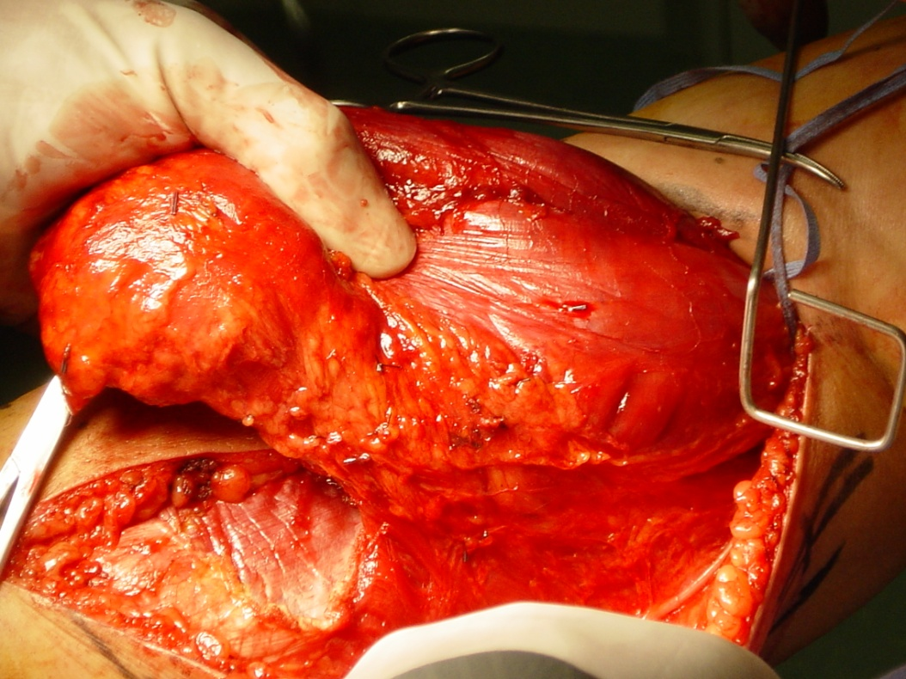
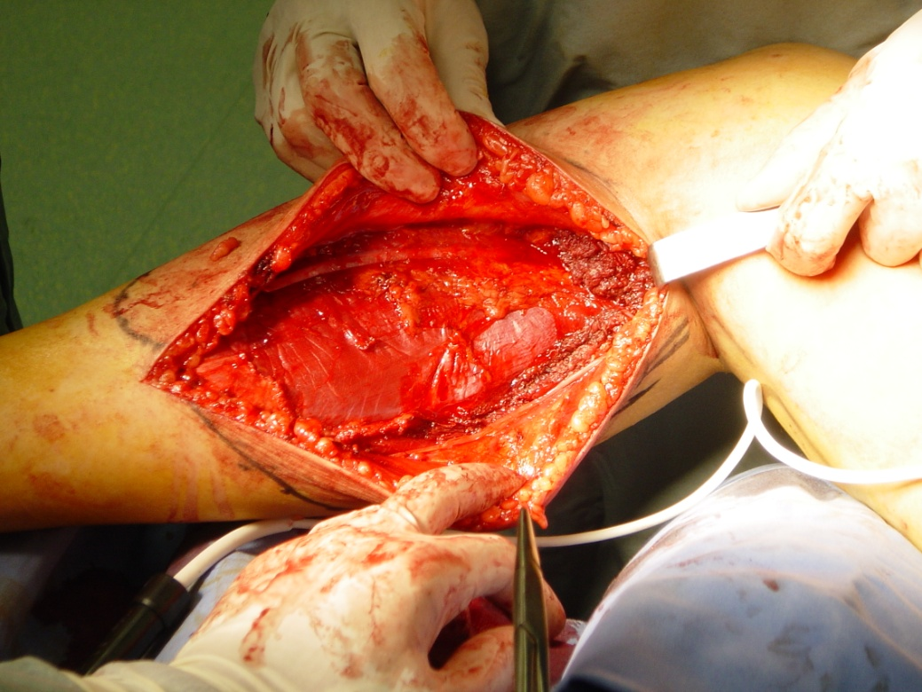

Slide 16
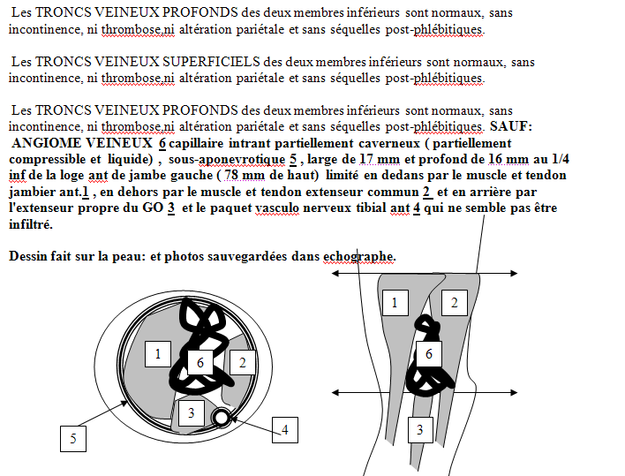
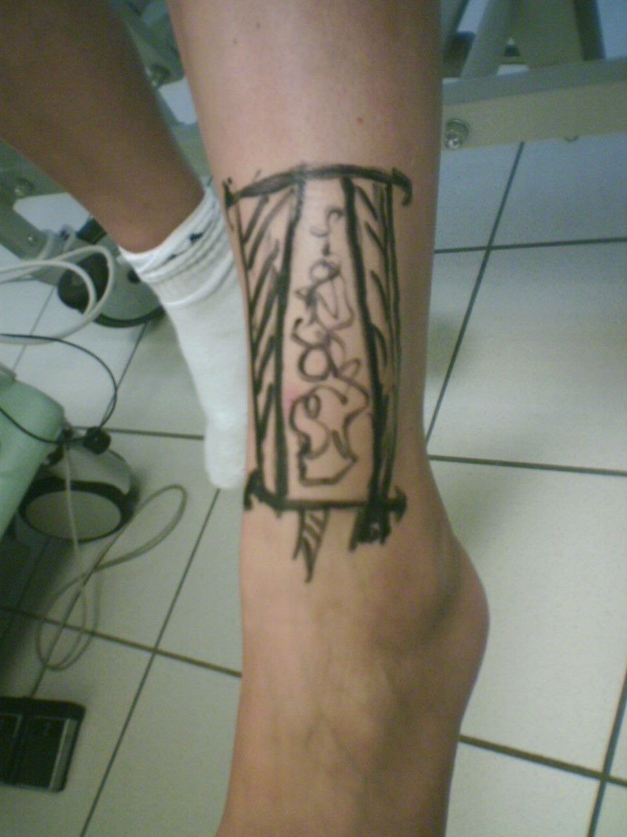
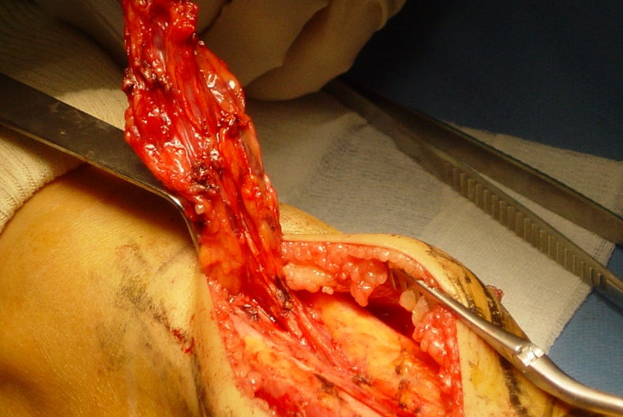
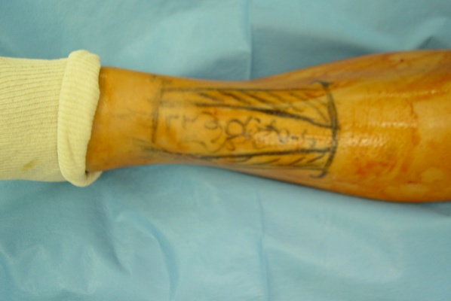

Slide 17
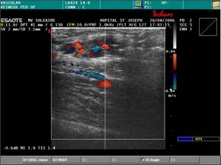
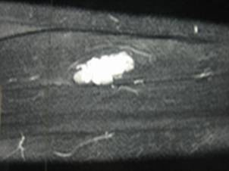
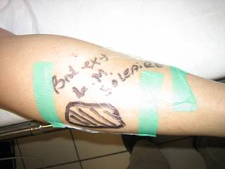
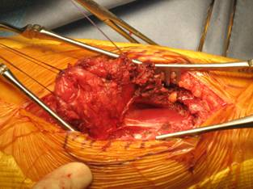
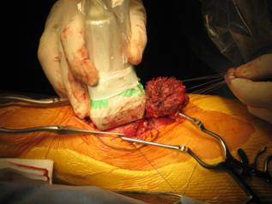
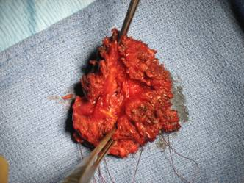
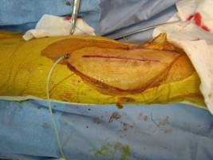
Duplex
MRI
Duplex marking

Slide 18
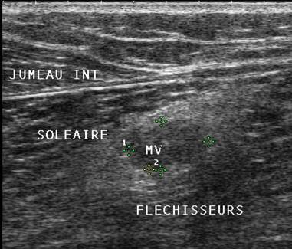
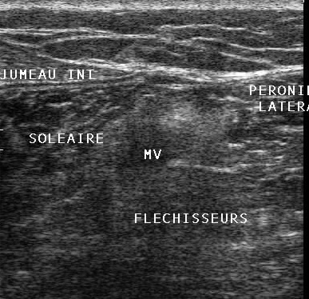
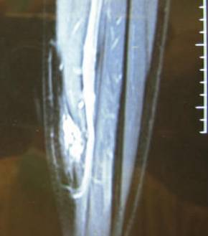
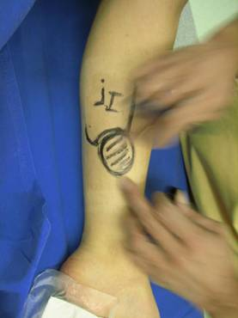
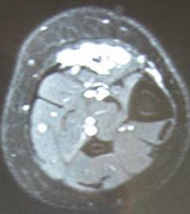
MALFORMATION VEINEUSE DU MUSCLE SOLEAIRE
Echodoppler
IRM
Marquage pré_opératoire

Slide 19
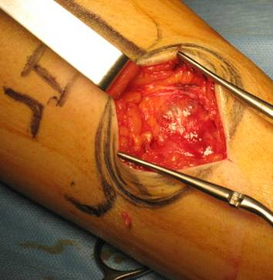
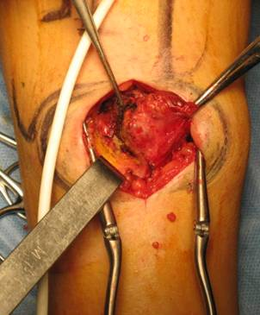
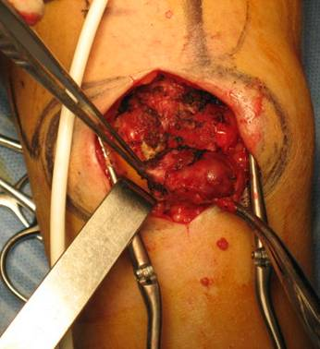
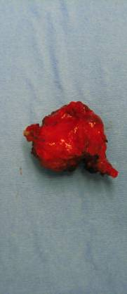
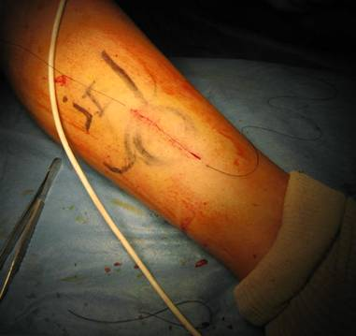
MALFORMATION VEINEUSE DU MUSCLE SOLEAIRE
EXERESE ECHOGUIDEE

Slide 20
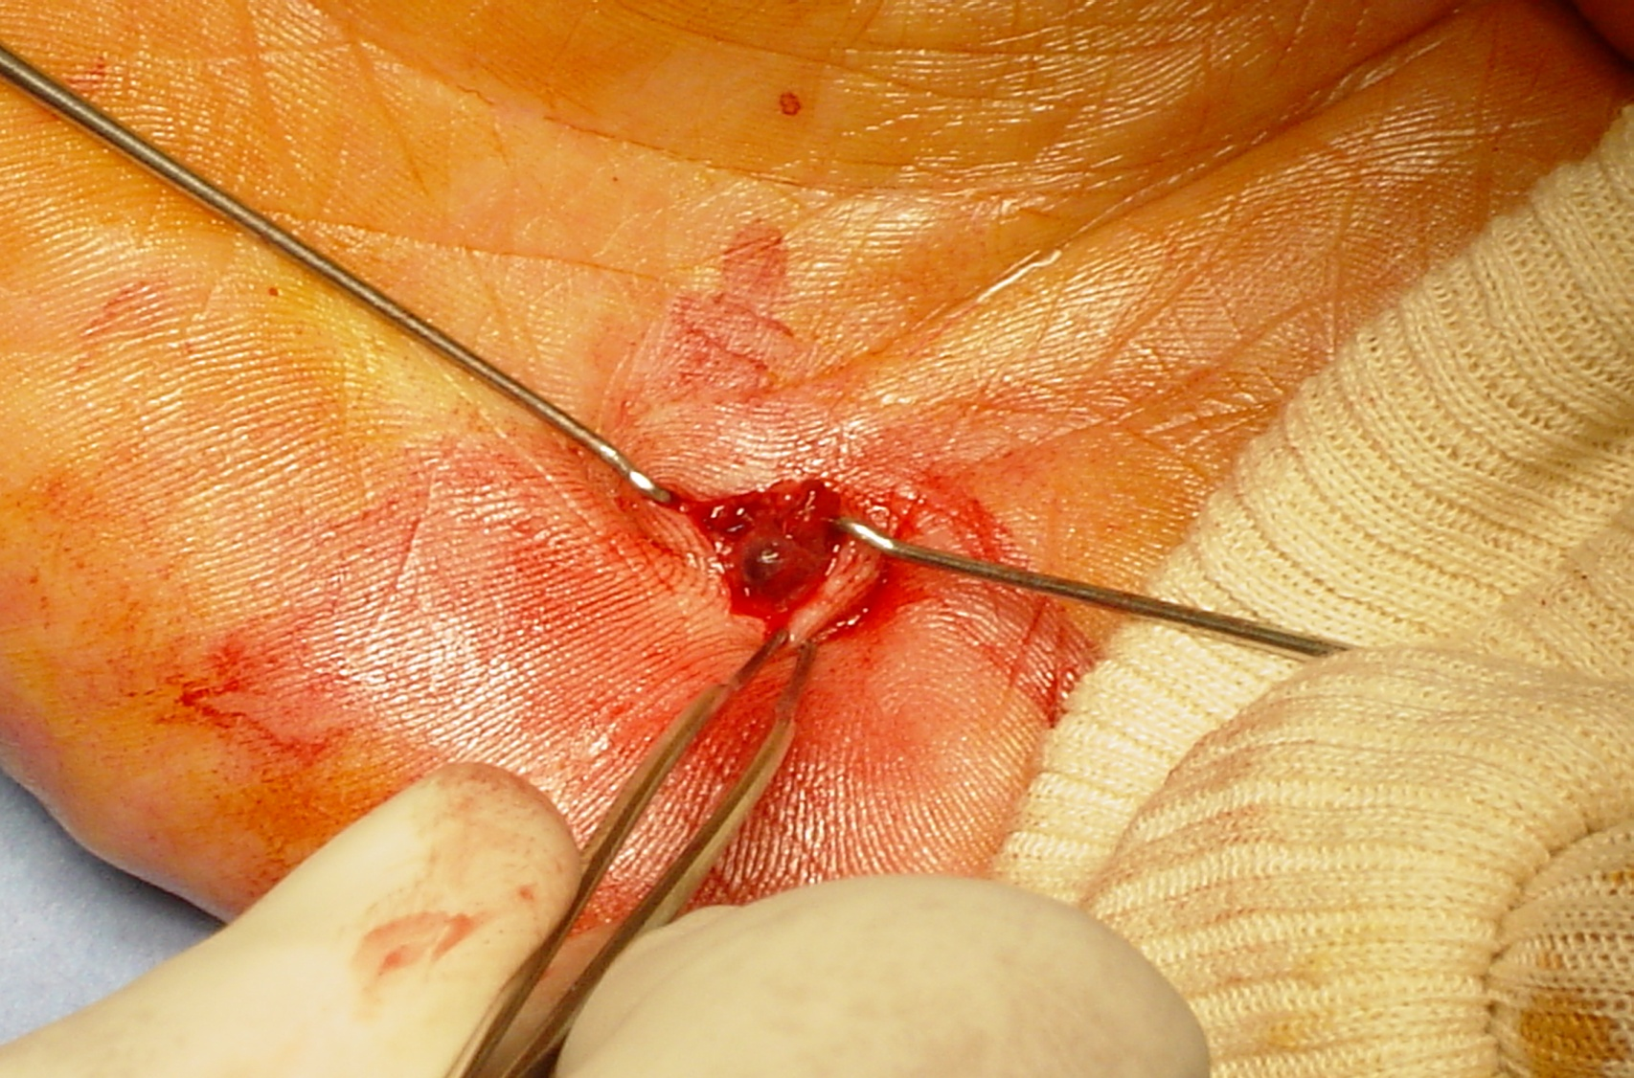
Multiple VM of upper limb

Slide 21
Simple device permitting easy hemostasis so reducing dramatically blood loss during the operations

Slide 22
ACURATE DEEP and SUPRFICIAL IDENTICAFITION of EVERY PATTERN and associated ones is MANDATORY in order to ELABORATE an appropriate STRATEGY and implement the most suitable TACTIQUE.
When STRATEGY is possible and its IMPLEMENTATION is feasible, the patients are relieved and some cross the freak borders to joins the community of “normal” esthetic concerns.
If not, we prefer therapy limited to compression….. in order to avoid “incomprehensible” complications due to a misunderstood situation.
The “Hemostator” would help to reduce the excesses of bleeding during the operations

