Slide 1

Varicose veins and venous malformations of the lower limbs
Duplex US assessment of the venous drainage and compensatory veins test
C. Laaengh Massoni, K. Betroune, C. Laurian, N. Paraskevas, A. Bisdorff, C.Franceschi
Consultation des angiomes Hopital Lariboisière Paris

Slide 2
Prospective study (2012 et 2013) of venous mallformations with varicose veins assessed by Duplex US : 56 patients (58 limbs).
Objective: identify the varicose veins necessary to the limb drainage in order to avoid their ablation witch could increase the obstructive syndrome.
Method: Probes: 14, 7 and 3 Mhz. Assessment of aplasia, hypoplasia and incompetence of the deep and superficial veins of the lower limbs, iliac and cava veins.
Compensatory Vein Test prosed by C. Franceschi.

Slide 3
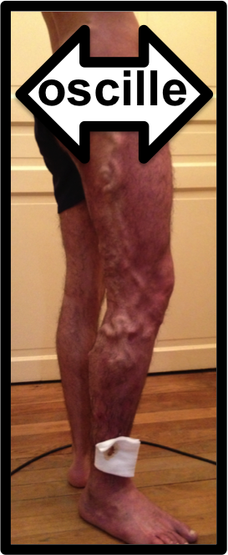
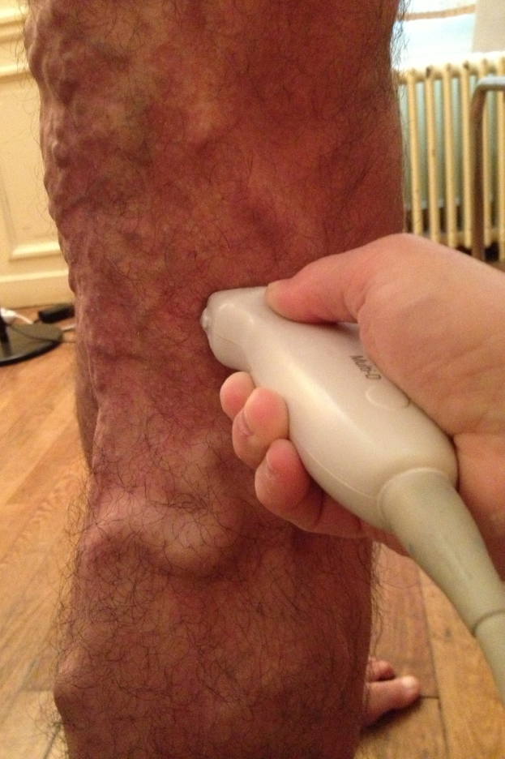
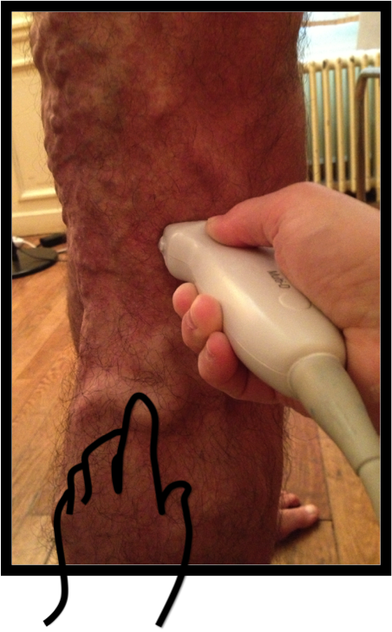
Compensatory Vein Test
While the patient rocks ( oscillates) , one hand compresses and occludes the varicose vein with the US probe and the other hand assesses its tension (pression) just below.
Compensatory vein: Tension increases
Not compensatory vein: Tension decreases

Slide 4
Varices are compensatory in
35% of varices located in the marginal vein territory
37% of varices located in the saphena vein territory ( in absence of marginal vein)
Not compensatory varices
36 patients (37 limbs) (20 Female 16 Male) Age: 4-64 years Mean 29 years
Varicose territory:
Saphena (17) Marginal (14) Saphena+Marginal (6)
Deep veins:
32 limbs: ectasia, avalvulation, extra-truncular ( muscle, nerve and interfascial infitration )
1 Limb: posterior tibial and fibular hypoplasia ( Compensatory anterior tibial vein)
3 Normal deep veins
Compensatory varices
20patients (21limbs) Patients ( 9 Female 11 Male) Age: 8-55years Mean 27 years
Varicose territory:
Saphena (10) Marginal (3)
Saphena+Marginal (8)
Deep veins:
aplasia and agenesia
1 stage: 7limbs: leg veins (5) Popliteal vein (1) and Femoral Veins V (1) .
2 stages: 8 limbs : leg + Popliteal vein ( 3) Leg + femoral vein (3) popliteal+ femoral vein (2) .
3 stages: 6 limbs ; leg+popliteal+Femoral vein (4) Popliteal+femoral+iliac veins (1) Femoral+iliac+Cava veins (1).

Slide 5
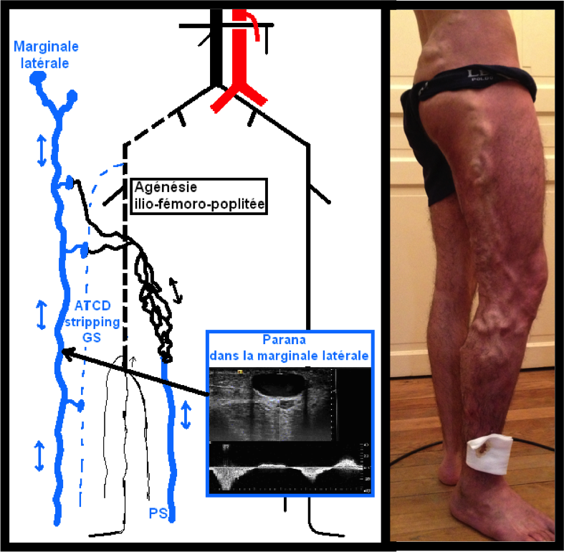
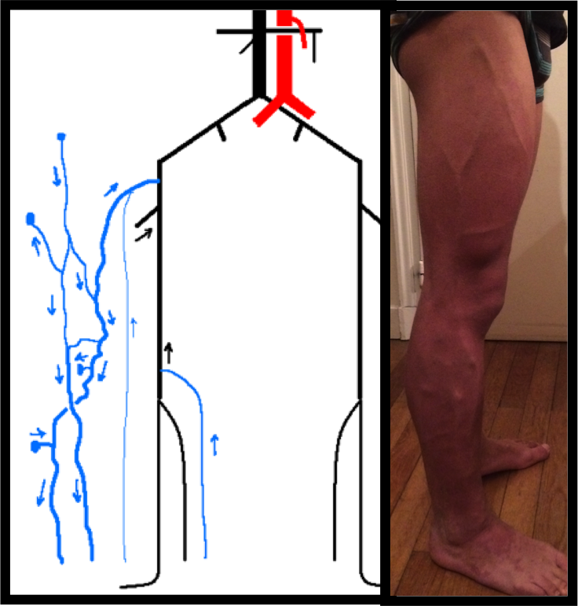
Example of Duplex Mapping
Not compensatory Varice
(No Open vicarious shunt)
Compensatory Varice
( Open vicarious shunt)
Blue = Superficial veins Black = Deep veins Dotted black = aplasia

Slide 6
In 35-37 % of Venous Malfornations including superficial varicose veins one ore more of them are compensatory .
Their ablation could increase the obstructive syndrome
An exhaustive topographic and hemodynamic mapping with compensatory vein test prevents theses mistakes.

