Slide 1
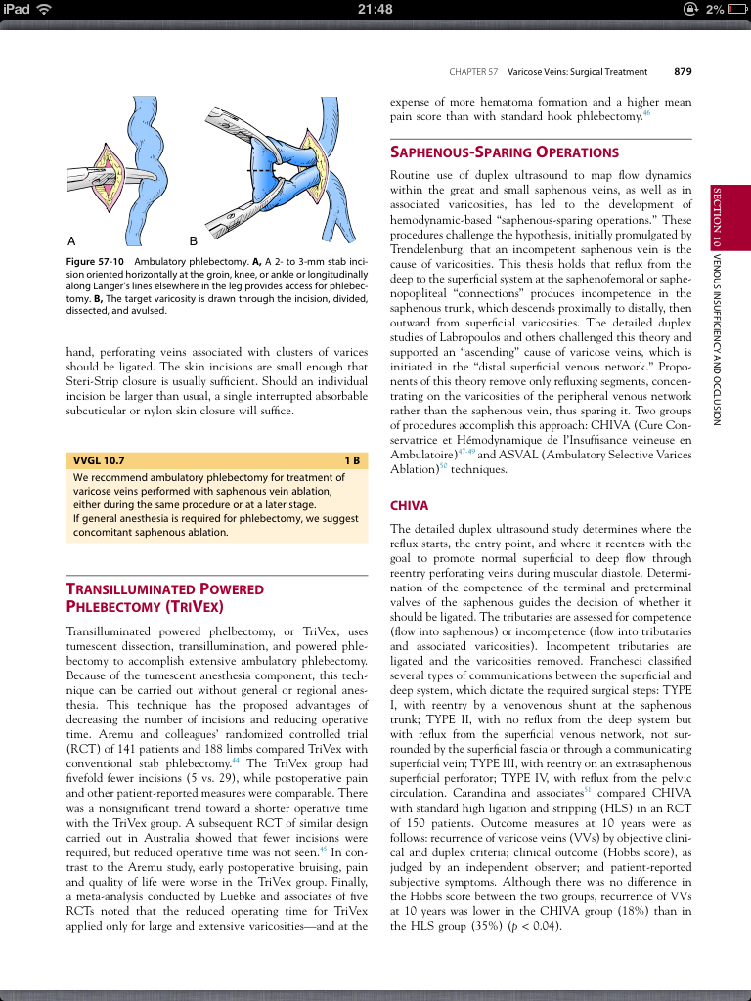
RUTHERFORD’S VASCULAR SURGERY AND ENDOVASCULAR
THERAPY, NINTH EDITION 2018
CHIVA has shown excellent results in lowering the recurrence of varicose veins; however, despite increasing facility with intraoperative DUS and minimally invasive techniques, this approach has not
found widespread adoption its pure form
Notes:
20018

