Slide 1
Salvare la SAPHENA
Perchè?

Slide 2
1- Salvare un materiale VITALE per futuro by-pass coronarico o arterioso
2- Ridure le recidive

Slide 3
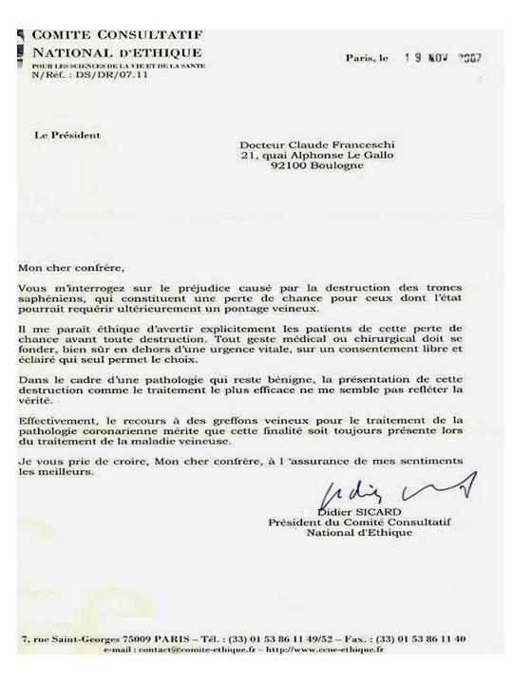
English summary: Great saphenous trunks destruction for varices needs the clear informed consent of the patient and cannot be presented to him as the most effective method

Slide 5
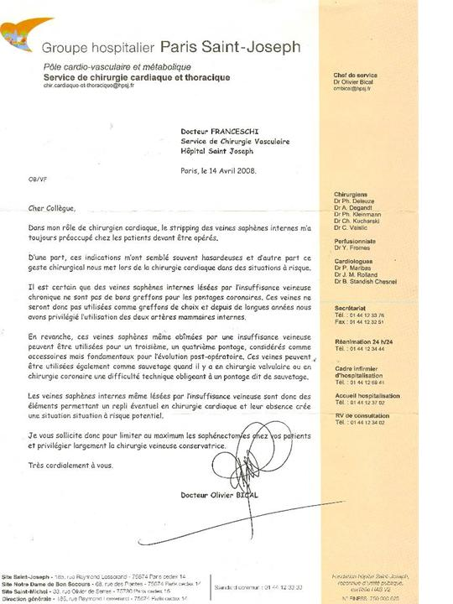

Slide 6
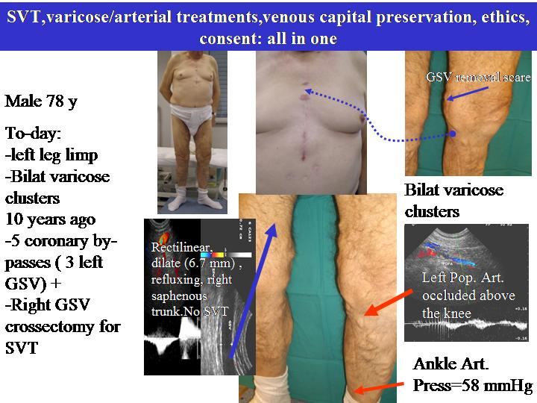

Slide 7
A- La Grande Safena e encora oggi il megliore materiale di by-pass sotto il ginocchio
1-Meta-analysis of infrapopliteal angioplasty for chronic critical limb ischemia
Marcello Romiti, MD,a Maximiano Albers, MD,a Francisco Cardoso Brochado-Neto, MD,aAnai Espinelli S. Durazzo, MD,b Carlos Alberto Bragança Pereira, PhD,c and Nelson De Luccia, MD,b ( J Vasc Surg 2008;47:975-81.)
2-Meta-analysis of popliteal-to-distal vein bypassgrafts for critical ischemia Maximiano Albers, MD, PhD,a Marcello Romiti, MD, PhD,a Francisco Cardoso Brochado-Neto, MD, PhD,a Nelson De Luccia, MD, PhD,a and Carlos Alberto Bragança Pereira, PhD,b Santos and São Paulo,São Paulo, Brazil ( J Vasc Surg 2006;43:498-503.)

Slide 8
RISPARMIARE LA SAFENA: VITALE!!!!
REVIEW 2014
OPTIMAL management of infrainguinal arterial occlusive disease
Authors: Pennywell DJ, Tan TW, Zhang WW
Full text: available on http://www.dovepress.com/article_18926.t34346121
Risk factors
Prevalence of 0.9% in people under age 50 and 23.2% in people over the age of 80.1
Autogenous vein is superior to synthetic graft as conduit for LEB,2,53–55 and the great saphenous vein (GSV) is superior to other autologous alternatives. An ideal vein conduit should be soft, compressible, at least 3 mm in diameter, and should not be calcified or sclerotic
Conclusion
Open infrainguinal GSV bypass remains the gold standard for revascularization in CLI, especially for patients at appropriate surgical risk and with suitable bypass conduit.

Slide 9
B- La Grande Safena prelevata « No touch » è uguale al’ateria Mamaria 1-No touch technique of saphenous vein harvesting: Is great graft patency rate provided?
Papakonstantinou NA1, Baikoussis NG2, Goudevenos J3, Papadopoulos G4, Apostolakis E5J Thorac Cardiovasc Surg. 2015 Oct;150(4):880-8. doi: 10.1016/j.jtcvs.2015.07.027. Epub 2015 Jul 15.
2-The no-touch saphenous vein for coronary artery bypass grafting maintains a patency, after 16 years, comparable to the left internal thoracic artery: A randomized trial.Samano N¹, Geijer H², Liden M², Fremes S³, Bodin L⁴, Souza D⁵. TRIAL REGISTRATION:ClinicalTrials.gov NCT01686100.Copyright © 2015 The American Association for Thoracic Surgery. Published by Elsevier Inc. All rights reserved.

Slide 10
The patency of sequential and individual vein coronary bypass
grafts: a systematic review.
Li, J; Liu, Y; Zheng, J; Bai, T; Liu, Y; Wang, X; Liu, N; Cheng, L; Chen, Y; Zhang, H
Ann. Thorac. Surg. 92, 12920 (2011)
Department of Cardiac Surgery, Beijing Anzhen Hospital, Capital Medical University, Beijing,
China.
Abstract CONCLUSIONS: The midterm and long-term patency of sequential vein grafts appears to be better than that of single vein grafts
and the patency of side-to-side anastomoses appears to be better than that of end-to-side anastomoses for sequential vein grafts.

Slide 11
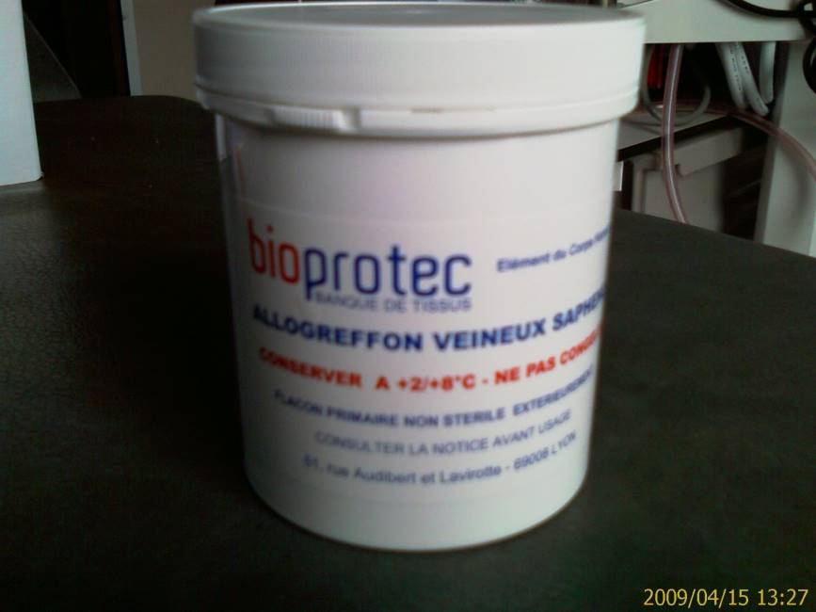
C- Le Safena omologa strippata per varici, è meno efficiente che l’autologa nei by-pass sotto il ginocchio.
1-Outcomes of cold-stored venous allograft for below-knee bypasses in patients with critical limb ischemia. Ziza V¹, Canaud L², Gandet T³, Molinari N⁴, Alonso W³, Chastan R³, Branchereau P³, Picard E³. J Vasc Surg. 2015 Oct;62(4):974-83. doi: 10.1016/j.jvs.2015.04.437. Epub 2015 Jul 2.
2-Since 1989, Bioprotec provides cold-stored GSV. ( 1561.40 Euros)

Slide 12

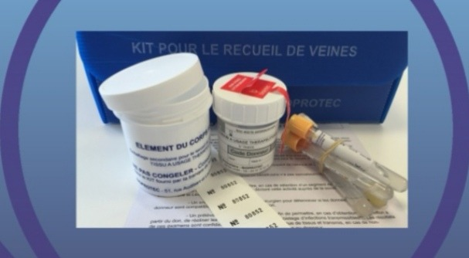
C- Homologus cold-stored stripped GSV from varicose patients, are less efficient than autologus as below-knee by-pass.
1-Outcomes of cold-stored venous allograft for below-knee bypasses in patients with critical limb ischemia. Ziza V¹, Canaud L², Gandet T³, Molinari N⁴, Alonso W³, Chastan R³, Branchereau P³, Picard E³. J Vasc Surg. 2015 Oct;62(4):974-83. doi: 10.1016/j.jvs.2015.04.437. Epub 2015 Jul 2.
2-Since 1989, Bioprotec provides cold-stored GSV. ( 1561.40 Euros)

Slide 13
Grande Safena dopo CHIVA: Istoarchitettura ottima per By-pass.
Thanks to the CHIVA strategy, may the histoarchitectureof great saphenous vein-sparing, make it suitable as graft for bypasses?
Roberto Delfrate Veins and Lymphatics 2019; volume 8:8227
In 21 cases the histoarchitecture of the vein was perfectly maintained with an intact
endothelial layer, a well-represented medium layer with three different smooth muscular
layers with only mild hypertrophy and hyperplasia, vessel in the medium layer to
feed the muscular cells, and finally an adventitial layer whit nerves and vessel with multiple endothelial cells surrounded by muscular smooth cells. The B-mode examination in all these veins showed a regular venous apparence

Slide 14
Come?

Slide 15
Le varici sono benigne
Possono
1- No essere tratate
2- Tratate con calze compressive
Altri tratamenti possono sempre possibili in caso di complicanza o di scelta estetica.
- Demolitivi
-Conservativi
SECONDO un Consenso Informato COMPLETO che deve comportare i dati della Medicina Basata sulle EVIDENZE come LA PERDITA o CONSERVAZIONE del patrimonio venoso ed i RESULTATI dei vari metodi, CONSERVATIVI e DEMOLITIVI.

Slide 16
INFORMAZIONE: Le terapie attuali
Le Varici sono una malatia benigna:
Terapie attuali:
1- Consigli igieno-dieteici e/o
2-Compressione elastica e/o
3- Procedure demolitive: Stripping e/o procedure endo-venose
4- Procedure conservative:
ASVAL: fattibile in casi limitati.
CHIVA fattibile in ogni casi
5-Le safene possono essere necessarie o salvare la vita in caso di futuro by-pass arterioso

Slide 17
INFORMAZIONE: cura CHIVA
La CHIVA,è una cura Conservativa ed emodinamica dell’insufficienza venosa in ambulatorio
E una chirurgia mini-invasiva sotto anestesia locale ed ambulatoriale
Superiore in tutti gli aspetti ai metodi demolitivi chirugichi come endovenosi seconde le EBM

Slide 18
INFORMAZIONE: cura CHIVA secondo le EBM
Superiore ai metodi demolitivi chirugichi come endovenosi in tutti gli aspetti
Dolore, Estetica, Recidive, Costo, safena conservata,
MA
Richiede una conoscenza approfondita dei nuovi concetti dell’emodinamica venosa , dell’indigine Ecocolordoppler e delle tecniche operatorie

Slide 19
INFORMAZIONE: cura CHIVA ed EBM
CHIVA vs Stripping
4 RCT CHIVA vs STRIPPING 5 e 10 ans follow up
Conclusione: Meno recidive, meno complicazioni.
1 ]Carandina S, Mari C, De Palma M, Marcellino MG,Cisno C, Legnaro A, et al.Varicose Vein Stripping vsHaemodynamic Correction (CHIVA): a long term randomised trial. European Journal of Vascular and Endovascular Surgery 2008;35(2):230–7 : Follow up 10 ans
[2] Parés JO, Juan J, Tellez R, Mata A, Moreno C, Quer FX,et l.Varicose vein surgery: stripping versus the CHIVA Method: a randomized controlled trial. Annals of Surgery 2010;251(4):624–31: Follow up 5 ans
[3] Iborra-Ortega E, Barjau-Urrea E, Vila-Coll R, Ballon-Carazas H, Cairols-Castellote MA. Comparative study oftwo surgical techniques in the treatment of varicose veins of the lower extremities: results after five years of followup. Angiología 2006; 58(6):459–68. Follow up 5 ans
[4] CHIVA vs STRIPPING . Follow up 10 ans. Publication en cours 2017 PUBBLICAZZIONE 2017

Slide 20
INFORMAZIONE: cura CHIVA ed EBM
CHIVA vs Stripping
1 COCHRANE REVIEW
Bellmunt-Montoya S, Escribano JM, Dilme J, Martinez-Zapata MJ. CHIVA method for the treatment of chronic venous insufficiency. Cochrane Database of Systematic Reviews 2012 , Issue 2 . Art. No.: CD009648. DOI:10.1002/14651858.CD009648 .
Conclusione: Meno recidive, meno complicazioni.
AUCUNE ETUDE PUBLIEE DEFAVORABLE A CHIVA
Malgré les affirmations non référencées des opposants à CHIVA qui allègent des récidives importantes.

Slide 21
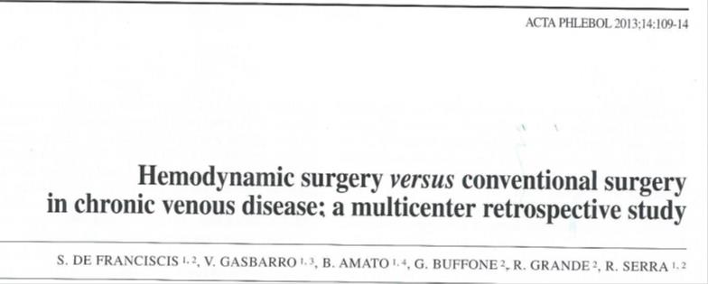
INFORMAZIONE: cura CHIVA ed EBM
CHIVA vs Stripping

Slide 22
CHIVA vs Stripping
CHIVA : A prospective study of a vein sparing technique for the
management of varicose vein disease
Marta Zmudzinski, BSc a, Pierre Malo, MD, FCSP b, Christine Hall, MD, FRCPC a, b,
Allen Hayashi, MD, FRCSC a, b, *a University of British Columbia, Faculty of Medicine,
The American Journal of Surgery 213 (2017) 967e969
Victoria, BC, Canada
Conclusion: Our results indicate that CHIVA appears to offer a promising alternative for the treatment of VVD

Slide 23
INFORMAZIONE: cura CHIVA ed EBM
CHIVA vs LASER
.
Chan, C.-Y.a , Chen, T.-C.b , Hsieh, Y.-K.a , Huang, J.-H.c
Retrospective comparison of clinical outcomes between endovenous laser and saphenous vein-sparing surgery for treatment of varicose veins (2011) World Journal of Surgery, 35 (7), pp. 1679-1686.
Conclusion: CHIVA: Less post operation pains , less residual varices.

Slide 24
INFORMAZIONE: cura CHIVA ed EBM
.
CHIVA vs LASER and Stripping
Hemodynamic classification and CHIVA treatment of varicose veins in lower extremities (VVLE).
. Hua Wang1, Qianyi Chen1, Zhewei Fei1, Endong Zheng2, Zhanghui Yang2, Xiaowang Huang2 Int J Clin Exp Med 2016;9(2):2465-2471 www.ijcem.com /ISSN:1940-5901/IJCEM0016552.
1Department of Vascular Surgery, Xinhua Hospital Affiliated to Shanghai
Conclusion: CHIVA treatment has significant better curative effect than traditional surgery and endovenous therapy in the treatment of varicose veins. CHIVA treatment induced less damage, quicker health recovery, high safety factor and lower complications. Thus, CHIVA treatment can be widely used in clinical restoration than general minimally invasive operations. DUNQUE , la cura CHIVA dovrebbe essere largamente proposta piutosto che gli altri metodi mini invasive.

Slide 25
Endo-venoso non è sinonimo di innocuo
International Angiology 2016 February;35(1):57-61
language: English
Morbidity and mortality after thermal venous ablations
Rafael D. MALGOR ¹, Antonios P. GASPARIS ², Nicos LABROPOULOS ² ✉
¹ Division of Vascular Surgery, The University of Oklahoma, Tulsa, OK, USA; ² Division of Vascular Surgery, Stony Brook University Medical Center, Stony Brook, NY, USA
CONCLUSION: EVA has gained high acceptance worldwide but the risks tend to be overlooked. Despite a very low complication rate, mortality has been reported. The complications found in MAUDE represent only a fraction as the majority of the practitioners are not aware of this database. Further investigation by a large national registry is warranted to better define the real magnitude of EVA complications.

Slide 26
CHIVA vs COMPRESSION in ULCERS
Minimally invasive surgical management of primary venous ulcers vs. compression treatment: a randomized clinical trial.. Zamboni Pand al A. EJ V E S. 2003
Conclusione: Molto meno recidive conla cura CHIVA

Slide 27
INFORMAZIONE: cura CHIVA ed EBM
GUIDE LINES
CHIVA, ASVAL and related techniques - Concepts and evidence
Alun Davis. Article in Phlebology 30(2 suppl):42-45 · November 2015
. Conclusion: Classically, superficial venous insufficiency has been treated with the removal of the incompetent trunk, via open surgery or, increasingly, with endovenous interventions. Minimally invasive treatment modalities aiming to preserve the saphenous trunk, such as CHIVA and ASVAL, may also play an important role in the treatment of the patient with varicose vein

Slide 28
INFORMAZIONE: cura CHIVA ed EBM
GUIDE LINES
The care of patients with varicose veins and associated chronic venous diseases: Clinical practice guidelines of the Society for Vascular Surgery and the American Venous Forum. Peter Gloviczki, MD, and al. JVS 2011
Results with preservation of the saphenous vein. Results with CHIVA. Such techniques were better than compression in preventing ulcer recurrence188 and were at least equivalent to stripping of varicose veins.
CHIVA is a complex approach, and a high level of training and experience is needed to attain the results presented in this RCT.
It still requires considerable education of venous interventionists willing to learn this approach.

Slide 29
INFORMAZIONE: cura CHIVA ed EBM
GUIDE LINES
CHIVA Experts and Non Experts
Milone M, Salvatore G, Maietta P, Sosa Fernandez LM, Milone Recurrent varicose veins of the lower limbs after surgery. Role of surgical technique (stripping vs. CHIVA) and surgeon's experience.F. G Chir. 2011 Nov-Dec;32(11-12):460-3
CHIVA PERFORMED by experts is best than stripping , but less when performerd by non experts.

Slide 30
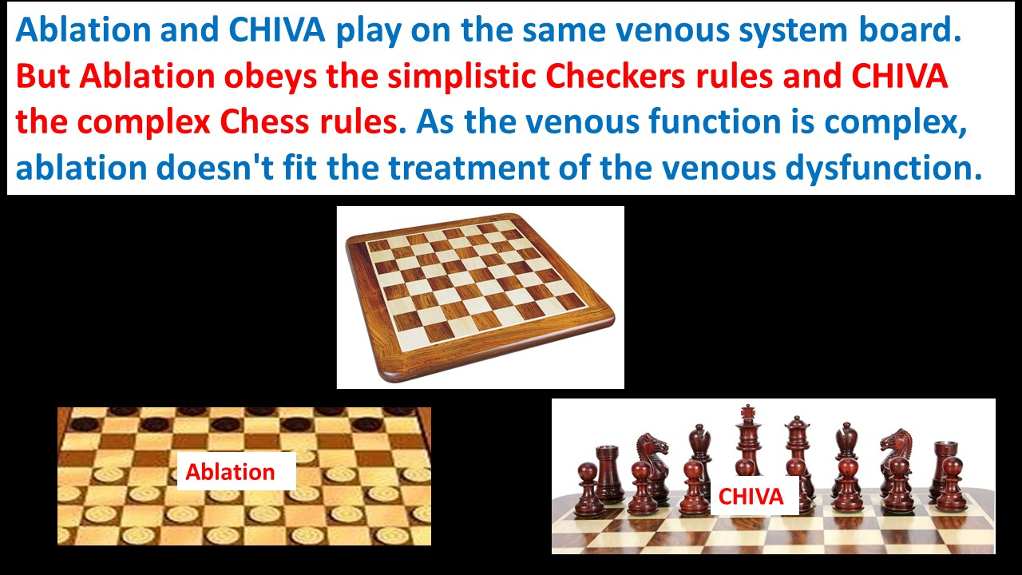
Il sistema venoso è una scacchiera « anatomica » con 5 tipi diversi di pedine diversa della damiera « anatomica » con 1 solo tipo di pedine. Fare CHIVA è giocare con le regole e le pedine degli scacchi. Trattare le vene con le regole simplicistiche del gioco di dama è più facile ma non addatato al sistema venoso. .

Slide 31

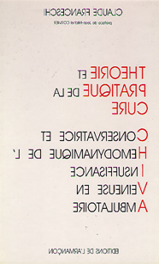
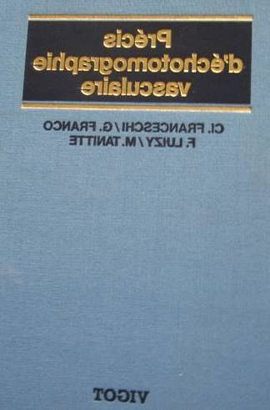
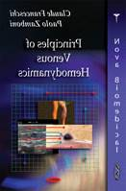
Affrontare le affermazioni:.
1- CHIVA is a complex approach, and a high level of training and experience is needed to attain the results presented in this RCT.
It still requires considerable education of venous interventionists willing to learn this approach (Glovici and al Guidelines)
2- CHIVA fatto da “esperti” meglio dello stripping
Stripping meglio della CHIVA fatta da “non esperti”( Milone M, Salvatore and al )
Non possono essere una scusa ma un incoraggiamento a apprendere per il meglio del paziente….e della professione.
BASTA STUDIARE!
Libri e Corsi da esperti

Slide 32
Italian, copies
Italian, English copies
Italian, Spanish copies

Slide 33
CONCLUSIONE 1
Secondo la EBM
Il by-pass safenico è sempre il gold standard della terapia delle arteriopatie.
La safena è conservabile con delle terapie non demolitive delle varici, da l’astenzione alla CHIVA e con risultati migliori delle demolitive.

Slide 34


CONCLUSIONE 2
Secondo l’ETICA e LEGGE
.
Il consenso informato deve riportare I dati EBM. Il consenso deve essere libero, consapevole e informato e può essere revocato in qualunque momento. In caso di intervento senza consenso, il medico (a prescindere dall'esito dell'intervento) può andare incontro a richieste di risarcimento del danno e, in determinati casi, anche a responsabilità penale.
GIURAMENTO di IPPOCRATE
LEGGE

Slide 36
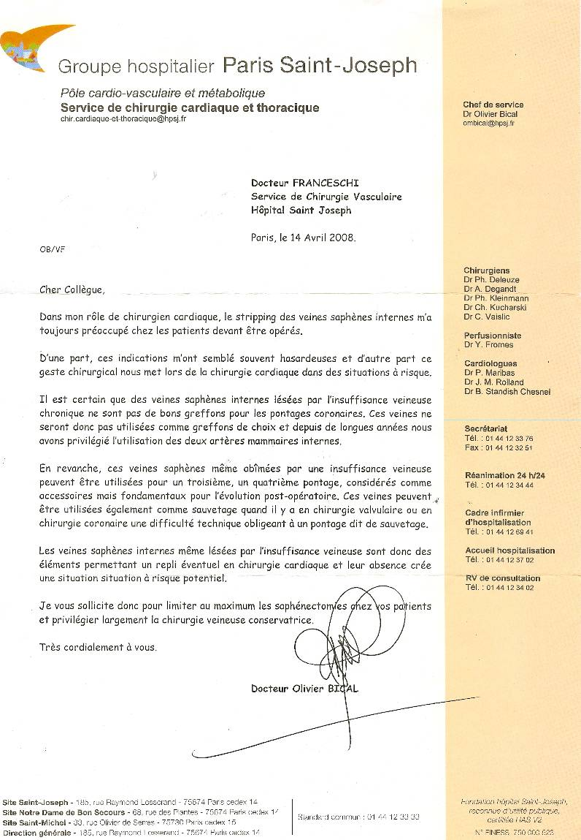
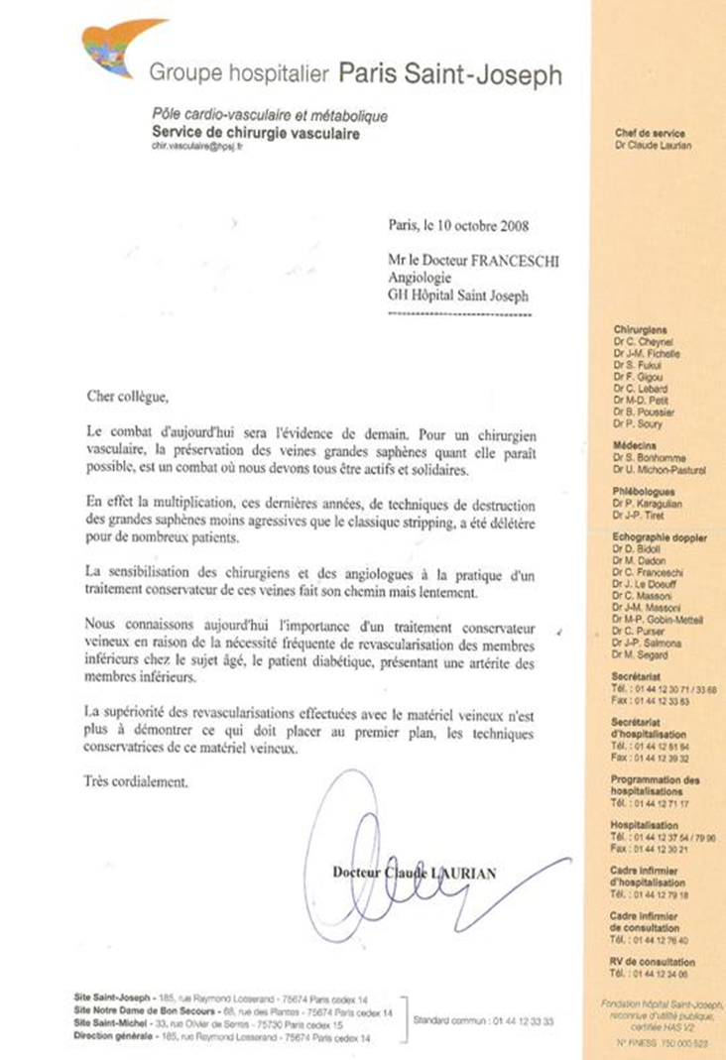

Slide 37
CONCLUSIONE 3
BUONA NOTIZIA
La cura CHIVA e fattibile da chi s’impegna ad imparare e progredire nella sua professione.
Noi, specialisti di malattie vascolari, possiamo ormai curarci della schizofrenia che ci fà sorridere quando distruggiamo una safena poi piangere quando ci mancara per un by-pass periferico o coronare.

Slide 38
Guo et al. Medicine (2019) 98:7
Long-term efficacy of different procedures for treatment of varicose veins
A network meta-analysis:
Liqin Guo, MDa, Rong Huang, MDa, Dunyong Zhao, MDb, Guilian Xu, MDa, Hui Liu, MDc, Jian Yang, MDa,Tao Guo, MD, PhDd,∗
Conclusion: CHIVA seemed to have superior clinical benefits on long-term efficacy for treating varicose veins

Slide 39
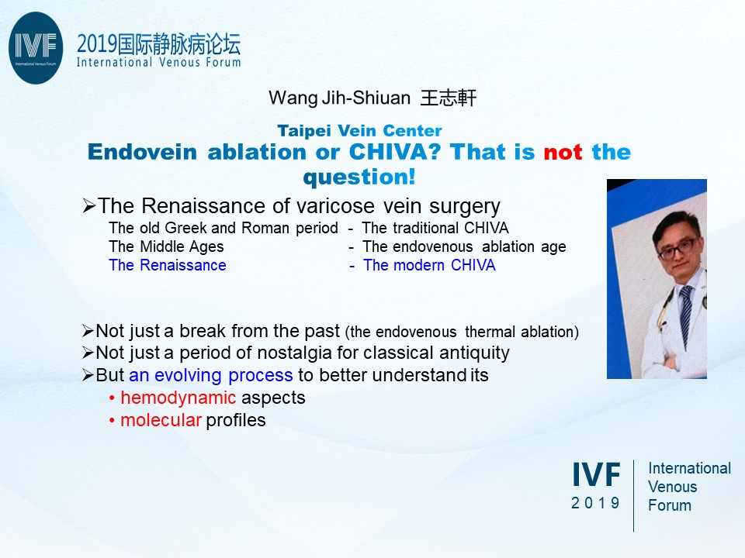

Slide 40
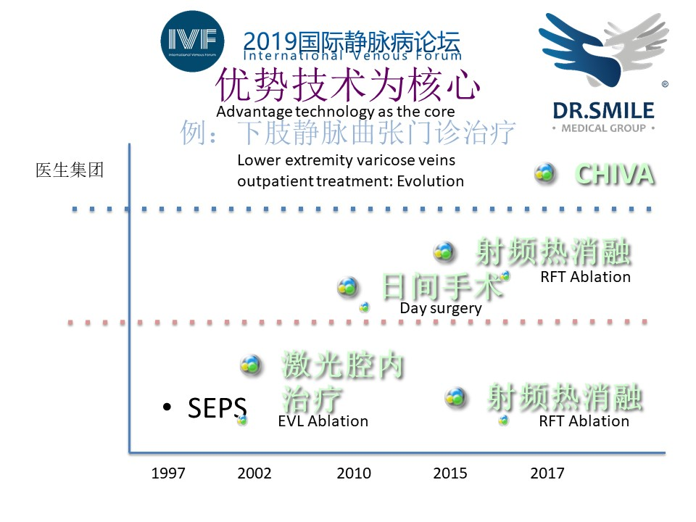

Slide 41
Grazie per l’attenzione

Slide 42
Int Angiol. 2016 Feb;35(1):57-61. Epub 2015 Feb 12.
Morbidity and mortality after thermal venous ablations.
Malgor RD¹, Gasparis AP, Labropoulos N.
CONCLUSION:
EVA has gained high acceptance worldwide but the risks tend to be overlooked. Despite a very low complication rate, mortality has been reported. The complications found in MAUDE represent only a fraction as the majority of the practitioners are not aware of this database. Further investigation by a large national registry is warranted to better define the real magnitude of EVA complications.

Slide 43
Int Angiol. 2016 Feb;35(1):57-61. Epub 2015 Feb 12.
Morbidity and mortality after thermal venous ablations.
Malgor RD¹, Gasparis AP, Labropoulos N.
BACKGROUND:
The treatment of saphenous vein reflux has evolved over the years with the development of thermal ablation techniques. This study was designed to analyze the complications of endovenous ablation (EVA) using data from an open, voluntary national database.
METHODS:
We analyzed 349 adverse events of endovenous laser (EVLT) and radiofrequency ablation (RFA) reported in the Manufacturer and User Facility Device Experience (MAUDE) database from January 2000 to June 2012. Outcomes of interest were pulmonary embolism (PE), deep vein thrombosis (DVT), death, and device failures (i.e. broken laser tip, broken sheath).
RESULTS:
Two hundred and three (58%) reports were patient-related injuries and the other 146 (42%) device-related failures. More complications were related to RFA compared to EVLT (216 vs. 133 procedures). Thirty (8%) non-fatal PEs and 123 (35%) DVTs were described. There were 7 (2%) periprocedural deaths, all from PE. Of the 135 device failure reports, 41(30%) required surgical intervention. Despite an increasing number of procedures, reported events peaked around 2008 and stabilized since then. Over the past 5 years, the incidence of adverse events reported for EVLT and RFA were 1 and 2 per 10,000 procedures. The complication ratio over the years was <1:2500 for DVT, <1:10,000 for PE, <1:50,000 for death.
CONCLUSION:
EVA has gained high acceptance worldwide but the risks tend to be overlooked. Despite a very low complication rate, mortality has been reported. The complications found in MAUDE represent only a fraction as the majority of the practitioners are not aware of this database. Further investigation by a large national registry is warranted to better define the real magnitude of EVA complications.

Slide 44
LA DESTRUCTION DE LA GRANDE SAPHENE EST EVITABLE ET N’EMPECHE PAS UN BON TRATEMENT DES VARICES selon la MEDECINE BASEE SUR DES PREUVES (EBM)
LA GRANDE SAPHENE EST TOUJOURS LE MEILLEUR MARERIEL DE PONTAGE
A- La Saphène Interne ou Grande saphène est le meilleur matériel de pontage des artériopathies periphériques notamment au-dessous du genou.
1-Meta-analysis of infrapopliteal angioplasty for chronic critical limb ischemia
Marcello Romiti, MD,a Maximiano Albers, MD,a Francisco Cardoso Brochado-Neto, MD,aAnai Espinelli S. Durazzo, MD,b Carlos Alberto Bragança Pereira, PhD,c and Nelson De Luccia, MD,b ( J Vasc Surg 2008;47:975-81.)
2-Meta-analysis of popliteal-to-distal vein bypassgrafts for critical ischemia Maximiano Albers, MD, PhD,a Marcello Romiti, MD, PhD,a Francisco Cardoso Brochado-Neto, MD, PhD,a Nelson De Luccia, MD, PhD,a and Carlos Alberto Bragança Pereira, PhD,b Santos and São Paulo,São Paulo, Brazil ( J Vasc Surg 2006;43:498-503.)
B- La Saphène Interne ou Grande saphène est équivalente l’artère Mammaire Interne pour les pontages aorto-coronariens.
1-No touch technique of saphenous vein harvesting: Is great graft patency rate provided?
Papakonstantinou NA1, Baikoussis NG2, Goudevenos J3, Papadopoulos G4, Apostolakis E5J Thorac Cardiovasc Surg. 2015 Oct;150(4):880-8. doi: 10.1016/j.jtcvs.2015.07.027. Epub 2015 Jul 15.
2-The no-touch saphenous vein for coronary artery bypass grafting maintains a patency, after 16 years, comparable to the left internal thoracic artery: A randomized trial.Samano N¹, Geijer H², Liden M², Fremes S³, Bodin L⁴, Souza D⁵. TRIAL REGISTRATION:ClinicalTrials.gov NCT01686100.Copyright © 2015 The American Association for Thoracic Surgery. Published by Elsevier Inc. All rights reserved.
C- Les allogreffes saphène prélevées lors du stripping puis congelées donnent de moins bons resultats que les greffes autologues.
1-Outcomes of cold-stored venous allograft for below-knee bypasses in patients with critical limb ischemia. Ziza V¹, Canaud L², Gandet T³, Molinari N⁴, Alonso W³, Chastan R³, Branchereau P³, Picard E³. J Vasc Surg. 2015 Oct;62(4):974-83. doi: 10.1016/j.jvs.2015.04.437. Epub 2015 Jul 2.
2-Fondée en 1989, Bioprotec a permis de fédérer sur le territoire français les activités de recueil de veines saphènes lors du stripping des varices. « Les Allogreffons veineux Bioprotec sont pris en charge en sus des GHS pour
les établissements privés et publics. L e tarif est de 1480.00 euros HT et de 1561.40 euros TTC
.
LA GRANDE SAPHENE PEUT ETRE PRESEVEE ET LA MALADIE VERIQUEUSE EST CORRECTEMENT TRAITEE.
A- Les méthodes conservatrices comme la cure CHIVA , préservent le capital veineux et donnent 2 fois moins de récidives que le stripping et moins d’effets secondaires.
1-Revue CHOCRANE. CHIVA method for the treatment of chronic venous insufficiency.Bellmunt-Montoya S¹, Escribano JM, Dilme J, Martinez-Zapata MJ. Cochrane Database Syst Rev. 2015 Jun 29;(6):CD009648. doi: 10.1002/14651858.CD009648.pub3.
2-CHIVA: hemodynamic concept, strategy and results. Claude FRANCESCHI, Massimo CAPPELLI, Stefano ERMINI, Sergio GIANESINI, Erika MENDOZA, Fausto PASSARIELLO, Paolo ZAMBON. International Angiology 2016 February;35(1):8-30
B- Autres études :
1-« La cure CHIVA donne moins de douleurs post opératoires et est plus efficace que le Laser end-veineux ». -Retrospective comparison of clinical outcomes between endovenous laser and saphenous vein-sparing surgery for treatment of varicose veins (2011) World Journal of Surgery, 35 (7), pp. 1679-1686 Chan, C.-Y.a , Chen, T.-C.b , Hsieh, Y.-K.a , Huang, J.-H.c
2-« La cure CHIVA donne de meilleurs résultats que la chirurgie traditionnelle et les traitements endo-veineux avec moins d’effets secondaires, une récupération plus courte, plus de sécurité et moins de complication s. C’est pourquoi la cure CHIVA doit être préférée aux autres méthodes ». Hua Wang1, Qianyi Chen1, Zhewei Fei1, Endong Zheng2, Zhanghui Yang2, Xiaowang Huang2 Int J Clin Exp Med 2016;9(2):2465-2471 www.ijcem.com /ISSN:1940-5901/IJCEM0016552
1Department of Vascular Surgery, Xinhua Hospital Affiliated to Shanghai Jiaotong University School of Medicine Chongming Branch, Chongming 202150, China; 2Department of General Surgery, Cangnan People’s Hospital, Wenzhou 325800, Zhejiang, China.
3-Le taux de récidives après les procédures endo-veineuses est équivalent à celui du stripping, donc supérieurs à la cure CHIVA.

Slide 45
Pourquoi la cure CHIVA
Conservatrice et
Hémodynamique de l’
Insuffisance
Veineuse en
Ambulatoire

Slide 46
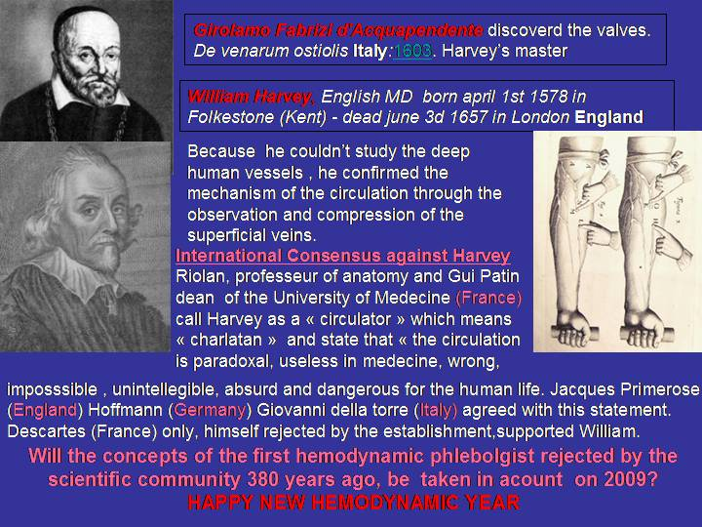




Harvey découvre que le sang circule et le démontre. Pourtant toutes les académies d’Europe le condamnent violemment . Seul Descartes le défend.

Slide 47
The patency of sequential and individual vein coronary bypass
grafts: a systematic review.
Li, J; Liu, Y; Zheng, J; Bai, T; Liu, Y; Wang, X; Liu, N; Cheng, L; Chen, Y; Zhang, H
Ann. Thorac. Surg. 92, 12920 (2011)
Department of Cardiac Surgery, Beijing Anzhen Hospital, Capital Medical University, Beijing,
China.
Abstract CONCLUSIONS: The midterm
and long-term patency of sequential vein grafts appears to be better than that of single vein grafts
and the patency of side-to-side anastomoses appears to be better than that of end-to-side anastomoses for sequential vein grafts.

Slide 50


Slide 51
COMMENT APPRENDRE et PRATIQUER LA CHIVA
CHIVA: Hemodynamic concept, strategy and results
Article in International angiology: a journal of the International Union of Angiology 35(1) · June 2015
https://www.researchgate.net/publication/277778981_CHIVA_Hemodynamic_concept_strategy_and_results?ev=prf_pub
Une connaissance théorique de la physiopathologie hemodynamique veineuse ( qui n’a pas été enseigné aux chirurgiens, angiologues et phlébologues français ) , une connaissance de la méthode échodoppler spécifique ainsi que les techniques chirurgicales sous AL simples et rapides mais particulières car différentes de la chirurgie classique, sont indispensables au succès de la cure CHIVA.
La courbe d’apprentissage demande l’aide de collègues expérimentés.

Slide 52
Fondée en 1989, Bioprotec a permis de fédérer sur le territoire français
les activités de recueil de veines saphènes lors du stripping des varices,
d’assurer la production d’allogreffons veineux et leur cession
aux établissements demandeurs.
La cession d’allogreffons veineux est en constante augmentation,
passant de 286 en 2001 à 490 en 2006. crits
Les Allogreffons veineux Bioprotec sont inscrits
à la LPPR sous le N° 3333073. Ils sont pris en charge
en sus des GHS pour les établissements privés et publics.
Le tarif est de 1480.00 euros HT et de 1561.40 euros TTC.

Slide 53
GUIDELINES
The care of patients with varicose veins and associated chronic venous diseases: Clinical practice guidelines of the Society for Vascular Surgery and the American Venous Forum. Peter Gloviczki, MD, and al. JVS 2011
Results with preservation of the saphenous vein. Results with CHIVA. Such techniques were better than compression in preventing ulcer recurrence188 and were at least equivalent to stripping of varicose veins.
CHIVA is a complex approach, and a high level of training and experience is needed to attain the results presented in this RCT.
It still requires considerable education of venous interventionists willing to learn this approach.
CHIVA da”esperti” e “non esperti”
Milone M, Salvatore G, Maietta P, Sosa Fernandez LM, Milone Recurrent varicose veins of the lower limbs after surgery. Role of surgical technique (stripping vs. CHIVA) and surgeon's experience.F. G Chir. 2011 Nov-Dec;32(11-12):460-3
CHIVA fatto da “esperti” meglio dello stripping
Stripping meglio della CHIVA fatta da “non esperti”

Slide 54
RISPARMIARE LA SAFENA: VITALE!!!!
REVIEW 2014
OPTIMAL management of infrainguinal arterial occlusive disease
Authors: Pennywell DJ, Tan TW, Zhang WW
Full text: available on http://www.dovepress.com/article_18926.t34346121
Risk factors
Prevalence of 0.9% in people under age 50 and 23.2% in people over the age of 80.1
Autogenous vein is superior to synthetic graft as conduit for LEB,2,53–55 and the great saphenous vein (GSV) is superior to other autologous alternatives. An ideal vein conduit should be soft, compressible, at least 3 mm in diameter, and should not be calcified or sclerotic
Conclusion
Open infrainguinal GSV bypass remains the gold standard for revascularization in CLI, especially for patients at appropriate surgical risk and with suitable bypass conduit.

Slide 56
Per meno rischio ed invasività: Un metodo particolare di legatura invece di Sezione
della Crosse della Grande Safena
 | No. | Follow up months | S-F reflux recurrences | Symptomatic recurrences | Re-do surgery
TSFL | 82 | 17.5 | 6% | 0 | 0
CROSSOTOMY | 60 | 28.3 | 3.3% | 0 | 0
TRIPLE LIGATION | 47 | 12 | 42% | 14.4% | 3
Table 1
Veins and Lym^hatics | TITLE
Vol 3, No 1 (2014) | Multiple ligation of the proximal greater saphenous vein in the CHIVA treatment of primary varicose veins | ABSTRACT PDF
Roberto Delfrate, Massimo Bricchi, Claude Franceschi, Matteo Goldon

Slide 57
In corso: (OB) Chiva : studio di una CHIVA modificata in termini di strategia e tàttica basata sulla chiusira della crosse della Grande Safena con il LASER
The Office Based (OB) Chiva Protocol
Fausto Passariello and al.

Slide 58
Tutti gli studi da > 20 anni confermano
-la validità dei nuovi concetti di fisiopatologia venosa che lhanno fata nascere la CHIVA
- la superiorità della CHIVA in termini di risultati clinici
- la giustificazione etica e professionale del risparmio della safena per possibile futuro by-pass salva arti e salva vita.

Slide 59
Pourquoi la cure CHIVA
Conservatrice et
Hémodynamique de l’
Insuffisance
Veineuse en
Ambulatoire

Slide 61
CHIVA’S STORY
-An hemodynamic pattern proposed in 1988.
-Proved 20 years later by Controlled Randomized Trials A GRADE

Slide 62
3 RCT CHIVA vs STRIPPING 5 e 10 anni follow up
Moins de recidives, moins de complications
1 ]Carandina S, Mari C, De Palma M, Marcellino MG,Cisno C, Legnaro A, et al.Varicose Vein Stripping vsHaemodynamic Correction (CHIVA): a long term randomised trial. European Journal of Vascular and Endovascular Surgery 2008;35(2):230–7
[2] Parés JO, Juan J, Tellez R, Mata A, Moreno C, Quer FX,et l.Varicose vein surgery: stripping versus the CHIVA Method: a randomized controlled trial. Annals of Surgery 2010;251(4):624–31
[3] Iborra-Ortega E, Barjau-Urrea E, Vila-Coll R, Ballon-Carazas H, Cairols-Castellote MA. Comparative study oftwo surgical techniques in the treatment of varicose veins of the lower extremities: results after five years of followup. Angiología 2006; 58(6):459–68.

Slide 63
5 years follow up : Recurrence rate: CHIVA vs stripping
Stripp. Clinical
Stripp. Duplex guided
St -MC
CHIVA
St -ED
TC
Duplex Guided Vs Clinical : NO difference
Duplex is USLESS for stripping
5ans. 550 Patients

Slide 64
1 COCHRANE REVIEW
Meno recidive, meno complicanze d
Bellmunt-Montoya S, Escribano JM, Dilme J, Martinez-Zapata MJ. CHIVA method for the treatment of chronic venous insufficiency. Cochrane Database of Systematic Reviews 2012 , Issue 2 . Art. No.: CD009648. DOI:10.1002/14651858.CD009648 .

Slide 65
1 nuovo RCT CHIVA vs STRIPPING a 10 anni follow up IN CORSO DI PUBBLICAZZIONE 2017
Meno recidive, meno complicanze

Slide 66
EVIDENCES | Level | Grade
meta-analyses de RCT | Ia | A | Strong
Au moins un RCT | Ib
Au moins une étude clinique bien conduite sans randomisation | IIa | B | Mid
Au moins un autre type d’étude clinique bien programmé et quasi expérimental | IIb
Au moins un autre type d’étude clinique bien programmée et non expérimentale | III
Opinions de comités d’experts ou expérience d’autorités reconnues | IV | C | Weak
CHIVA (4 RCT)
CHIVA (4 RCT)
+ Cochrane Library REVEW in preogress
Other venous technics at this level????
Stripping still Gold standard? CHIVA ?

Slide 68
CHIVA vs LASER
.
Chan, C.-Y.a , Chen, T.-C.b , Hsieh, Y.-K.a , Huang, J.-H.c
Retrospective comparison of clinical outcomes between endovenous laser and saphenous vein-sparing surgery for treatment of varicose veins (2011) World Journal of Surgery, 35 (7), pp. 1679-1686.
Conclusion: CHIVA: Less post operation pains , less residual varices.

Slide 69
CHIVA vs LASER et STRIPPNG
-« La cure CHIVA donne de meilleurs résultats que la chirurgie traditionnelle et les traitements endo-veineux avec moins d’effets secondaires, une récupération plus courte, plus de sécurité et moins de complication s. C’est pourquoi la cure CHIVA doit être préférée aux autres méthodes ». Conclusion: CHIVA treatment has significant better curative effect than traditional surgery and endovenous therapy in the treatment of varicose veins. CHIVA treatment induced less damage, quicker health recovery, high safety factor and lower complications. Thus, CHIVA treatment can be widely used in clinical restoration than general minimally invasive operations. Keywords: Varicose veins, hemodynamic classification, CHIVA
. Hua Wang1, Qianyi Chen1, Zhewei Fei1, Endong Zheng2, Zhanghui Yang2, Xiaowang Huang2 Int J Clin Exp Med 2016;9(2):2465-2471 www.ijcem.com /ISSN:1940-5901/IJCEM0016552. Hemodynamic classification and CHIVA treatment of varicose veins in lower extremities (VVLE).
1Department of Vascular Surgery, Xinhua Hospital Affiliated to Shanghai Jiaotong University School of Medicine Chongming Branch, Chongming 202150, China; 2Department of General Surgery, Cangnan People’s Hospital, Wenzhou 325800, Zhejiang, China

Slide 70
International Angiology 2016 February;35(1):57-61
language: English
Morbidity and mortality after thermal venous ablations
Rafael D. MALGOR ¹, Antonios P. GASPARIS ², Nicos LABROPOULOS ² ✉
¹ Division of Vascular Surgery, The University of Oklahoma, Tulsa, OK, USA; ² Division of Vascular Surgery, Stony Brook University Medical Center, Stony Brook, NY, USA
CONCLUSION: EVA has gained high acceptance worldwide but the risks tend to be overlooked. Despite a very low complication rate, mortality has been reported. The complications found in MAUDE represent only a fraction as the majority of the practitioners are not aware of this database. Further investigation by a large national registry is warranted to better define the real magnitude of EVA complications.

Slide 71
CHIVA, ASVAL and related techniques - Concepts and evidence
Alun Davis. Article in Phlebology 30(2 suppl):42-45 · November 2015
. Classically, superficial venous insufficiency has been treated with the removal of the incompetent trunk, via open surgery or, increasingly, with endovenous interventions. Minimally invasive treatment modalities aiming to preserve the saphenous trunk, such as CHIVA and ASVAL, may also play an important role in the treatment of the patient with varicose vein

Slide 72
CHIVA: Hemodynamic concept, strategy and results
Article in International angiology: a journal of the International Union of Angiology 35(1) · June 2015
https://www.researchgate.net/publication/277778981_CHIVA_Hemodynamic_concept_strategy_and_results?ev=prf_pub

Slide 73
Minimally Invasive Surgical management of primary venous Ulcer vs. Compression Treatment: a randomized Clinical Trial
P.Zamboni and all
Eur J vasc Endovasc Surg 00,1 6 (2003)

Slide 74
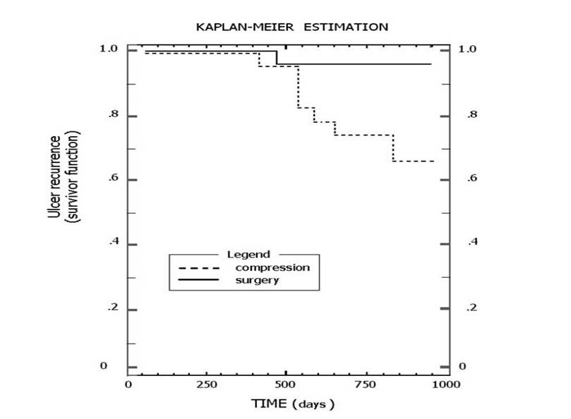
Minimally invasive surgical management of primary venous ulcers vs. compression treatment: a randomized clinical trial.. Zamboni Pand al A. EJ V E S. 2003
KAPLAN-MEIR ESTIMATION
1.0
1.0
CHIVA
0.8
0.8
0.6
compression
0.6
0.4
0.4
0.2
0.2
0
0
0
250
500
500
1000
750
TIME (days)
Notes:
Chap12 Fig 6 Ulcer recurrences a 3 years after CHIVA I or CHIVA I+II performed for venous ulcers, straight line, and by standard compression, interrupted line.

Slide 75
PRESERVER LA SAHENE : VITAL!!!!
REVIEW 2014
OPTIMAL management of infrainguinal arterial occlusive disease
Authors: Pennywell DJ, Tan TW, Zhang WW
Full text: available on http://www.dovepress.com/article_18926.t34346121
Risk factors
Prevalence of 0.9% in people under age 50 and 23.2% in people over the age of 80.1
Autogenous vein is superior to synthetic graft as conduit for LEB,2,53–55 and the great saphenous vein (GSV) is superior to other autologous alternatives. An ideal vein conduit should be soft, compressible, at least 3 mm in diameter, and should not be calcified or sclerotic
Conclusion
Open infrainguinal GSV bypass remains the gold standard for revascularization in CLI, especially for patients at appropriate surgical risk and with suitable bypass conduit.

Slide 76
Fondée en 1989, Bioprotec a permis de fédérer sur le territoire français
les activités de recueil de veines saphènes lors du stripping des varices,
d’assurer la production d’allogreffons veineux et leur cession
aux établissements demandeurs.
La cession d’allogreffons veineux est en constante augmentation,
passant de 286 en 2001 à 490 en 2006. crits
Les Allogreffons veineux Bioprotec sont inscrits
à la LPPR sous le N° 3333073. Ils sont pris en charge
en sus des GHS pour les établissements privés et publics.
Le tarif est de 1480.00 euros HT et de 1561.40 euros TTC.

Slide 78
GUIDELINES
The care of patients with varicose veins and associated chronic venous diseases: Clinical practice guidelines of the Society for Vascular Surgery and the American Venous Forum. Peter Gloviczki, MD, and al. JVS 2011
Results with preservation of the saphenous vein. Results with CHIVA. Such techniques were better than compression in preventing ulcer recurrence188 and were at least equivalent to stripping of varicose veins.
CHIVA is a complex approach, and a high level of training and experience is needed to attain the results presented in this RCT.
It still requires considerable education of venous interventionists willing to learn this approach.
CHIVA Experts et Non Experts
Milone M, Salvatore G, Maietta P, Sosa Fernandez LM, Milone Recurrent varicose veins of the lower limbs after surgery. Role of surgical technique (stripping vs. CHIVA) and surgeon's experience.F. G Chir. 2011 Nov-Dec;32(11-12):460-3
CHIVA PERFORMED by experts is best than stripping , but less when performerd by non experts.
Conclusion: LET’S LEARN OUR JOB!

Slide 79
Combien d'amputations sur les membres inférieurs en France ?
Le diabète, quel que soit son type, expose à des complications vasculaires et neurologiques pouvant affecter les membres inférieurs et conduire dans les cas les plus graves à l'amputation. A l'échelon mondial, le diabète est ainsi la cause principale des amputations aux membres inférieurs (AMI) puisqu'il est à l'origine de plus de 50 % d'entre elles. En France, les données épidémiologiques sont, à cet égard très insuffisantes. Ceci a justifié le lancement en 2001 d'un programme de recherche qui a notamment permis de collecter des informations sur les AMI pratiquées dans les établissements de soins, en particulier les centres hospitaliers, afin d'en préciser la fréquence et les causes.
L'étude a porté sur 17 551 admissions en milieu hospitalier (n=15 353) en rapport avec une amputation, pendant l'année 2003. Au sein de cette cohorte, 7 955 patients étaient atteints d'un diabète. La fréquence globale des amputations a été estimée à 378/100 000. Leur fréquence standardisée en fonction du sexe et de l'âge s'est avérée 12 fois plus élevée chez les diabétiques que chez les non diabétiques (158 vs. 13/100 000).
Des complications rénales, une AOMI et/ou une neuropathie ont été respectivement constatées chez 30 % et 95 % des diabétiques qui ont subi une AMI. Les causes traumatiques (à l'exception des contusions simples) et les maladies osseuses (à l'exclusion de l'ostéomyélite) ont été respectivement rapportées pour 3 % et 6 % des diabétiques amputés, de fait 5 à 13 fois plus fréquentes que chez les non diabétiques.
Cette étude est la première à préciser les caractéristiques épidémiologiques de l'AMI chez les diabétiques en France. Elle met en exergue l'impact majeur du diabète et le rôle pathogénique de l'AOMI, de la neuropathie des membres inférieurs mais aussi des complications rénales.
Fosse S et coll. : Incidence and characteristics of lower limb amputations in people with diabetes. Diabetic Medicine 2009; 26: 391-6.
378/100 000 soit 245700/65 000 000 de français

