Slide 1
a
?
a
a
b
=0
b
?
b
?
f
c
c
c
g
?
e
?
?
d
d
d
Shunt II
Shunt III
1
2
3

Slide 2
a
e
a
b
b
c
c
?
?
d
d
Shunt I + II
Shunt IV
5
4

Slide 3
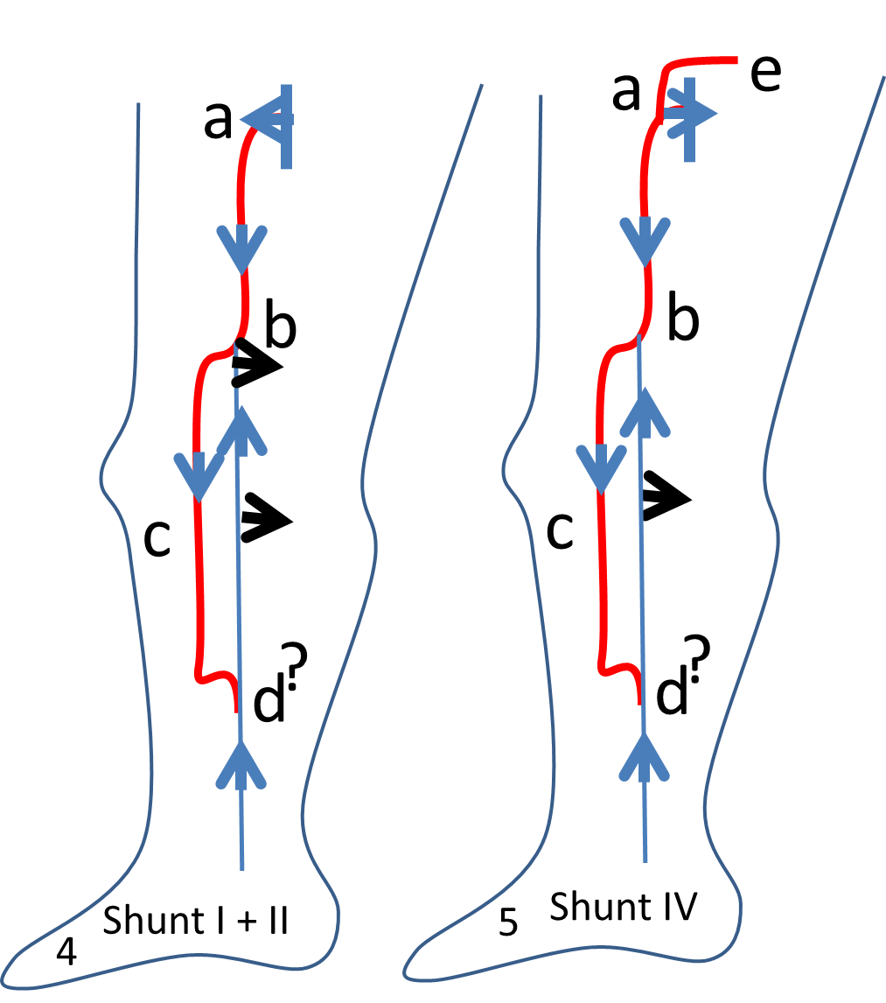
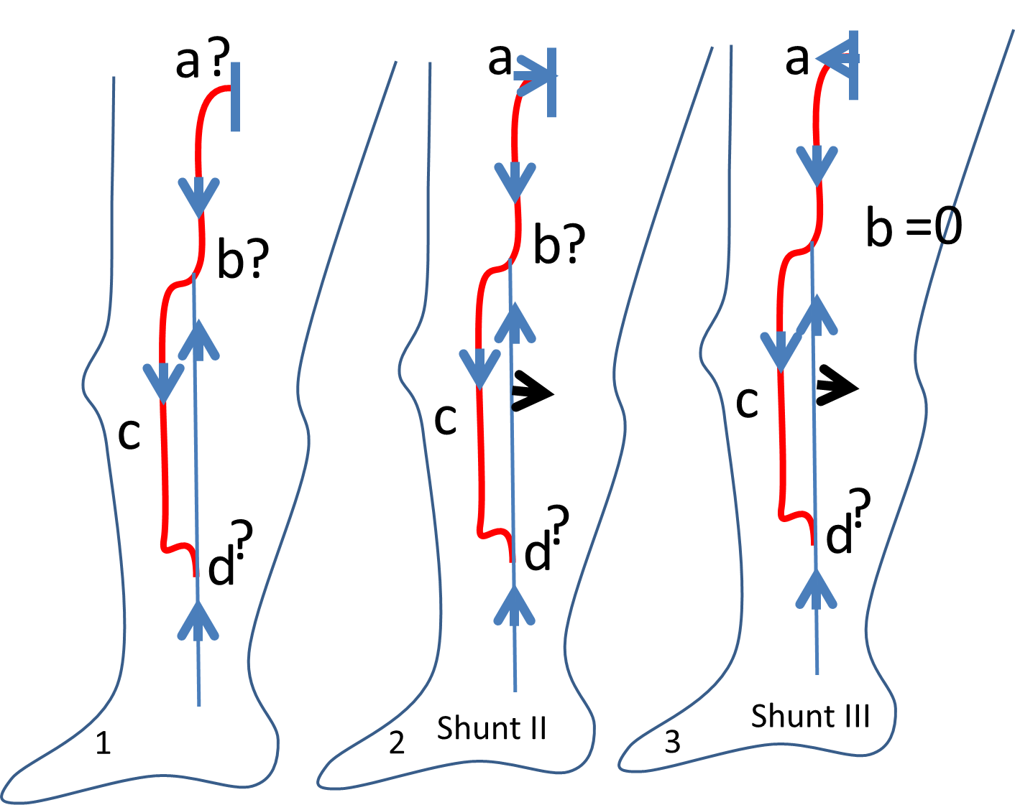
Diagnosis: (1) Reflux GSV mid-thigh then tributary. Complementary data are necessary to implement an hemodynamic and hemodynamic tretment (CHIVA)
SFJ Valsalva + or - ?
Intermediate perforator re-entry in b?
Terminal re-entry : d?

Slide 4
p
Diagnosis:
(2) Shunt II if terminal valve comptent ( Valsalva -) . Treatment: disconnection in b (3) Shunt III if terminal valve incompetent ( Valsalva +) and absence of perforator b. Treatment: CHIVA 2 steps disconnection b then a when secondary reflux( (80% of the cases) or a + b disconnection + devalvulation down to the perforator p
(4) Shunt I + II: terminal valve incompetent ( Valsalva +) and presence of intermediate perforator b. Treatment: a + b disconnection
(5) Shunt IV: Valsalva (-)terminal valve but (e) valsalva + (point I or O) : treatment: e + b disconnection

Slide 5
a
b
a
b
a
b
a
b
g
g
g
c
c
c
c
e
d
e
d
e
d
e
d
f
f
f
f
1
2
3
4
1:DEEP CLOSED SHUNT: a-b and c-e.
2: a-b CS disconnection at a ( refluxing superficial FV) leaves competent b ( collateral or deep FV) so fractionning the column at the thigh
3: c-e : CS disconnection at e healthy skin ( refluxing tibial vein ) leaves competent b ( deep calf competent collateral or fibular) so fractionning the column at the mid calf and relieving the perforator burden, easing the ulcer drainage towards the competent fibular vein through their anatomosis f.
4: staged calf and thigh disconnections.

