Slide 1
SHUNT CONCEPT
The veno-venous shunt is a venous flow derivation in the opposite direction to physiological.
They can be open or closed and be activated in systole and/ or diastole.

Slide 2
TYPE 3 SHUNT: CONCEPT
N 1
Escape point of the deep venous system to the saphenous vein (N1-N2).
There is an interposition of a saphenous’s collateral (N3 or N4) between this vein and the point of reentry.
N 2
N 3
N1
N 2
N 3
N 1

Slide 3
TYPE 3 SHUNT: INCIDENCE
N 1
The shunt type 3 comprises 62% of all venovenous shunts explored in our laboratory
74% of operated cases of varicose veins using CHIVA strategy in our service had a type 3 shunt
N 2
N 3
N1
N 2
N 3
N 1

Slide 4
TYPE 3 SHUNT
N1
N1
N2
N2
N4L
N3
N1
N2
N3
N4
N1
N2
N4L
N1

Slide 5
TYPE 3 SHUNT
N1
N1
N2
N2
N4L
N4T
N1
N 1
N 2
N 4T
N 2
N 1
N1
N2
N4L
N2
N3
N1

Slide 6
CHIVA STRATEGY
Fragmentation of the pressure column
N2
R2
N1
N4
N3
C. Franceschi 1988.

Slide 7
CHIVA STRATEGY
Fragmentation of the pressure column.
Interruption of veno-venous shunts.
N2
R2
N1
N4
N3
C. Franceschi 1988.

Slide 8
CHIVA STRATEGY
Fragmentation of the pressure column
Interruption of veno-venous shunts
Preservation of reentry perforators.
N2
R2
N1
N4
N3
C. Franceschi 1988.

Slide 9
CHIVA STRATEGY
Fragmentation of the pressure column
Interruption of the veno-venous shunts
Preservation of reentry perforators
Suppression of undrained N3 or N4.
N2
R2
N1
N4
N3
C. Franceschi 1988.

Slide 10
CHIVA: 1 CONCEPT
Applying the principles of the strategy at a single time CHIVA ensuring a saphenous vein drained

Slide 11
CHIVA 1: Elective treatment
IN TYPE 3 SHUNT: Cartography favourable
N1
N2
When the escape point is not sapheno-phemoral junction
N3

Slide 12
CHIVA 1: Elective treatment
IN TYPE 3 SHUNT: Cartography favourable
N1
N2
In cases of type 3 shunt with anterograde diastolic flow in in the Giacomini vein
N3

Slide 13
CHIVA 1: Elective treatment
IN TYPE 3 SHUNT: Cartography favourable
N1
N2
When a straight longitudinal N 4 R retrograde serves, from which emerges the visible N3.
N4
N3

Slide 14
CHIVA 1. Elective tratment
IN TYPE 3 SHUNT: Fauvorable cartography
N1
N2
When there is a perforator vein in the proximal part of the N3
N3

Slide 15
CHIVA 1: Elective tratment IN TYPE 3 SHUNT: Devalvulation
When there is a N4 L with an anterograde saphena > 2 mm. and re-entry point N2>N1, it’s possible the saphenous devalvulation, leaving a drained system
D

Slide 16
CHIVA 1: Elective tratment IN TYPE 3 SHUNT: Devalvulation
When there is a N4 L with an anterograde saphena > 2 mm. and re-entry point N2>N1, it’s possible the saphenous devalvulation, leaving a drained system
D

Slide 17
CHIVA 1: Elective tratment IN TYPE 3 SHUNT: Devalvulation
When there is a N4 L with an anterograde saphena > 2 mm. and re-entry point N2>N1, it’s possible the saphenous devalvulation, leaving a drained system
D

Slide 18
CHIVA 1 Sub-optimal treatment
IN TYPE 3 SHUNT
N1
Good symptomatology results
Poor cosmetic results
N2
N3

Slide 19
CHIVA 1 Sub-optimal treatment
IN TYPE 3 SHUNT
N1
INDICATED IN:
Safenous vein >1 cm.
N3 located at zone trophic disorders
Cases in which it is not intended aesthetic result.
N2
N3

Slide 20
CHIVA: 2 CONCEPT
Applying the principles of the strategy CHIVA in 2 possible time.
A first time he acted on the escape point N2-N3.
If we see the developent of a re-entry point N2>N3, on 2 time we will perfor the escape point N1>N2 interruption.

Slide 21
CHIVA 2
IN TYPE 3 SHUNT
N1
1 Time: Acting on the escape point N2-N3.
N2
-Disappearance of N3
-Drainage by saphenonous perforator
N3
N3
2 Time: Closed of the escape point N1-N2.

Slide 22
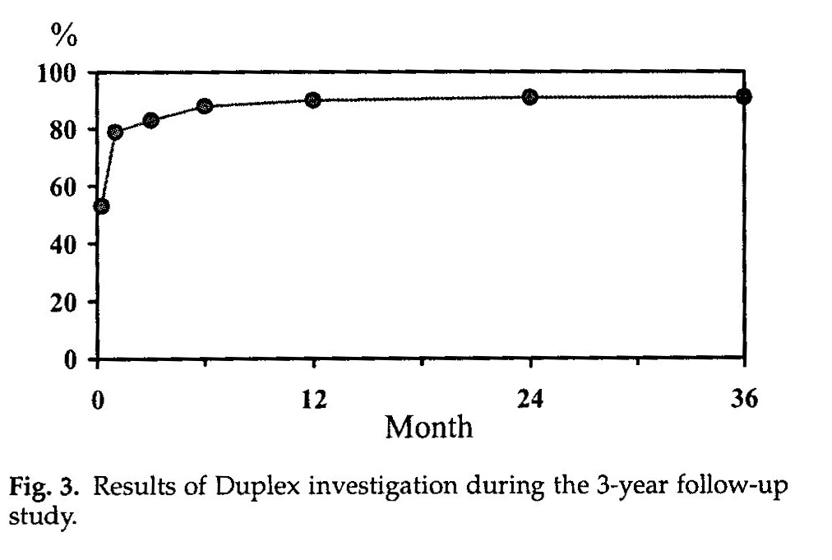
CHIVA 2: Evolution after 1 time Durability of anterograde flow
91% Reflux reapperance
Escribano and As. Eur J Vasc Endovasc Surg 25, 159-163(2003)

Slide 23
CHIVA 2: Evolution after 1 time Durability of anterograde flow
GSV < 6mm
N3 in thigh
Escribano and As. Eur J Vasc Endovasc Surg 25, 159-163(2003)

Slide 24
CHIVA 2: VALORATION
Is the optimal strategy in the type 3 shunts of GSV (in cases that do not apply CHIVA 1).
Precise follow up with serially Duplex ultrasound to determine the possible realization of the 2 nd surgical time.

Slide 25
CHIVA 2: VALORATION
Contraindicated if safenous vein > 9 mm.
Contraindicated if atrophic distal saphenous vein.
Contraindicated if follow up can not be done with Duplex ultrasound

Slide 26
CHIVA 1+2: CONCEPT
Applying the principles of the CHIVA strategy at a time, generating a non-drained system on the saphenous vein (type 3 shunt).

Slide 27
CHIVA 1+2
EN SHUNT TIPO 3
R 1
R 2
Interruption in a single time on escape point N1-N2 and N2-N3
R 3

Slide 28
CHIVA 1+2
Some people do not consider it CHIVA
No Consevador Hemodynamic Treatment 40% of thrombosis of saphenous vein

Slide 29
CHIVA 1+2 SAPHENOUS VEIN THROMBOSIS EVOLUTION
Asymptomatic en most cases.
Risk of being symptomatic if the diameter of the saphenous vein > 8.5 mm.
Recanalization at 6 months

Slide 30
CHIVA 1+2 DRAINAGE POST RECANALALIZATION
- 50% for saphenous vein perforator
- 50% for neo N3
. 50% dep no visibles N3
. 50% superficial visible N3 (Clinical recurrence)

Slide 31
CHIVA 1+2 Neo N3 treatment:
Interruption of neo N3 (Only half are clinically visibles).

Slide 32
CHIVA 1+2: Elective treatment
Type 3 shunt of saphenous vein
Hemodynamics of the SSV perforators makes that the drainage is activated early on that vein.
R 1
R 2
R 3

Slide 33
CHIVA 1+2 Sub-optimal treatment
In type 3 shunt
N1
INDICATED IN:
GSV <8.5 mm.
Indicated if duplex follow up is not posible.
Presents clinical recurrence 20 to 25%
N2
N3

Slide 34
CHIVA 1+2: Recourse treatment
Type 3 shunt of internal saphenous vein vith distal saphenous <3 mm.
R 1
Is not possible devalvulation or CHIVA 2
R 2
Represents 20%of type 3 shunts
R 3

Slide 35
TYPE 3 SHUNT: CHIVA ESTATEGY
Conclusion
In the case of type 3 shunt is necessary to customize the CHIVA strategy based on the clinical situation, mapping data and patient follow-up possibilities

