Slide 1
CHIVA – Technical Aspects and Evicence
Erika Mendoza
Wunstorf, Germany
Conflict of interest: None

Slide 2
Aims of CHIVA
Treatment of the venous insufficiency
Preservation of venous blood drainage in epifascial venous system
Cure Hemodynamique de
l’Insufficiance Veneuse en Ambulatoire
Developed and published by Claude Franceschi, 1988

Slide 3
Strategy
Preservation of saphenous trunks
Preservation of reentry-perforators
Interruption of reflux points
Interruption of pressure-column
Disconnection of shunts
Elimination of non draining, esthetically disgusting network

Slide 4
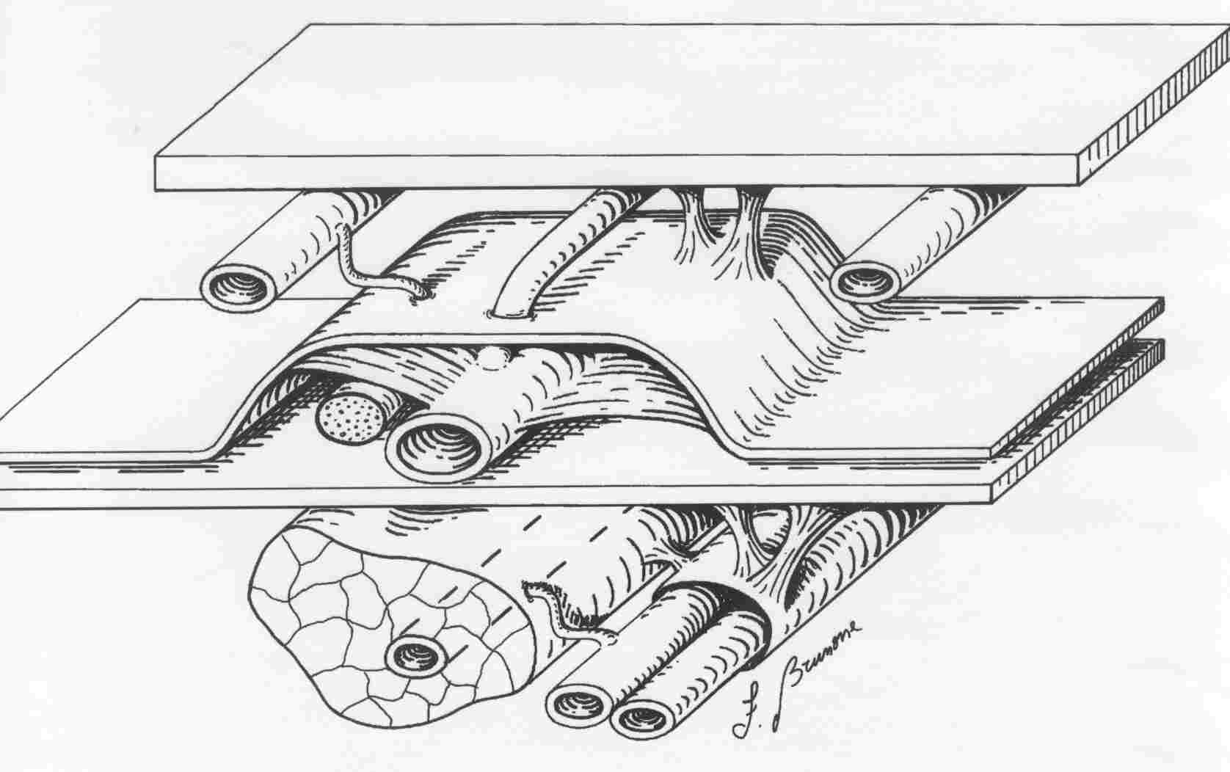
Venous networks (Franceschi 1988)
Dermis
Saphenous
fascia
Muscular
fascia
Saphenous
nerve
Caggiati, Circulation,1999
Caggiati, UIP Statementdocument, Anatomy, 2003

Slide 5
Venous networks
N3
Epifascial compartment
N2
Saphenous compartment
N1
Deep venous system
Caggiati, Circulation,1999
Caggiati, UIP Statementdocument, Anatomy, JVS 2003

Slide 6
Venous networks
Deep venous system
Saphenous trunks
Perforators
Tributaries

Slide 7
Venous networks
Deep venous system
Saphenous trunks
Perforators
Painted as dots
Tributaries

Slide 8
Shunts in venous insufficiency
A veno-venous shunt is the base of the venous insufficiency in superficial leg veins
It is defined by an escape point and a reentry point
To describe the technique of CHIVA we will base on the most common recirculations:
  Shunt Type 1
  Shunt Type 3

Slide 9
Shunt Type 1
Incompetent terminal and preterminal valve
Reflux in GSV
Reentry through a paratibial perforator
(Not necessary, but frequent: incompetent tributary visible on the leg).

Slide 10
Treatment in Shunt Type 1
Interruption of the saphenofemoral junction with ligation and disruption of the connection between GSV and deep venous system preserving the pelvic tributaries, if they are not refluxive

Slide 11
Treatment in Shunt Type 1
Interruption of the tributary “en niveau” of the GSV.
Mini-Phlebectomy of tributary is an optional choice

Slide 12
Treatment in Shunt Type 1
As a result the blood in the deep veins is obliged to leave the leg towards the heart and is no more able to reenter the recirculation.
The blood of healthy tributaries of GSV is drained through perforators

Slide 13
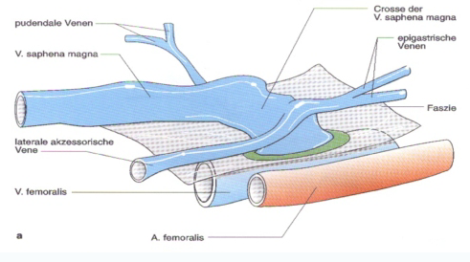
Treatment of the SFJ in CHIVA “1”
Pudendal veins
GSV
SFJ
Epigastric vv.
Fascia
AASV
Femoral vein
Femoral artery
Open Surgery

Slide 14
Treatment of the SFJ in CHIVA “1”
Pudendal veins
GSV
SFJ
Epigastric vv.
Fascia
AASV
Femoral vein
Femoral artery
Newer Options: Endoluminal treatment

Slide 15
Shunt Type 3
Incompetent terminal and preterminal valve
Reflux in GSV
No dilated reentry perforator on GSV
Reentry through a tributary

Slide 16
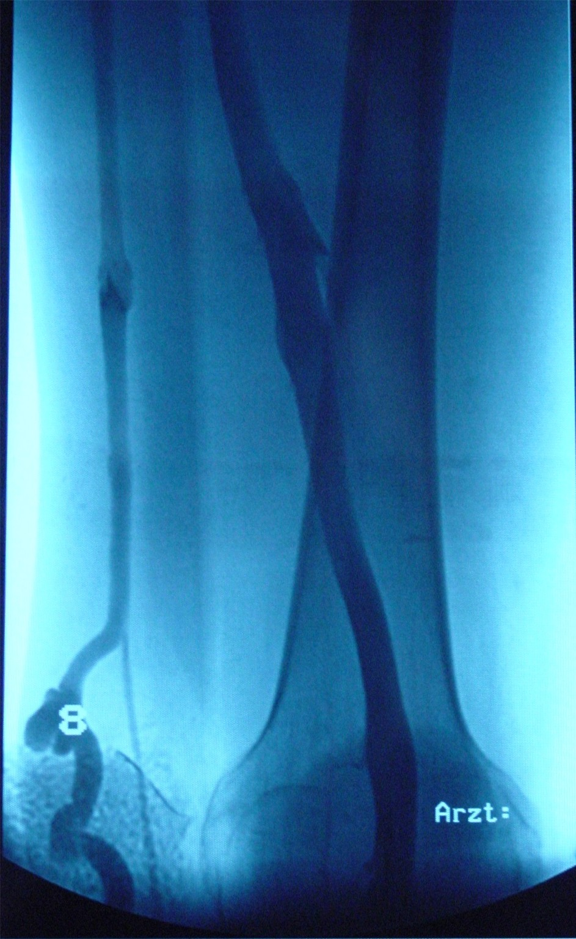
Shunt type 3
Femoral vein
refluxive GSV
Refluxive
tributary

Slide 17
Treatment in Shunt Type 3 CHIVA “2”
Disconnection of the tributary

Slide 18
Treatment in Shunt Type 3 CHIVA “2”
Disconnection of the tributary – and then:
Either competent GSV afterwards depending on:
  Diameter
  Distance between SFJ and point of disconnection

Slide 19
Treatment in Shunt Type 3 CHIVA “2”
Disconnection of the tributary and then:
Persistence of the Reflux with opening of a reentry perforator as second option
Then Performance of treatment of SFJ in a second step

Slide 20
Treatment in Shunt Type 3 in one step
Disconnection of the SFJ and tributary
Devalvulation down to the next draining perforator
Avoidance of two steps

Slide 21
CHIVA - Evidence
CHIVA has no sponsors, so all the trials are investigator initiated and investigator financed, excepting the Spanish group (Pares), financed by the Spanish health care System.
That is the reason, why there are not that big series as industry funded series with endoluminal devices, as an example.

Slide 22
CHIVA - Evidence
EVIDENCES | Level | Grade
meta-analyses of RCT | Ia | A | Strong
At least one RCT | Ib
At least one clinic trial properly conducted without randomisation. | IIa | B | Mid
At least any type of clinical trial properly planned and nearly experimental. | IIb
At least one well programmed not experimental clinical trial. | III
Expert opinion | IV | C | Weak
CHIVA (4 RCT) and 1 Review
CHIVA (4 RCT)

Slide 23
Cochrane Review
Bellmunt-Montoya S, Escribano JM, Dilme J, Martinez-Zapata MJ (2012)
CHIVA method for the treatment of chronic venous insufficiency.
Cochrane Database of Systematic Reviews 2012, Issue 2, Art. No.: CD009648 DOI: 10.1002/14651858.CD009648.

Slide 24
1- Varicose Vein Surgery Stripping versus the CHIVA method: a Randomized Controlled Trial Josep oriol Pares and al Annals of Vascular Surgery* Volume 251, Number 4, April 2010 [ISRCTN52861672]. (international standard randomised controlled trial number )www.controlled-trials.com
2- Minimally Invasive Surgical management of primary venous Ulcer vs. Compression Treatment: a randomized Clinical Trial
P.Zamboni and all
Eur J vasc Endovasc Surg 00,1 6 (2003)
3- Clinical and random study comparing two, surgical techniques for varicose vein treatment : immediate results
Iborra and all
Angiologia 2000:6, 253-258
4-Varicose Vein Stripping vs Haemodynamic Correction (CHIVA):
a Long Term Randomised Trial.
Carandina, C. and al.
Eur J Vasc Endovasc Surg 35 (2): 230 – 237 (2008)

Slide 25
Parés: 5 years follow up of 550 patient : Recurrence rate: CHIVA vs stripping
Stripp. Clinical
Stripp. Duplex guided
St -MC
CHIVA
St -ED
TC
Up to 18 months: NO difference CHIVA vs Stripping
Difference favorable to CHIVA appears and increases with time after 2 years
5ans. 550 Patients

Slide 26
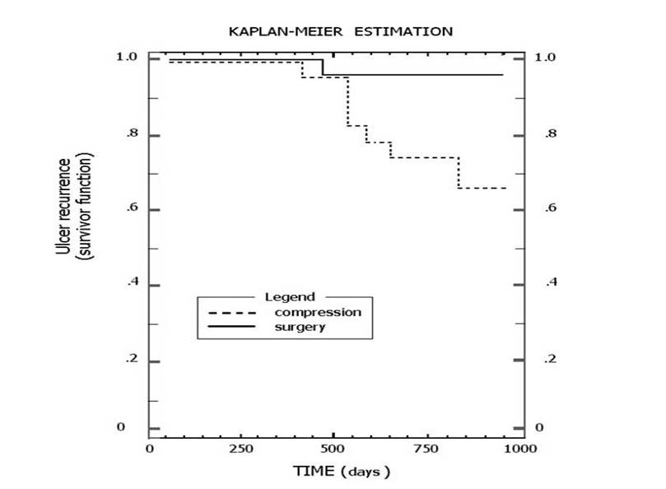
Zamboni: Ulcer healing CHIVA vs. Compression EJVES 2003
KAPLAN-MEIR ESTIMATION
1.0
1.0
CHIVA
0.8
0.8
0.6
compression
0.6
0.4
0.4
Difference dramatically favourable to CHIVA
0.2
0.2
0
0
0
250
500
500
1000
750
TIME (days)
Notes:
Chap12 Fig 6 Ulcer recurrences a 3 years after CHIVA I or CHIVA I+II performed for venous ulcers, straight line, and by standard compression, interrupted line.

Slide 27
S.Carandina, et al EJVES 2008
1O years follow up : Recurrence rate: CHIVA vs stripping
2,25
2,2
Objective evaluation
2,15
2,1
Stripping
2,05
2
1,95
1,9
CHIVA
Stripping
1,85
CHIVA
1,8
BEST SCORES
1,75
P<0.05
Notes:
Chap12 Fig 11 Hobbs score (best 1 worse 4) was significantly better after 10 years in the haemodynamic CHIVA group ( 1.9 vs 2.2 , P< 0.038).

Slide 28
Cochrane Review: Main results
Four RCTs with 796 participants selected
Three RCTs compared the CHIVA method with vein stripping, and one RCT compared the CHIVA method with compression dressings in people with venous ulcers.
The overall risk of bias across studies was high because neither participants nor outcome assessors were blinded to the interventions (which is impossible in surgical reviews with different techniques)

Slide 29
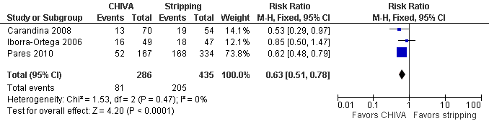
Cochrane Review:
Recurrence of varicose veins:
The primary endpoint, clinical recurrence, pooled between studies over a follow-up of 3 to 10 years, showed more favorable results for the CHIVA method than for vein stripping

Slide 30
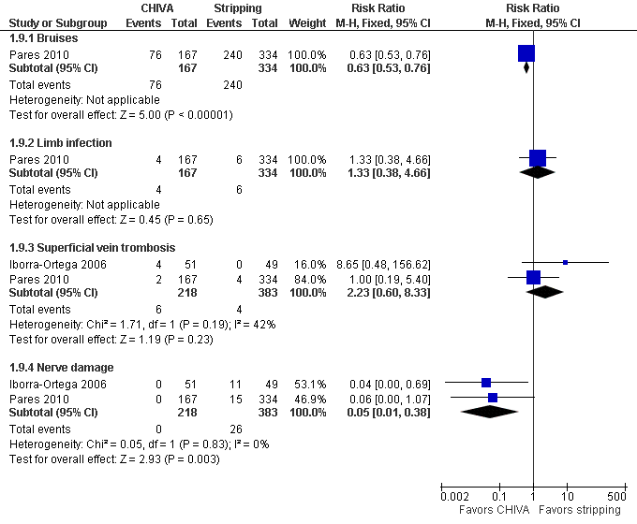
Bruises
Limb infection
Superficial vein thromb.
Nerve damage

Slide 31
Cochrane review: Conclusions
Authors conclusions:
The CHIVA method reduces recurrence of varicose veins and produces fewer side effects than vein stripping. However, we based these conclusions on a small number of trials with a high risk of bias as the effects of surgery could not be concealed (personal note: which is impossible).
New RCTs are needed to confirm these results and to compare CHIVA with approaches other than open surgery.

Slide 32
Further Trials – CHIVA vs. LASER
Chan, C.-Y.ª , Chen, T.-C.^{b} , Hsieh, Y.-K.ª , Huang, J.-H.^{c}
Retrospective comparison of clinical outcomes between endovenous laser and saphenous vein-sparing surgery for treatment of varicose veins
(2011) World Journal of Surgery, 35 (7), pp. 1679-1686.
The CHIVA patients had less pain postoperatively and a significantly higher sclerotherapy-free period compared to patients in the EVL group.

Slide 33
Further Trials – Long term effect on deep veins
Mendoza E (2013)Diameter reduction of the great saphenous vein and the common femoral vein after CHIVA. Long term results. (2013) Phlebologie 42: 65-69
Retrospective evaluation of 43 patients: Diameter reduction in femoral vein after CHIVA of GSV stated prospectively after 8 – 25 weeks lasts for 5 years

Slide 34
Conclusions Technique
High importance of correct preoperative mapping
Minimally surgical procedure
Conservation of the saphenous veins as drainage pathways

Slide 35
Conclusions Evidence
4 RCT accepted by Cochrane Review Group
CHIVA vs. Stripping:
  more favorable results for the CHIVA method than for vein stripping concerning clinical recurrence
CHIVA vs. Compression in Ulcus patients
  Higher healing rate in the CHIVA Group

Slide 36
Thank you for your attention
Erika Mendoza
Wunstorf
Germany

