Slide 1
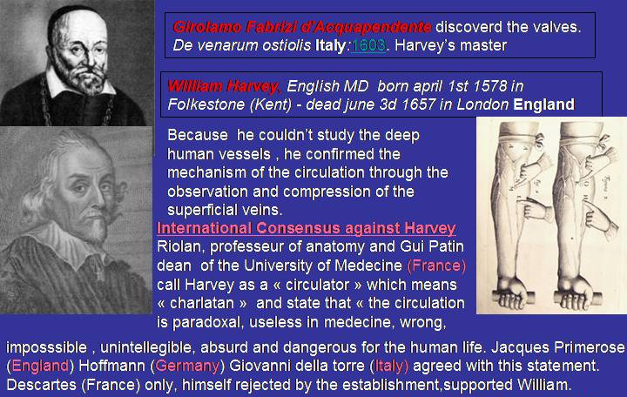





Slide 2
CHIVA’S STORY
-An hemodynamic pattern proposed in 1988.
-Proved 20 years later by Controlled Randomized Trials A GRADE

Slide 3
3 RCT CHIVA vs STRIPPING 5 e 10 anni follow up
Moins de recidives, moins de complications
1 ]Carandina S, Mari C, De Palma M, Marcellino MG,Cisno C, Legnaro A, et al.Varicose Vein Stripping vsHaemodynamic Correction (CHIVA): a long term randomised trial. European Journal of Vascular and Endovascular Surgery 2008;35(2):230–7
[2] Parés JO, Juan J, Tellez R, Mata A, Moreno C, Quer FX,et l.Varicose vein surgery: stripping versus the CHIVA Method: a randomized controlled trial. Annals of Surgery 2010;251(4):624–31
[3] Iborra-Ortega E, Barjau-Urrea E, Vila-Coll R, Ballon-Carazas H, Cairols-Castellote MA. Comparative study oftwo surgical techniques in the treatment of varicose veins of the lower extremities: results after five years of followup. Angiología 2006; 58(6):459–68.

Slide 4
5 years follow up : Recurrence rate: CHIVA vs stripping
Stripp. Clinical
Stripp. Duplex guided
St -MC
CHIVA
St -ED
TC
Duplex Guided Vs Clinical : NO difference
Duplex is USLESS for stripping
5ans. 550 Patients

Slide 5
1 COCHRANE REVIEW
Meno recidive, meno complicanze d
Bellmunt-Montoya S, Escribano JM, Dilme J, Martinez-Zapata MJ. CHIVA method for the treatment of chronic venous insufficiency. Cochrane Database of Systematic Reviews 2012 , Issue 2 . Art. No.: CD009648. DOI:10.1002/14651858.CD009648 .

Slide 6
1 nuovo RCT CHIVA vs STRIPPING a 10 anni follow up IN CORSO DI PUBBLICAZZIONE 2017
Meno recidive, meno complicanze

Slide 7
EVIDENCES | Level | Grade
meta-analyses de RCT | Ia | A | Strong
Au moins un RCT | Ib
Au moins une étude clinique bien conduite sans randomisation | IIa | B | Mid
Au moins un autre type d’étude clinique bien programmé et quasi expérimental | IIb
Au moins un autre type d’étude clinique bien programmée et non expérimentale | III
Opinions de comités d’experts ou expérience d’autorités reconnues | IV | C | Weak
CHIVA (4 RCT)
CHIVA (4 RCT)
+ Cochrane Library REVEW in preogress
Other venous technics at this level????
Stripping still Gold standard? CHIVA ?

Slide 8
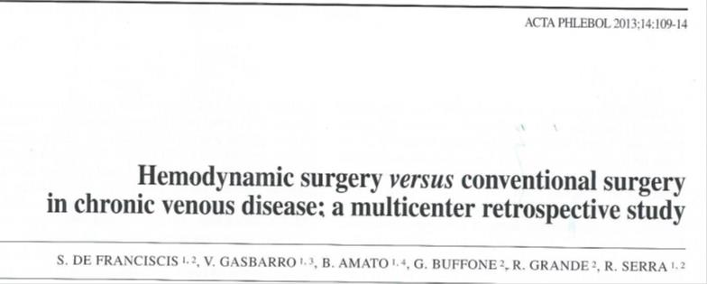

Slide 9
CHIVA vs LASER
.
Chan, C.-Y.a , Chen, T.-C.b , Hsieh, Y.-K.a , Huang, J.-H.c
Retrospective comparison of clinical outcomes between endovenous laser and saphenous vein-sparing surgery for treatment of varicose veins (2011) World Journal of Surgery, 35 (7), pp. 1679-1686.
Conclusion: CHIVA: Less post operation pains , less residual varices.

Slide 10
Minimally Invasive Surgical management of primary venous Ulcer vs. Compression Treatment: a randomized Clinical Trial
P.Zamboni and all
Eur J vasc Endovasc Surg 00,1 6 (2003)

Slide 11
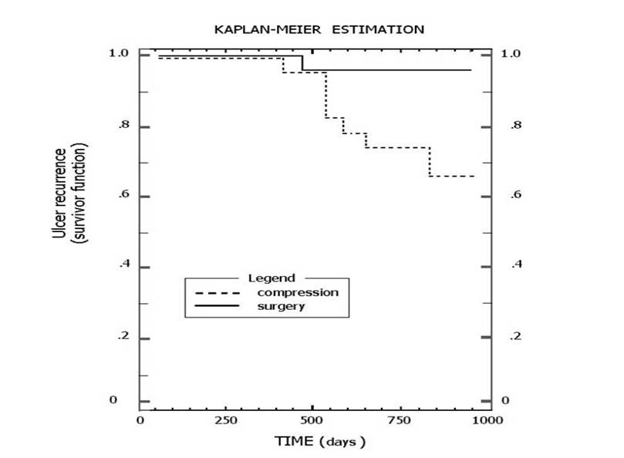
Minimally invasive surgical management of primary venous ulcers vs. compression treatment: a randomized clinical trial.. Zamboni Pand al A. EJ V E S. 2003
KAPLAN-MEIR ESTIMATION
1.0
1.0
CHIVA
0.8
0.8
0.6
compression
0.6
0.4
0.4
0.2
0.2
0
0
0
250
500
500
1000
750
TIME (days)
Notes:
Chap12 Fig 6 Ulcer recurrences a 3 years after CHIVA I or CHIVA I+II performed for venous ulcers, straight line, and by standard compression, interrupted line.

Slide 12
PRESERVER LA SAHENE : VITAL!!!!
REVIEW 2014
OPTIMAL management of infrainguinal arterial occlusive disease
Authors: Pennywell DJ, Tan TW, Zhang WW
Full text: available on http://www.dovepress.com/article_18926.t34346121
Risk factors
Prevalence of 0.9% in people under age 50 and 23.2% in people over the age of 80.1
Autogenous vein is superior to synthetic graft as conduit for LEB,2,53–55 and the great saphenous vein (GSV) is superior to other autologous alternatives. An ideal vein conduit should be soft, compressible, at least 3 mm in diameter, and should not be calcified or sclerotic
Conclusion
Open infrainguinal GSV bypass remains the gold standard for revascularization in CLI, especially for patients at appropriate surgical risk and with suitable bypass conduit.

Slide 13
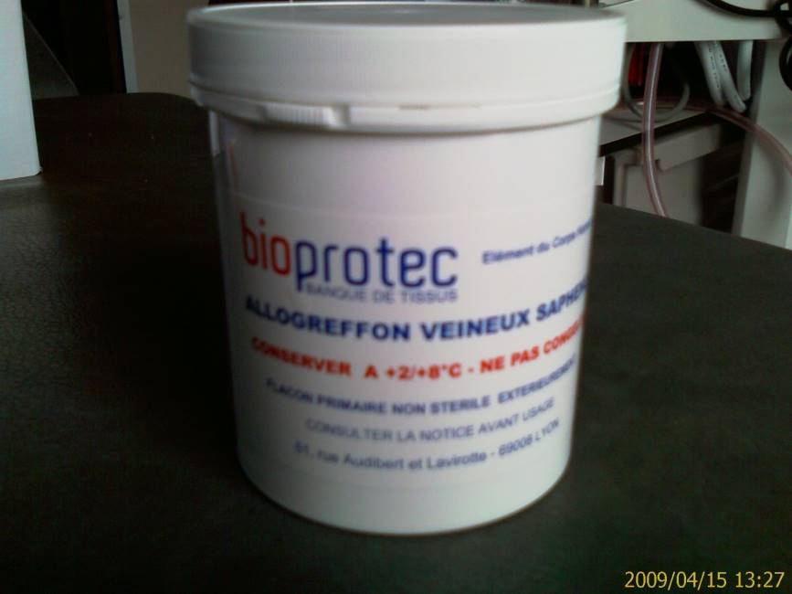
Fondée en 1989, Bioprotec a permis de fédérer sur le territoire français
les activités de recueil de veines saphènes lors du stripping des varices,
d’assurer la production d’allogreffons veineux et leur cession
aux établissements demandeurs.
La cession d’allogreffons veineux est en constante augmentation,
passant de 286 en 2001 à 490 en 2006. crits
Les Allogreffons veineux Bioprotec sont inscrits
à la LPPR sous le N° 3333073. Ils sont pris en charge
en sus des GHS pour les établissements privés et publics.
Le tarif est de 1480.00 euros HT et de 1561.40 euros TTC.

Slide 14
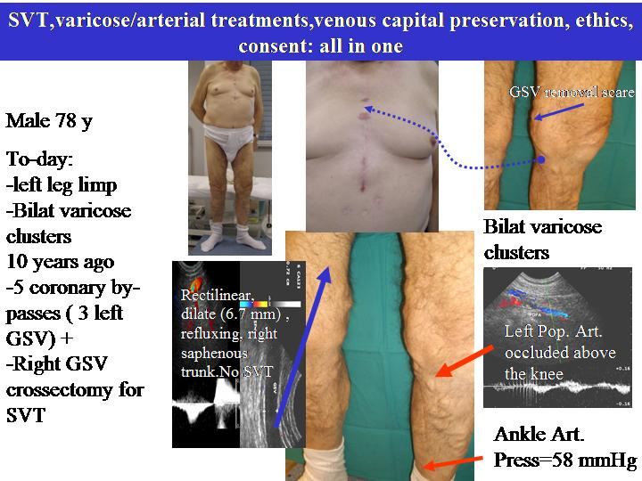

Slide 15
GUIDELINES
The care of patients with varicose veins and associated chronic venous diseases: Clinical practice guidelines of the Society for Vascular Surgery and the American Venous Forum. Peter Gloviczki, MD, and al. JVS 2011
Results with preservation of the saphenous vein. Results with CHIVA. Such techniques were better than compression in preventing ulcer recurrence188 and were at least equivalent to stripping of varicose veins.
CHIVA is a complex approach, and a high level of training and experience is needed to attain the results presented in this RCT.
It still requires considerable education of venous interventionists willing to learn this approach.
CHIVA Experts et Non Experts
Milone M, Salvatore G, Maietta P, Sosa Fernandez LM, Milone Recurrent varicose veins of the lower limbs after surgery. Role of surgical technique (stripping vs. CHIVA) and surgeon's experience.F. G Chir. 2011 Nov-Dec;32(11-12):460-3
CHIVA PERFORMED by experts is best than stripping , but less when performerd by non experts.
Conclusion: LET’S LEARN OUR JOB!

