Slide 1
New proposal for the management of Sapheno-Popliteal reflux based on different flow patterns

Slide 2
Flow direction definitions
Centripetal : a flow toward the heart
Centrifugal : a flow toward the perifery
Inward: a flow toward the muscle tissue
Outward: a flow toward the skin
Inward Flow
N3
N1
N2
Subcutaneous tissue
Muscolar Tissue
Skin
Outward Flow
N1 Deep Veins
N3 Tributary v.
N2 Saphenous axe.
Centripetal Flow
Centrifual Flow

Slide 3
The SPJ
The SPJ is a junction of an important converging segment for the venous returns from the lower leg located in the middle between the calf and thigh muscle pump.
In this junction, the convergence of distal flow from multiple origins to the popliteal vein occurs: the flow of the tibio-peroneal veins, that of the soleal-gastrocnemius venous system and of the SSV.
The flow goes upward into the deep thigh veins and also in the Giacomini vein at the same time.
In this junction area, different hemodynamic /flow patterns may develop during the walking by the synchronism of the muscle activity between calf and thigh and by the stretching of the popliteal vein, as demonstarted through the following slides.

Slide 4
The Giacomini Vein
The Giacomini Vein (GV) is one of superficial veins together with LSV and SSV. The GV starts from the arc of the SSV and runs upward, being connected to the upper third of the GSV; it therefore runs obliquely along the posterior aspect of the upper leg/thigh. The valves are normally oriented for a centripetal flow , but its diameter is small and flow volume is low in general so that it would need the experiences to check with the ECD properly. However, it becomes visible in various pathological conditions (e.g. compensatory flow for deep veins obstruction).
Giacomini
LSV
Tributary
Deep Veins
SSV
Perforator

Slide 5
The ‘accessory’ Giacomini V. Connected to the deep femoral v.
Vein draining the SPJ to deep femoral vein
This ‘accessory’ Giacomini vein also originates from the arc of the SSV like GV and goes upward to the middle of the thigh, BUT, it drains directly into the Profunda Femoral Vein . Like the ordinary GV , its caliber is small and flow rate is usually low so that it is also difficult to check the flow with the ECD. But it becomes clearly visible in various pathologic conditions, e.g. for a compensatory flow for deep venous obstruction and in the case of a centripetal flux that is originated from the SPJ during muscle contraction.
LSV
Tributary
Deep Veins
SSV
Perforator

Slide 6
The muscle pump activity
Normal subject
The muscle pump is the most important mechanism of venous return, it pushes the venous flow from the peripheral area to the heart and from the surface to the deep tissue. Calf contraction increases pressure up to 140-150 mmHg in the deep veins and moves the blood up to the femoral vein and above. Calf contraction also increases pressure in the superficial system and gives origin to a centripetal flow in this network.
During the relaxation phase, pressure in the deep system diminishes. This has no hemodynamic consequences in the superficial venous system, if it is competent.
During relaxation no flow event may be detected by US in a competent system in both a superficial and deep network.
Contraction Phase
Relaxation Phase

Slide 7
The muscle pump activity
Contraction and relaxation impact to an incompetent superficial system
The calf contraction of the muscle pump increases pressure in the superficial system even if it is incompetent: this often gives origin to a centripetal flow.
During relaxation, If the superficial system is incompetent, the hydrodynamic pressure in the thigh saphenous axe ( where the hydrostatic column is not fractioned by the valve closure) is higher than in the deep calf veins ( PTV ). This leads to a pressure gradient from the thigh to the calf and consequently to a flow from the surface to the deep veins, passing through the calf perforator veins. If the SFJ or the SPJ are incompetent, an outward flow is determined by this pressure gradient.
A ,B = Hydrodynamic energy level in superficial and deep system during relaxation
Contraction Phase
Relaxation Phase
A
B

Slide 8
The muscle pump activity
The flow in the calf perforators
In the calf this centrifugal flow rate affects the perforators’ caliber, which lose their valvular competence. For this reason, as well as in relation to the perforator’s angle of insertion, a short outward flow is possible during muscle contraction. During relaxation, even if there is a valve incompetence, the flow follows the pressure gradient and goes inward into the deep calf veins. This inward flow has a long duration.
Contraction Phase
Contraction flux
Relaxation Phase
Relaxation flux
In summary: in a varicose system the flow is centripetal during the contraction phase and centrifugal during relaxation.
Finding a reflux ( outward flow ) in a varicose system during contraction is an atypical situation due to particular hemodynamic patterns that are the objectives of this presentation.

Slide 9
Muscle pump contraction and relaxation and flow directions in the SPJ
Incompetent SPJ refluxing during the muscle relaxation phase
The most common situation in a SPJ is that of an inward( centripetal) flow during muscle contraction and an outward( centrifugal ) flow during muscle relaxation.
Contraction flux
Relaxation flux
Contraction= inward flow
Relaxation= outward flow

Slide 10
Muscle pump contraction and relaxation and flow directions in the SPJ
Incompetent SPJ refluxing during the muscle contraction and relaxation phase
During the muscle contraction, an outward flow from the SPJ can occur. In this case, the flow follows the same direction in both contractive and relaxation phases .
This outward contraction flow results from an increasing pathologic pressure.
Contraction flux
Relaxation flux
Contraction = outward flow
Relaxation= outward flow

Slide 11
Physical differences between a Relaxed and a Contracted Reflux
The flow direction between 2 points, Point A and Point B , is defined by 2 conditions:
The Valve competency , or the valve direction
The pressure gradient between Point A and Point B.
A Relaxed Reflux originates from Point A , above, and Point B , below, thanks to the lower pressure in point B during the muscle relaxation. Its direction is always from Point A above to Point B below.
Direction of flow
Downward
Point A
Point A
Point B
Pressure Lowering
Point B
Pressure Lowering

Slide 12
Physical differences between a Relaxed and Contracted Reflux
A Contractive Phase Reflux originates from Point A by the fact that during muscle contraction the pressure here increases. In this situation the increased pressure can push the blood to Point B which position can vary above or below Point A.
Point A
Pressure
Increasing
Direction of flow downward
Point A
Pressure
Increasing
Point B
Point B
Point B
Direction of flow upward
Point A
Pressure
Increasing

Slide 13
Depending upon the conditions involved in interconnecting veins as draining collaterals, the drainage pattern of the refluxed blood from SPJ will belong to one of three types as follows:
Type 1
Type 2
Type 3

Slide 14
Concept of “Private (NOT isolated) circulation”
A superficial venous insufficiency is characterized by the presence of an escape point , an incompetent trunk and one or more perforators that the flow uses to go back into the deep system. The flow goes upward during the contraction phase of the muscle pump and comes back downwards during the relaxation phase, giving rise to a vicious circle between the escape point ( leaking point) and the calf perforators ( re-entry points) . This flow overloads the muscle pump function and leads to the CVI development.
Escape point
Escape point
Perforator
Perforator
Contractive Phase
Relaxation Phase

Slide 15
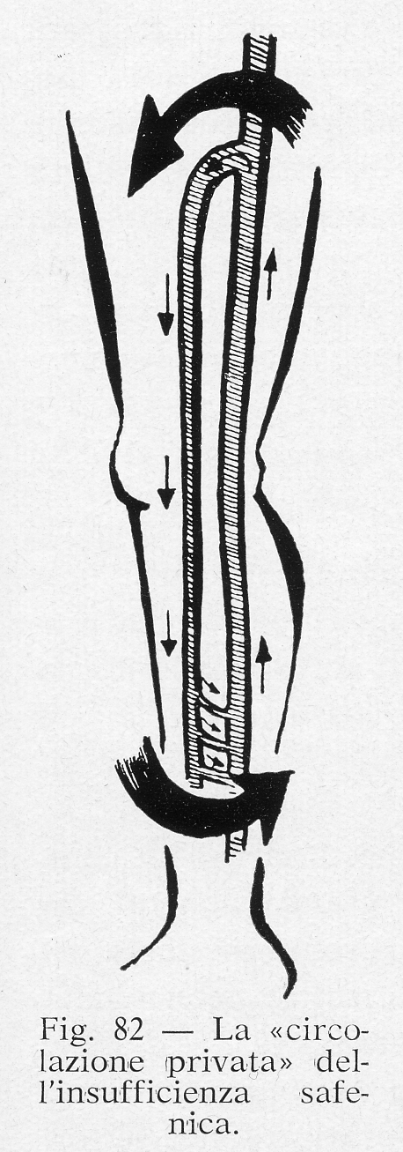
History of vicious recirculation concept, the so called “Private Circulation”
The first to speak of private circulation was Trendelemburg in 1891. This is the translated text of his work:
“It is very difficult to form an exact picture as to what the circulatory relationships were before the ligation. In every case the relationships vary according to whether the patient stands without muscular activity or moves about and allows for the play of the muscles. In the first case the blood in the deep tracts provided with valves and in the dilated saphenous will be driven by practically the same vis a tergo and moved forward in the same way.
On the other hand, as soon as the muscles come into action the pumping action of the venous valves in the deep tracts come into play. As the result of this the blood stream in the deep veins will move appreciably faster; the blood will be sucked out of the communicating veins "xx.
It will not remain out since the blood from the reservoir of the filled saphenous flows after and is replaced from above from the femoral, so that in this case we are dealing with a private circulation of the 'lower leg so to speak, in that the blood in the deep veins of the leg is pumped up and in part flows down again through the saphenous.”
The concept of private circulation as expressed by Trendelemburg was revaluated by Glauco Bassi in 1962 ( see the picture) in his book “ Le varici degli arti inferiori”.
Diagram from G.Bassi
Private circulation of saphenous insufficiency

Slide 16
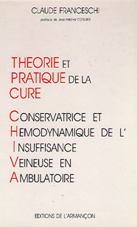
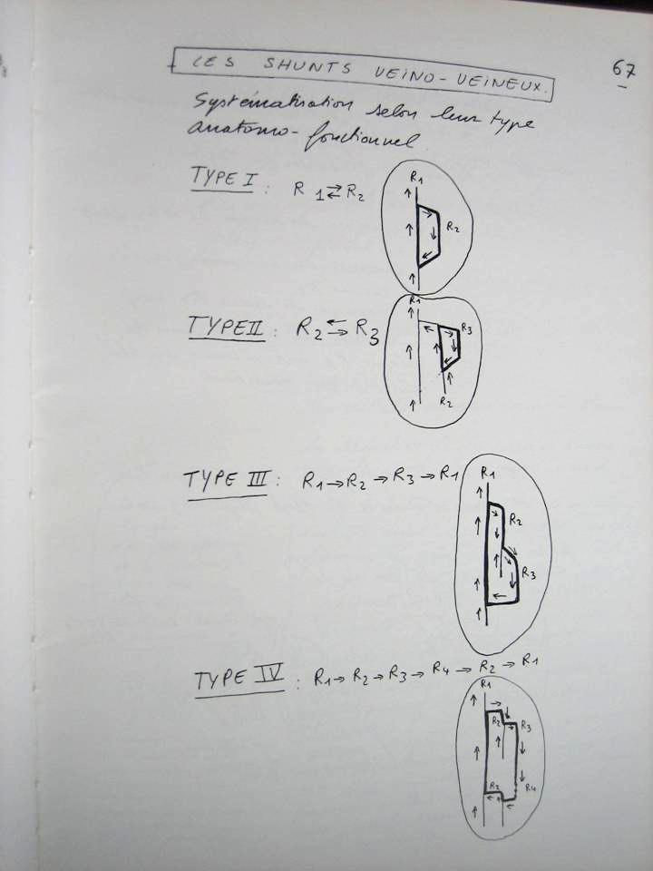
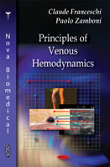
History of vicious recirculation concept, the so called “Private Circulation”
In 1988, Claude Franceschi proposed anatomo-hemodynamic patterns of the venous circulation based on ultra-sound imaging/Dopple findings where the private circulation was called Closed Shunt and classified in various sub-patterns according to the escape point location , the involved superficial veins pathways ( N1, N2, N3, N4 according to theire location sub, intra or supra fascial) and their re-entry location. The closed shunts were differenciated from other shunts called open vicarious shunts when the veins drive a compensatory lflow and open deviated shunt when a superficial vein drains other superficial venous departments in addition to its physiological, without closed shunt re-circulation from the deep departement.

Slide 17
Concept of Escape and Re-Entry points
Slide 15
Escape/leaking Point:
Point of transition of an outward flow from a deep to a more superficial network, e.g. an incompetent SFJ.
Re-Entry Point:
The point where the pathologic flow passes from a superficial to a deep network.
If the re-entry point is placed below the escape point , between the first and the second , this ‘private’ circulation is established ( fig. !)
If the re-entry point is placed above the escape point, such ‘private’ circulation loop can not develop ( fig. 2). This situation occurs only in the case of a contractive reflux.
Re-entry point
Escape point
Escape point
Re-entry point

Slide 18
Calf muscle contraction outward flow
Venous blood flow through the sapheno-popliteal junction (SPJ) during the calf muscle contraction will change its normal direction. This occurs as the result of a deep vein obstruction or other functional conditions.
This pathologically directed flow is a natural compensation to the deep obstructive stenosis.
Giacomini
Thrombosis
LSV
Deep Veins
SSV
The flow in the Giacomini v. compensates the deep vein obstruction

Slide 19
About the calf muscle contraction outward flow
In this diagram the venous blood flow direction through the sapheno-popliteal junction (SPJ) during the calf muscle contraction flows in the same direction as the previous slide, however in this case the deep veins in the thigh are competent and pervious.
This flow in the Giacomini v. results from an ambulatory pressure gradient whose origin is in the popliteal fossa for causes that are not always identifiable.
In this pattern the pressure in the deep system increases after SPJ ligation, and this is why there are frequent recurrences following traditional treatment.
Giacomini
LSV
Deep Veins
SSV
The flow in the Giacomini does not have a compensative function

Slide 20
Hemodynamic patterns of the outward contractive flow in the SPJ
A centrifugal and/or a centripetal flow can originate from the contractive outward flow in the SPJ. In both situations various patterns are possible, and are shown in the following slides.
Giacomini v.
Giacomini v.
Popliteal v.
Popliteal v.
SSV
SSV

Slide 21
Muscle contraction flux
Reflux Type 1
Muscle relaxation flux
The SPJ and the SSV axe are affected by an outward and centrifugal flow during the relaxation and also during the contractive phase of the muscle pump activity
Contractive-Relaxation reflux
Contraction
flux
Relaxation flux

Slide 22
Reflux Type 1
Re-entry points disposition
Reflux Type 1
Slide 9/B
In Type A the flow originates from the N1 network, reaches the N2 network and through the re-entry point, returns to the N1 network
In Type B the flow originates from the N1 network, reaches the N2 network, but before returning to the N1 network, it engages the N3 network ( and feeds a varicose vein ) .
In Type C a direct re-entry perforator ( Type A) and a Re-entry point that originates from a tributary ( Type B ), are present.
Re-entry Type A
Re-entry Type B
Re-entry Type C

Slide 23
Reflux Type 1 = centrifugal and centripetal destination of the outward flow
The outward flow that originates from the popliteal vein, in addition to the SSV, can also engage the Giacomini or the collateral ‘accessory’ GV directly connected to the deep femoral vein .
In this situation other hemodynamic patterns are possible, and are summarized in the upcoming slides and in the following topic, Type 2 reflux.
Giacomini v.
Popliteal v.
SSV

Slide 24
Type 1
Centripetal and centrifugal destination of the outward flow.
Variables
Either the Giacomini or the collateral vein is visible, with a muscle contraction centripetal flow.
Destination of this flow
Undefinied
In a Perforator
In a Tributary
In the LSV
More variables are subsequently shown

Slide 25
Type 2
The outward contractive flow originating from the SPJ has a centripetal flow towards the Giacomini vein or the accessory GV vein that connects the SPJ to the deep femoral vein. The reflux does not involve the SSV.
Muscle contraction flux
Muscle relaxation flux
The destination of this flow is explained in the next slides
SSV is competent
SPJ is incompetent

Slide 26
Type 2/A
= Perforator
In this pattern the flow that originates from the SPJ during the muscle contraction phase, goes upwards in the Giacomini v, and returns into the deep vein through a perforator.
This condition develops with the Giacomini v. and also with the accessory GV vein that connects the SPJ to the deep femoral vein.
In this pattern there is no relaxation centripetal flow in the Giacomini vein because the flow returns to the deep system through a re-entry point located above its original escape point.
The absence of a relaxation centripetal flow is explained later.
Type 2/A
Type 2/A

Slide 27
Type 2/B
In this pattern the contractive centripetal flow returns to the common femoral vein through the LSV axe and the SFJ.
No relaxation flow is detected in this pattern as well because the re-entry point is located above the escape- point.
Type 2/B

Slide 28
The Siphon Effect
The siphon effect explains the presence of a relaxation centripetal flow in the Giacomini v.
The siphon effect occurs when a tube in an inverted U shape causes a liquid to flow upwards, above the surface of the reservoir, without pumps, powered by the fall of the liquid as it flows down the tube under the pull of gravity, and discharges at a level lower than the surface of the reservoire it comes from ( http://en.wikipedia.org/wiki/Siphon ) .
The real siphon effect works in a open circuit. In the venous system the circuit is closed and the effect of gravity’s potential energy is charged by muscle pump activity.
Tank A
Tank A
Tank B
Tank B

Slide 29
= Perforator
Type 2/C
In this pattern the contraction and the relaxation flow run in two different directions.
The contractive flow originating from the SPJ , goes upwards via the Giacomini v. and further more via the interpositioned LSV, returning to the common femoral vein ( Red Line).
The relaxation flow originates from the SPJ, goes upwards through the same tract of the Giacomini vein, and when it reaches the tributary vein, it returns downwards ( centrifugal flow) to a perforator situated lower than SPJ ( point of flow origin ). By way of this perforator, the flow returns into the deep system ( Blue Line).
This relaxation centripetal flow in the Giacomini vein results from a “pseudosiphon effect” that allows the flow to pass from its origin (the SPJ) to its destination ( the calf perforator) crossing a point higher than its origin.
Type 2/C

Slide 30
Type2/D
= Perforator
There are the same hemodynamic conditions of Type 2/C in this and the following patterns.
The presence of a perforator allows the relaxation flow to return to the deep system by a re-entry perforator situated below the escape point.
Whether or not the saphenous axe is interposed and the perforator is disposed will determine different hemodynamic situations.
In each of these conditions, the “pseudo siphon effect”is present.
Type 2/D

Slide 31
Type 2/E
= Perforator
The only difference between these 3 patterns ( 2/C , 2/D , 2/E ) is the blood flow circuit from the escape point to the re-entry point and the consequent distribution of visible varicose veins.
This circuit will condition the strategy treatment.
Type 2/E

Slide 32
Type 3
The destination of this flow is shown in the previous slides
The characteristic of this pattern is that the contractive flow does not originate from the SPJ, but from a gastrocnemious vein.
The various destinations of this flow are the ones shown in the previous slides.
Type 3

Slide 33
Strategy Treatment
The recurrence of an escape point generally leads to the recurrence of varicose veins, and this is what occurs following the recurrences of a crossectomy in LSV insufficiency. Fortunately, the recurrence of reflux in a correctly performed crossectomy is a rare occurrence.
The SFJ has the following 2 features:
It is easy to perform a flush ligation
The blood refluxes during the relaxation phase of the muscle pump resulting from a decrease in pressure in the calf, therefore there is no pathologic increase in pressure in the SFJ, neither during muscle contraction nor relaxation.
Effects of the SFJ recurrence
Before treatment
SFJ flush lig + Stripping
Recurrence of the SFJ ligation

Slide 34
In the popliteal fossa these two conditions are different:
It is not simple to perform a flush ligation
A reflux resulting from an increase in pressure in the escape point during the contraction phase of the muscle pump is possible.
This means that the general treatment principles usually applied to the most common varicose veins, i.e. escape point treatment and saphenous ablation, is not usable in these patterns, because the pressure gradient and the absence of a flush ligation are two conditions that lead to a high frequency of recurrence.
Diameter
With every increase of vessel diameter the radial tension on the wall increase (Laplace's law)

Slide 35
The refluxes that originate from the popliteal fossa during the muscle pump contraction phase describe various patterns that are summarized in:
A contractive flow that can be:
Centrifugal
Centripetal
A relaxation flow whose final destination is always centrifugal
Contractive Flow
Relaxation Flow
Centrifugal
Centripetal
Centrifugal

Slide 36
Even if it is pathologic, every centripetal flow in the Giacomini v., independently from its original cause, compensative to a venous obstruction or derivative of an increase in the functional pathological pressure inside the popliteal fossa, is never pathogenic and must be conserved. Its suppression will lead to a venous stasis below its original point and to an increase in pressure at the SPJ and below it.
A centripetal flow is always supported by a contractive flow.
Muscle Pump Contraction
Stop Derivative flow
->Pressure Increase
Derivative flow
->Pressure decrease
Pressure increase

Slide 37
A centrifugal flow instead gives origin to a private circulation, overloads the pump function, and leads to the development of CVI, and is therefore pathogenic.
A centrifugal flow is always supported by a relaxation flow, which can also be accompanied by a contractive flow.
Muscle Pump Contraction
Muscle Pump Relaxation

Slide 38
Contractive and relaxation centrifugal flow in the SSV axe.
A centrifugal flow can be supported by both a relaxation flow and by a contractive flow.
A centrifugal contractive flow always originates from the escape point N1->N2, which is also the origin of the centrifugal relaxation flow. In this case both relaxation and contraction flows contribute to a private circulation and are pathogenic.
The pathogenicity of this flow results from:
The presence of a vicious recirculation and its flow rate
The height of the hydrodynamic column
Contractive
Relaxation
Contractive/Relaxation

Slide 39
A vicious recirculation supported by a contraction/relaxation centrifugal flow can only be cured by closing the escape point.
As we have explained, this surgical procedure has a high recurrence rate, and must be carefully evaluated.
The elements that must be checked by US at the SPJ level are:
The anatomy of the junction and the possibility of a flush ligation
The presence of a common trunk with the gastrocnemius veins
The presence of the Giacomini vein, its caliber and the direction of its flow
The flow rate (speed and time) of the contractive reflux
The origin site of the contraction reflux
The SPJ
A popliteal perforator
A gastrocnemius vein
With all these elements we can have an idea of the risk of recurrence and consequently create a treatment strategy.

Slide 40
Possibility for controlling the SPJ reflux:
A flush ligation
A proximal ligation with an intraoperative sclerotherapy of the stump
Ligation below the Giacomini vein. This forces the flow into the Giacomini v. from the SPJ therefore absorbing the contractive pressure. Prior to this surgical procedure, a close checkup of the Giacomini v. flow must be performed with a dynamic test. We can evaluate the outcome of this procedure by finger compressing the projected ligation point and rechecking the flow in the SPJ with the ECD while simultaneously performing a dynamic test.
Contractive Flow
Contractive Flow after finger compression

Slide 41
Pro Flush Ligation | Pro below the Giacomini
Feable/weak Systolic (outward) flow | Strong systolic reflux
Functional absence of the Giacomini v. | Big Giacomini Vein with detectable flow
Surgical anatomy of the SPJ (*) | Surgical anatomy of the SPJ (**)
Third possibility
SPJ ligation and retrograde sclerotherapy
(*) possibility to perform a real flush ligation
(**) impossible to perform a real flush ligation

Slide 42
How to reduce the vicious recirculation pathogenicity without interrupting the SPJ reflux:
There are various possibilities, related to the type of vicious recirculation, to partially reduce the energy of the hydrodynamic flow rate. These are demonstrated in the following diagrams.

Slide 43
Strategy treatment of the contractive centripetal flow in the Giacomini vein ( Type 2) :
The strategy of this type of contractive reflux is simpler and gives good results because in this situation the contractive centripetal flow is not pathogenic but is a compensative/derivative flow, and must be conserved.
The strategy has 3 goals:
The mandatory conservation of the contractive flow
The treatment of the varicose veins included in the contractive centripetal circuit
The treatment of the private circulation that originates during the relaxation phase
1
2
3

Slide 44
Treatment of the varicose veins included in the centripetal circuit
This tributary diverges from the previous situation because it does not directly give origin to a private circulation, but is a part of the centripetal flow circuit. Before its disconnection we must control the destination of the centripetal contractive flow, e.g. after repetition of the dynamic test with a finger compression of the tributary origin. This flow depends on the presence (a) or absence(b) of an N2 network above this origin or of a perforator ( c & d) that can ensure a centripetal flow.
a
b
c
d

Slide 45
Treatment of the viciuos recirculation loop
This private circulation does not originate directly from the escape point, but from the centripetal contraction circuit, i.e. from the Giacomini v.
The flow in the Giacomini v. can give an origin to a private circulation loop with 2 different hemodynamic patterns:
1) By the way of a tributary that originates directly from the Giacomini v. and that can feed:
a) The saphenous axe
b) A posterior thigh tributary
2) For a direct drainage of the Giacomini v. in an incompetent LSV.
1/a
1/b
2

Slide 46
Origin of a tributary from the Giacomini v.
This private circulation originated directly from the Giacomini v. which is combined with a contraction flow must be conserved. The disconnection of this compartment jump must be performed with a flush ligation and is generally very simple.
This compartment jump can be associated to:
1) The presence of the N2 ( Giacomini v) above the N3 ( tributary) origin .
2) The absence of the N2 above the origin of the N3.
3) The presence or not of an N2 perforator below (3a) or above (3b) the N3 origin
These variables affect the presence of the centripetal contractive flow in the Giacomini vein after the tributary disconnection
1
2
3/a
3/b

Slide 47
Drainage of the Giacomini v. in an incompetent LSV
In this pattern the Giacomini v. drain directly, without any tributary interposed, in the saphenous axe. If the saphenous axe is incompetent this flow supports a relaxation centrifugal flow. Diverse patterns are possible, in relation to the re-entry points disposition
Pattern A
Pattern B
Pattern C
The goal of the strategy is to conserve the saphenous axe, that is the acceptance system of the Giacomini flow, addressing this retrograde saphenous flow directly in the deep veins without tributary interposition.

Slide 48
Drainage of the Giacomini v. in an incompetent LSV
In Pattern A there are no visible varicose veins. This situation requires treatment only if the saphenous axe is incompetent up to the ankle and is responsible for CVI ( pattern A/2).
In this pattern we can disconnect the saphenous axe below a perforator, reducing the height of the hydrodynamic column and guiding/relocating the re-entry point to a non pathophysiological route.
= Perforator
Pattern A/1
Pattern A/2
Pattern A/2
Strategy Treatment

Slide 49
Drainage of the Giacomini v. in an incompetent LSV
In this pattern the flow from the LSV returns to the deep veins passing through a visible varicose vein. We propose to treat this reflux pattern with the flush ligation of the tributary. If, as demonstrated in this diagram, there is no re-entry point between the Giacomini insertion and the tributary origin, this action leads to the disappearance of the relaxation centrifugal flow and to the restoration of a contraction centripetal flow that starts from the competent saphena (Evolution A). This new assesment can remain unchanged or can devolop a new re-entry perforator giving rise again to a centrifugal flow, but without visible varicose veins (Evolution B). This change depends on the centripetal flow rate in the competent saphena and the weight of the hydrodynamic energy in the incompetent saphena
Pattern B
Treatment
Consequence A
Consequence B

Slide 50
Drainage of the Giacomini v. in an incompetent LSV
In this pattern the LSV centrifugal flow re-enters into the deep veins in two ways:
The tributary, which feeds the visible varicose veins
A re-entry perforator that originates from the saphenous axe and allows the flow to go back into the deep veins without feeding varicose veins.
The flush ligation of the tributary maintains a re-entry point that allows the drainage of the Giacomini vein’s flow into the deep system without varicose vein interpositions.
Pattern C
Treatment
Consequence

Slide 51
Consequences of saphenous ablation in case of Giacomini centripetal flow
In case of LSV varicose veins , the presence of a centrifugal flow in the Giacomini v. can be underestimated. The cartographic element that requires further investigation is the increase in diameter of the LSV after the Giacomini insertion. The LSV is the natural destination of the Giacomini flow. Its ablation leads to a varicose vein recurrence whose strategy treatment provides the ligation of the compartment jump, that must be repeated up to the formation of a Giacomini perforator, allowing the restoration of the centripetal flow without varicose veins.
Disconnection
Re-entry perforator
∂
∂

