Slide 1

Hemodynamic bases for a better diagnosis and a better therapeutic strategy in arterial and venous vascular pathology. Reading
Claude Franceschi
Pressure
Transmural
=
Lateral vasal pressure
=
P. Hydrostatic +
Motor P.
External pressure
=
Tissue P. +
atmospheric p.

Slide 2
1-Hemodynamics is fluid mechanics applied to blood circulation.
-It is made up of pumps and ducts.
-Its final function is biological
and vital, because it irrigates
the tissues with nutrients
and drains their catabolites .

Slide 3
2 The clinic and biology of circulatory failure depend on:
Trans-Mural Pressure
Blood/walls conflict
Transmural
Pressure
=
Lateral vasal pressure
=
P. Hydrostatic +
Motor P.
External pressure
=
Tissue P. +
atmospheric p.

Slide 4
3 Knowing and understanding hemodynamics and its physio-pathological relationships improves the quality of
-research,
-clinical and instrumental diagnosis, and
-treatment of vascular diseases.

Slide 5
3
National and international controversies are explained by the difference in hemodynamic concepts - largely due to a different use of the EchoDoppler. - particularly in Anglo-Saxon countries where this technique is practiced not by doctors but only by technicians.

Slide 6
4 Clinical semiology is essential because it can recognize important symptoms and signs.
However, it has to be completed by biological and instrumental examinations.
In fact, sometimes the clinical picture can be unremarkable, but masks a severe pathology and vice versa.

Slide 7
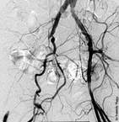
5 Images do not provide sufficient hemodynamic information
- a hemodynamic evaluation is necessary to define the therapeutic strategy.
hemodynamic abnormalities may be asymptomatic if they have not reached a sufficient functional level.

Slide 8
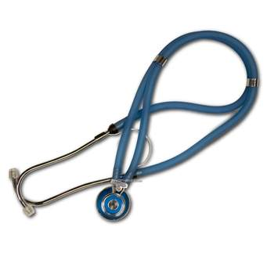

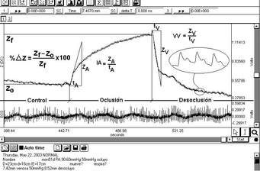
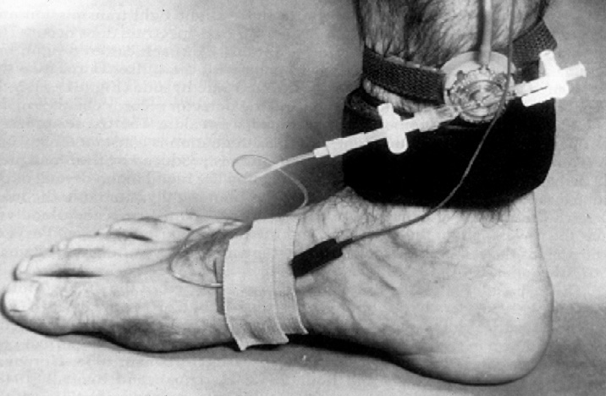
6 Hemodynamic evaluations have come a long way since palpation and auscultation of the vessels. Sphygmomanometry, catheterization and plethysmography have represented progress.

Slide 9
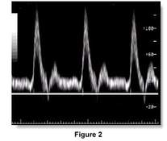
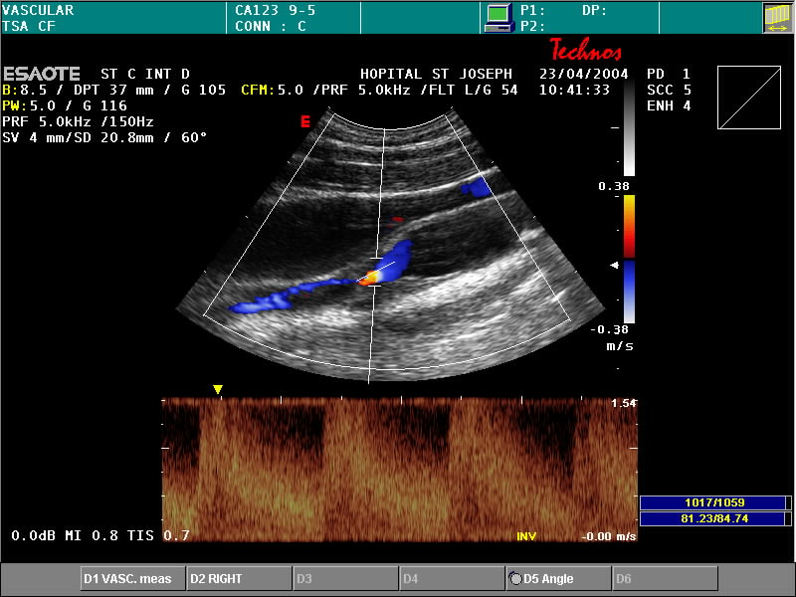
6 The introduction of ultrasound has revolutionized vascular research . No procedure like Doppler can study hemodynamics , the central objective of circulation .
Unfortunately, the procedure is not sufficiently used in all its possibilities .

Slide 10
For this reason, specialists and researchers have to deepen their knowledge in hemodynamics and Doppler scanning .
, prejudices and statements in official recommendations can be analyzed, criticized and corrected .

Slide 11
Physiopathological definition of hemodynamic insufficiency

Slide 12
8
Arterial insufficiency is the inability of the arterial system to ensure:
- Cardiofugal flow with
-Flow and Pressure adapted to the irrigation needs of the tissues .

Slide 13
8Venous insufficiency is the inability of the venous system to
-ensure a unidirectional cardiopetal flow with the output and pressure
-adapted to the needs
-of tissue drainage ,
-thermoregulation and
-hemodynamic reserve regardless of position and muscle activity.

Slide 14

9, Physical bases of fluid mechanics
Pascal: PH= ῤgh ,
Bernoulli : ΔP = p + (1/2) mv ² + ῤ gh
Poiseuille : Δ P = 8 L μ Q/ π r ⁴
Reynolds: Re= VL/v
Navier -Stokes

Slide 15
10 Definition of Pressure:
Absolute pressure : Pressure with respect to vacuum.
Relative pressure is the pressure with respect to atmospheric pressure. It is the one used in practice, It is conventionally called negative pressure when it is less than the atmospheric pressure (0 to 760 mmHg) of the absolute pressure.
+
+
Absolute Pressure
Relative Pressure
0
-
0
-76mmHg

Slide 16
11 Definition of Pressure-Volume-Resistance-Compliance: P/V/R/C
In a rigid tube, the flow rate Q varies only with the Pressure P / resistances R: Q=P/R. In a distensible tube , the flow rate Q can vary without a variation in pressure d P.
Rigid
P= Q. R
P = Q. R
Distensible
c

Slide 17
12
Definition of Pressure-Volume-Resistance-Compliance: P/V/R/C
In effect, this tube can expand its caliber, increasing its radius r without a change in pressure dP. The reason is compliance
Compliance C= dT = d( 2π. r)
TensionT = P. r (Laplace's Law).
dP dP
T
r
Compliant
dP
Rigid

Slide 18
13
Thus, the higher the Compliance , the more important is the amortization of pressure variations, between the limits of the Young's Modulus of the walls.
c
Compliance:
Capacity of a vessel to contain more volume of blood depending on the Pressure
DCp
Mod. Young
SCp
C= PTM. CP
C: Venous caliber
Cp:Compliance
1 - Static compliance SC = C /P
2- Dynamic compliance DC = d C /dP
Q
Q

Slide 19
14 Windkessel effect on the arteries .
Compliance​ of the walls, amortizes the pressure variations of the arteries ,
because it decreases systolic pressure and
increases diastolic pressure
due to the recovery of caliber
due to arterial elasticity.

Slide 20
15 Windkessel effect on the arteries.
The Doppler shows a biphasic proto -diastolic curve
that increases with elasticity pathology of the walls
- and/or micro-circulatory resistance (R) and Pressure (P)
Q
R

Slide 21
16 Windkessel effect on the arteries .
For this reason,
-the atherosclerotic rigidity of the walls -increases the differential arterial pressure ( systolic hypertension )
-and decreases the proto -diastolic biphasic curve at Doppler .

Slide 22
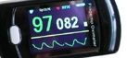
Infrared PLETHYSMOGRAPHY: Varies with superficial blood volume. Evaluates arterial microcirculation, that is, variations in arterial and venous pressure.
It can replace the Döppler for measuring thepressure of the big toe or Pole Test.
17
Notes:
22

Slide 23
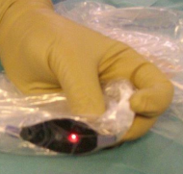
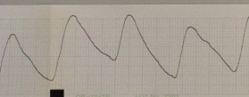
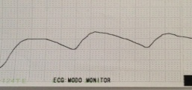
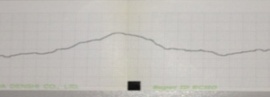
Infrared PLETHYSMOGRAPHY:.
It is better than Doppler to evaluate intestinal ischemia and prevent fistulas of intestinal anastomoses .
It can also evaluate the superficial venous emptying time.
18
Infrared parietal colorectal flowmetry: a new application of the pulse oximeter. Is this method useful for general surgeons in preventing anastomotic leakage after colorectal resections? Dovepress http://dx.doi.org/10.2147/OAS.S81138
Normal Ischemia
Notes:
23

Slide 24
19 Pressure wave in the arteries.
The systolic pressure wave moves from the heart toward the microcirculation with a velocity independent of that of flow, but proportional to the stiffness due to decreased compliance of the walls. Its sum with the reflection of the wave from the preceding systole approaches the heart when the speed of the wave increases.

Slide 25
20
The sum of these 2 waves produces a local hyper-pressure that leads to greater cardiac stress , when it gets too close to the heart, by increasing the central pressure (proximal aortic pressure), favoring heart failure.
It can be measured with the Doppler measuring the passage time of the systolic wave between two Doppler probes separated by a known distance.

Slide 26
21Resistance in the arteries.
Flow occurs only when its pressure is greater than the resistance. On Doppler examination, systolic and diastolic velocities progressively reduce with increasing distal resistances. The Pourcelot Index IP (AB)/A (A= Systolic velocity, B= Diastolic velocity), can only measure resistance less than or equal to the diastolic pressure. It is useful for low resistance organs such as the brain or kidney.
TO
b
IP Yes
IP No

Slide 27
22 Arterial resistance.
The pressure variation can also modulate this index .
Pressure-Perfusion Index
Diastolic Pressure mmHg /Diastolic Velocity cm + 1
In the muscles and skin, at rest and at normal temperature, diastolic flow is zero; it appears after exercise and/or heat in proportion to the drop in micro-circulatory resistance.

Slide 28
23 “Reservoir” effect in the veins.
Venous compliance is much greater than arterial compliance . It allows large variations in venous volume with minor variations in Pressure.

Slide 29
24
“Reservoir” effect in the veins.
Venous compliance is much greater than arterial compliance . It allows large variations in venous volume with minor variations in Pressure.

Slide 30
25
This “Reservoir” effect is one of the functions of the venous system.
Because it can permanently provide pre-loading of the right ventricle both at rest and during exercise.

Slide 31
26 “Reservoir” effect in the veins and deactivation of the cardiac pump.
The Heart Pump can be deactivated due to a drop in volume and thoracic venous pressure. in case of uncompensated hemorrhage, or when the pregnant uterus of the supine woman blocks the inferior vena cava. This is prevented with the left lateral decubitus position.

Slide 32
27 Deactivation of the cardiac pump in immobile standing due to excessive venous blood accumulation in the lower extremities, as seen during prolonged venous Doppler investigations .
It is prevented with Atropine and/or elastic stockings.
It is treated with supine position with vertical elevation of the legs.
It can be diagnosed with the Tilt Test.
Tilt Test

Slide 33
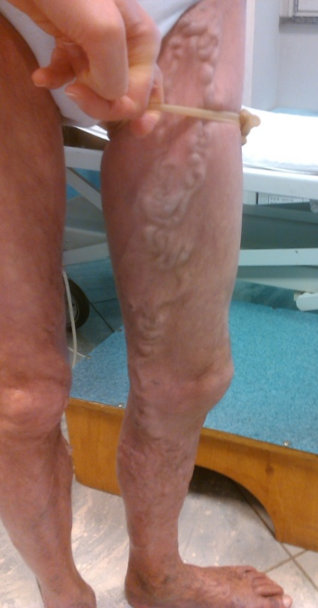
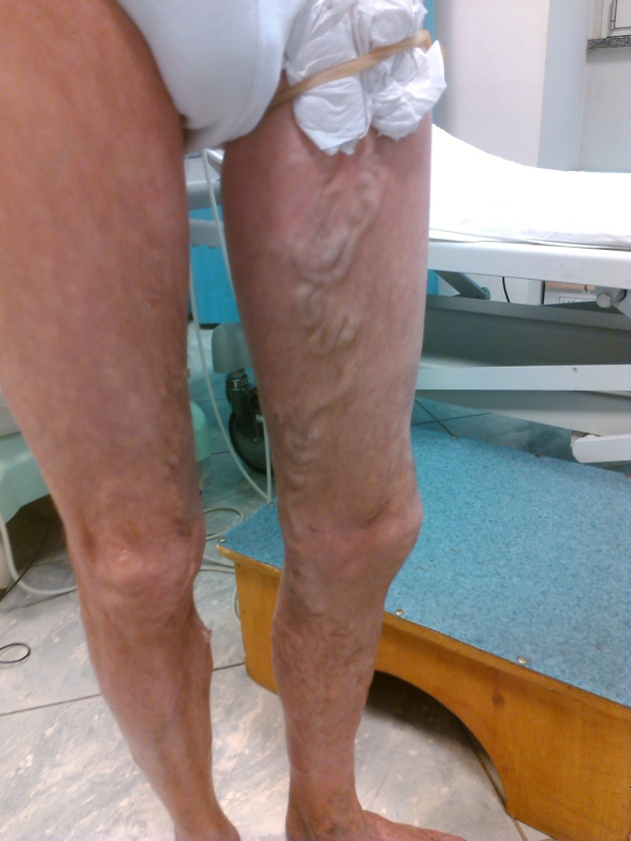
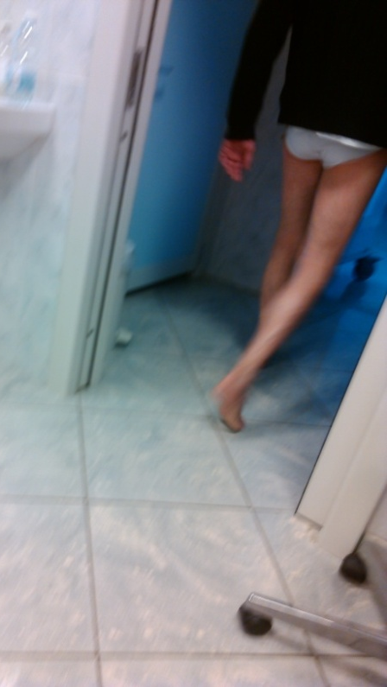
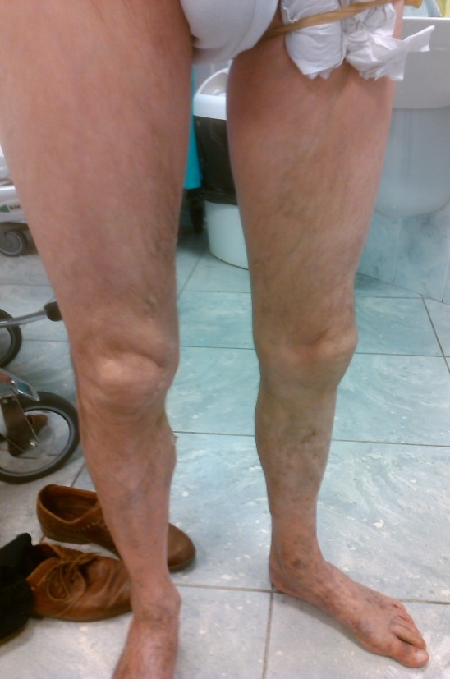
28 What is called “varicose reservoir” is not responsible but a consequence of the evolution of varicose veins.Its destruction is not necessary because it is passive and empties when it is not overloaded as confirmed by the Perthes Maneuver and the CHIVA Cure ...also it disappears after paralysis of the lower extremities because the muscular pump paralysis cannot activate the venous shunt!
Perthes CHIVA maneuver

Slide 34
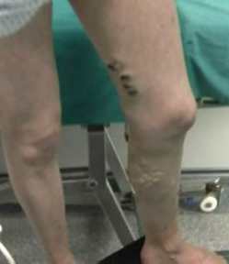
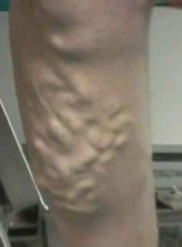
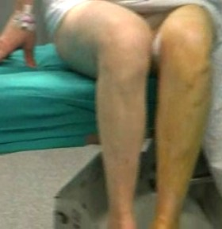
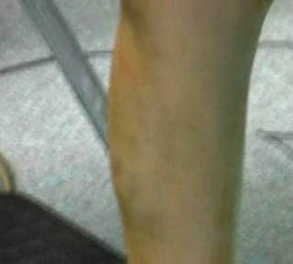
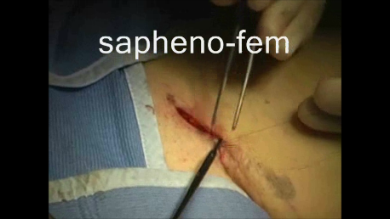
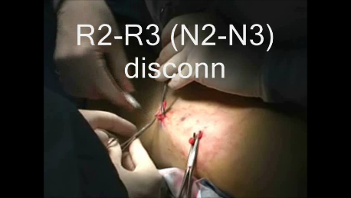
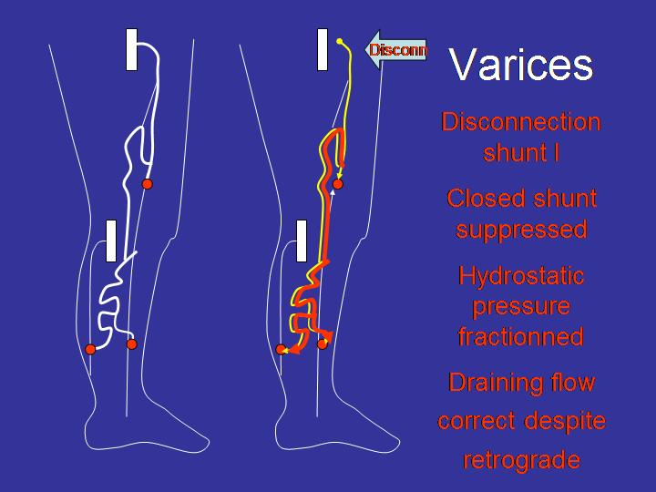
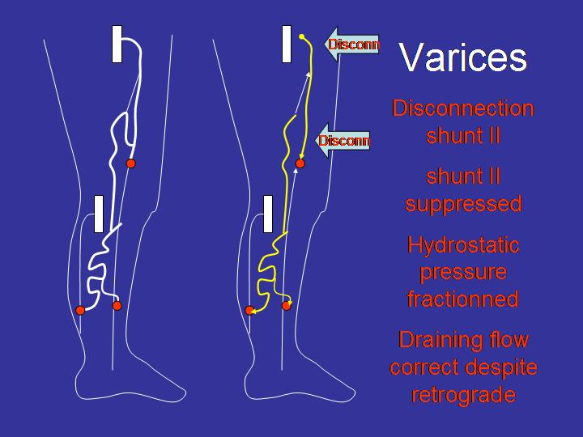
29
CHIVA: pre and post. No phlebectomy or sclerosis
Notes:
34

Slide 35
30 Hemodynamic characteristics of blood. Blood is not a perfect fluid in the Newtonian sense, that is viscous with laminar flow without turbulence.
Laminar flow

Slide 36
31 Nevertheless, Bernoulli 's law can be applied to normal blood flow. It cannot be applied when speeds are too high.
Then Poiseuille 's law is used
.

Slide 37
32 Both laws cannot be used when there is too much turbulence, that is, when the Reynolds Number Re exceeds 2000-3000 .
In this case, there is the Navier Stokes equation , differential, nonlinear fields of unknown pressure and velocity, however it is practically impossible to apply to blood flow.

Slide 38
33 Bernoulli
Total Pressure
Pt= (p + (1/2) ṗ v ² + ṗ gh constituted by
static pressure p +
dynamic pressure (1/2 ṗ v ² ) +
hydrostatic pressure ṗ gh
(1/2) ṗ v ²
h
p
ṗgh​

Slide 39
34 Hydrostatic pressure ṗ gh is:
the pressure due to the gravitational force ṗ g multiplied by the height of the blood column h.
(1/2) ṗ v ²
h
p
ṗgh​

Slide 40
35 As measure the BERNOUILLI equation
Ptotal = p + (1/2) rv ² + ῤ gh
p: pressure static , ῤ : mass volume Kg/m ^{3:} blood = 1060 Kg/m ³ v: speed m/sg = gravity 9.81 m/sh = height meters m Pt= Pressure static in Pascals
Example of static p measurement :
If Pt = 50 mmHg and v = 100cm/s, p =6091Pa =45 mmHg, which lowers the TMP to 5 mmHg.

Slide 41
36 Hydrostatic pressure ῤ gh in the arteries . Arterial hydrostatic pressure at the ankle varies with posture: In standing position ῤ gh 90 mmHg is added to BP: p + (1/2) ṗ v ²
Hydrostatic in recumbent ṗ gh is null. There is only the motor power of the heart
BP (p + (1/2) ṗ v ²⁾ + 90 mmHg ῤ gh
BP (p + (1/2) ṗ v ²⁾ + 0 mmHg ῤ gh

Slide 42
37 As hydrostatic pressure is added to motor pressure, foot blood pressure can be increased by standing or sitting .
This is very useful in case of critical ischemia to reduce pain and improve vascularization.
Edema is avoided with light Doppler -controlled venous containment .
.
h
h
DOPPLER

Slide 43


38 In addition, the increase in arterial flow due to sitting improves the Doppler ultrasound examination of the arteries of the leg and foot in difficult situations. Particularly, it can help determine angiosomes with Doppler curve modulated by selective manual compressions of the leg and forefoot arteries.
DOPPLER
DOPPLER
DOPPLER
DOPPLER

Slide 44
39 The driving pressure in the arteries (p + (1/2) ῤ v ² ) = Cte because they convert one into the other. It is the blood pressure produced by the left ventricle .
Venous compression increases microcirculatory resistance , which reduces velocity and increases static pressure p, which improves tissue irrigation.
Thus , controlled venous containment can help treat critical ischemia.
.

Slide 45
40 Pressure Hydrostatic Pole Test and Ischemia criticism
The h blood column can be used for a reliable Pole Test measurement of foot pressures less than 65 mmHg for the diagnosis of critical ischemia, regardless of the stiffness of the arteries.
Doppler or IR Plethysmography
POLE TEST
h = 65cm P =50mmHg

Slide 46
41 Hydrostatic pressure ῤ gh in the veins .
When standing at rest, the valves are open and the venous pressure in the ankle is about 90 mmHg = 120 cm H²0, that is, less than the height of the individual (about 175 cm.)
?

Slide 47
42 Hydrostatic pressure ῤ gh in the veins . This is because atmospheric pressure is not transmitted to the veins of the brain, neck and thorax due to the protection of their osteo-muscular armor . This explains gas embolisms due to jugular puncture while seated. The Absolute Pressure is positive but lower than atmospheric pressure, so the Relative Pressure is negative.
-20
-20
0
0
90
+90

Slide 48
43This distal pressure of 90 mm Hg is too high for correct drainage of the tissues, fortunately it fragments with ambulation , reducing it to 30 mm Hg at the ankle.
The cause of the dynamic fragmentation of the DFHP hydrostatic pressure is the alternating systolo -diastolic closure of the proximal and distal valves of the valvulo -muscular pump of the leg, particularly the calf.
UNEMPLOYMENT
SYSTOLE
DIASTOLE
c
flux
c

Slide 49
44 . When damaged or absent valves cannot close , FDPH is not performed and ankle pressure does not decrease. This may be due to deep or superficial venous valve incompetence (due to closed shunt effect).
90
Valve Incompetence
30
Normal
fifteen
standing
Party
March
Unstanding
Sitting
Lying down
- 40
upside down

Slide 50
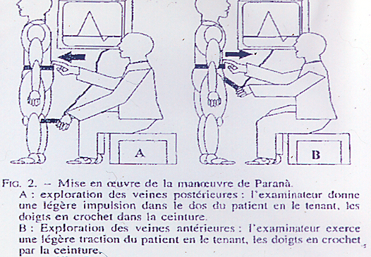
45 With the Doppler ultrasound and the compression-decompression maneuvers , or better the Paranà maneuver (more physiological) and the Vasalva , deficient DFHP can be diagnosed by reflux and closed or open derivative shunts . Air plethysmography shows insufficient reduction in leg volume with exercise. Disconnection of the shunts with fragmentation of the hydrostatic pressure column are one of the bases of the CHIVA cure.
R 1
R 1
R 2
R 2
R 3
Paraná maneuver

Slide 51
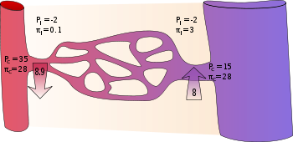
45 the Residual Pressure PR is -Motive Pressure: p + (1/2) ῤ v ² - which results from the Arterial Pressure A decreased by the loss of charge (pressure) through the micro-circulatory resistances MCR . Its value is much lower than the arterial value: approximately 15, versus 100 mmHg .
PA
RMC
PR

Slide 52
46 The Venturi Effect : aspiration effect of the drop in static pressure due to high flow velocity according to Bernoulli 's Law . In practice, this situation does not exist in the venous system due to its low velocities.
For example, for a total pressure Pt = 100mmHg, and a high speed v = 100cm/s the static pressure loss is only = 4mmHG = 4%. For Pt = 50 mmHg v= 100cm/s = Loss p = 4 mmHG = 8% except Pitot that explains the existence of systolic flows of the perforators according to their direction with respect to the flow
ABC
Pitot tubes
A: (p + (1/2) ṗ v ²⁾ + ῤ gh
V
B: p + ῤ gh
P 1
Q 2
C: (p - (1/2) ṗ v ²⁾ + ῤ gh

Slide 53
47 Low micro-circulatory resistances R increase flow Q and residual pressure PR : -inflammation, thermoregulation to heat, muscular movements, Arterovenous fistulas
PR Q
1/R

Slide 54
48The Residual Pressure PR of the posterior tibial vein at rest and after exercise can be measured with the Doppler .
Patient lying down, examined to measure blood pressure with a manometer.
PR = (p + (1/2) ṗ v ²⁾ + 0 mmHg ῤ gh
DOPPLER

Slide 55
49 High resistance increases venous pressure until obstacles are overcome due to the accumulation of Residual Pressure with the Pressure of the valve-muscular pumps during exercise: possible venous claudication
.
OBSTACLE
90
Incompetence
valvular
30
Normal
fifteen
standing
Starting
March
standingt
Sitting
Lying down
- 40
upside down

Slide 56
50 The obstacle may be right heart failure with tricuspid reflux that can be transmitted to the femoral and saphenous veins, sometimes confused with an AVF.
When the obstacle is at the ilio -cavus level, the Doppler shows a demodulated curve (heart and respiratory rate), sometimes only after exercise.

Slide 57
51The Poiseuille equation , vessel caliber, stenoses, Reynolds Number and Turbulence . The Poiseuille equation is applied to Newtonian fluids, that is, with viscosity.
dP = P1-P2 = Q.8L μ / π r ⁴
It is a resistance to flow responsible for a pressure loss (head) due to the resistance according to the viscosity μ , the flow rate Q , the length L , and mainly to the caliber (Radius to the fourth power r ⁴ ).

Slide 58
52 How to measure the Poiseuille equation :
Pressure Gradient or Head Loss and Flow Resistance = P1- P2
P1-P2 = Q.8L μ / π r ⁴
P1-P2= pressure gradient = Pa (Pascal)
1Pa = 1/98.0638 cmH²O = 0.76/ 98.0638 mmHg
Q=Flow: m ³ /s L= Length in meters r=radius in meters μ = Viscosity blood = 6.10 ⁻³

Slide 59
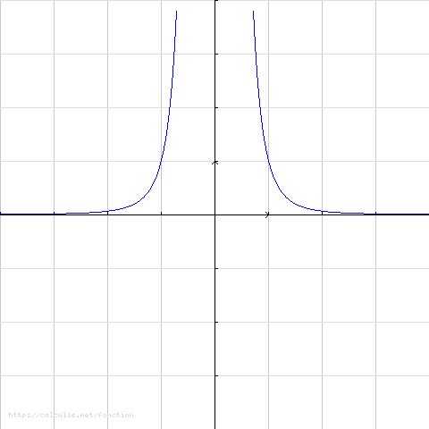
53 d P = 8 L μ Q/ π r ⁴ .
The pressure loss increases exponentially with the 1/ r ^{4 gauge} .
His greatest interest is in the hemodynamic evaluation of stenoses and measurement of the size of bypasses and stents appropriate to the flow.
DP
Q, L.
r
4
V
r
P 1
l
Q 2
r,Q,L

Slide 60
54 Stenosis
Flow rate 120ml/ mn , Length L= 1 cm and Linear reduction of radius r: 8, 4, 2, 1 mm
Load loss:
Exponential increase with 1/ r ⁴ dP = 0.05, 0.08, 1.30 and 20.7 mmHg .
Linear increase with Length L and Flow
Thus, a 75% stenosis is 16 times more significant than a 50% stenosis.
.
DP
Q, L.
r
4
r,Q,L

Slide 61
55 The “dimensionless” Reynolds number (Re)
It varies with Velocity (V), length ( L) , and kinematic viscosity v. Re = VL/v .
When the blood temperature exceeds 2500 , the laminar regime becomes turbulent.
.
Turbulent regime

Slide 62
56Turbulence slows down the flow with charge loss in addition to Poiseuille.
They appear on Doppler due to a dispersion of the spectral analysis.
They are the cause of Korotkoff noises during acoustic measurement of blood pressure in the arm.
They are the cause of murmurs and “thrills” of stenosis and AVF.

Slide 63
57 The dispersion of velocities and pressures against the walls: Shear stress Produces post -stenotic aneurysms
They dilate the vessels overloaded by excessive speed (arteries and veins of the AVF, closed venous shunts ) until their calibers are such that the speed is reduced and turbulence is suppressed (when the Reynolds Number < 2500).
Poststenosis aneurysm

Slide 64
58 In normal arteries and veins, the caliber is adequate to the flow rate and the pressurecharge loss is minimal .
Its value is more or less between 0.08 and 1 mmHg without pathological effect or Doppler manifestation .
However, this charge loss becomes in parietal stress that has to be compensated biologically throughout life .
.

Slide 65
59 The hemodynamic measurement of
P = 8 L μ Q/ π r ⁴ and Re = VL/v
Only the echo- doppler can approximately reveal, depending on anatomical conditions, Pressure, L, r, Q and Turbulence! .

Slide 66
60 In the arteries: Doppler
The loss of pressure (charge) is translated into an amortization of the systolic velocity with spectrum dispersion due to turbulence.
The damping is due to the progressive braking effect with the velocity of the diastolic flow with its delayed peak ( lengthened peak time ).

Slide 67
61 The arteries
The maximum velocity alone cannot define the pressure loss if the caliber and length of a stenosis are not known. D P = 8 L μ Q/ π r ⁴ .
This is a very erroneous approximation in more than 20% of cases (1 patient out of 5!).
Percent stenosis is also a dangerous approximation , particularly at the carotid level.
.

Slide 68
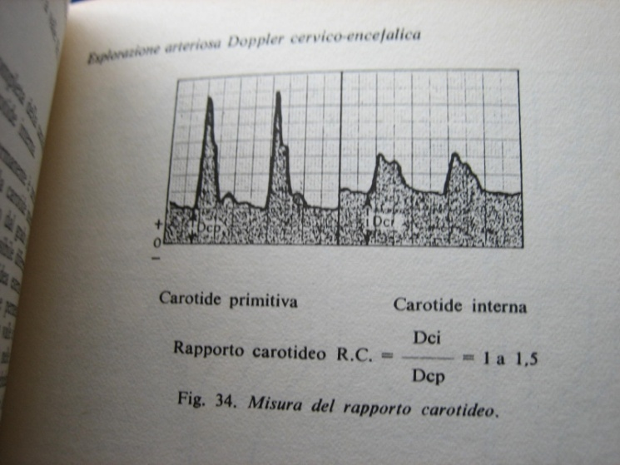

62 Carotids
NASCET assesses stenosis of the internal carotid (AB/A) x100, (A = post-bulbar caliber, B = stenosis caliber) considers the stenosis significant when it reaches 70%. However, its significance does not depend on the caliber of the post bulbar internal carotid A , but only on the caliber of the stenosis, its length and its flow.
Carotid relationship
Speed ratio =
Caliber area ratio
.

Slide 69
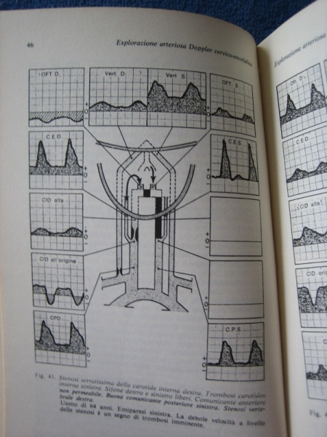
63 Thus, the percentage can vary from 43 to 64% when the post bulbar caliber varies from 3.5 to 5.5 mm for a stenosis caliber = 2 mm.
Right = 5.5mm
C.Int post Bulbar
Left = 3.5mm
Stenosis caliber = 2 mm
NASCET 64%
NASCET 43%
For the same 2 mm stenosis, the Nascet % varies according to the post-bulbar caliber.

Slide 70
64 For a caliber = 1.8 mm, d P = 8 L μ Q/ π r ⁴ the pressure loss can go from 28 to 56 mmHg if its length goes from 5 to 10 mm for a flow rate of 300ml/ min .
If the flow rate is doubled due to an obstruction of the contralateral carotid, the pressure loss is doubled...
. It can be concluded that stenosis begins to be significant when the caliber reaches 1.9 mm over a length of 5 mm. And the significance is only established when there is turbulence and/or damping of the Doppler curves .

Slide 71
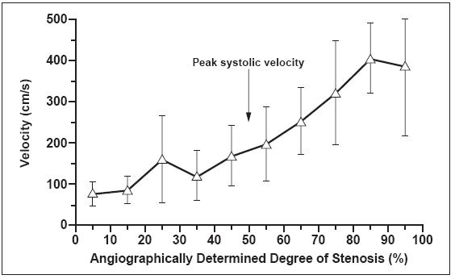
65 All of this explains the measurement discrepancies with angiograms.
Carotid Ultrasound Leslie M. Scoutt1, Edward G. Grant2 2009 ARRS Categorical Course

Slide 72
66 All of this explains the measurement discrepancies with angiograms.
In addition to load loss, plate fracture and embolism due to mechanical vibration stress due to turbulence, is the most frequent cause of cerebral ischemia.
They can be studied with the Döppler : Hits!
Turbulent regime

Slide 73
67 Arteries of the extremities:
In normal arteries, at rest the diastolic flow is zero. With exercise, distal pressure and both systolic and diastolic flows rise without damping.
Stenosis cushions and elevates the velocity curves and lowers the distal pressure due to loss of load proportional to the drop in distal resistance.

Slide 74
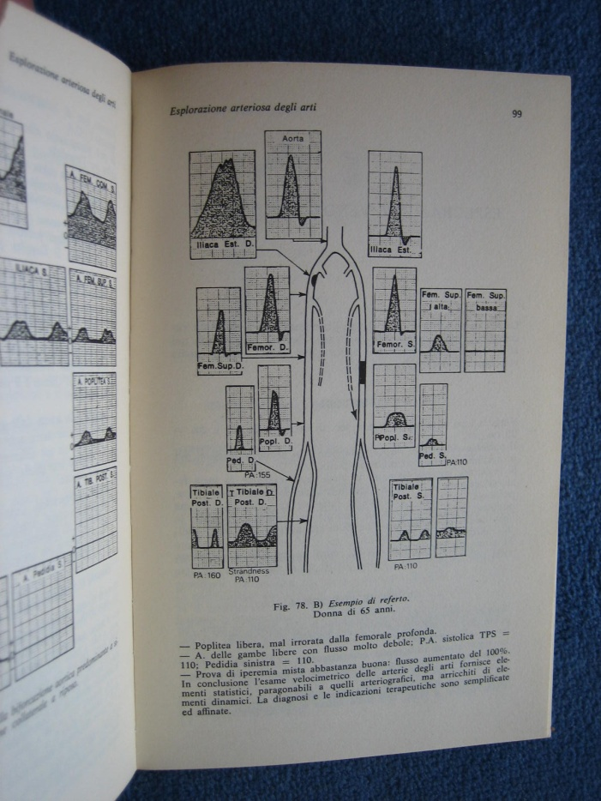
68 Arteries of the extremities:
The search, localization and assessment of stenoses and obstructions is carried out at rest and post-exercise using anatomical and hemodynamic mapping .
.

Slide 75
69The veins
Thus, a pressure loss of only 15-20 mmHg significantly influences the Residual Pressure, and initiates the braking of tissue drainage .
Therefore, the choice of venous stent size must take into account the resting and stress flow rate of the vein.
.

Slide 76
70 Doppler distal manometric blood pressure :
The Strandnes Index is better than the Windsor Index because it can also diagnose significant stenosis with exercise.
Pole Test better in case of critical ischemia
Laser Doppler and Oximetry are not very reliable and pressure of the toe is not always possible.
.

Slide 77
71 The veins
The same pressure loss (charge) is much more significant in the veins than in the arteries because the residual pressure is much smaller than the arterial pressure (15 versus 100 mm Hg), that is, 6 times more important.
Given a pressure loss of only 15-20 mmHg , the Residual Pressure has to rise higher so that the venous flow does not stop, which increases the venous Pressure at the microcirculatory level , edematizes the extremity and prevents correct drainage. Therefore, choosing the size of venous stents must take into account the resting and stress flow rate of the vein.

Slide 78
72 The veins
The same pressure loss (chatge) is much more significant in the veins than in the arteries because the residual pressure is much smaller than the arterial pressure (15 versus 100 mm Hg), 6 times more important.
With a pressure loss of only 15-20 mmHg, the Residual Pressure has to rise so that the venous flow is not stopped, which increases the venous Pressure at the microcirculatory level, edematizes the extremity and prevents correct drainage. Therefore, the choice of the size of venous stents must take into account the resting and stress flow rate of the vein.

Slide 79
73 Thus, each obstacle to drainage increases the Residual Pressure that develops collaterals and neoangiogenesis, and It explains most of the complications and recurrences of destructive techniques for varicose veins.
For this reason, CHIVA proposes a conservative strategy
PA
RMC
x
PR

Slide 80
74 Turbulence due to inadequate caliber at the flow, creates, as in arteries, parietal stress that dilates the veins until the caliber is wide enough to reduce speed. .
This is particularly seen in primary varicose veins which are usually due to excessive flow/pressure from closed shunts. Its normalization during the Perthes Maneuver and the CHIVA Cure is due to the fact that both suppress this excess load.
CHIVA
PERTHES
.
DIASTOLE
DIASTOLE

Slide 81
75 Pressure Gradient
Pumps and
Valves
.

Slide 82
76 The Pressure Gradient is the difference in Pressure P1-P2 between two distant points of a length L of a continuous fluid .
dP = (P1-P2)/L.
This is what determines the flow movements always from higher to lower pressure.
Normal flow is not reversed with the gradient by closing the valves .
.

Slide 83
77. However, there is a small initial physiological reflux necessary to close the valves just as a little wind needs to pass before closing a door.
This physiological reflux is detected with the Doppler
in the arteries (Aortic Valve)
and in the veins Venous Valves.
.

Slide 84
78. Arterial reflux due to incompetent Aortic Valve.
.

Slide 85
79 in the veins
In the recumbent position, the venous pressure gradient of the cardiac and thoraco-abdominal pumps is minimal (about 20 mmHg), without inversion.
In standing, the gravitational gradient ῤ gh goes from 0 to 90 mmHg with a retrograde flow that stops when all the veins are full.
This gradient is fragmented by the action of the vavulo-muscular pump of the extremities during walking. FDPH.
Depending on the degree of valve incompetence, the pressure column is not fragmented correctly.
.

Slide 86
80
thoraco -abdominal pump gradient is reversed when
you cough, you defecate, you carry weights,
and the Valsalva Maneuver is activated
with reflux when the valves are incompetent.

Slide 87
81 The diastolic gradient of the Valvulo -muscular Pump is reversed without reflux under normal conditions, with reflux in the deep and/or superficial incompetent veins.
Sometimes there is no reflux in the Saphena, even if it is varicose when there is a deep COMPETITIVE reflux , which fills the muscular pump faster.
DIASTOLE

Slide 88
82 All these conditions can be verified with Echo Doppler during the hemodynamic, Valsalva and Paraná
The Perthes maneuver is clinical and confirms the correct emptying of the varicose veins when the Calf Pump works well or the absence of emptying in case of deep reflux COMPETITIVE

Slide 89
83 Trans mural pressure TMP and Starling Model.
The TMP is the difference between the lateral blood pressure PL and the tissue pressure PT combined with the atmospheric pressure Pat.
TMP = PL – (PT + Pat).
PL= Static pressure p + Hydrostatic pressure ṗ gh .
57 Trans mural pressure PTM and Starling Model.
The MTP is the difference between the lateral blood pressure PL and the tissue pressure PT combined with the atmospheric pressure Pat.
PTM = PL – (PT + Pat).
PL= Static pressure p + Hydrostatic pressure ṗ gh .

Slide 90
84
TMP controls the volume and caliber of the vessels.
However, the vital and main objective of the hemodynamic conditions of the pumps and vessels of the circulation is to provide the capillaries with a trans mural pressure (TMP) essential to nourish and drain the tissues .

Slide 91
85 ARTERIAL INSUFFICIENCY = low TMP
INSUFFICIENCY = high TMP
Diagnosis : Look for anomalies in the pumps and vessels responsible for the TMP being too low or too high.
Treatments : Treat the anomalies and act on the TMP parameters : Intravascular Pressure : Motive and hydrostatic External Pressure : tissue and atmospheric until Restore the high TMP for the arteries and low for the veins.

Slide 92
86 The External Pressure EP constituted by:
Tissue Pressure + Atmospheric
To establish the TMP:
Intravenous lateral pressure - EP
.

Slide 93
87 Starling Model deals with Micro-circulation .
Capillary Trans-Mural Arterial Pressure is higher than the opposite Oncotic Pressure . It results in passage to the tissues.
Trans-Mural Venous pressure is lower than the opposite Oncotic Pressure . It results in passage to the capillaries.
PTM art
TMPvein
Oncotic P
Oncotic P.

Slide 94
88 Starling Model deals with Micro-circulation .
While the trans-mural pressure parameters of arterial capillaries are quite simple, those of venous capillaries are more complex. However, its interferences can be known schematically to better understand and treat its anomalies.
PTM art
TMPvein
Oncotic P
Oncotic P.

Slide 95
Normal tissue drainage parameters
VENOUS CAPILLARY
FABRICS
ATMOSPHERE
COMPRESSION
P. ATMOSPHERIC
TISSUE P.
PTM .
RESIDUAL P.
SIDE P.
HYDROSTATIC P.
P. INTERSTITIAL ONCOTICA
P. ONCOTIC GRADIENT
P. PLASMATIC ONCOTICA
SEWER SYSTEM.

Slide 96
Residual P. Lateral P. PTM Drain
VENOUS CAPILLARY
FABRICS
ATMOSPHERE
COMPRESSION
P. ATMOSPHERIC
TISSUE P.
PTM .
RESIDUAL P.
SIDE P.
HYDROSTATIC P.
P. INTERSTITIAL ONCOTICA
P. ONCOTIC GRADIENT
P. PLASMATIC ONCOTICA
SEWER SYSTEM.

Slide 97
Residual P. HYDROSTATIC P. P.Lateral PTM Drain
VENOUS CAPILLARY
FABRICS
ATMOSPHERE
COMPRESSION
P. ATMOSPHERIC
TISSUE P.
PTM .
RESIDUAL P.
SIDE P.
HYDROSTATIC P.
P. INTERSTITIAL ONCOTICA
P. ONCOTIC GRADIENT
P. PLASMATIC ONCOTICA
SEWER SYSTEM.

Slide 98
Residual P. AND/OR Hydrostatic P. P.Lateral COMPRESSION PTM Drain
VENOUS CAPILLARY
FABRICS
ATMOSPHERE
COMPRESSION
P. ATMOSPHERIC
TISSUE P.
PTM .
RESIDUAL P.
SIDE P.
HYDROSTATIC P.
P. INTERSTITIAL ONCOTICA
P. ONCOTIC GRADIENT
P. PLASMATIC ONCOTICA
SEWER SYSTEM.

Slide 99
P. Atmospheric PTM Drain
VENOUS CAPILLARY
FABRICS
ATMOSPHERE
COMPRESSION
P. ATMOSPHERIC
TISSUE P.
PTM .
RESIDUAL P.
SIDE P.
HYDROSTATIC P.
P. INTERSTITIAL ONCOTICA
P. ONCOTIC GRADIENT
P. PLASMATIC ONCOTICA
SEWER SYSTEM.

Slide 100
P. Atmospheric COMPRESSION PTM Drain
VENOUS CAPILLARY
FABRICS
ATMOSPHERE
COMPRESSION
P. ATMOSPHERIC
TISSUE P.
PTM .
RESIDUAL P.
SIDE P.
HYDROSTATIC P.
P. INTERSTITIAL ONCOTICA
P. ONCOTIC GRADIENT
P. PLASMATIC ONCOTICA
SEWER SYSTEM.

Slide 101
P. Oncotica plasmatic and/or P Onctotic Intertical Gradient Oncotic Drainage
VENOUS CAPILLARY
FABRICS
ATMOSPHERE
COMPRESSION
P. ATMOSPHERIC
TISSUE P.
PTM .
RESIDUAL P.
SIDE P.
HYDROSTATIC P.
P. INTERSTITIAL ONCOTICA
P. ONCOTIC GRADIENT
P. PLASMATIC ONCOTICA
SEWER SYSTEM.

Slide 102
P. Oncotica plasmatic and/or P Onctotic Intertical Oncotic Gradient COMPRESSION Drainage
VENOUS CAPILLARY
FABRICS
ATMOSPHERE
COMPRESSION
P. ATMOSPHERIC
TISSUE P.
PTM .
RESIDUAL P.
SIDE P.
HYDROSTATIC P.
P. INTERSTITIAL ONCOTICA
P. ONCOTIC GRADIENT
P. PLASMATIC ONCOTICA
SEWER SYSTEM.

Slide 103
external compression
Reinforces
External Pressure

Slide 104
When elastic compression is Active : its volume varies like that of the leg, maintaining its pressure. It can be dangerous and ischemic when blood pressure drops due to a drop in Motor or Hydrostatic Pressure (for example, going from standing to recumbent).
When inelastic compression is Passive : its volume does not vary with that of the leg. Since it cannot dilate when the leg is dilated, it reinforces calf systole during walking. But, its effect decreases with ambulation since the volume of the leg is reduced. .

Slide 105
In the veins: External compression is very important.
ITS MAIN ACTION is:
MICRO-CIRCULATORY REDUCTION of TMP, that is, facilitates drainage: Edema, skin disorders and venous ulcers
ITS SECONDARY ACTION is:
Reduction in the caliber of the veins. It reduces the pressure of the deep veins more than the superficial ones, due to the superficial drainage pressure gradient: superficial pressure greater than the deep one.

Slide 106
The solution is to first deflate the leg to the maximum with the feet up posture (suitcase method ) for 2 hours and then, band (inelastic) with Doppler arterial flow control in the forefoot​

Slide 107
ALWAYS
THINK
At the TMP!!!!

Slide 108
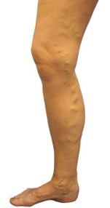

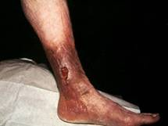
Venous insufficiency
Edema, Varicose veins, Trophic disorders, Ulcer
A cause
TMP
Notes:
108

Slide 109
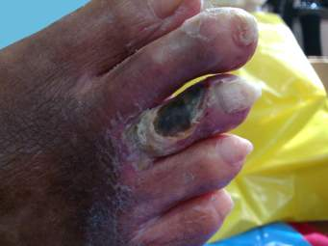
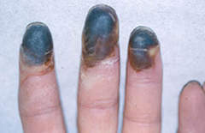
Arterial insufficiency
Claudication, Ulcer, Gangrene
A cause
Trans Mural Pressure
TMP
Notes:
109

Slide 110
Thank you so much

