Slide 1
Hemorrhoids The 4th Factor
Claude Franceschi
claude.franceschi@gmail.com

Slide 2

When medical research
Not only treats illness
But improves the wellness
Of healthy people

Slide 3
cleanliness
hygiene
Prevention
Treatment
Healthy
Everyday Wellness

Slide 4
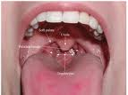

True for oral and dental health
cleanliness
hygiene
Prevention
Treatment
Sain
Everyday Wellness

Slide 5
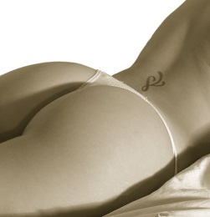
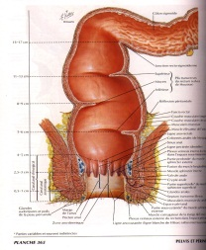
cleanliness
True :BECAUSE both Annal and Oral mucosa are transition mucosa

Slide 6
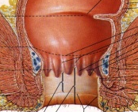
Vero anche per la zona Ano-Rettale
Cleanless
How?
Ano-rectal hydro-washing
Unbelievable feeling of comfort and wellness

Slide 7
Cleanless
but how?
SPECIAL distant WaterJet

Slide 8



PENETRATING Water Jet THANKS to a SPECIAL JET
DISTANT
without any introduction or body contact
Rectum
PENETRATING JET
Usual shower
and
bidet water
cannot
penetrate through
the anus
Anus
SPECIAL Jet
External Distant

Slide 9
Cleanless
For heathy people
slight coolness
Unbelievable sfeeling of comfort and wellness

Slide 10

Cleanless
For who suffurs
Action against the cause
Suppresses the stools mechanical and chemical stress

Slide 11
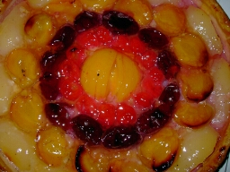
Cleanless
Which diseases?
Inflammation, Pruritus, Emorrhoids,
Anal Fissures, Constipation, Bleeding
Pain, Thrombosis, Bowel weakness

Slide 12
Mechanical stool trauma
Chemical stpol Agression
AnalCanal transition mucosa
Anitis
Oozing
HYPOTHESIS:
4th Factor
Ano-rectal mucosa agression by stools
Bleeding
Venitis ThromboPhlébitis
Prolapsus

Slide 13


Cleanless
CAUSE N°1
4th FACTOR Anal canal and anus Mucosa intolerant to inside and outside ano-rectal bowels residues
Inflammation, Emorrhoids, Anal Fissures,, Bleeding Pain, Thrombosis,
Rests of macro and micro residues

Slide 14

Cleanless
SOLUTION N°1
RINSE +++ Ouside and particularly inside ano-rectal
After the bowel evacuation
Eliminate macro and micro residues

Slide 15

Cleanless
CAUSE N°2
Constipation
Ano-rectal mucosa Traumatized by Hard bowels
Traumatic hard stools evacuation

Slide 16

Cleanless
SOLUTION N°2
Before to push for evacuate
MELTS the bowels
Smooting and e lubrification

Slide 17
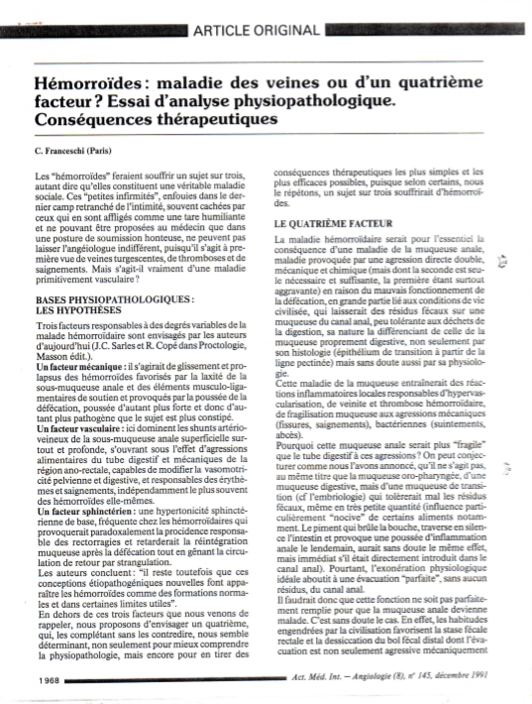
Sepp
Sepp

Slide 18
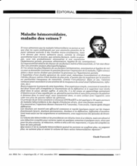
Sepp
Sepp

Slide 19
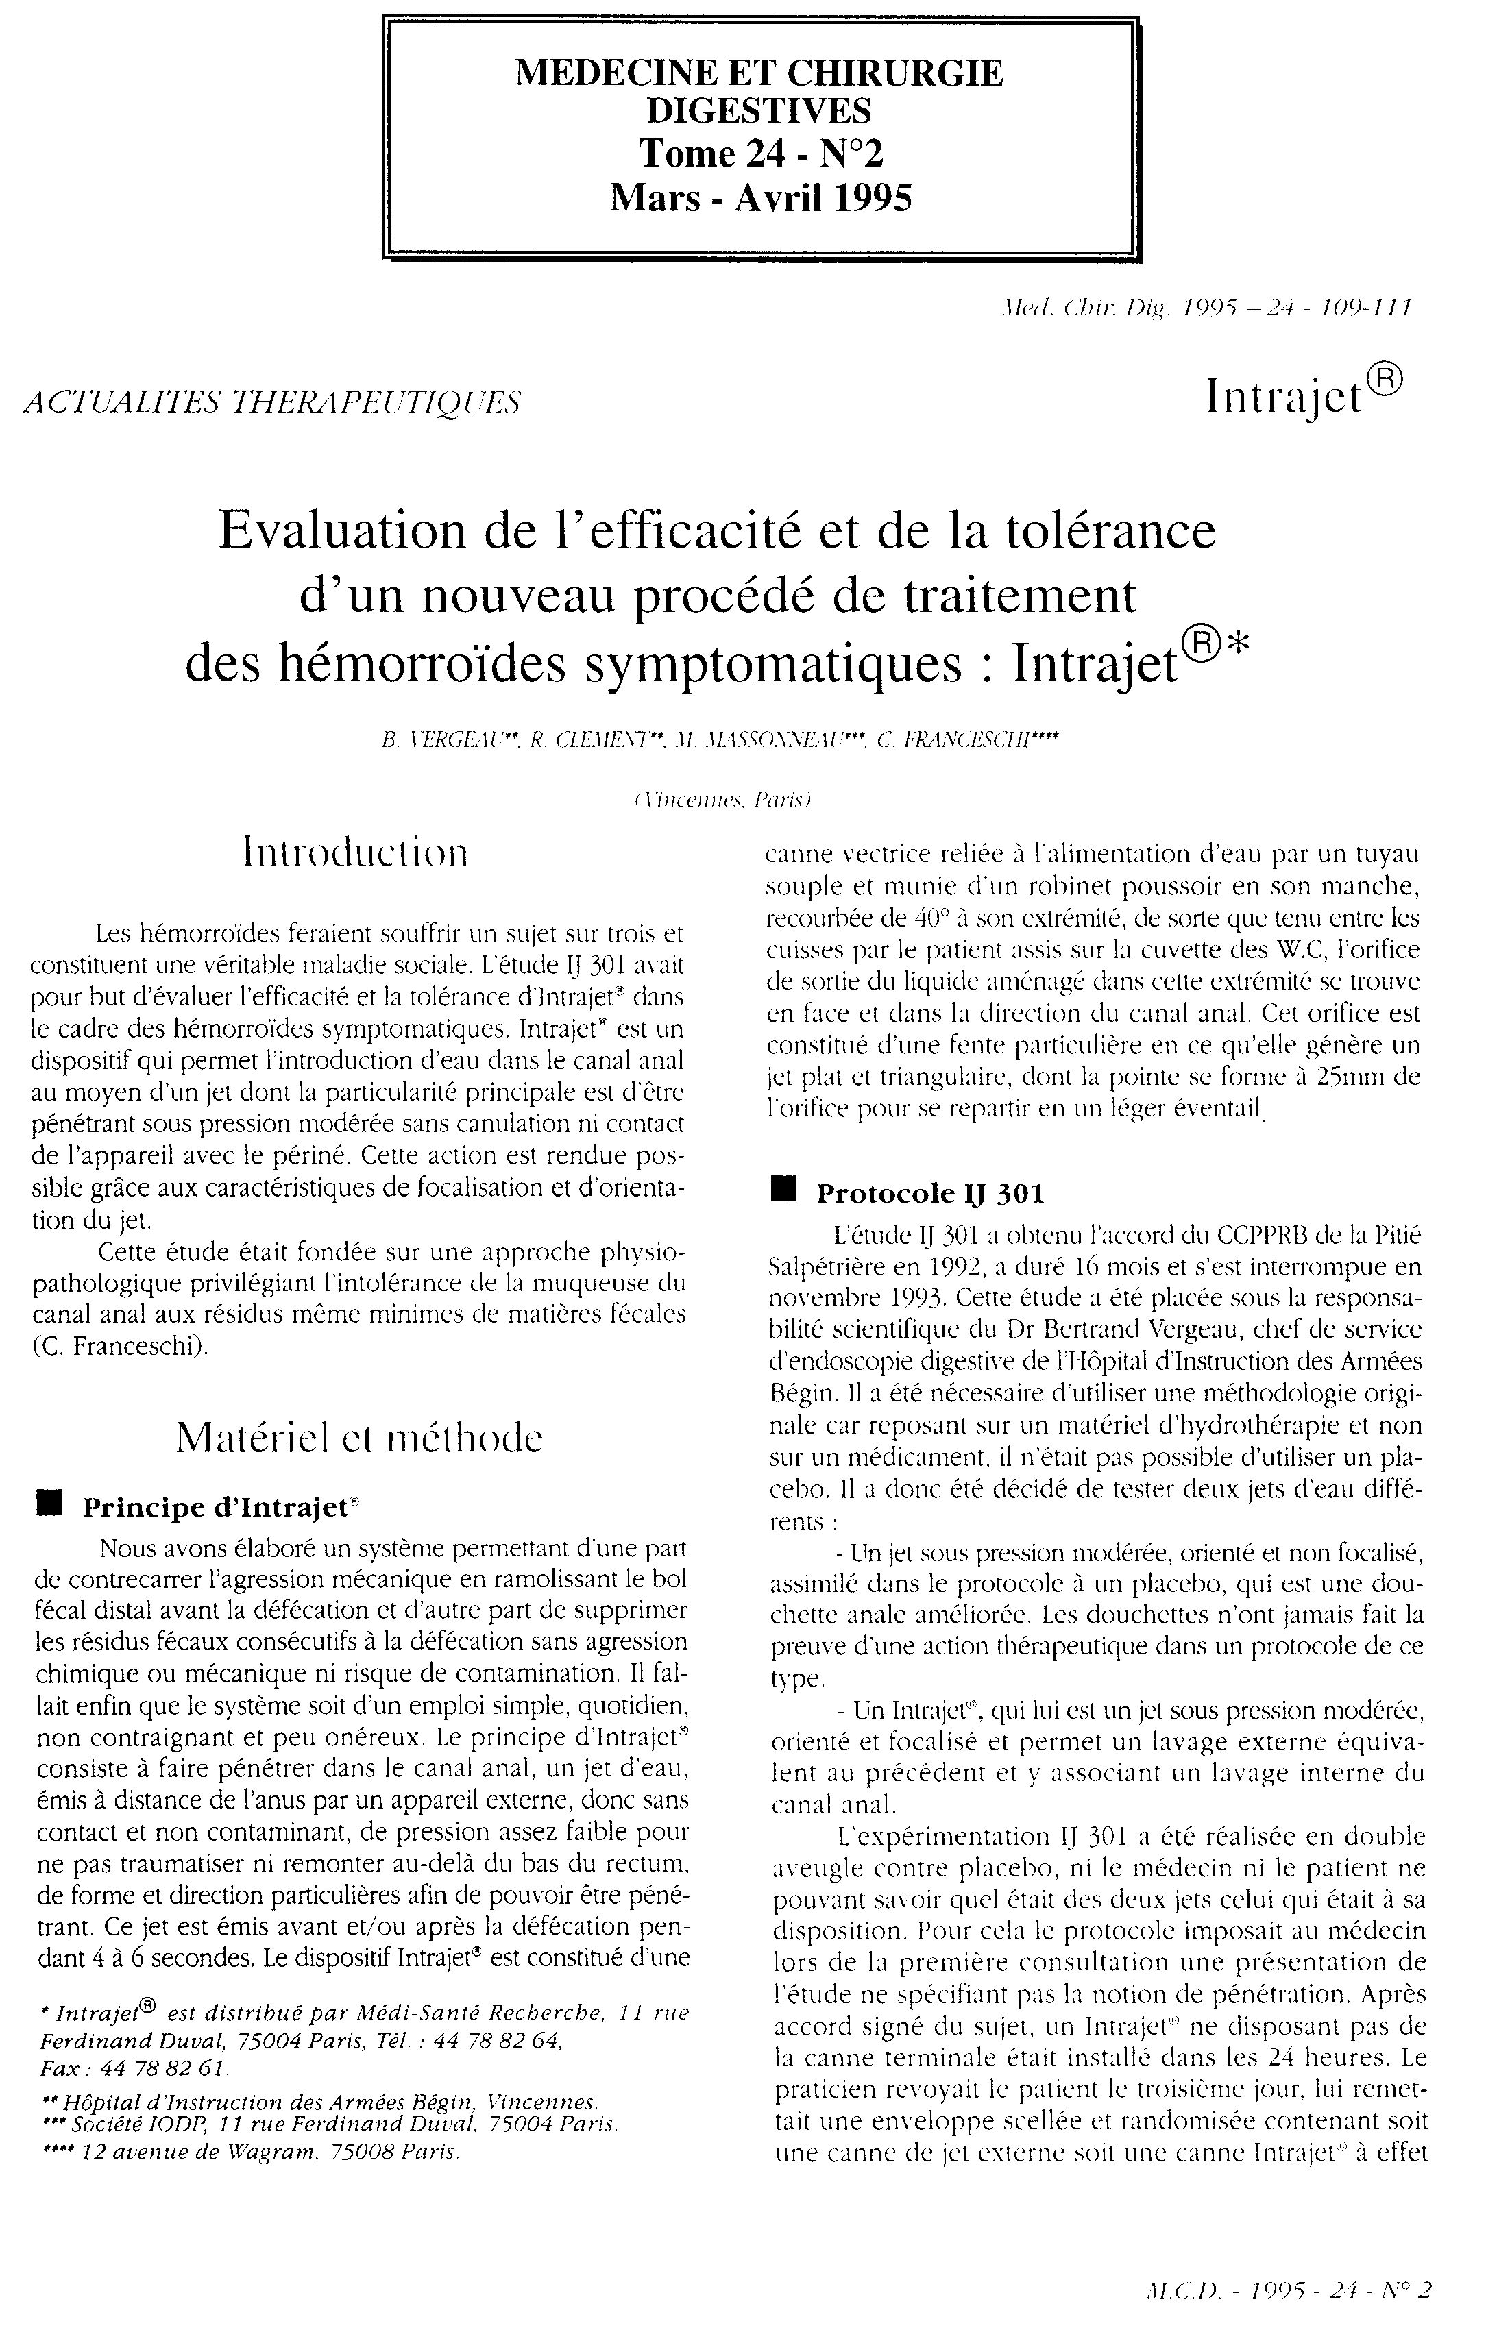
RCT IJ301 proves the efficacy of this treatment and the relevance of the 4th factor theory
INTRAJET TRIAL
Sepp
Sepp

Slide 20
INTRAJET TRIAL
3
External jet
2
Intra Rectal Jet
1
0
J-3
J-15
J-90
CONSTIPATION
3
2
1
0
J-3
J-15
J-90
DYSCHESIA

Slide 21
INTRAJET TRIAL
10
External jet
Intra Rectal Jet
5
0
J-3
J-15
J-90
LAXATIVE USE

Slide 22
INTRAJET TRIAL
5
External jet
3
Intra Rectal Jet
0
J-3
J-15
J-90
SPICE INTOLERANCE
3
2
1
0
J-3
J-15
J-90
ALCOOL INTOLERANCE

Slide 23
INTRAJET TRIAL
8
External jet
Intra Rectal Jet
4
0
J-1
J-15
J-90
BLEEDING
5
3
0
J-3
J-15
J-90
DIARRHEA

Slide 24
INTRAJET TRIAL
6
External jet
Intra Rectal Jet
4
0
J-1
J-15
J-90
Hemorrhoids > 5mm
15
8
0
J-3
J-90
Hemorrhoid scars

Slide 25
INTRAJET TRIAL
External jet
15
Intra Rectal Jet
8
0
J-3
J-90
Red Anus
10
5
0
J-3
J-90
Simple Hemorrhoids

Slide 26
INTRAJET TRIAL
External jet
10
Intra Rectal Jet
5
0
J-3
J-90
Complicated hemorrhoids
10
5
0
J-3
J-15
Thrombosis

Slide 27
INTRAJET TRIAL
4,5
External jet
Intra Rectal Jet
0
J-1
J-15
J-90
Oozing

Slide 28
INTRAJET TRIAL
4,5
Jet externe
IntraJet
0
J-1
J-15
J-90
PRURITUS

Slide 29
INTRAJET TRIAL
4,5
External jet
Intra Rectal Jet
0
J-1
J-15
J-90
Pain

Slide 30


Ano-rectal Hygiene
Women hygene too!
non invasive
Who
Is doing
well will feel
even better
Who is
sick will
feel
much better
Daily Wellness
Unbelievable feeling of comfort and wellness

Slide 31



Daily oro-dental hygiene
is no more controversed
Daily Ano-rectal Hygiene
will be a second milleniumstandard

Slide 32
Every Day
Before to evacuate, Inject water until you feel a rectal fullness
When you decide
Immediate painless evacuation

Slide 33
Every Day
Before to evacuate, Inject water until you feel a rectal fullness
When you decide
Immediate painless evacuation

Slide 34
Every Day
Before to evacuate, Inject water until you feel a rectal fullness
When you decide
Immediate painless evacuation

Slide 35
Every Day
When you decide
Then rinse the residues
Immediate painless evacuation

Slide 36
Every Day
When you decide
Then rinse the residues
Immediate painless evacuation

Slide 37
Every Day
When you decide
Then rinse the residues
Immediate painless evacuation

Slide 38
Every Day
When you decide
Then rinse the residues
Immediate painless evacuation

Slide 39

The day will be beautiful

Slide 40
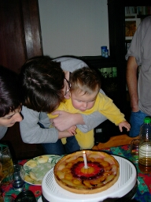
4th FACTOR

